Slide 1

Agentic AI-Based Email Classification and OCR
Team : AI_Anywhere

Slide 2

Context
Problem Statement / Current State.
Gen AI vs Agentic AI
Text Extraction
Agentic AI Model Design.
Model details.
Deployment - Groq – Fast AI Inference.
Tech Stack
Input/output.

Slide 3
Problem Statement / Current State
Business Context:
Commercial Bank Lending Service Team's Email-Based Servicing Request Process.
Background:
The Commercial Bank Lending Service team receives a large volume of servicing requests via email. These emails contain diverse requests, often with attachments, which need to be ingested into the loan servicing platform to create service requests.
Current Process:
The incoming service requests (SRs) via email require manual triage by a team of gatekeepers. This manual process is time-consuming, inefficient, and prone to errors, particularly when dealing with a large volume of requests.
Pain Points:
1. Manual triage process is time-consuming and labor-intensive.
2. Inefficient process leads to delays in processing service requests.
3. Error-prone process results in inaccuracies and potential rework.
4. Scalability issues arise when dealing with a large volume of requests.
Proposed Solution:
Implement an Agentic AI (Large Language Model) based solution to automate email classification and extraction, aiming to:
Improve Efficiency: Reduce manual effort and processing time for email triage.
Enhance Accuracy: Minimize errors in email classification and data extraction.
Accelerate Turnaround Time: Faster processing of emails, enabling quicker response times.
Minimize Gatekeeping Activities: Reduce the need for manual gatekeeping, freeing up resources for higher-value tasks.

Slide 4
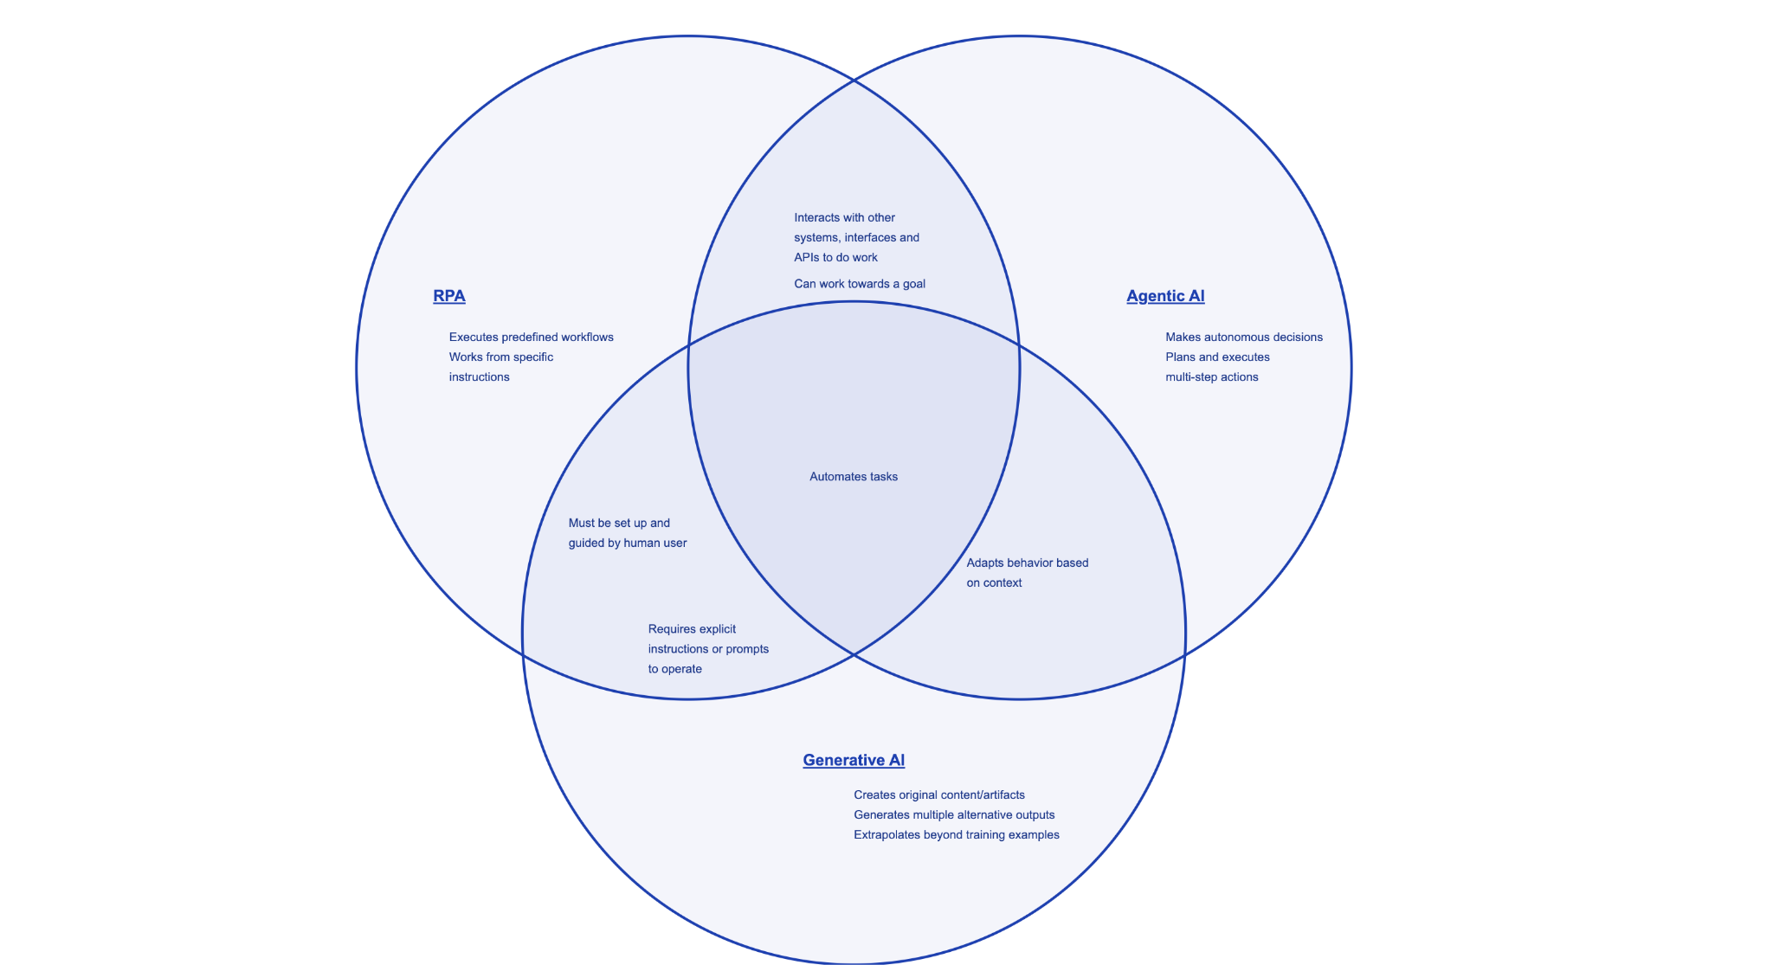
Gen AI vs Agentic AI
An Agentic AI is a specialized AI system designed to perform tasks autonomously by following predefined logic and rules. In email classification, it processes emails based on structured workflows, applying logic-driven decision-making for sorting, labeling, or forwarding emails using Large Language Models (LLMs).
Agentic AI follows structured rules to automate tasks, while Gen AI creates new content based on learned patterns.

Slide 5
Text Extraction
We implemented a comprehensive text extraction system to handle a wide range of document formats, ensuring seamless content retrieval and processing. Our approach integrates multiple specialized libraries:
PDFs are processed using PyMuPDF (fitz) to extract both text and embedded images, which are further analyzed using pytesseract for OCR-based extraction.
Word documents are handled via python-docx for DOCX files, while Docling is leveraged for parsing and extracting content from older DOC files.
Excel and CSV files are processed using pandas, allowing structured data extraction from multiple sheets or tabular formats.
Email messages (MSG & EML) are parsed using extract_msg and email.parser, capturing metadata, body content, and attachments.
Images (PNG, JPG, JPEG) undergo OCR-based text extraction using pytesseract, enabling text retrieval from scanned documents or screenshots.
For email attachments, our system automatically identifies and extracts their content based on file type, ensuring no critical information is missed. By integrating these technologies, we have built a robust and scalable text extraction pipeline that automates document processing efficiently.

Slide 6
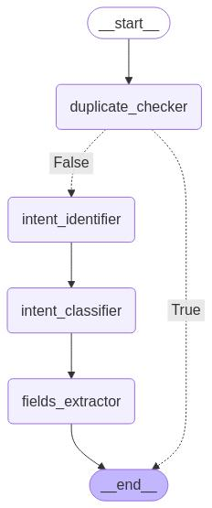
Agentic AI Model Design
Start → The process begins.
Duplicate Checker Agent
If True (duplicate email found), it directly ends the process.
If False (no duplicate email), it moves to the next steps.
Intent Identifier Agent → Identifies the type of intent from the input (email body and attachments/PDF’s/Doc’s).
Intent Classifier Agent→ Classifies the identified intent into a specific category (Request type, Sub Request type).
Fields Extractor Agent → Extracts relevant fields (deal name, amount, expiration date) for further processing.
End → The process concludes.

Slide 7
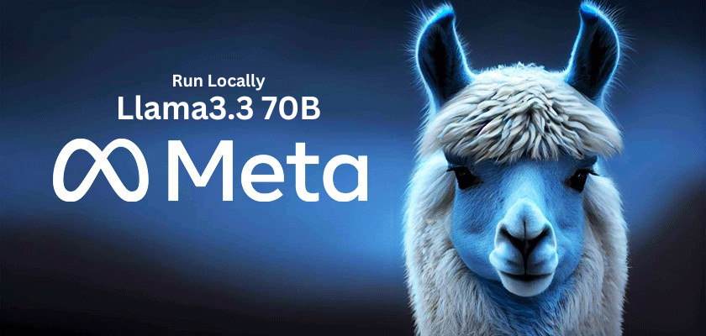
Model details
Llama-3.3-70b-versatile:
LLaMA 3.3 is a large language model developed by Meta AI, and the "70B" refers to the model's size, which is approximately 70 billion parameters.
The "versatile" label suggests that this model is designed to be a general-purpose language model, capable of performing a wide range of natural language processing tasks, such as:-
Classification
Text generation
Question answering
Sentiment analysis-
Language translation
LLaMA 3.3 is a significant improvement over its predecessors, with enhanced capabilities in areas such as:-
Contextual understanding-
Common sense reasoning
Emotional intelligence.
The model's architecture is based on a transformer-based design, which allows it to process input sequences in parallel, making it more efficient and scalable.

Slide 8
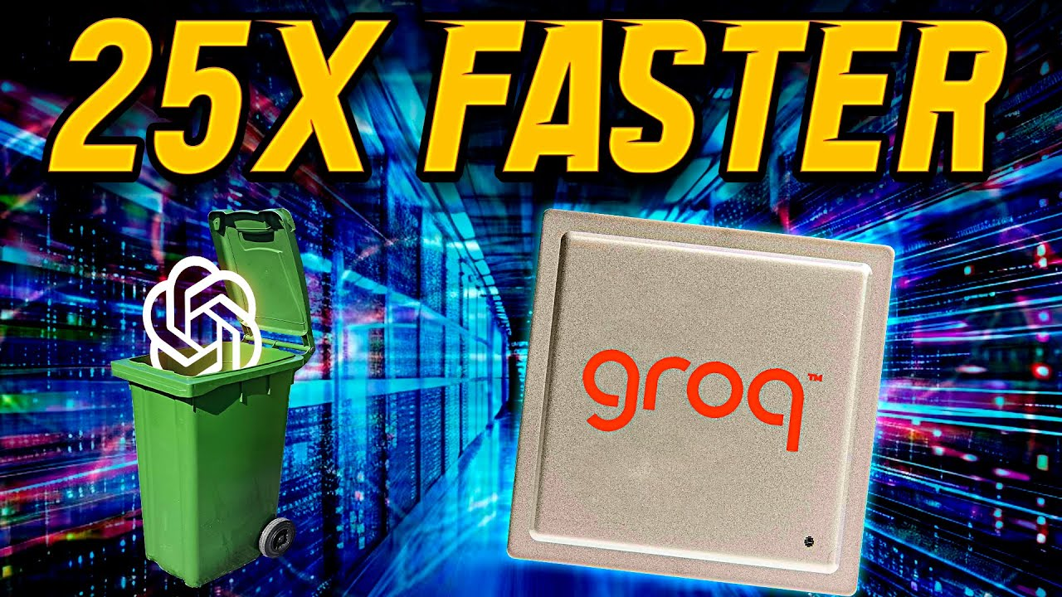
Deployment - Groq – Fast AI Inference
Groq:
Groq is a cloud-agnostic AI inference platform that accelerates AI model deployment, providing:
Fast Inference: Groq's proprietary compiler and runtime technology enables fast and efficient AI model inference.
Scalability: Groq's platform scales to meet the needs of large-scale AI deployments.
Flexibility: Groq supports a wide range of AI models, frameworks, and hardware.
Groq's Fast AI Inference benefits:
Reduced Latency: Faster inference times enable real-time AI applications.
Increased Throughput: Process more AI requests per second.
Improved Efficiency: Reduce computational resources and costs.
Groq's platform supports various AI applications, including:
1. Computer Vision
2. Natural Language Processing (NLP).
3. Recommendation Systems By leveraging
Groq's Fast AI Inference, organizations can accelerate their AI deployments, achieving faster time-to-market and improved ROI.

Slide 9
Tech Stack
Python
Model - LLM (Large Language Model) - Llama-3.3-70-versatile
Cloud – Groq
Backend - FastAPI
Frontend –
UI - Streamlit

Slide 10

Input/output

Slide 11
Thank you

