Slide 1
Gen AI Orchestrator for Email and Document Triage/Routing
Hackathon-2025
Submission By
Kritika Agarwal- Team Captain
Savita Govinda
Rathnakar Ksheerasagar

Slide 2
Overview
The purpose of this document is to define the architecture of an Email Classification System that reads emails and classifies them into request and sub-request types. The system is implemented using Python in the PyCharm development environment, leveraging the Llama-3.1-8B-Instruct model for natural language processing (NLP).
Technology Stack
Programming Language: Python
IDE: PyCharm
Machine Learning Model: Llama-3.1-8B-Instruct
Email Handling: IMAP/POP3 (via imaplib or poplib)
Database: PostgreSQL/MongoDB/SQLite
API Framework: FastAPI/Flask/Django

Slide 3
WorkFlow
Fetch predefined emails from the local folder.
Extract relevant content and metadata.
Pre-process and clean the email text.
Use Llama-3.1-8B-Instruct and train it based on the mapped input and outputs set in predefined emails.
Then system picks the input email from InputRequest.docx.
Post that the solution returns the json output with the classification.

Slide 4
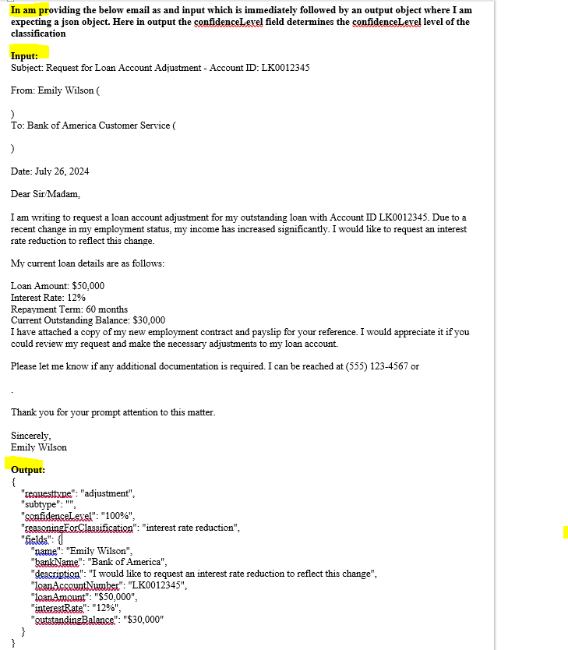
Training the model
Data created for training the model,
Screenshot here shows the sample.
Map the input and output as shown in order to train the model.
Top we have to mention the prompt so that the model know what it needs to
do and what is the expected output.
Add the email which we want to classify in the InputRequest.docx.

Slide 5
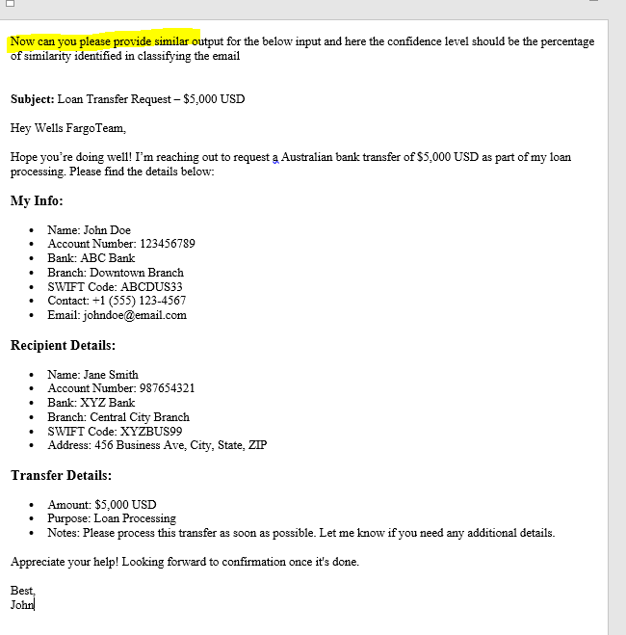
InputRequest.docx content
Prompt is mentioned at the stop in order to inform the
model to set the output data based on the earlier training
data and provide the confidence level based on the similarity.

Slide 6
Console application
Currently we have created the console application where the training data and final email to be classified is sent in single request to the model.
Run the serverless.py file directly. Next slide shows the output.

Slide 7
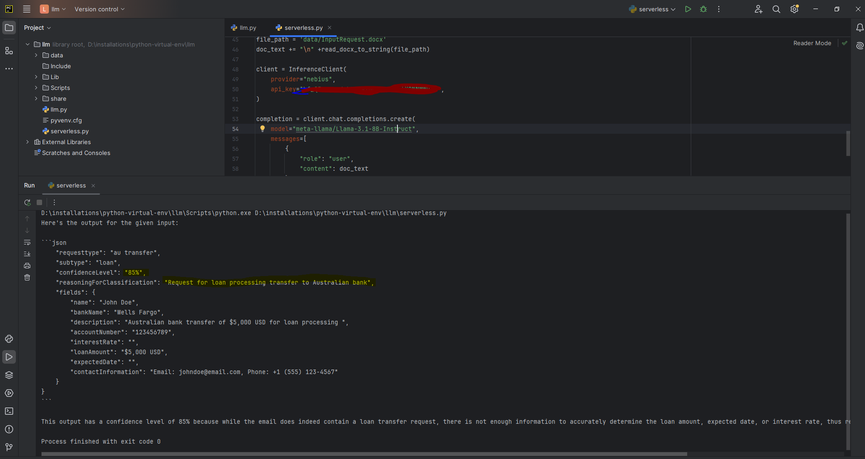
Output

Slide 8
Thank you!

