Slide 1
TECHNOLOGY HACHATHON Problem Statement: Gen AI Orchestrator for Email and Document Triage/Routing
Team Name :AI_Enthusiasts

Slide 2
High Level Implementation Steps:
Email Ingestion:
1.API to read Emails/attachments(.eml files or .msg files)
(alternate approach to keep .eml files in same folder and run the program)
Duplicate Email Check:
1.Storing all the emails + attachments in FAISS vector DB.
2.Creating embedding of the current email
3.Searching simila email in FAISS using similarity_search_with_score
4.Finding similar email or potential similar
Extract Email Data:
1.Using Python libraries to extract email attachment and messages(example: PyPDF)

Slide 3
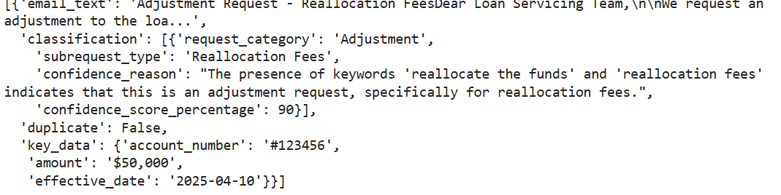
High Level Implementation Steps Cont…
Email Classification:
1.Reading Config file to get Request Type, Request Sub-Type, Key attribute metrics.
2.Config file can be extended with types and metrics.
3.Creating Prompt using file and context
4.Fetching email classification output containing Request type and sub-type along with confidence score, other key attributes.
Sample Output:

Slide 4
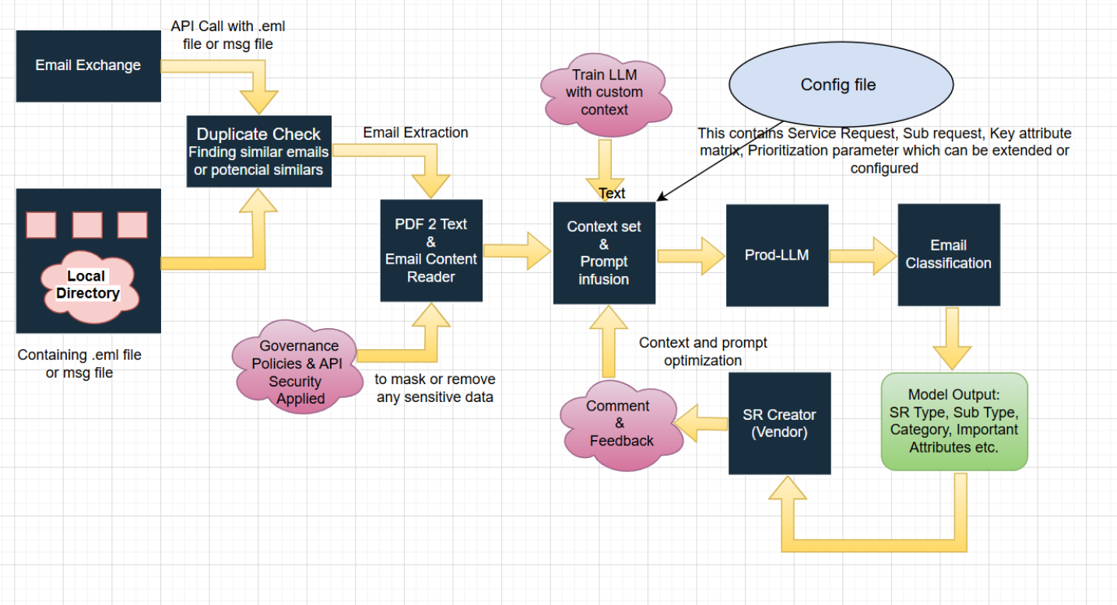
Architecture Diagram

Slide 5
Features
Email Classification: Classifies service requests in emails into predefined categories and subtypes using advanced prompts designed to understand the context and intent of the email content. It can intelligently identify and categorize multiple service requests within a single email, even if they are expressed in different parts of the email body.
Key Data Extraction: Extracts relevant data points (e.g., sender, amount, dates) from email content using dynamic prompts that adapt to the specific information being requested.
Duplicate Detection: Identifies duplicate emails using embeddings and a similarity threshold.
Flask API: Provides a REST API for seamless integration with other systems.
Ngrok Integration: Exposes the Flask API publicly using Ngrok for easy access.

Slide 6
Configuration
This project utilizes a configuration file (configuration.py) to store important settings and data. This file allows you to easily customize the behavior of the assistant.
Key Configuration Options:
keyMetrics: A list of key data points that the assistant will try to extract from emails.
requestTypesAndSubTypes: A dictionary defining the different request categories and subcategories used for email classification.
duplicateCheckThresold: The similarity threshold used to determine if an email is a duplicate.
NGROK_AUTH_TOKEN: Your Ngrok auth token for exposing the API publicly.
How to Configure:
Add your settings: Define the configuration variables in configuration.py in the root directory of your project. according to your needs.
Example configuration.py:

Slide 7
Requirements and Libraries
Python 3.7+
LangChain
llama3.1:8b
Ollama
Flask
Pyngrok
Hugging Face Transformers
FAISS
eml_parser
pypdf
accelerate
Flask
pyngrok
langchain
langchain_community
faiss-cpu
eml_parser
pypdf
transformers

Slide 8
Installation
1.Clone the repository: git clone https://github.com/ewfx/gaied-ai-enthusiasts/
Install dependencies: pip install -r requirements.txt
Download Ollama model: !curl -fsSL https://ollama.com/install.sh | sh
starting ollama server locally import subprocess import time process = subprocess.Popen("ollama serve", shell=True) time.sleep(5) # Wait for 5 seconds
Download llama3 model using ollama ollama serve ollama pull llama3.1:8b
Configure Ngrok:
Sign up for an free Ngrok account and obtain an auth token from https://dashboard.ngrok.com/get-started/your-authtoken
Replace NGROK_AUTH_TOKEN in the configuration file

Slide 9
Usage
1..
As a Python API:
Run emailClassification.py: This file contains the Flask API implementation. Execute it to start the API server.
Access the API: Use a tool like Postman or curl to send requests to the API endpoint /process_email with your EML file

