Slide 1
Gen-AI based Email Classification and OCR
Team: AI Innovators
Sivakumar Mohan
Dhruva Karir
Satish Sabapathi
Rehan Farooqui

Slide 2
Problem Statement
Commercial bank lending service teams handle a high volume of servicing requests via email, often with attachments. The current manual triage process involves reading emails, classifying requests, extracting key attributes, and assigning them to the appropriate teams. This approach is inefficient, time-consuming, and prone to errors, especially at scale.

Slide 3
Approach
To address this challenge, we propose an AI-driven solution leveraging Generative AI (LLMs) and Vector DB to automate email classification and data extraction. The system will intelligently classify requests, extract relevant banking attributes, and enable skill-based routing, improving efficiency, accuracy, and turnaround time while reducing manual intervention.

Slide 4
Acquire Emails & Content Extraction
Target State: We will use an Email Connector to connect an email box and pole the emails as soon as they arrive and put it into a NAS/Cloud Store. And extract content from email content using libraries Tesseract,pyPDF.
PoC: We are picking the emails from a local folder, processing it and extracting the content, attachments and subject using libraries Tesseract,pyPDF

Slide 5
Context Based Data Extraction
Target State: Extracting the key attributes like Banking Properties, from the email content using LLM and propagating it into the Service Ticket.
PoC: We are extracting the Key Properties and returning them in the REST response and displaying the same in an User Interface.

Slide 6
Multi Request emails - Primary Intent Detection
Target State: We can train a RAG which can differentiate multiple service requests, classify them in different Request & Sub Request Types and create service tickets accordingly.
PoC: Our LLM response takes the primary intent of the email sender from the content and attachments and classifies it to the corresponding Request & Sub Request Buckets.

Slide 7
Priority Based Extraction
Target State: We can train a RAG which prioritizes the property values from Content over Attachments and send it back in response.
PoC: Our LLM response captures the details from both email body and attachments are responds with all the Key Attributes in the response.

Slide 8
Duplicate Email Detection
Target State: We will use a Cloud based Vector DB to store the Content, Attachments and Sender Details and persist the entries for a fixed period of time, to check if the incoming email has already been tied to a Service Request.
PoC: We have used a Vector DB which persists the information locally, in the runtime and responds with the Duplicate Flag if found in the DB.

Slide 9
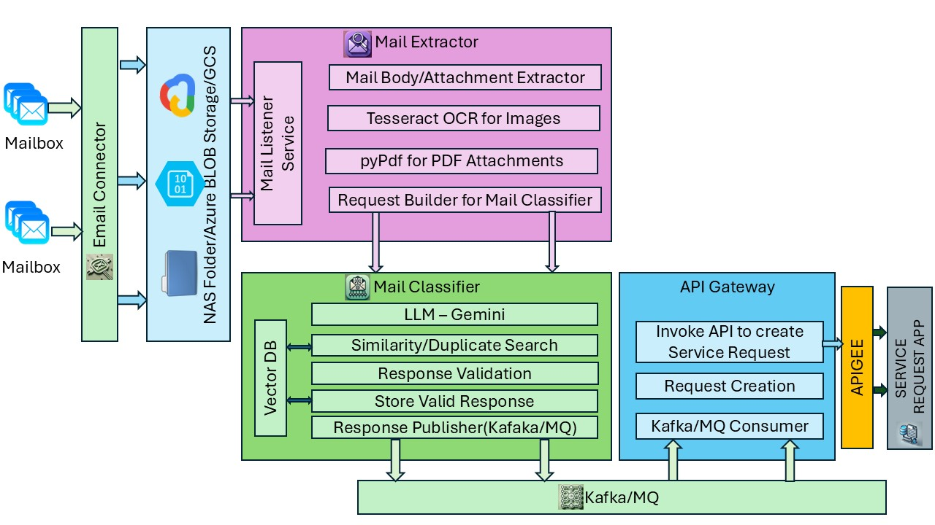
Target State Architecture Diagram

Slide 10
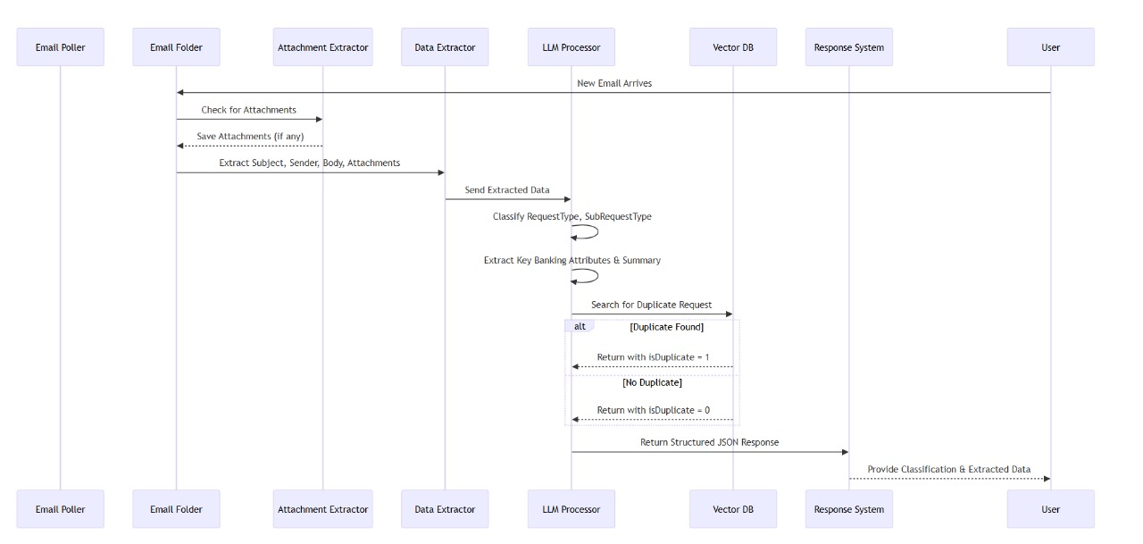
PoC State Architecture Diagram

Slide 11
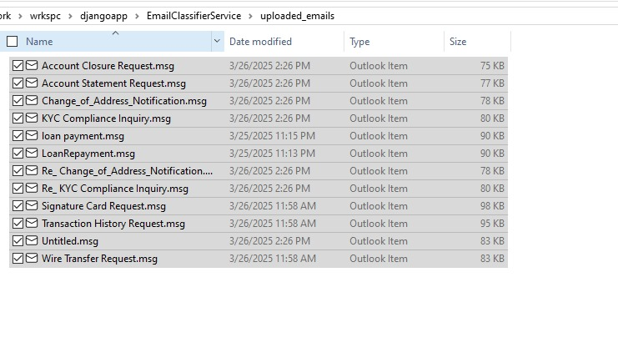
Sample Input
Input Files at the Poled Location

Slide 12
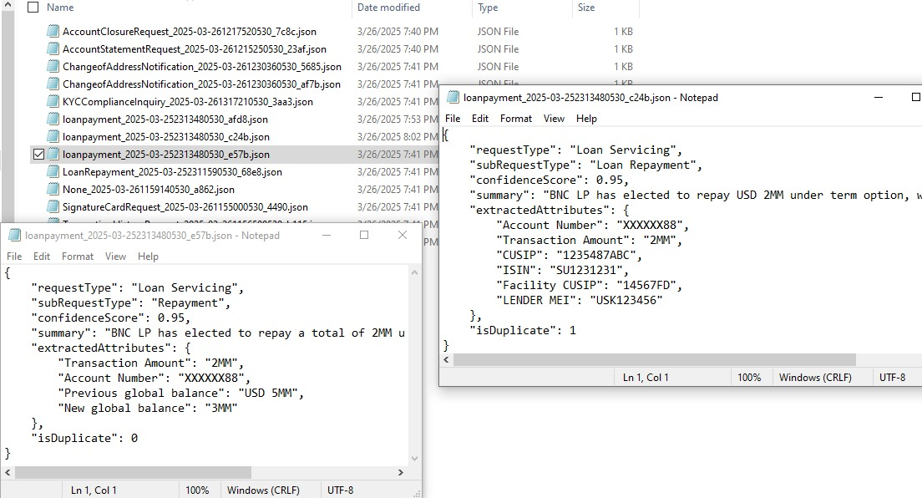
Sample Output
Result JSON Response at the Destination Location

