Slide 1
Gen AI Based Email Triageand OCR
by Binary Brains Team
(A.Divyakala & P.Yamini)

Slide 2
Introduction
Problem statement:
This system automates service ticket creation by extracting text from emails and attachments, analyzing content using AI, and generating tickets based on confidence scores.
Importance of having Gen AI based Email Triage:
It tackle the challenges of email overload and enhances their productivity
It enable organizations to deliver faster, more efficient, and personalized customer service by automating the classification

Slide 3
Tech stack
uvicorn: Server to host
Llama-3.3-70B-Instruct-Turbo: Model
FastAPI: Framework to connect to Model
NLTK: Lammetiser

Slide 4
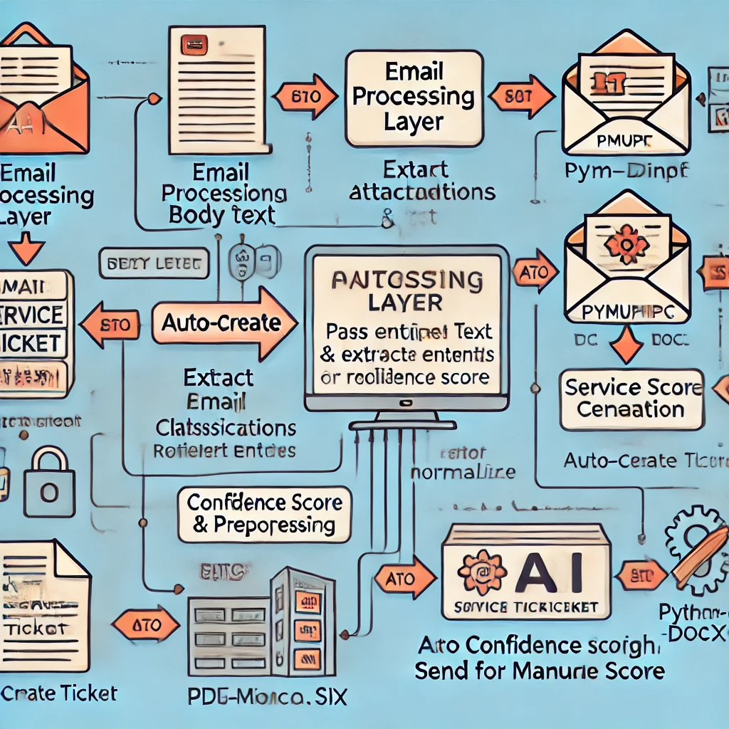
Architectural Flow
Email processing Layer
Llama Model
JSON output

Slide 5
Email Processing Layer
- Extract email body text
- Extract attachments (PDF, DOC, etc.) using PyMuPDF, pdfminer.six, or python-docx

Slide 6
Text Aggregation & Preprocessing
Combine extracted text
Clean and normalize data using
lemmatizer

Slide 7
AI Model Processing Layer
Pass combined text to a pre-trained Llama model
Perform intent classification & extract relevant entities
Compute confidence score

