Slide 1
Gen AI Based Email Triageand OCR
by Binary Brains Team
(A.Divyakala & P.Yamini)

Slide 2
Introduction
Problem statement:
This system automates service ticket creation by extracting text from emails and attachments, analyzing content using AI, and generating tickets based on confidence scores.
Importance of having Gen AI based Email Triage:
It tackle the challenges of email overload and enhances their productivity
It enable organizations to deliver faster, more efficient, and personalized customer service by automating the classification

Slide 3
Tech stack
uvicorn: Server to host
Llama-3.3-70B-Instruct-Turbo: Model
FastAPI: Framework to connect to Model
NLTK: Lammetiser
Python: programing language
IDE: VSCODE

Slide 4
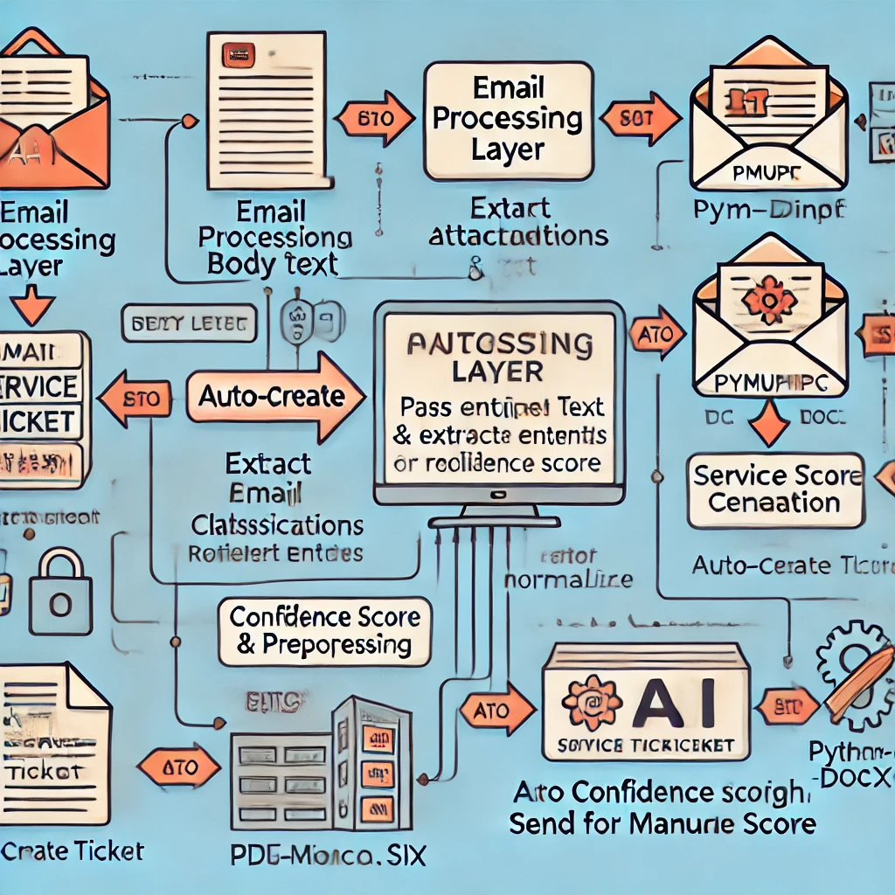
Architectural Flow
Email processing Layer
Llama Model
JSON output

Slide 5
Current Implementation & Limitations
Acheived:
1.We have come up with an “API” wchich Accepts email in different formats (.pdf/.doc/.eml) along with attachments (.pdf/.doc/.txt) as an input and returns "JSON" having classification details such as
request type
sub request type
confidence score
urgency
keyPhrases
details as attributes
with the results we can determine
improtance of email using "urgency" attribute
classify email based on "request type" and "sub request type"
can create "service reqeust" ticket based on "confidence score"
2.we can enhance requesttype and sub request type in future through configuration provided.
Limitations:
can scale it to process images in attachment and html content in email boady
Need to finetune it for spam detection
Scope for scaling it to "service reqeuest generation tool" ingegration to create tickets.

Slide 6
How We Built It
step 1: API will take the input file ( .docx/.pdf/.txt/.eml) ( email_Doc_triage.py)
step 2: Data preprocessing
-Cleans and preprocesses email text for better model performance
-part of performing data preprocessing we are doing cleaning of text ( predictor.py) and lemmetization(preproocess.py) using nltk
step 3: connect to LLAMA3 api using together API platform and perform email classification by
-reading content from uploaded file (.eml/.pdf/.docx/.txt) -along with attachment (.pdf/.docx/.txt)

Slide 7
Tests covered
executed following test cases with the api we have developed.
-upload plain text file
use uploads/sample.txt
-upload docx file
use uploads/documentsumbmissionforLoanApproval.docx
-upload pdf file
use uploads/emailattachment.pdf
-upload .eml file
use uploads/loan_application.eml
-upload .eml with attachment
use uploads/loan_application_with_attachments.eml
## attached test results code\test\BinaryBrain _TestResultsscreenshots.docx

