Slide 1
Gen AI-Based Email Classification and OCR
Hemavathy Ponraj
Preethi rani Murugesan

Slide 2
Introduction
Loan servicing teams receive a high volume of emails with different requests. Our AI solution automates classification and extraction of key details, improving efficiency and accuracy.

Slide 3
Problem Statement
Handling loan-related emails is time-consuming and error-prone. Teams manually extract information from various file formats, leading to delays and inconsistencies.

Slide 4
Our Solution
AI-Powered Email Classification: Automates processing of loan servicing emails and attachments (PDF, DOCX, EML), categorizing them into requests like Adjustments, AU Transfer, Closing Notice, and Commitment Change, along with sub-requests like reallocation fees, amendment fees, and interest changes.
Context-Aware AI Processing: Uses Gemini AI to detect intent across multiple follow-up emails, extracting key information and classifying requests with high accuracy.
User-Friendly React Frontend: Provides an intuitive React-based UI for uploading, processing, and viewing classified emails, with search and filter functionalities.
Scalable & High-Performance Backend: Powered by FastAPI, ensuring fast processing, support for bulk email classification, and seamless integration with loan servicing systems.

Slide 5
How It Works
Email & Attachment Processing: Users upload emails and attachments (PDF, DOCX, EML) via the React frontend, which sends the files to the FastAPI backend for processing.
Text Extraction & Preprocessing: The backend extracts text from emails and attachments using PyMuPDF, python-docx, and email parsers, ensuring all relevant content is captured.
AI-Powered Classification: The extracted content is passed to Gemini AI, which analyzes the text, identifies key terms, and classifies the request based on predefined categories like Adjustments, AU Transfer, Closing Notice, etc.
Results Display & Export: The classified emails are displayed in the frontend with their detected categories and intent. Users can filter, search, and export results for further action.

Slide 6
Key Features
Multi-Format Support – Processes emails and attachments in PDF, DOCX, and EML formats for comprehensive classification.
AI-Powered Classification – Uses Gemini AI to analyze text, detect key terms, and categorize emails accurately.
Context-Aware Intent Detection – Recognizes primary and sub-requests even in multi-threaded email conversations.
User-Friendly Dashboard – React-based UI allows users to upload, view, filter, search, and export classified emails.
Scalable & Extensible – Built with FastAPI for high performance and easy integration into existing workflows.

Slide 7
Tech Stack
- Backend: FastAPI, Hugging Face Transformers, Spacy, Fuzzy Matching
AI Model - Gemini AI
- Frontend: React, TailwindCSS
- Storage and Processing: PyMuPdf, python-docx, email.parser

Slide 8

Demo Screenshots

Slide 9
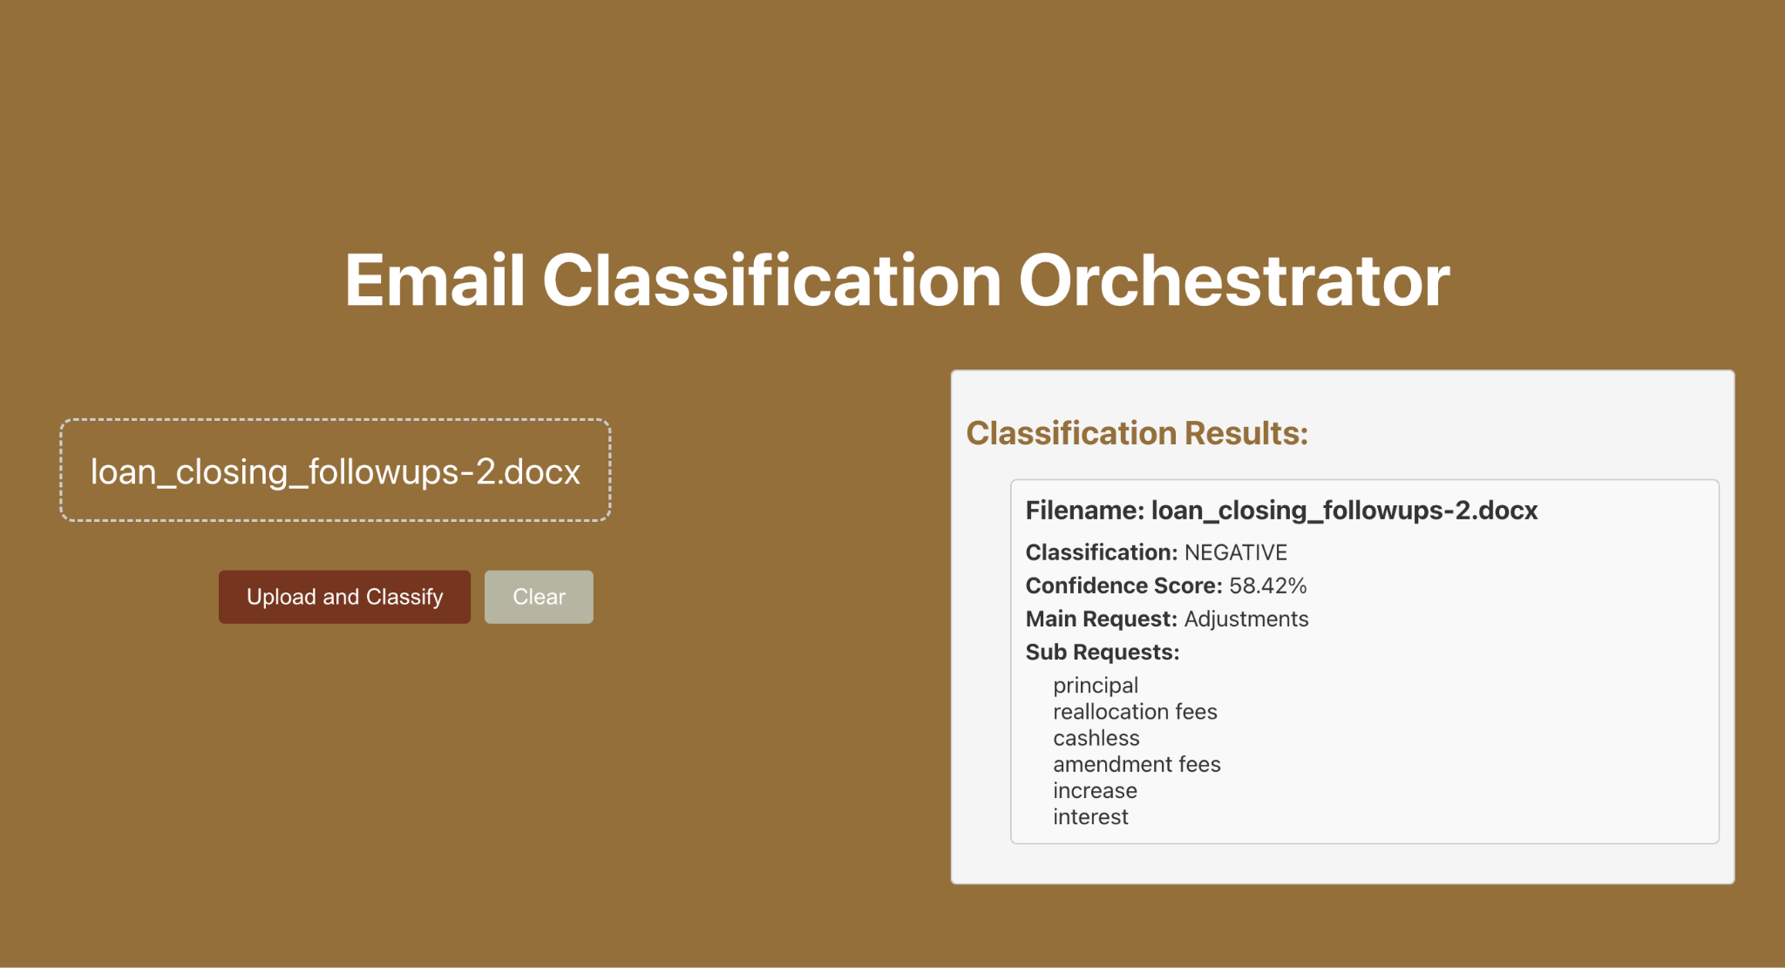

Slide 10
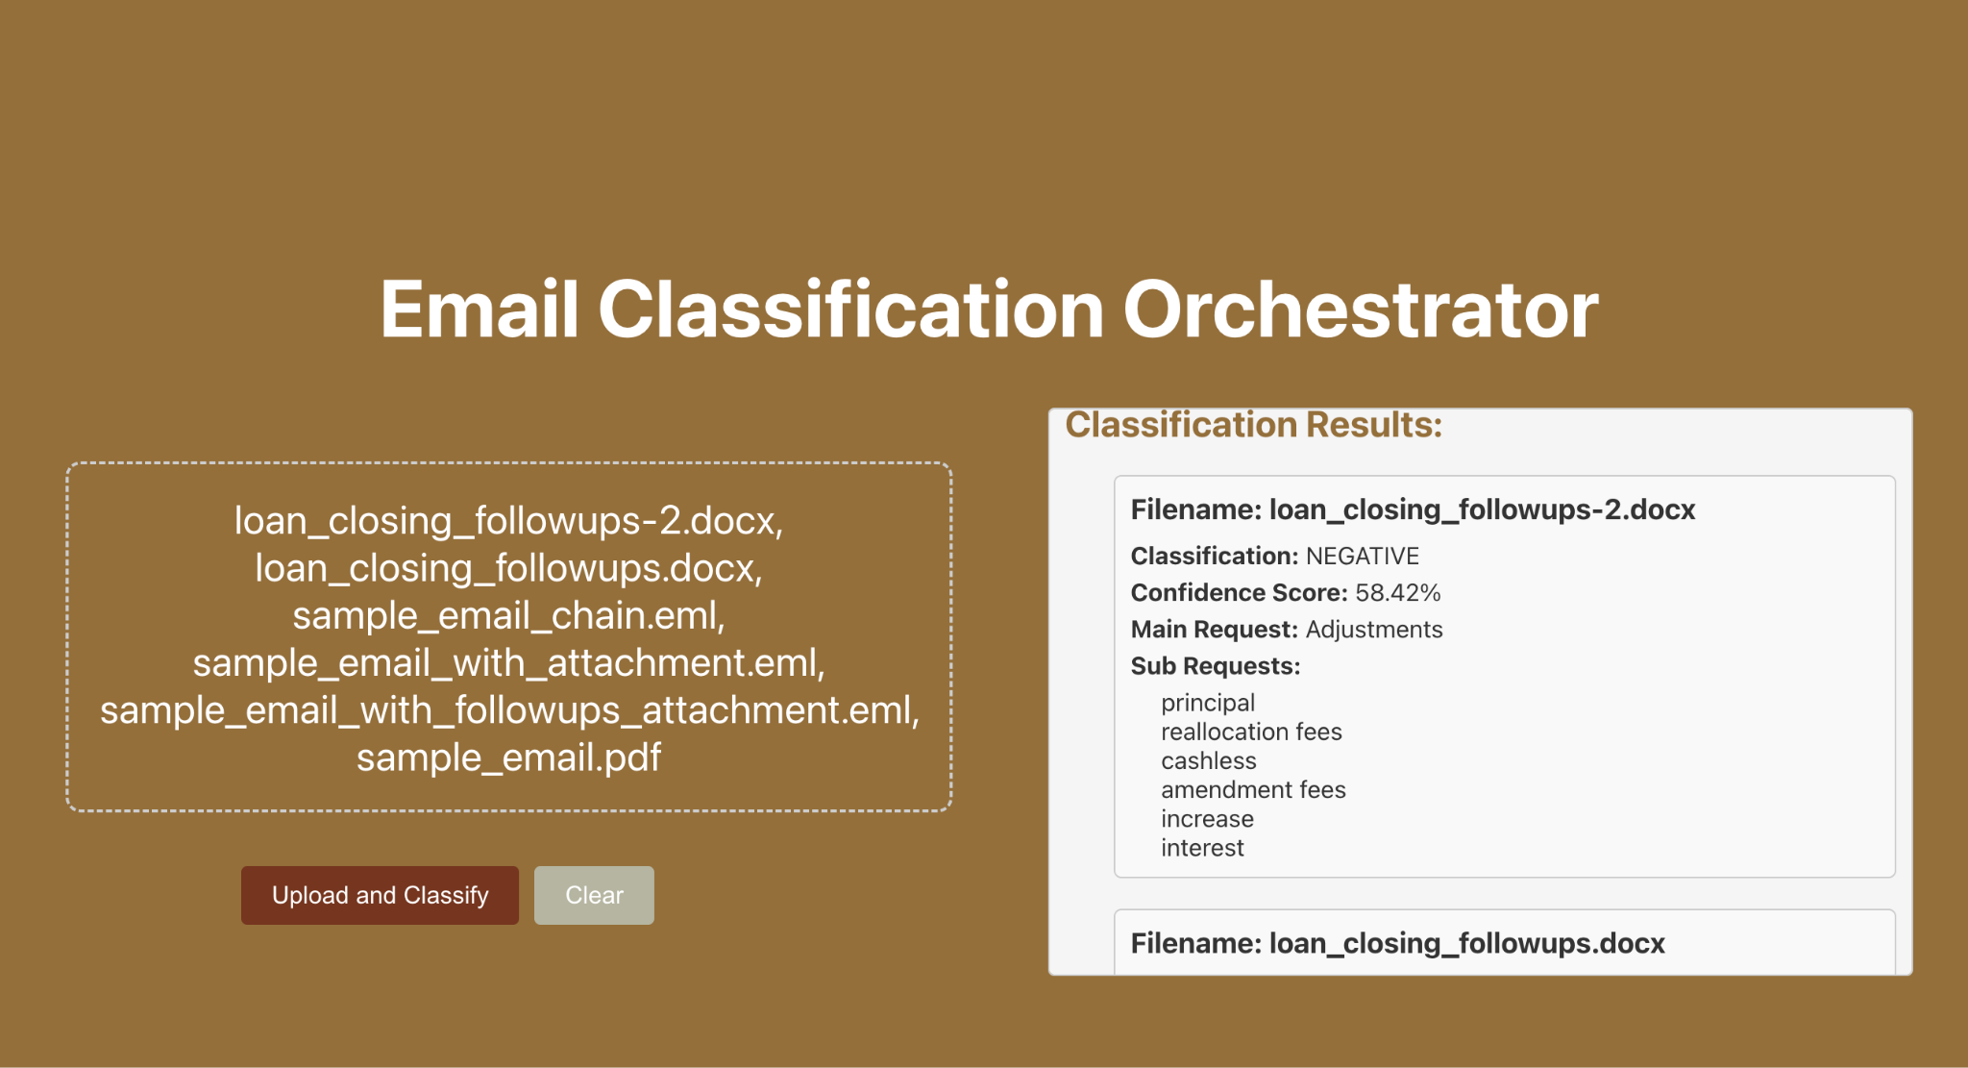
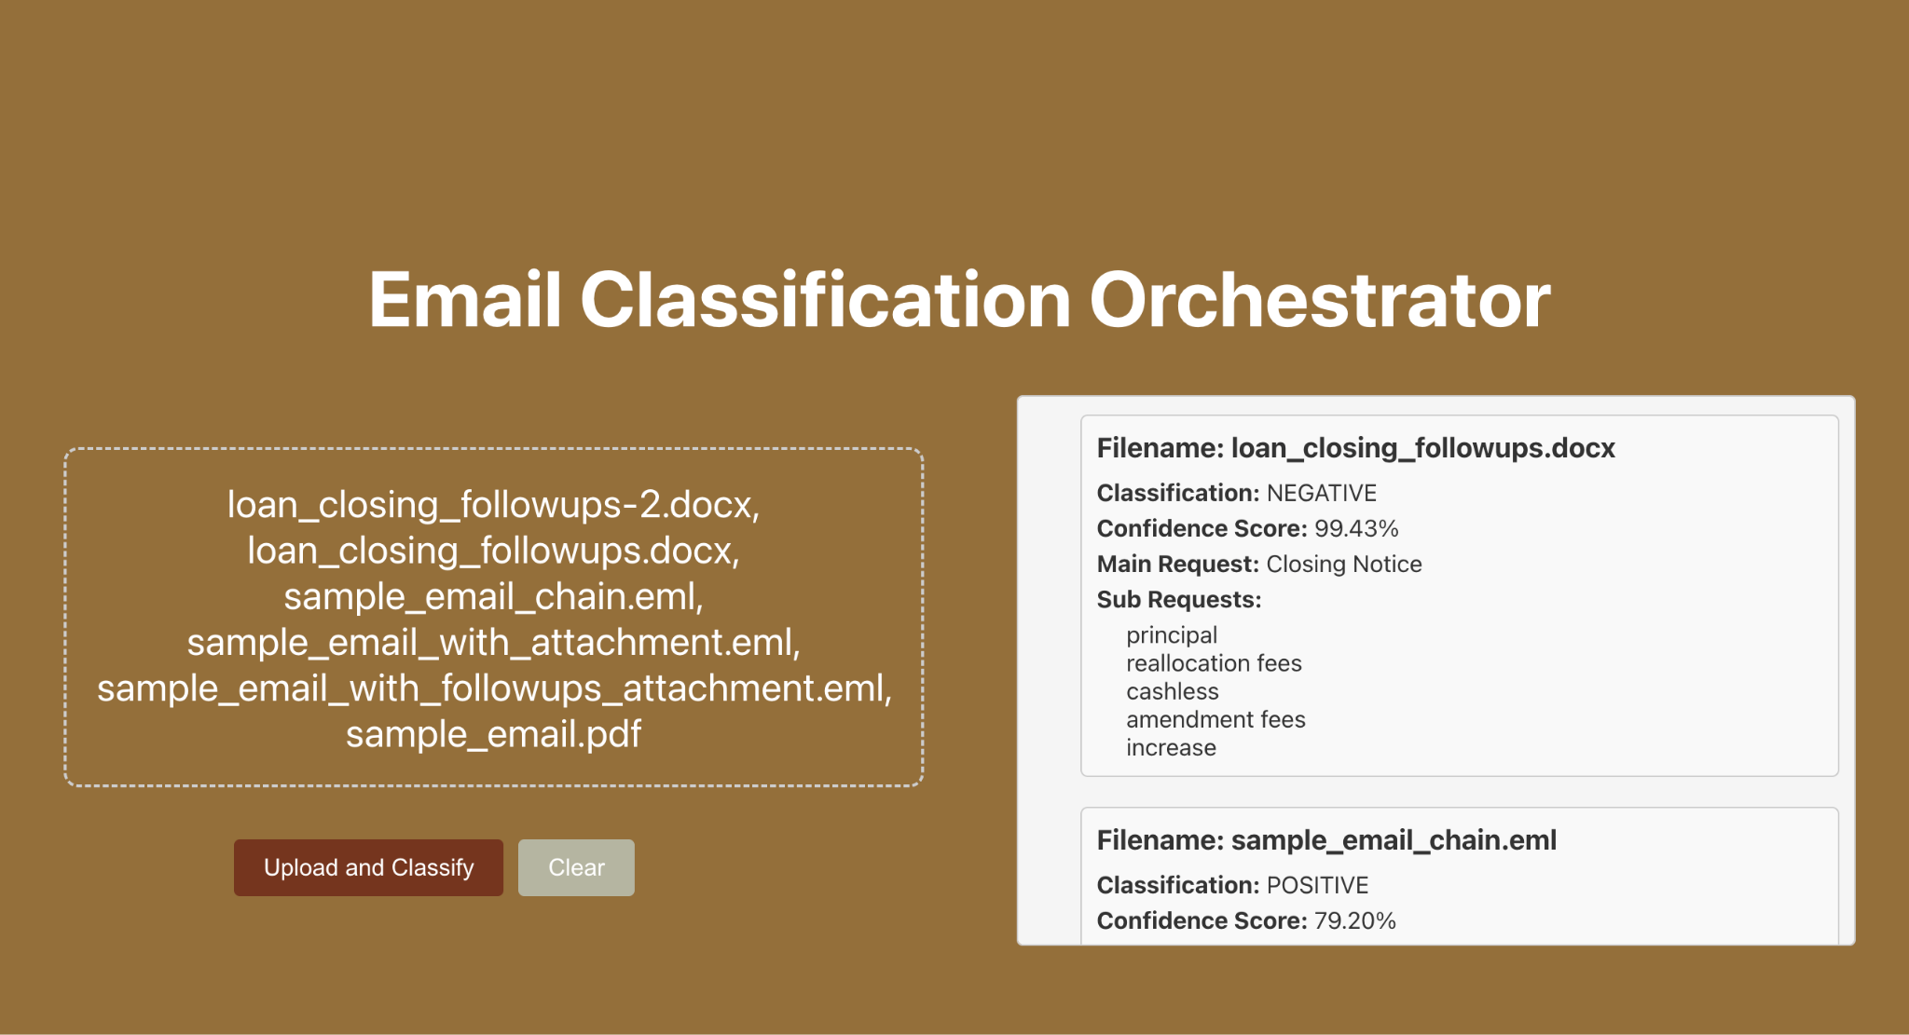

Slide 11
Future Enhancements
- Integrate OCR for image-based PDFs
- Improve sub-request classification with contextual AI models
- Implement real-time email ingestion from inbox
- Expand multi-language support

Slide 12
Conclusion
Our AI-powered email classification system streamlines loan servicing requests, reduces manual effort, and enhances accuracy. Future improvements will further automate the process.

