Slide 1

Gen AI Powered Email Classification and OCR Solution
Accurately extract, interpret, and categorize emails.
Team : CORT_Gems
Arun P K
Jithin M P
Karthik V
Sahaja Pulluru
Aneesh Kumar M

Slide 2

The Problem: Email Overload and Inefficient Processing
Commercial Bank Lending Service teas receive a significant volume of service requests through emails. These emails contain diverse requests, often with the attachments and will be ingested to the loan servicing platform and creates a service request which will go through the workflow processing.
Time Consumption
Manual Inefficiency
The average worker spends 28% of their day on email.
Manual email classification is time-consuming and error-prone.

Slide 3
Introducing the Gen AI Solution
A robust framework designed to categorize, process, and extract valuable insights from emails. Leveraging advanced NLP and machine learning methodologies, the system efficiently classifies email content, identifies key information, and produces structured, actionable reports.
Overview
Benefits
Leveraging Gen AI for advanced email understanding.
Automated categorization for efficient email
management.
OCR for extracting text from images and documents.
Contextual analysis to interpret email content accurately.
API for triggering extraction and classification.
Duplicate detection using semantic similarity with
Sentence-BERT
Classification with Together.AI

Slide 4
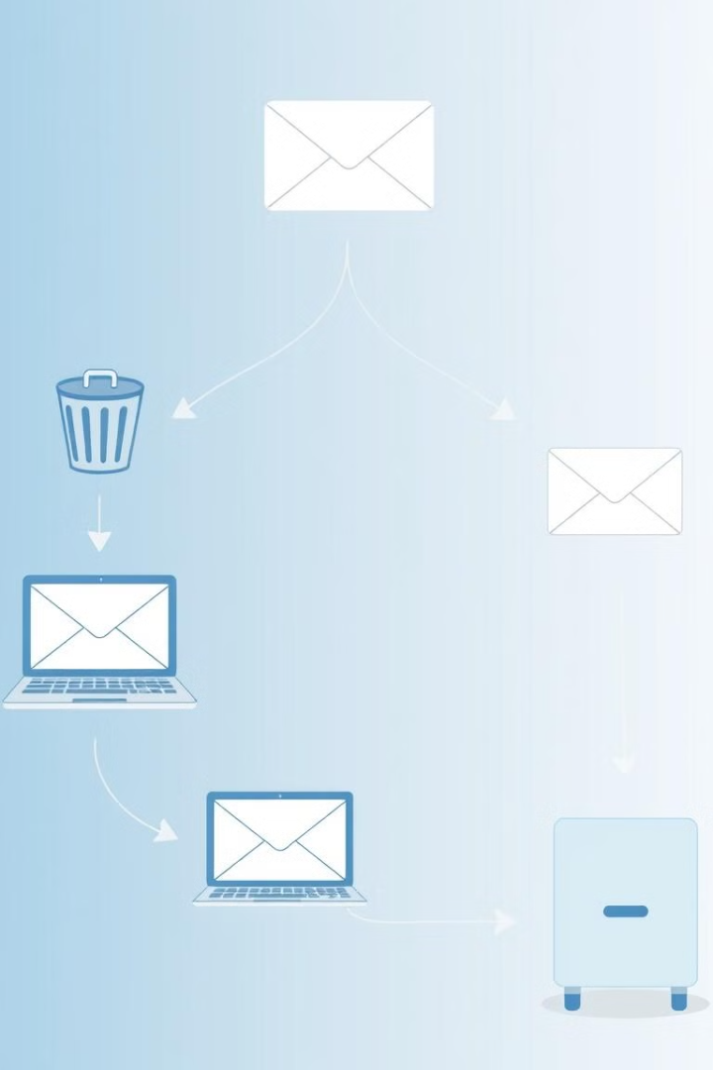



Core Components and Architecture
Email Shared Folder
Attachment Extraction
Email Body Extraction
Centralized storage for all emails.
Automated extraction of attachments.
Comprehensive extraction of email body content.
Supports PDFs, Word documents, images, text, HTML and inline images.

Slide 5
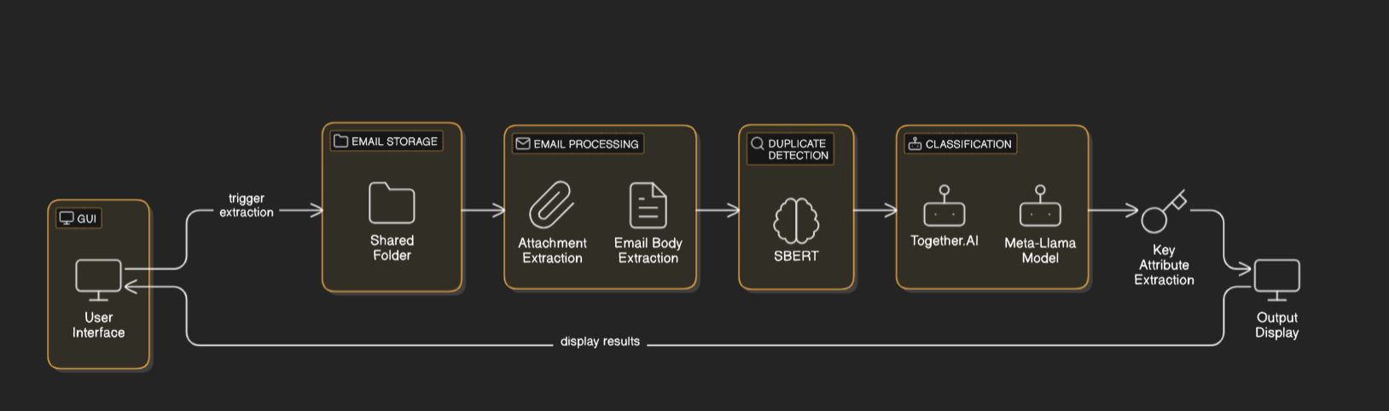
High Level Design

Slide 6
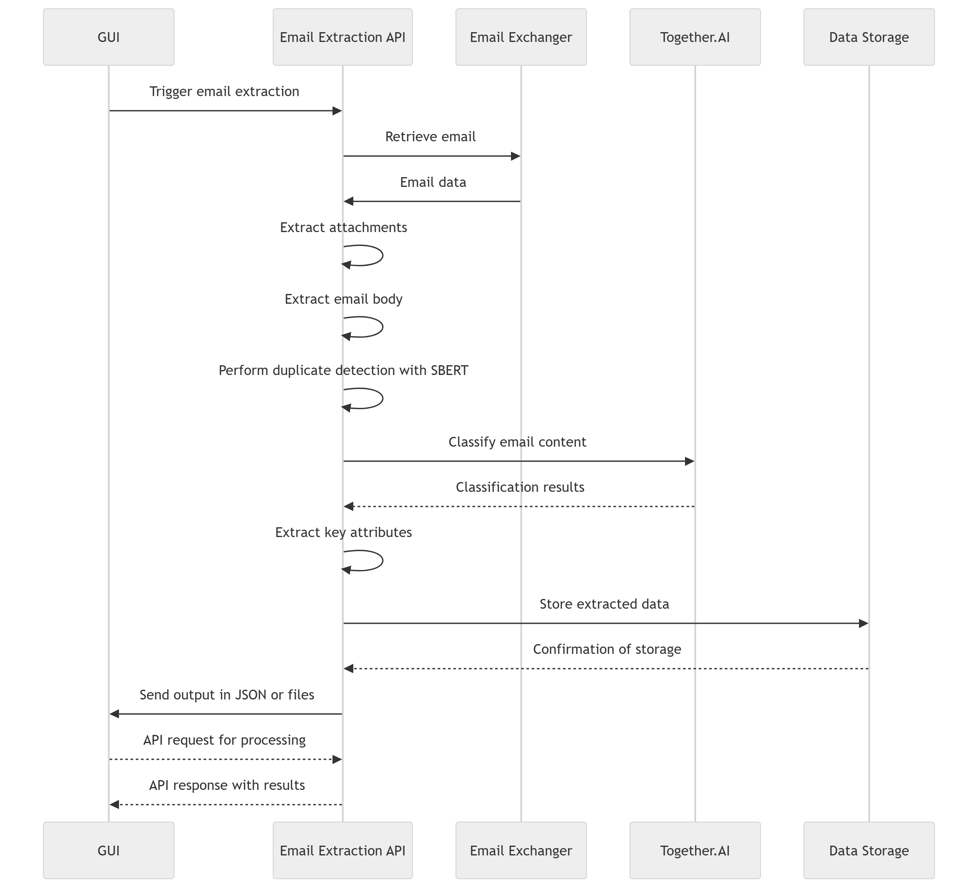
Sequence Diagram

Slide 7
Key Technologies and Libraries
Gen AI Model
OCR Engine
Technology
Fine-tuned for email classification and context understanding. Trained on a large dataset.
LLaMA → For text generation and complex analysis.
Sentence Transformers (BERT-based) → For semantic similarity detection using embedding.
Together.AI → models using APIs.
Extracts text from images, Utilizes Tesseract OCR with custom pre-processing.
Python, API, HTML, JSON
Email Extraction
User-friendly interface for triggering extraction and classification.
python-docx → For handling Word documents
PyPDF2 → For reading and extracting text from PDF files.
BeautifulSoup4 parses HTML.

Slide 8
How does it work?
AI-Based Email Classification Process Overview
1. Email Extraction & Attachment Parsing
Extract text from .eml files and attachments (PDF, DOC, Images) using PyPDF2, docx, and pytesseract.
Save extracted content in the extract_data folder.
2. Duplicate Detection
Generate embedding using SentenceTransformer and compare with existing emails.
Mark as duplicate if similarity ≥ 90%.
3. Key Attribute Extraction
Use Llama-3.3-70B-Instruct-Turbo API to dynamically extract attributes.
Save extracted attributes (e.g., Borrower, Deal Name, Amount).
4. Email Classification
Classify emails into categories and sub-categories.
Extract Category, Sub-Category, Reasoning, and calculate Confidence Score.
5. Result Generation & API Integration
Aggregate results and save to email_duplicates_with_attributes.json.
Flask API (/process_email) triggers classification and updates HTML dataGrid.

Slide 9





Functionality and Features
API
Manual initiation.
Attachment Processing
Extraction and processing.
Contextual Understanding
For accurate categorization.
Automatic Classification
Into predefined categories.
Email Exchange folder

Slide 10








Benefits of the Solution
Increased Efficiency
Improved Accuracy
Enhanced Productivity
Cost Reduction

Slide 11
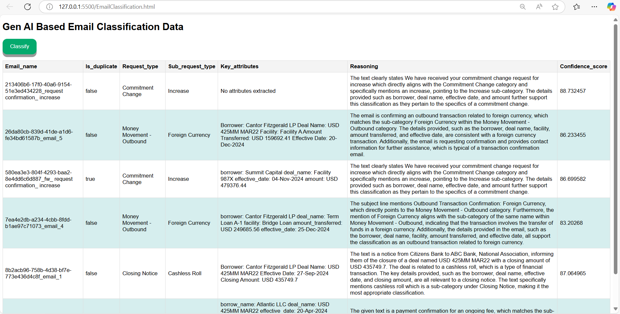
UI Report

Slide 12
Thank You!

