Slide 1
InboxGenie
-Your AI assistant for the inbox
Automated Email Parsing, Classification, and Ticket Generation
Team EliteEagles

Slide 2
Project Overview
This system ingests emails in multiple formats (.eml, .pdf, .docx), applies OCR and preprocessing, and uses Gemini GenAI to extract entities and classify intents. It outputs structured JSON used for ticket generation and routing.

Slide 3
Key Features
- Multi-format email ingestion
- OCR + Preprocessing pipeline
- Gemini API for entity extraction and classification
- Confidence scoring
- Structured JSON output
- Auto-ticket generation

Slide 4
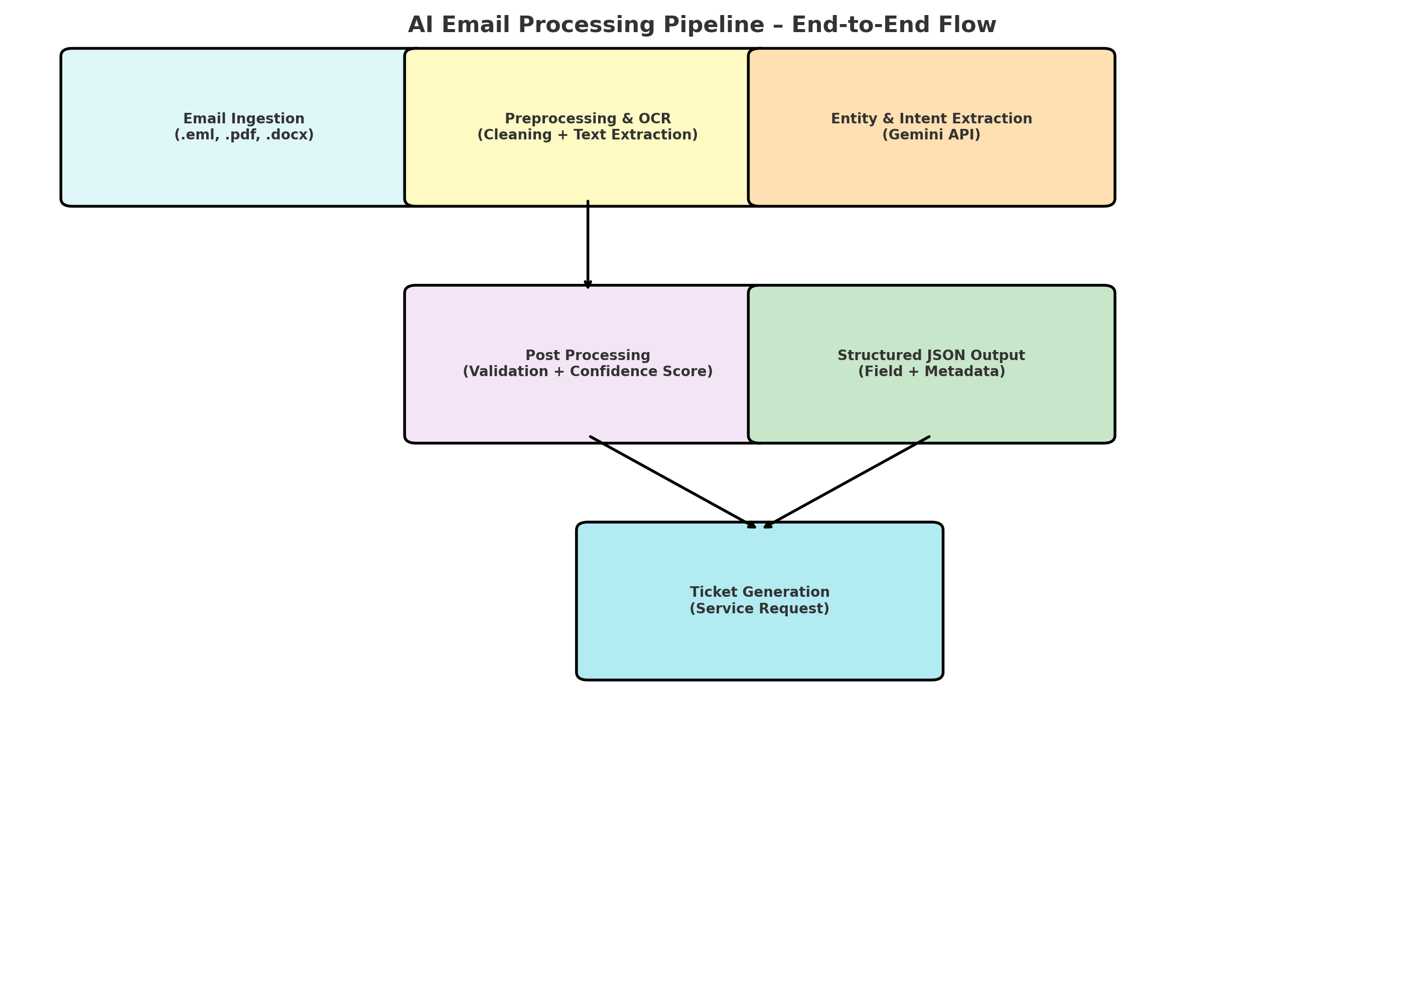
Pipeline Flow Diagram

Slide 5
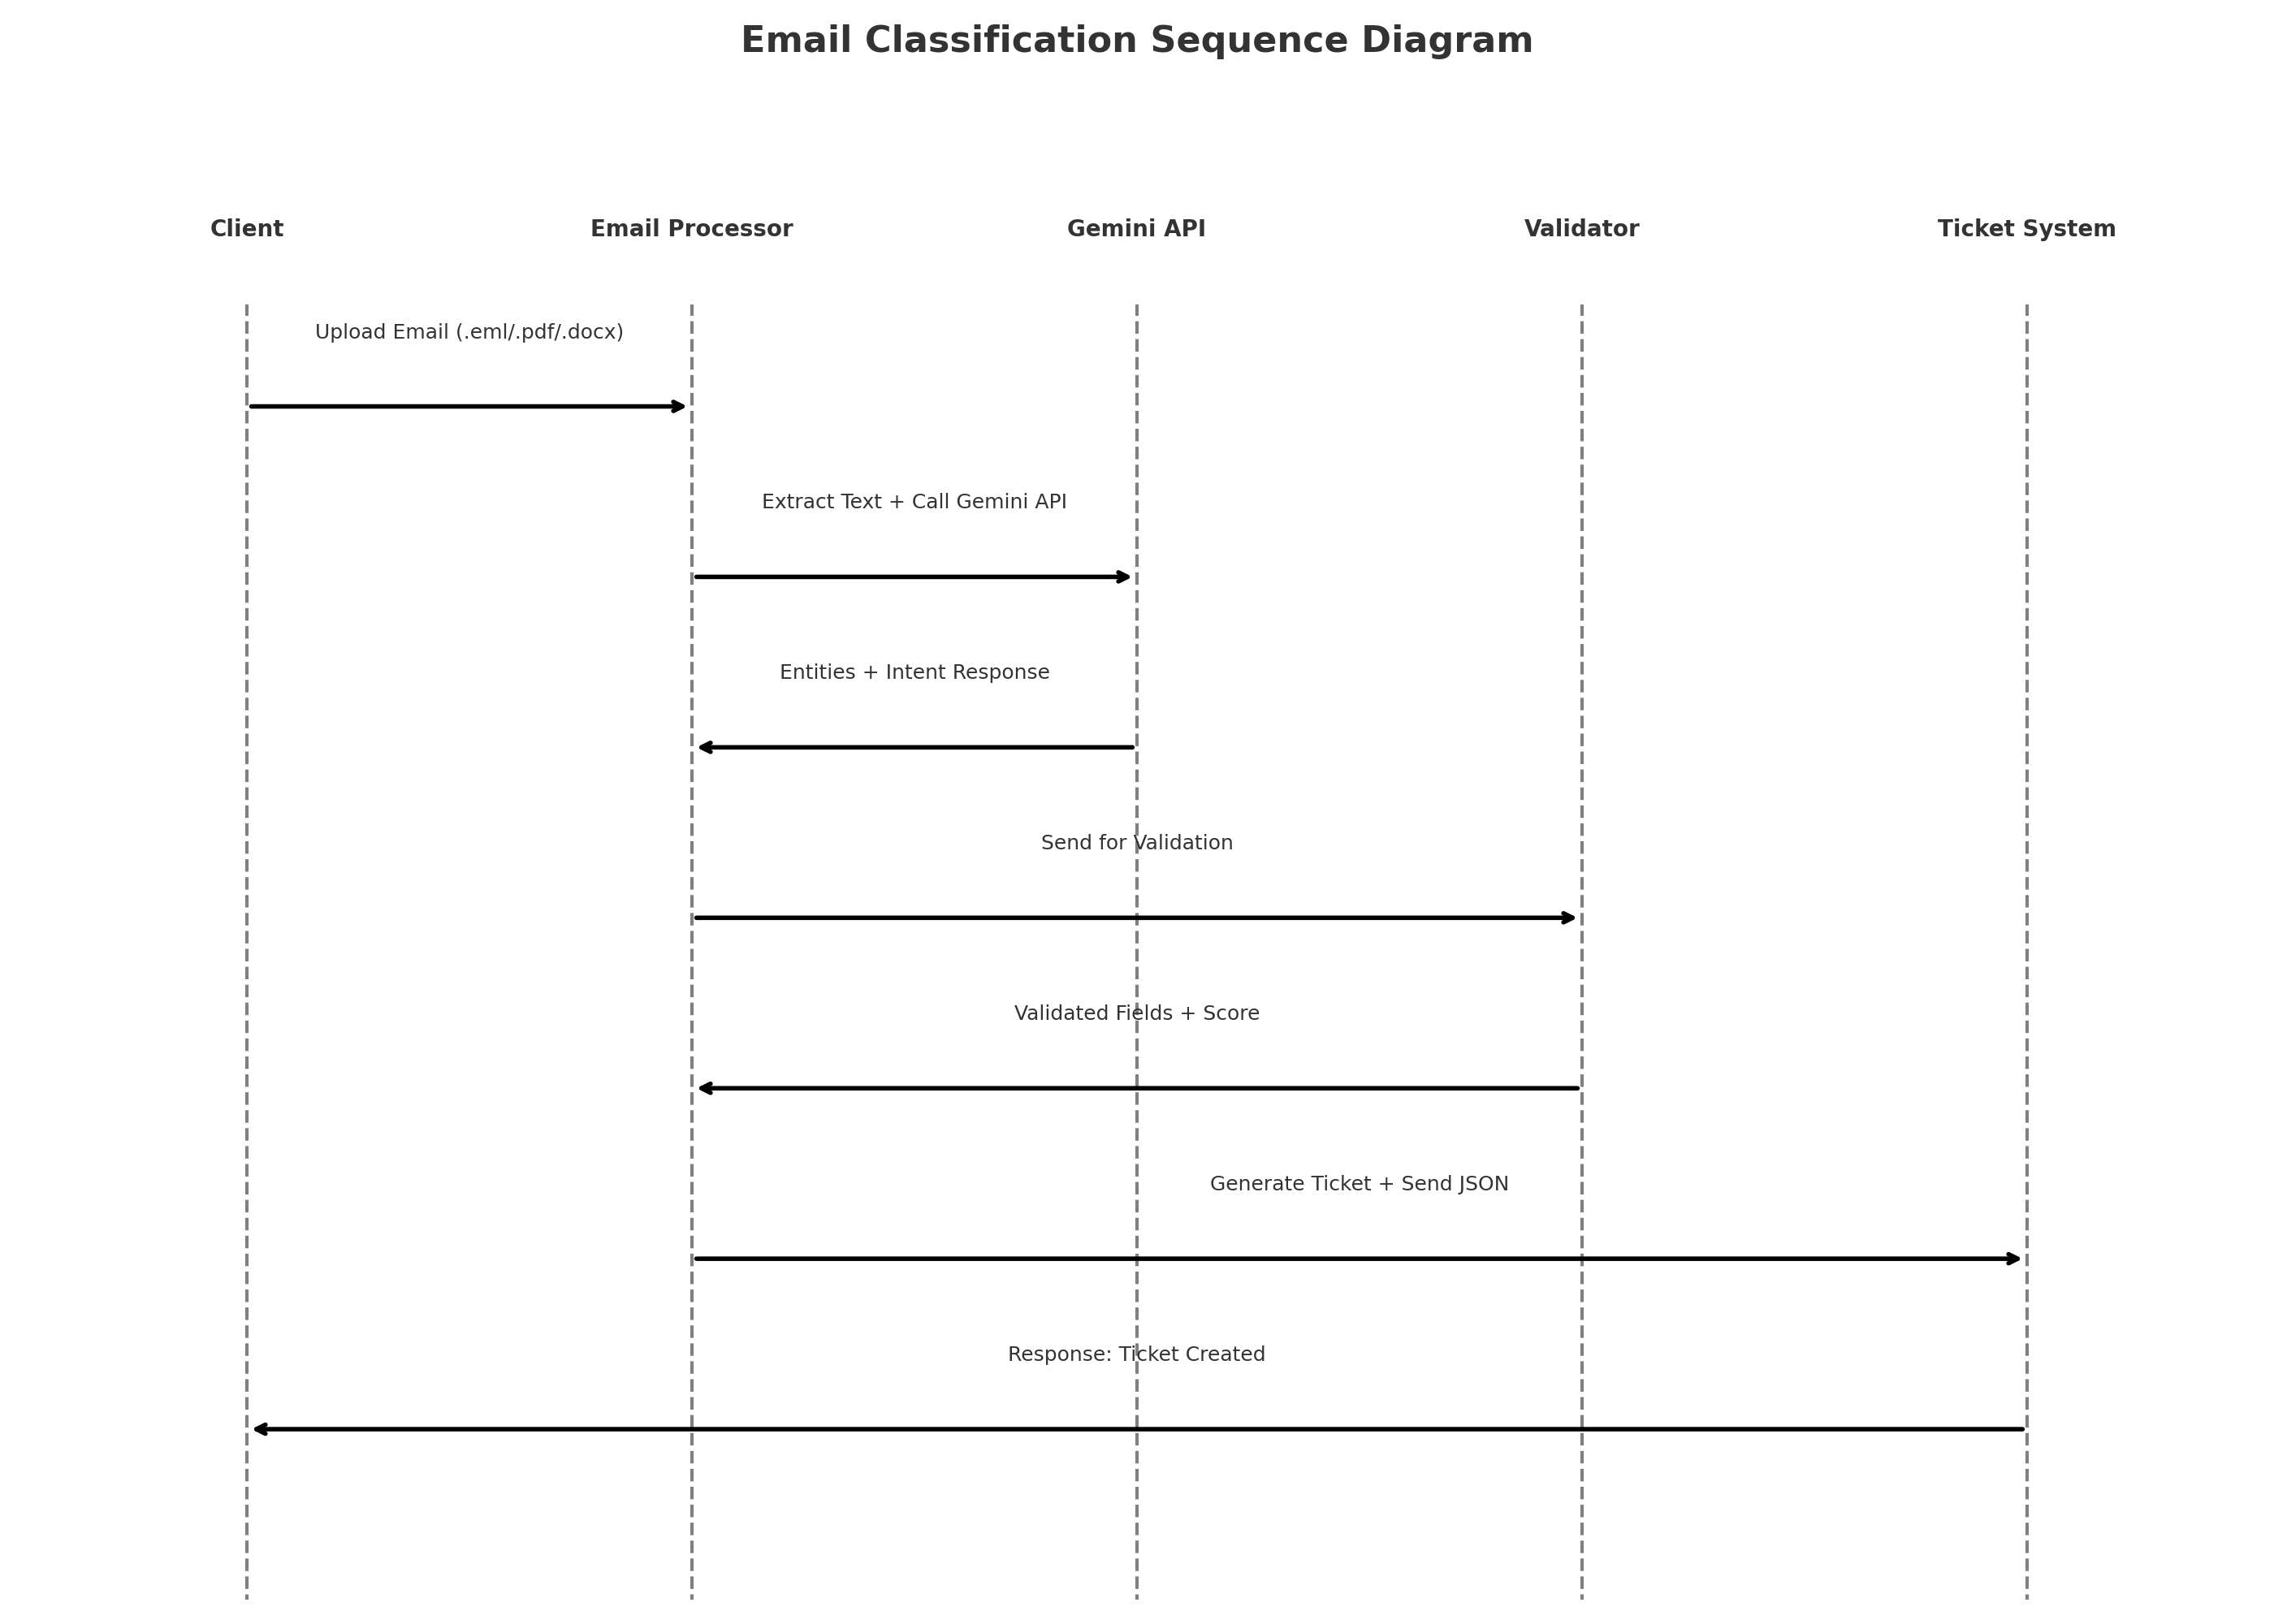
Sequence Diagram

Slide 6
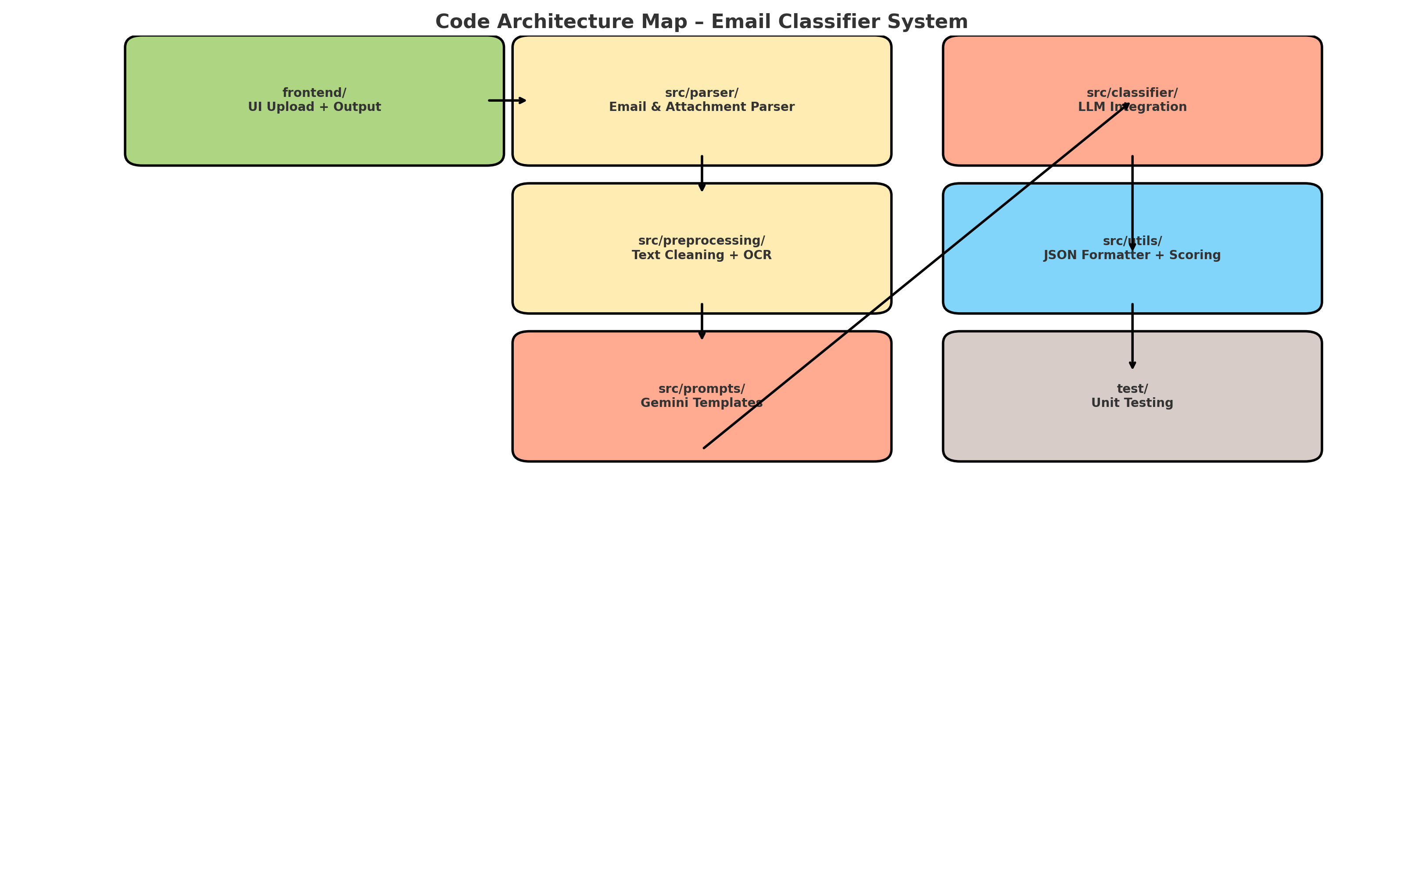
Code Architecture Map

Slide 7
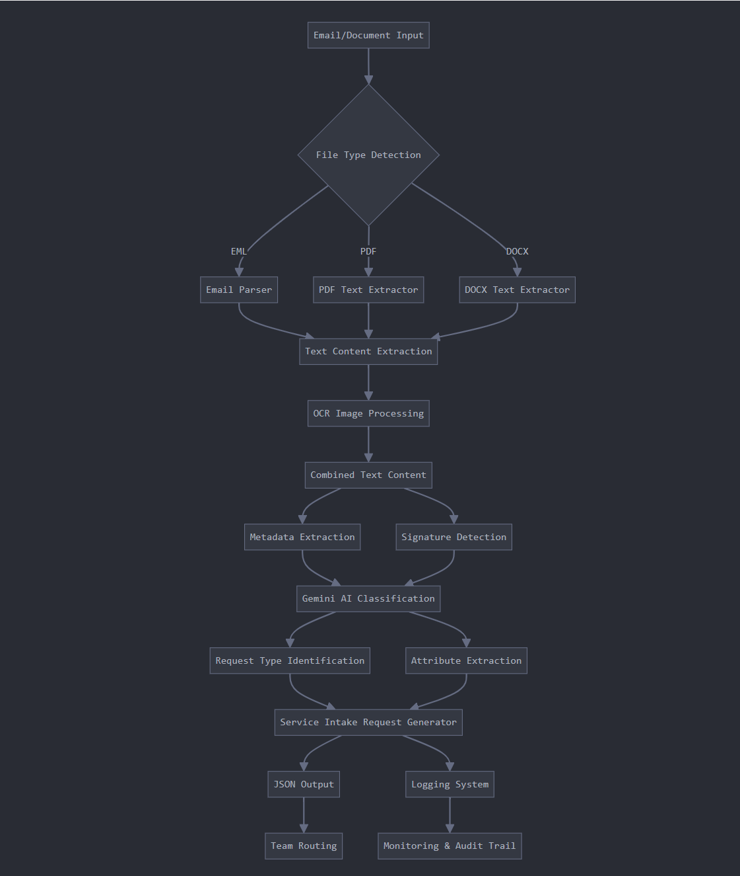
Flow Diagram from Artifacts

Slide 8
UI Screenshots Summary
- Upload Panel: Accepts .eml/.pdf/.docx
- File processing
- Output Viewer: extracted entities, intents
- JSON Export options for integration

Slide 9
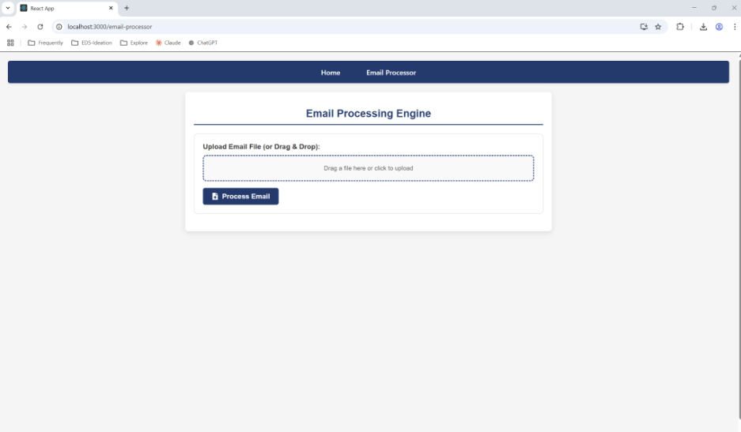
UI Email processing Home page

Slide 10
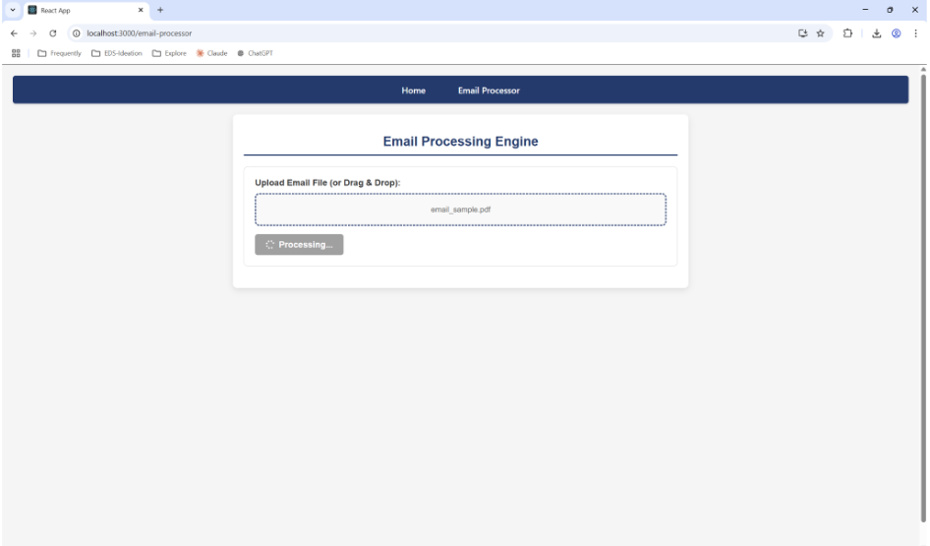
File being processed

Slide 11
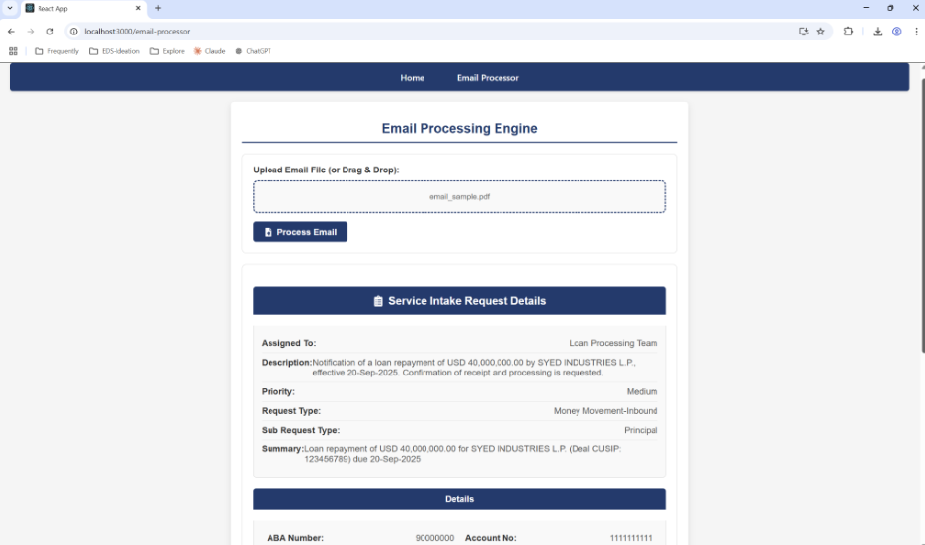
Output – part1

Slide 12
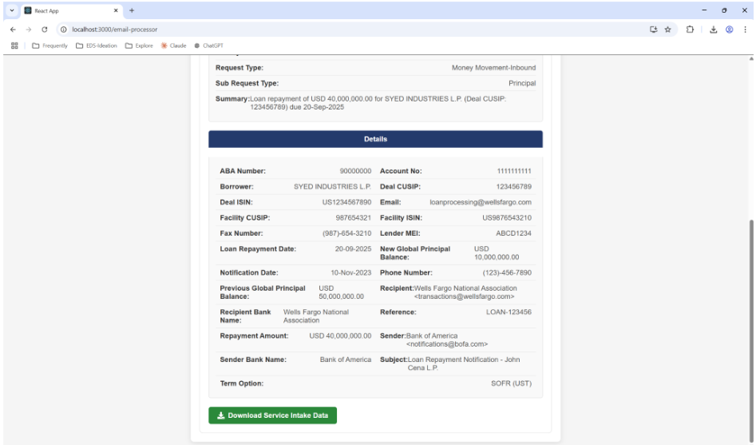
Output – Part2

Slide 13
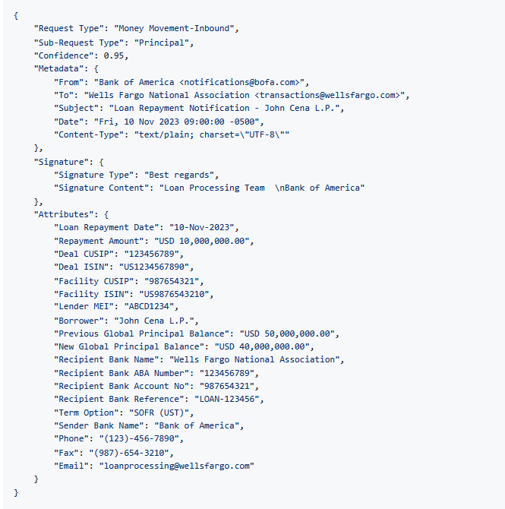
JSON Response : Email Classification

Slide 14
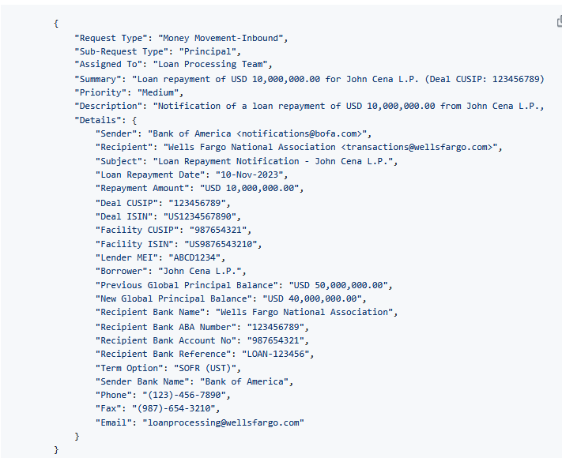
JSON Response : Service Intake Request

