Slide 1
Automated Email Classification and Data Extraction
For Commercial Bank Lending Service Team

Slide 2
Introduction
• The Commercial Bank Lending Service Team receives servicing requests via email.
• Emails often contain attachments with crucial details.
• Manual classification and data extraction is time-consuming and error-prone.
• Automating this process enhances efficiency, accuracy, and turnaround time.

Slide 3
Objective
• Implement an AI-driven solution using Generative AI (LLMs) to classify emails.
• Extract key attributes from email content and attachments.
• Automate service request creation and routing.
• Minimize manual gatekeeping activities.

Slide 4
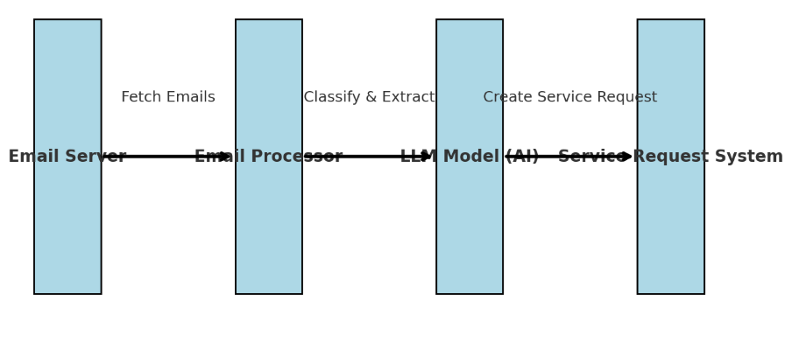
Data flow Diagram

Slide 5
Process Flow
1. Fetch unread emails from the inbox.
2. Extract email content and process attachments (PDF, DOCX, XLSX).
3. Use LLM to classify request type and extract key attributes.
4. Populate service request details automatically.
5. Route service request to appropriate processor based on skill-based routing.

Slide 6
Key Features
• Automated email classification using AI.
• Intelligent extraction of key attributes from emails & attachments.
• Seamless integration with service request systems.
• Improved accuracy and reduced manual effort.
• Faster response time and better customer service.

Slide 7
Conclusion
• The AI-driven approach streamlines email processing and service request creation.
• Enhances operational efficiency and minimizes errors.
• Enables intelligent routing based on skill-based processing.
• A scalable solution for future banking automation needs.

