Slide 1

Agentic AI Model– Email Classification
Team Name: exceptionally-unhandled
Rohini Ramachandran
Raghuram Nandepu

Slide 2
Problem Statement
Rising email volumes lead to missed or delayed service requests
Manual email classification is time-consuming and prone to errors
Identifying service requests from attachments adds complexity
Need for efficient duplication detection

Slide 3

Proposed Solution
Agentic AI system using Gemini model
Multi-agent architecture for improved efficiency
Intelligent prioritization based on email context and content
Duplicate detection for faster response times

Slide 4
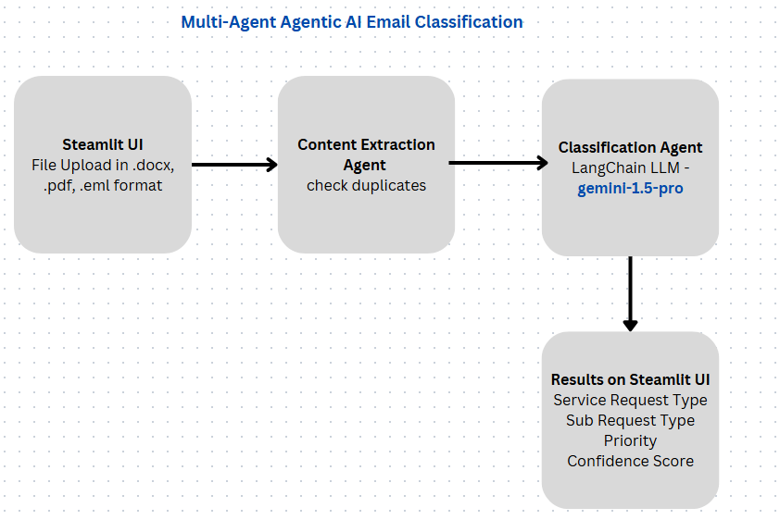
Architecture

Slide 5
Design Flow – Key Components
Input Layer (User Interaction)
File Upload (Supports .docx, .pdf, .eml)
Streamlit Interface (UI Layer)
Pre-Processing Layer
Content Extraction Agent (Reads email body, attachments, etc.)
Normalization Module (Cleans text for consistent input)
AI Decision Layer (Core Intelligence)
Classification Agent (Uses Gemini or LLaMA with prompt engineering for request type identification)
Duplicate Detection Agent (Compares content to previous records)
Priority Agent (Assigns urgency levels based on request type)

Slide 6
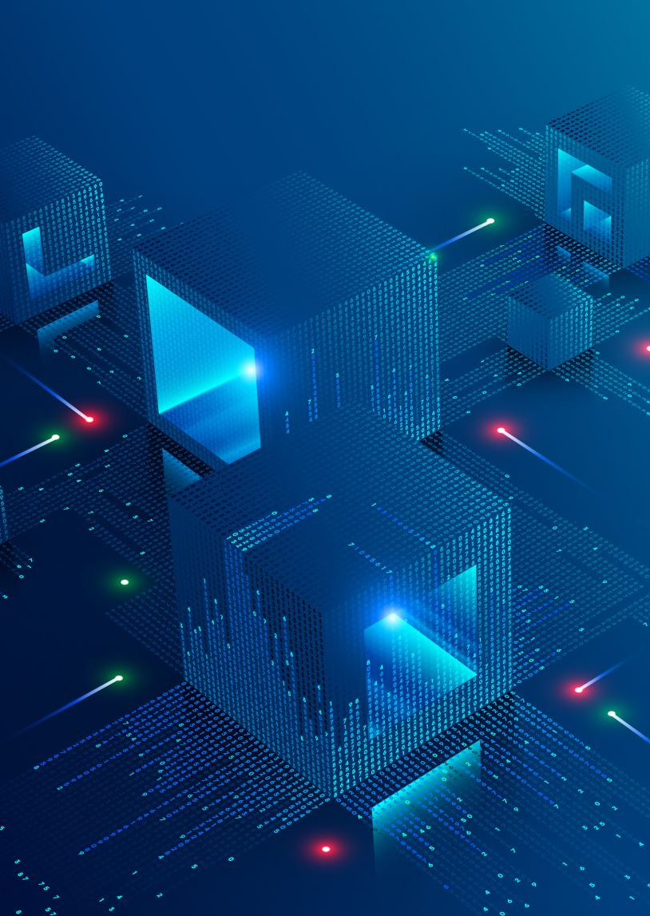
Scalability & Future Enhancements
Scalability: Adding Dask for parallel processing
Future Improvements:
Enhanced NLP model integration
Improved attachment analysis
Adaptive learning for keyword updates

