Slide 1
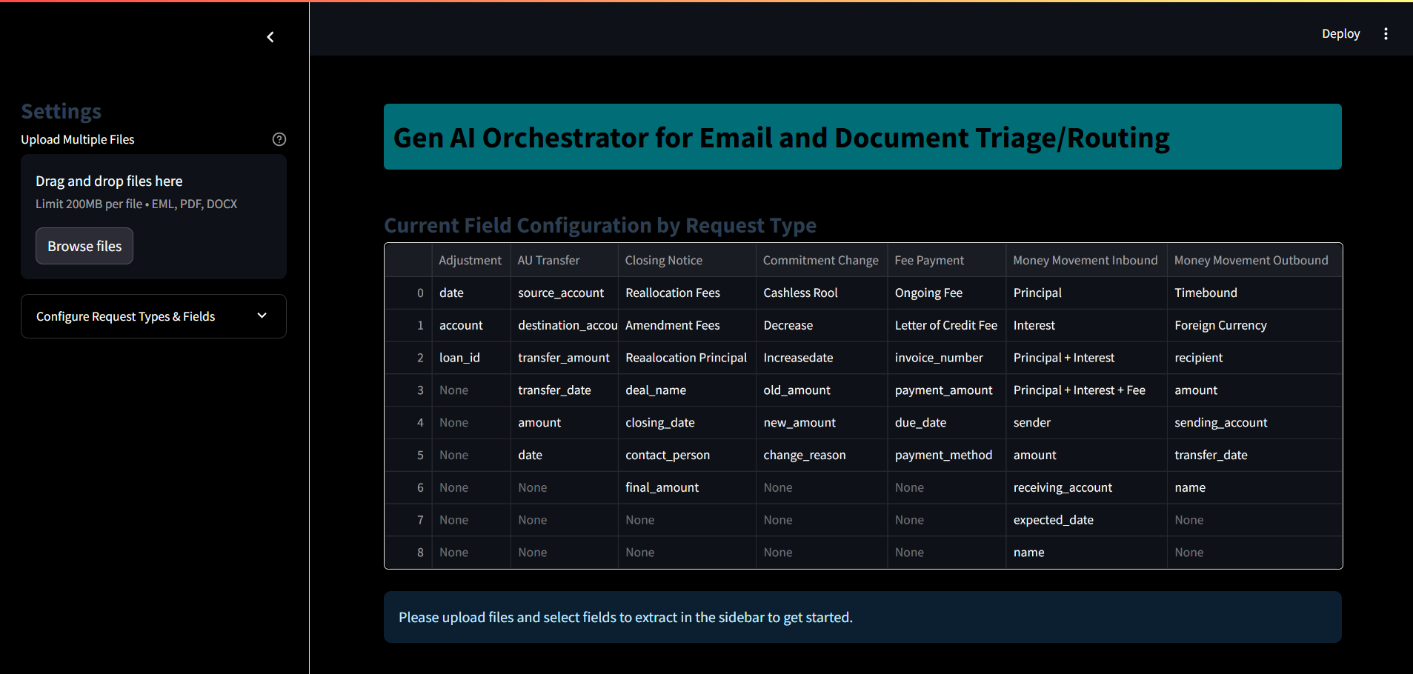
Application landing page

Slide 2
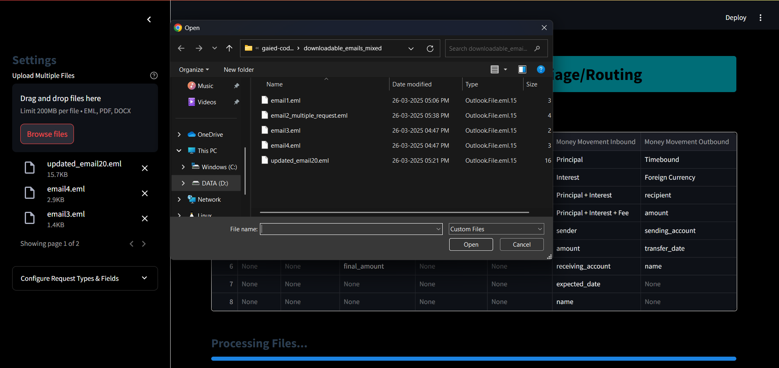
Upload files (email / pdf / attachements)

Slide 3
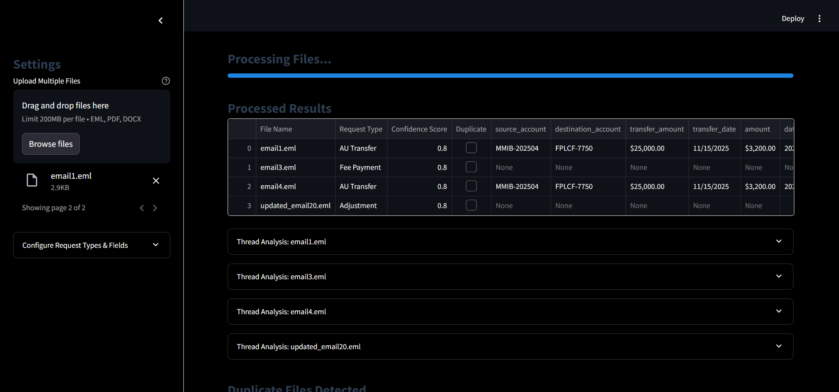
Processed Results

