Slide 1
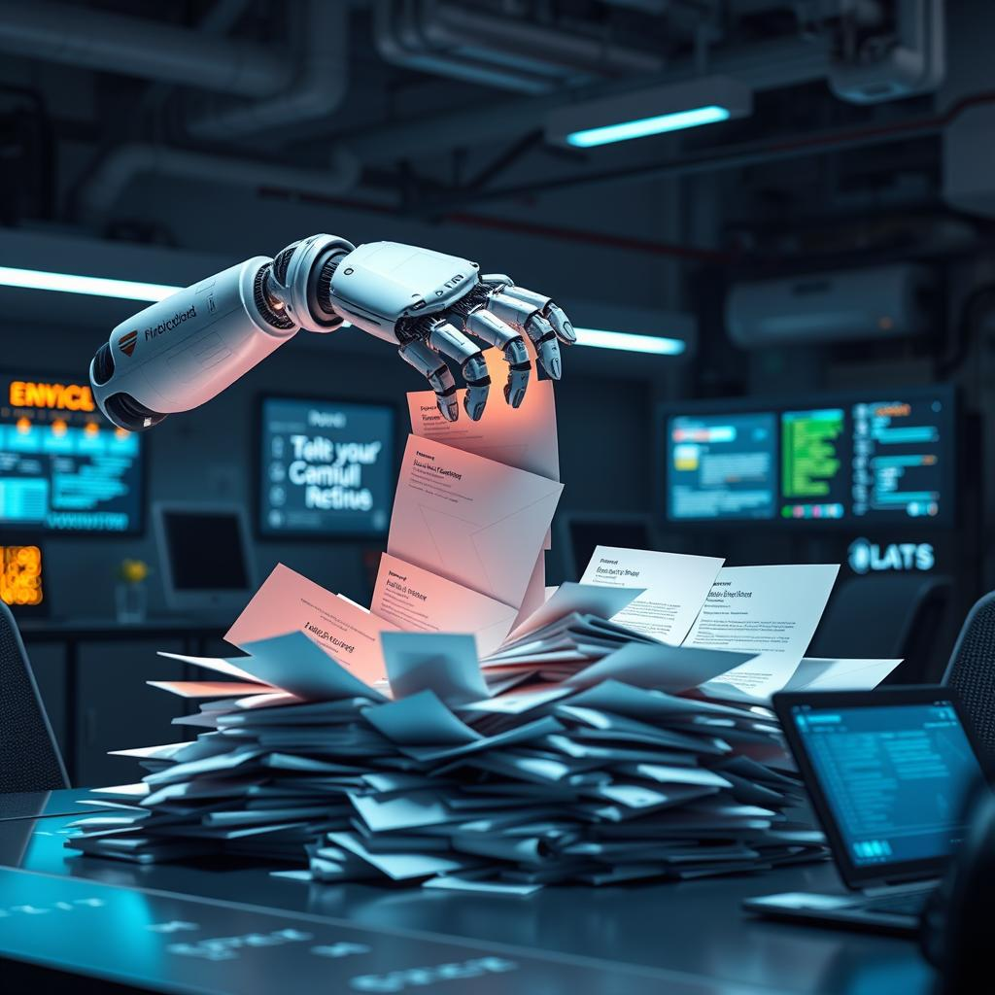
AI Orchestrator for Email and Document Triage/Routing
Intelligent Email/Document Classification and Organization
Team - Fraud Breakers :
Vivek K Tripathi (Manager)
Vijaya Nagaraj SN(Architect)
Sree Deepthi Chintala (Development Lead)
Raghunatha R Devireddy (Development Lead)
Amit Agrawal (Quality & Service Virtualization Lead)

Slide 2

Problem Statement
Manual email processing creates bottlenecks in loan servicing
“Gate Keeper “ role currently handles classification and data extraction
High potential for human error and processing delays
Complex emails with multiple requests along with attachments require contextual understanding

Slide 3
System Overview
Intelligent email classification system using LLM
Context-based Data Extraction
Multi-Request Handling with Intent Detection
Priority-based Extraction
Duplicate Email Detection
Modular architecture for easy maintenance and scalability

Slide 4
Core Components
Email/Document Extractor
Content Token Processor
LLM Integration
Email/Document Analyser
Email/Document Categorization
Configuration Update

Slide 5
Approach
Approach 1:
Email or document extraction and parsing tokens
Used Zero Shot Classification, used bart-large-mnli LLM
Display results
Approach 2:
Email or document extraction and parsing tokens
Used Sliding Window Attention , used Mistral-7B-Instruct-v0.1 LLM
Error Handling:
Comprehensive exception management
Detailed logging system
Graceful error recovery
Configuration:
Environment-based API key management
Extensible category system and Configurable logging

Slide 6
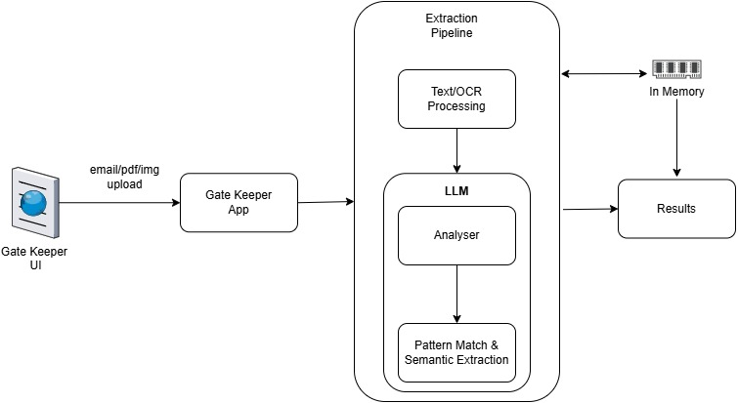
Current Architecture

Slide 7
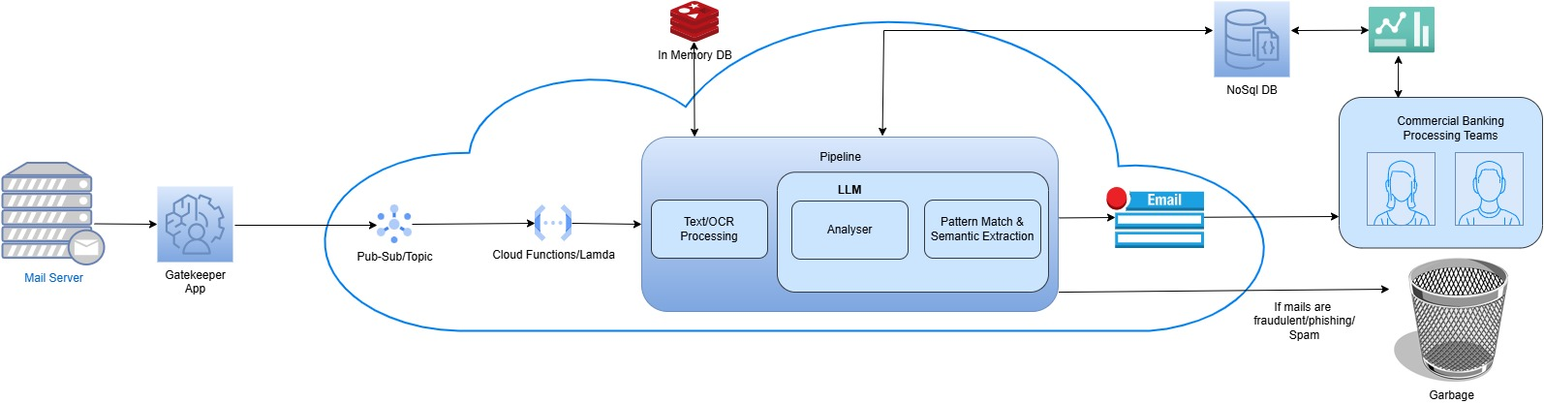
Proposed Architecture

Slide 8
Future Enhancements
Advanced LLM Integration:
Custom models training
Specialized Multiple models GPT usage
Enhanced Classification:
Dynamic categories
Learning from lending processor feedbacks
UI/API Development:
Web interface
REST API endpoints exposure

Slide 9
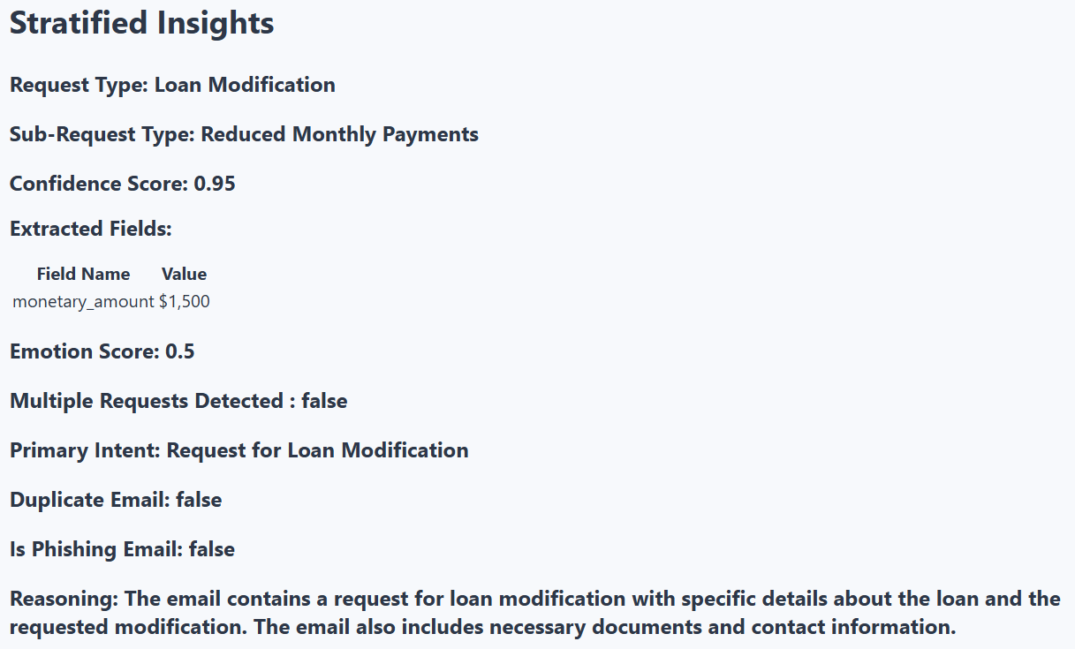
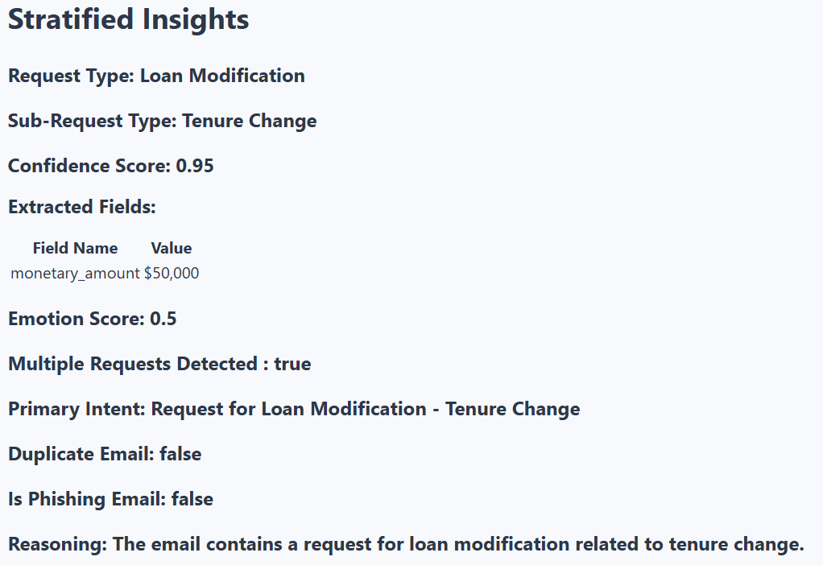
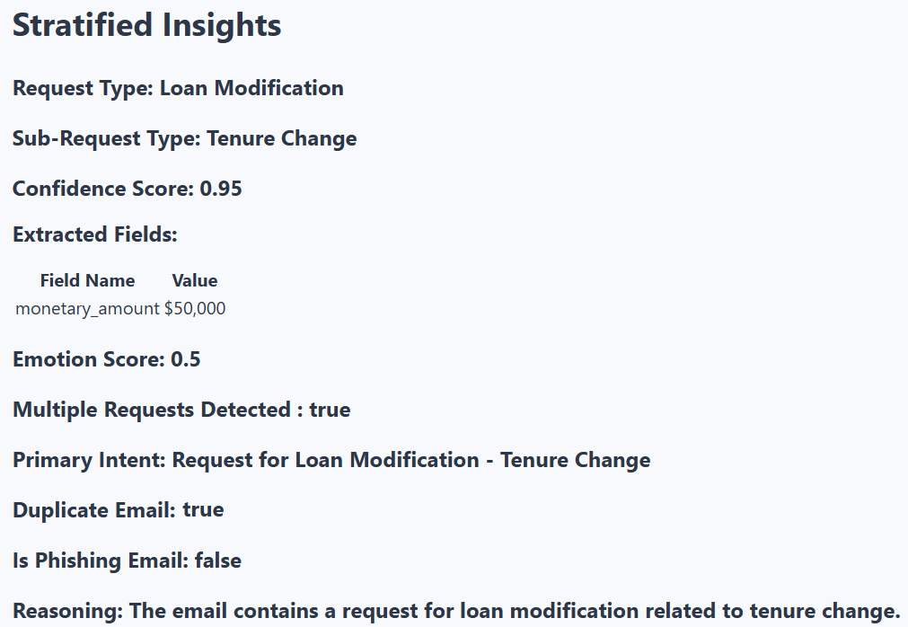
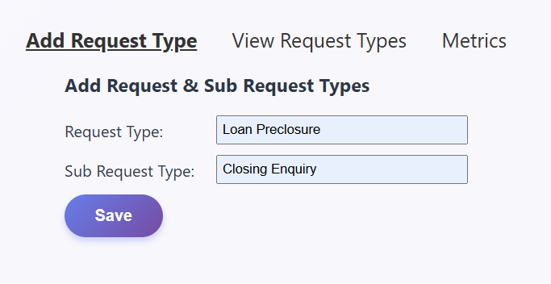
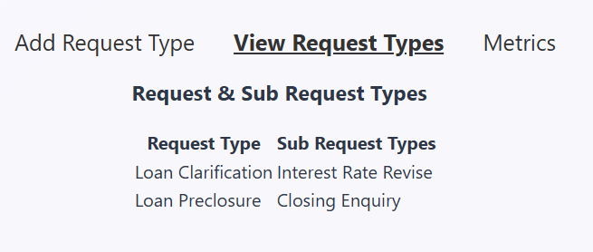


Outcome
Single Request
Multiple Requests
Duplicate Email
Configuration Update

Slide 10
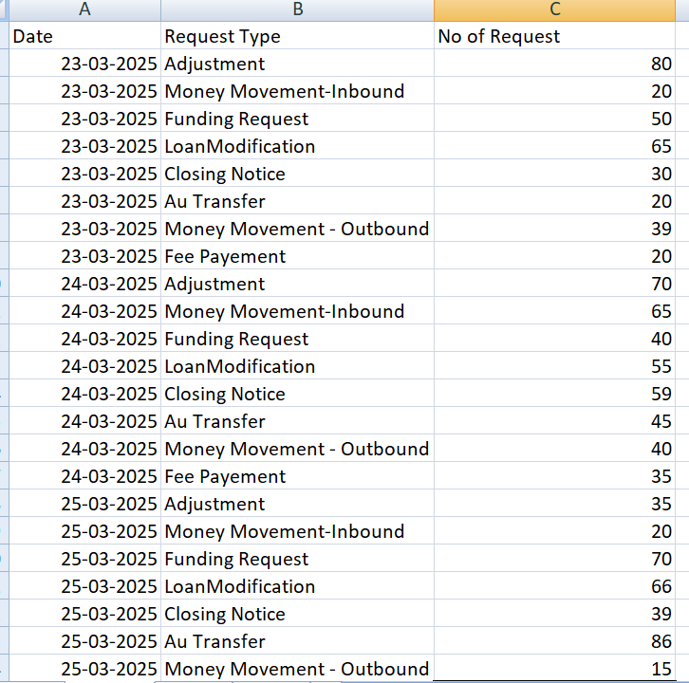
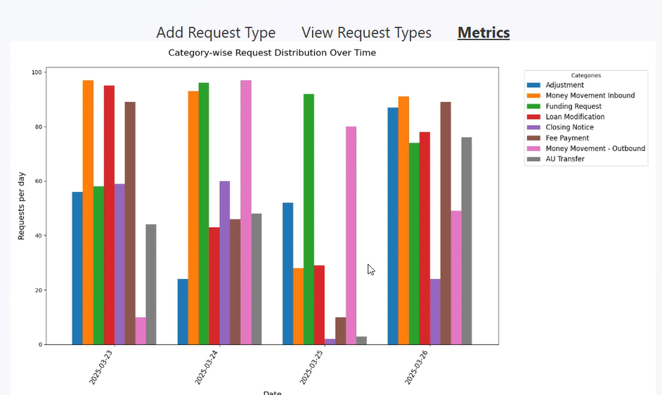
Metrics & Visualization

Slide 11
Thanks

Slide 12
Appendix

Slide 13
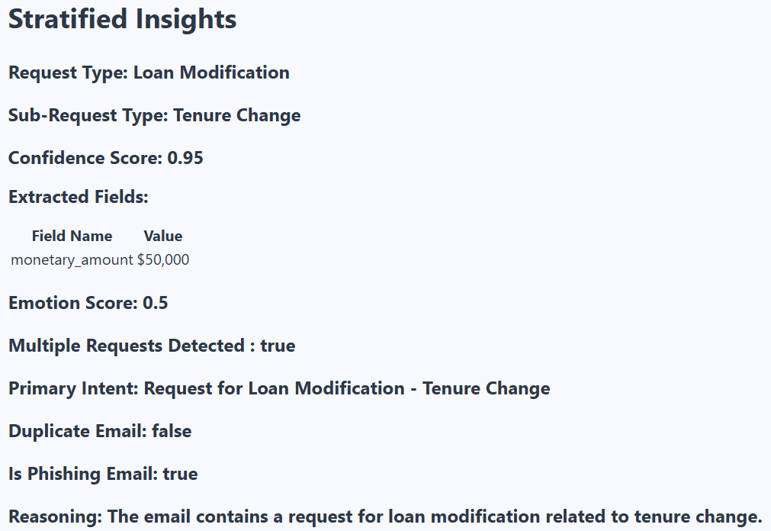

Outcome
Is Phishing Email

