Slide 1
AI Orchestrator for Email and Document Triage/Routing
Intelligent Email/Document Classification and Organization
Team - Fraud Breakers :
Vivek K Tripathi (Manager)
Vijaya Nagaraj SN(Architect)
Sree Deepthi Chintala (Development Lead)
Raghunatha R Devireddy (Development Lead)
Amit Agrawal (Quality & Service Virtualization Lead)

Slide 2

Problem Statement
Manual email processing creates bottlenecks in loan servicing
"Gatekeeper" role currently handles classification and data extraction
High potential for human error and processing delays
Complex emails with multiple requests along with attachments require contextual understanding

Slide 3

System Overview
Intelligent email classification system using LLM
Context-based Data Extraction
Multi-Request Handling with Intent Detection
Priority-based Extraction
Duplicate Email Detection
Modular architecture for easy maintenance and scalability

Slide 4
Core Components
Email/Document Extractor:
Content Token Processor:
LLM Integration
Email/Document Analyser
Email/Document Categorization

Slide 5
Approach
Approach 1:
Email or document extraction and parsing tokens
Used Zero Shot Classification, used bart-large-mnli LLM
Display results
Approach 2:
Email or document extraction and parsing tokens
Used Zero Shot Classification, used Mistral AI LLM
Error Handling:
• Comprehensive exception management
• Detailed logging system
• Graceful error recovery
Configuration:
• Environment-based API key management
• Extensible category system and Configurable logging

Slide 6
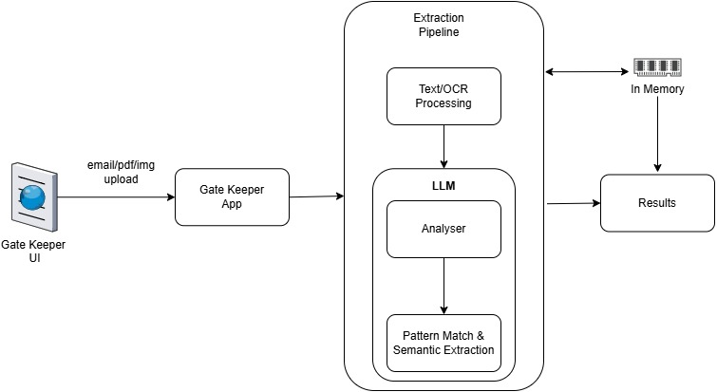
Current Architecture

Slide 7
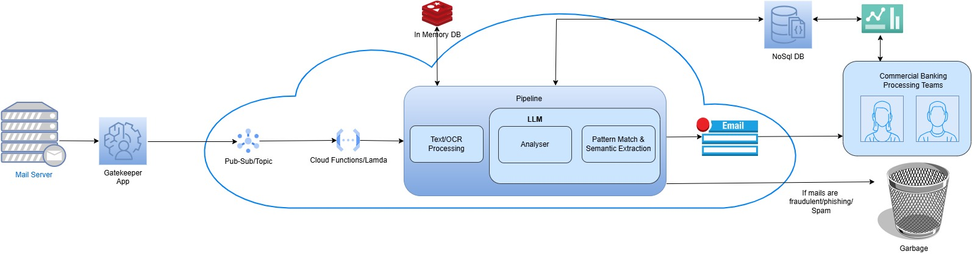
Proposed Architecture

Slide 8
Future Enhancements
Advanced LLM Integration:
Custom models training
Specialized Multiple models GPT usage
Enhanced Classification:
Dynamic categories
Learning from lending processor feedbacks
UI/API Development:
Web interface
REST API endpoints exposure

Slide 9
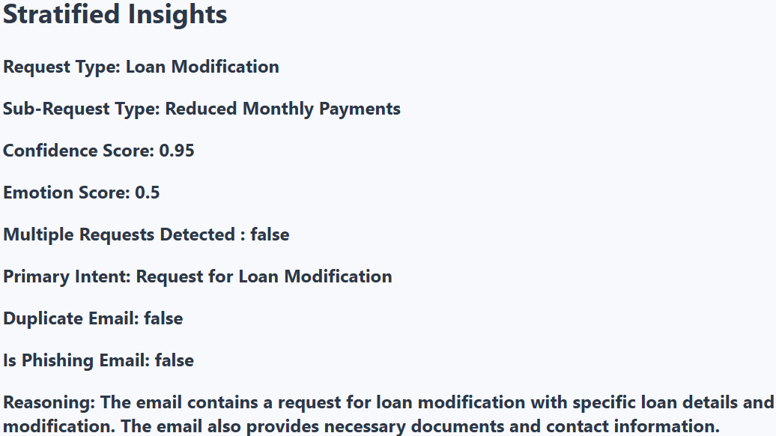
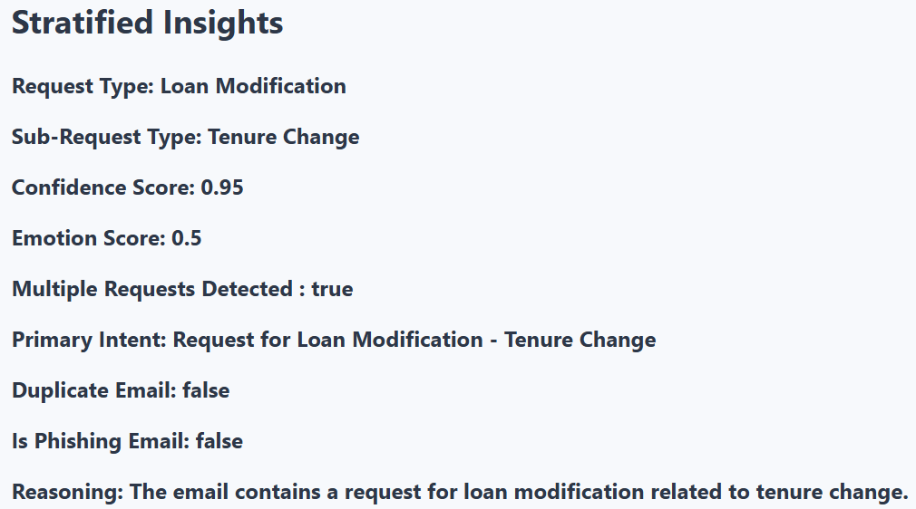

Outcome
Single Request
Multiple Requests

Slide 10
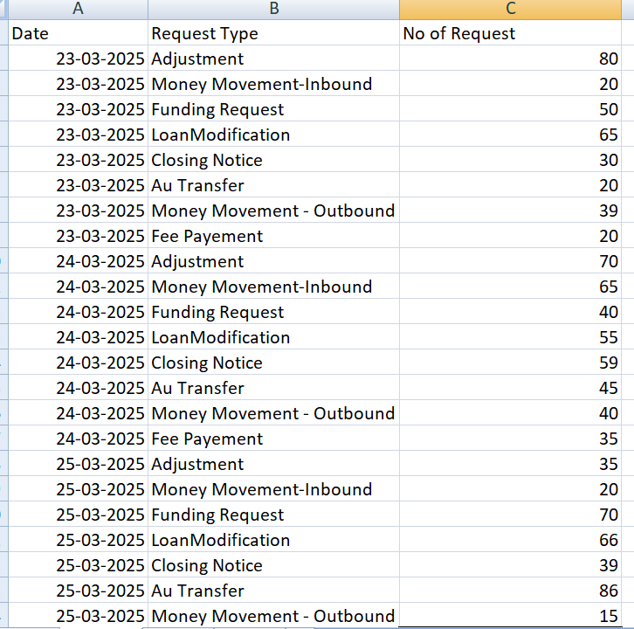
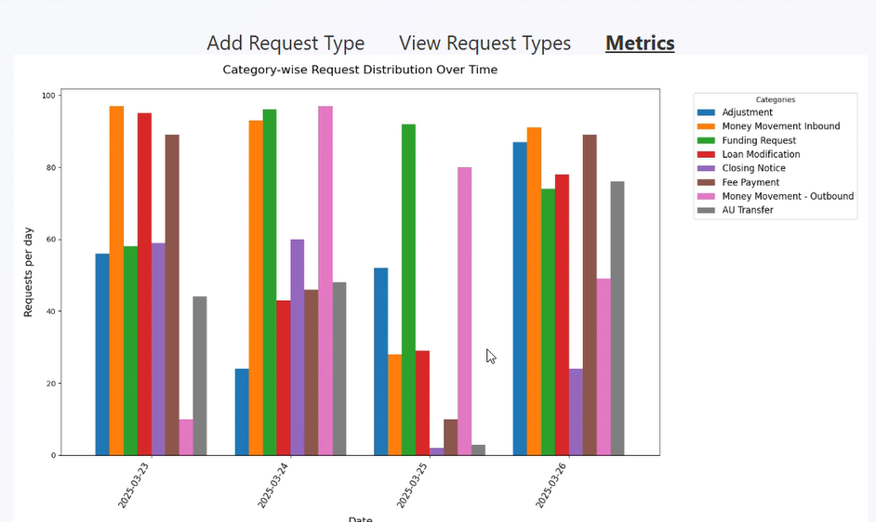
Metrics & Visualization

Slide 11
Thanks

