Slide 1
Generative AI Email Classification System
By Gen AI Bots

Slide 2
Team Details
Suresh
Narayana
Venkata Ranga
Pranava
Priya

Slide 3
Overview
The system processes emails related to Commercial Bank Lending Services (CBLS) and classifies them based on request types (e.g., Fee Payment, Money Movement). It uses a Generative AI model to extract key attributes from emails and attachments. Classified emails are stored in a MongoDB database and assigned to appropriate teams or users.

Slide 4
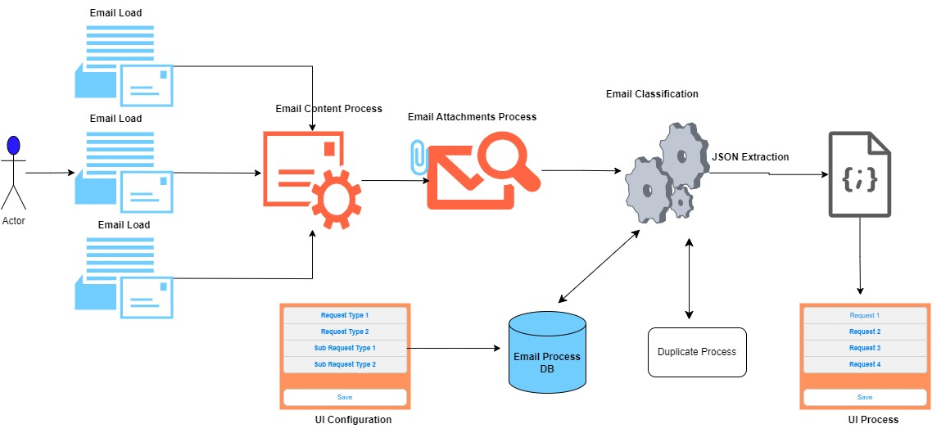
System Architecture

Slide 5
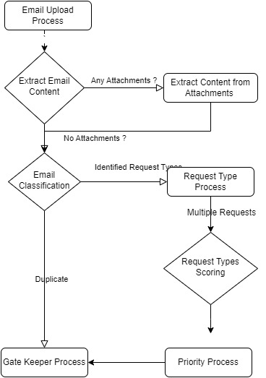
Flow Diagram

Slide 6
Key Components
Frontend (UI)
Web interface for users to upload emails, view uploaded emails and also configure request and sub-request types.
Backend (Flask API)
Handles email uploads, extraction and classification using LLM, storage, and retrieval.
API endpoints:
/api/email (CRUD operations for emails)
/api/request_types (Manage classification request types)
/api/email/add_new, /api/email/update_existing (Email processing)
Database (MongoDB)
Stores classified emails, assigned teams, urgency levels, request types, and users.
Collections:
email_classifications
assigned_to
assigned_team
urgency
request_types
AI Processing
Email Extraction Module (extract.py)
Extracts email content and attachments to structured format -

Slide 7
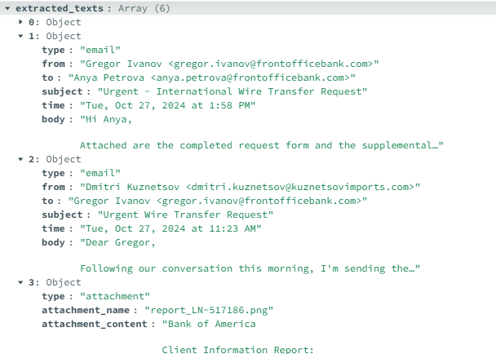

Slide 8
Functional Flow
Step 1: Email Upload
A user uploads an .eml email file via the UI (/add).
The file is read, and its content is extracted using LLM (extract_email_chain_and_attachments).
Attachments (PDFs, images, DOCX) are processed with OCR/Tesseract.
Step 2: AI-Based Classification
The extracted email text is passed to analyze_with_llm.
AI returns a structured JSON with:
request_type
sub_request_type
from, to, subject
customer_name, urgency, confidence_score
reason, secondary_intent

Slide 9
Functional Flow
Step 3: Duplicate Check
The system searches for similar emails in MongoDB (find_duplicate).
If a duplicate exists:
The user can classify it as a new email
The user can discard it
The user can update the existing email chain
Step 4: Team Assignment
The system assigns a team based on the request type (get_users_for_team).
Step 5: Storage & Retrieval
Classified emails are stored in MongoDB (email_classifications).
Users can:
View emails (/view/<email_id>)
Edit classifications (/edit/<email_id>)
Manage request types (/manage_requests)

Slide 10
Functional Flow
Step 6: API Operations
GET /api/email?id=<email_id> → Retrieve a classified email.
POST /api/email → Upload a new email.
PUT /api/email → Update an existing classification.
DELETE /api/email?id=<email_id> → Remove an email.

Slide 11
Thank You !!!

