Slide 1
Using Google Gemini for Email Categorization
Content-Based Data Extraction & Attachment Processing into Predefined Request Types

Slide 2
Challenges in Email Categorization
• Unstructured email content makes classification difficult.
• Attachments contain critical information but need processing.
• Manual sorting and gate-keeping is time-consuming and inefficient.

Slide 3
Implementation Approach Using Gemini
• Google Gemini is an advanced AI model capable of understanding and processing text.
• It helps categorize emails by extracting key content and analyzing attachments.
• Uses NLP and machine learning to classify emails into predefined request types.
• Uses NLP to extract structured data from email text.
• Processes attachments like PDFs and images for key information.

Slide 4
Workflow of Gemini Email Categorization
1. Email received with text and attachments.
2. NLP extracts relevant data from the email body.
3. Attachments are analyzed using OCR and AI models.
4. AI assigns predefined request and sub-request types.
5. Categorized emails are stored or routed accordingly.

Slide 5
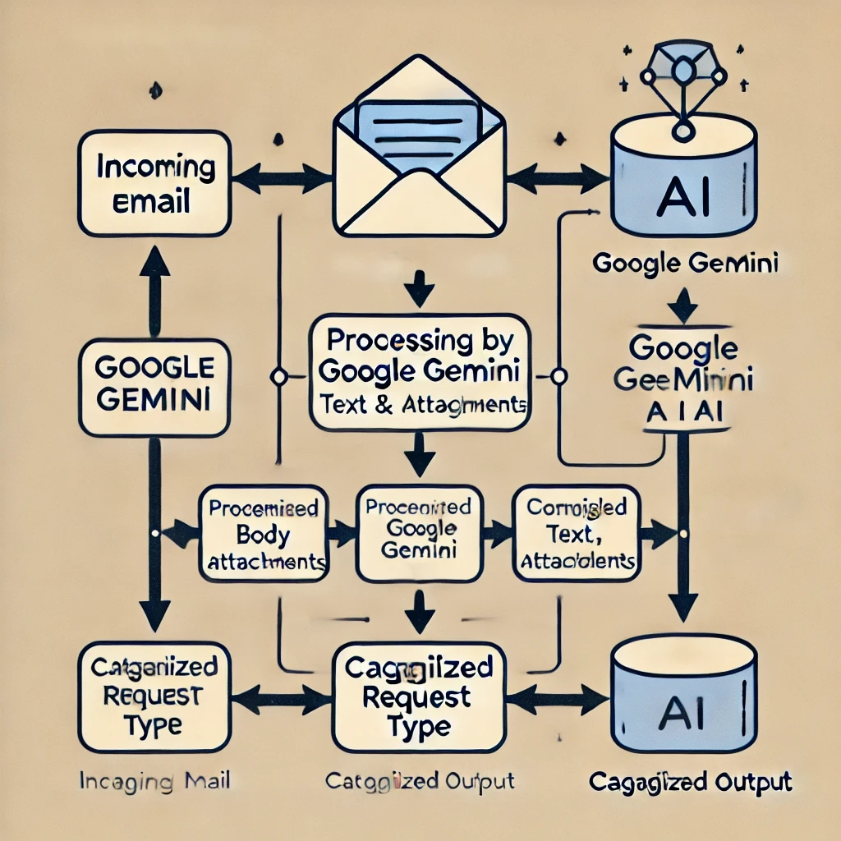
Block Diagram for Email Categorization

Slide 6
Benefits of AI-Powered Email Categorization
• Automates email classification, reducing manual effort.
• Enhances efficiency in handling customer and business requests.
• Improves accuracy in sorting emails with attachments.

Slide 7
Challenges & Considerations
• AI accuracy depends on training data and model performance.
• Privacy concerns with processing sensitive email data.
• Handling large attachments requires additional processing power.

Slide 8
Conclusion & Future Enhancements
• AI-driven email categorization can improve efficiency.
• Future enhancements: better NLP models, deeper attachment analysis.
• Potential for automation, smart tagging, and prioritization.

