Slide 1
AI-Powered Email & Document Classification
Automating information extraction from various documents.
Hyndavi Nandhigama
Radhika Boddapati
Navya Alugubelli
Notes:
AI-generated content may be incorrect. --- Welcome to our presentation on AI-Powered Email & Document Classification. Today, we'll explore how our solution automates the extraction of request types and sub-types from various document formats. My name is [Your Name], and I will be guiding you through this presentation.

Slide 2
Project Overview
Project Aim
The project focuses on classifying emails and documents into specific request types and sub-types using AI.
Supported Formats
Our solution supports multiple file uploads including .eml, .msg, .pdf, .docx, and .txt formats.
AI Techniques
We leverage AI techniques like Zero-shot Classification and Retrieval Augmented Generation to enhance accuracy.
Notes:
This project aims to process emails and documents, classifying them into defined request types and sub-types. Our solution supports multiple file uploads including .eml, .msg, .pdf, .docx, and .txt formats. By leveraging AI techniques like Zero-shot Classification and Retrieval Augmented Generation, we enhance classification accuracy.

Slide 3
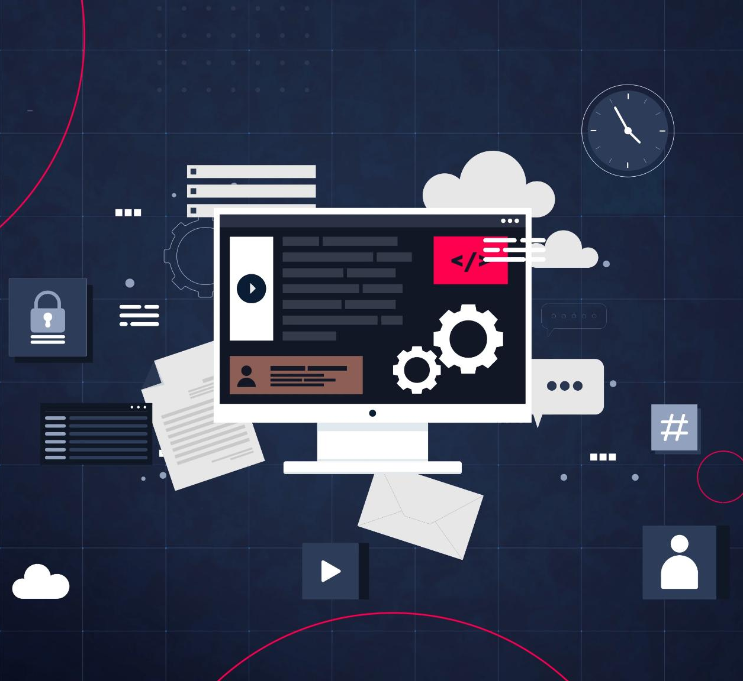
Technologies Used
Backend Framework
FastAPI is utilized for developing robust APIs, enhancing performance with Python's capabilities.
AI Classification Tool
Hugging Face Transformers facilitates advanced AI classification and natural language processing tasks.
Document Extraction Libraries
Libraries like PyPDF2 and python-docx are essential for text extraction from documents.
Frontend Framework
Angular 16 powers the frontend, utilizing Angular Material for a responsive UI.
Notes:
The backend of our solution is developed using FastAPI with Python. Key technologies include FastAPI for API development, Hugging Face Transformers for AI classification, and libraries like PyPDF2 and python-docx for document text extraction. The frontend is built with Angular 16, utilizing Angular Material for UI components and HTTPClient for API communication.

Slide 4
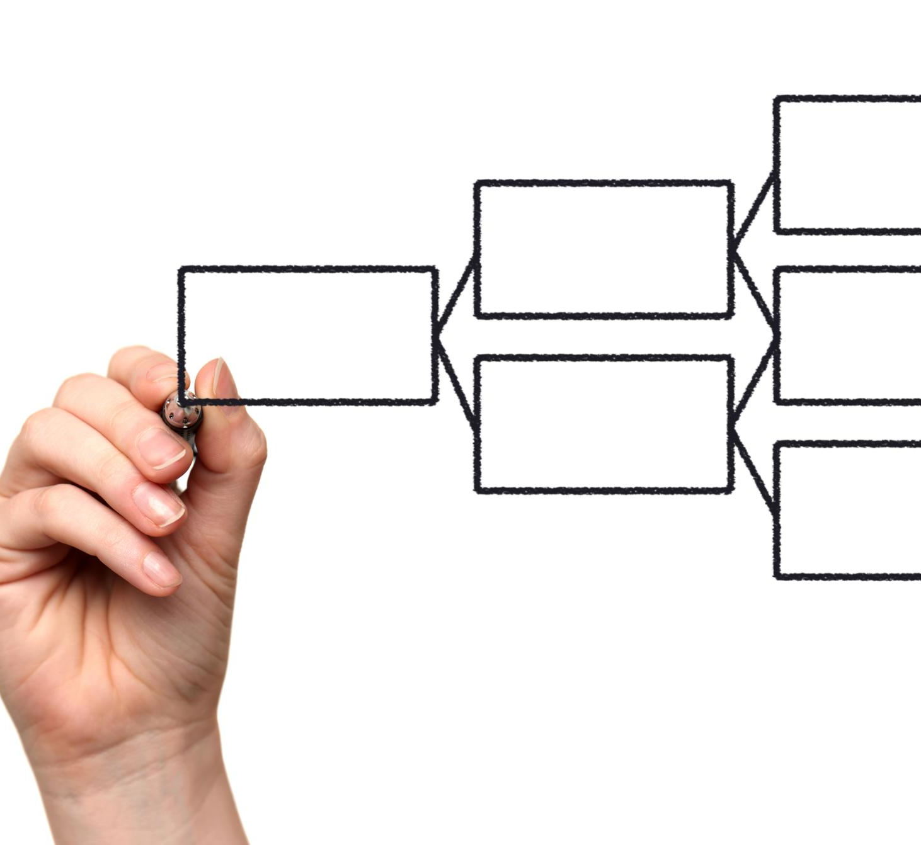
System Architecture
User Uploads
Users can upload emails or documents seamlessly through the user interface.
Backend Processing
The backend processes uploads to extract relevant text from emails and attachments.
AI Classification
An AI classifier analyzes the uploads to determine their request type and sub-type.
Display Results
Results from the AI classification are displayed back to the users in the interface.
Notes:
Here's an overview of our system architecture. Users upload emails or documents via the user interface. The backend processes these uploads to extract text from the email bodies and attachments. Then, an AI classifier determines the request type and sub-type, and results are displayed back in the UI. An architecture diagram will illustrate this flow.

Slide 5

API Workflow
File Upload Endpoint
The /upload-file/ endpoint handles multiple file types for email extraction. It prepares data for AI classification.
Email Classification Endpoint
The /classify-email/ endpoint offers direct classification using JSON inputs. It processes subject and body easily.
AI Classification Process
Both endpoints utilize AI to classify emails effectively. Results are returned to users promptly.
Notes:
The API workflow consists of two main endpoints. The /upload-file/ endpoint accepts various file types and extracts email content for AI classification, while the /classify-email/ endpoint allows direct classification using JSON input for subject and body. Both endpoints run the AI classification process and return results to the user.

Slide 6
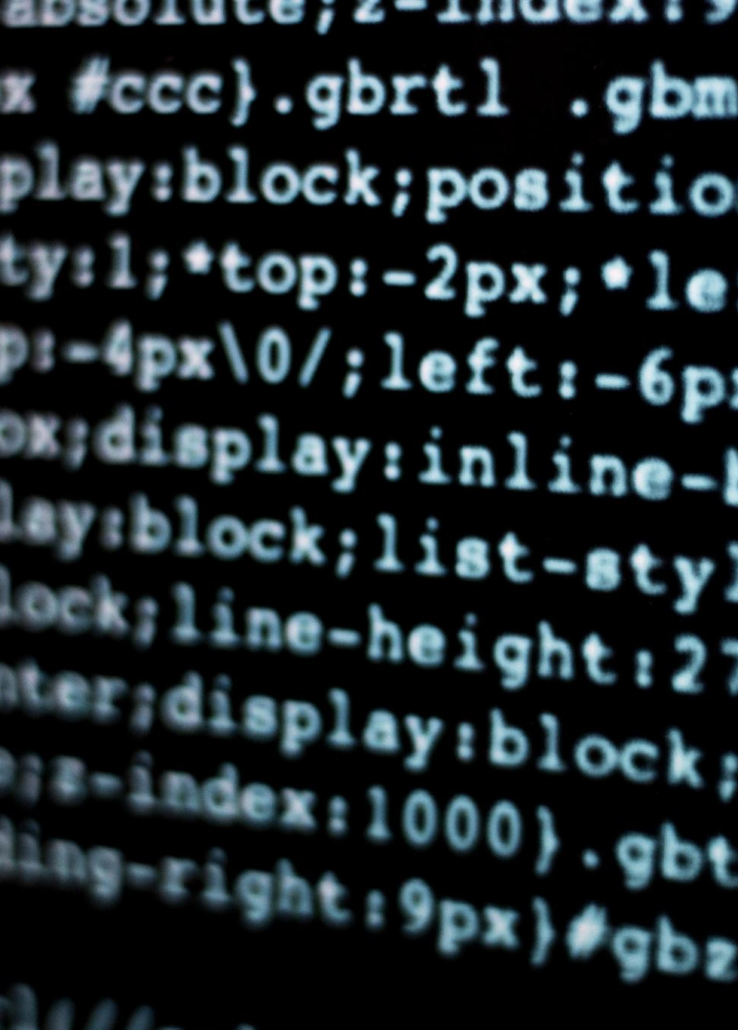
How to Run the Solution
Backend Setup
Install necessary dependencies using pip and start the API with uvicorn to ensure functionality.
Frontend Setup
Install Angular dependencies and start the UI using the Angular CLI for user interaction.
Ready for Interaction
Both backend and frontend setups are necessary for a fully functional application.
Notes:
To set up the backend, install the necessary dependencies using pip, and start the API with uvicorn. For the frontend, install Angular dependencies and start the UI with the Angular CLI. This process ensures that both the backend and frontend are ready for interaction.

Slide 7

Demo & Testing
Uploading Samples
We'll demonstrate the process of uploading sample emails and documents through the UI.
Verification of Results
We'll verify the extracted text and classification results after the upload.
API Testing with Postman
We will utilize Postman to test the APIs and ensure proper functionality.
Notes:
In this section, we will demonstrate how to upload sample emails and documents through the UI. We'll verify the extracted text and classification results. Additionally, we can test the APIs using Postman to ensure everything is functioning correctly.

Slide 8
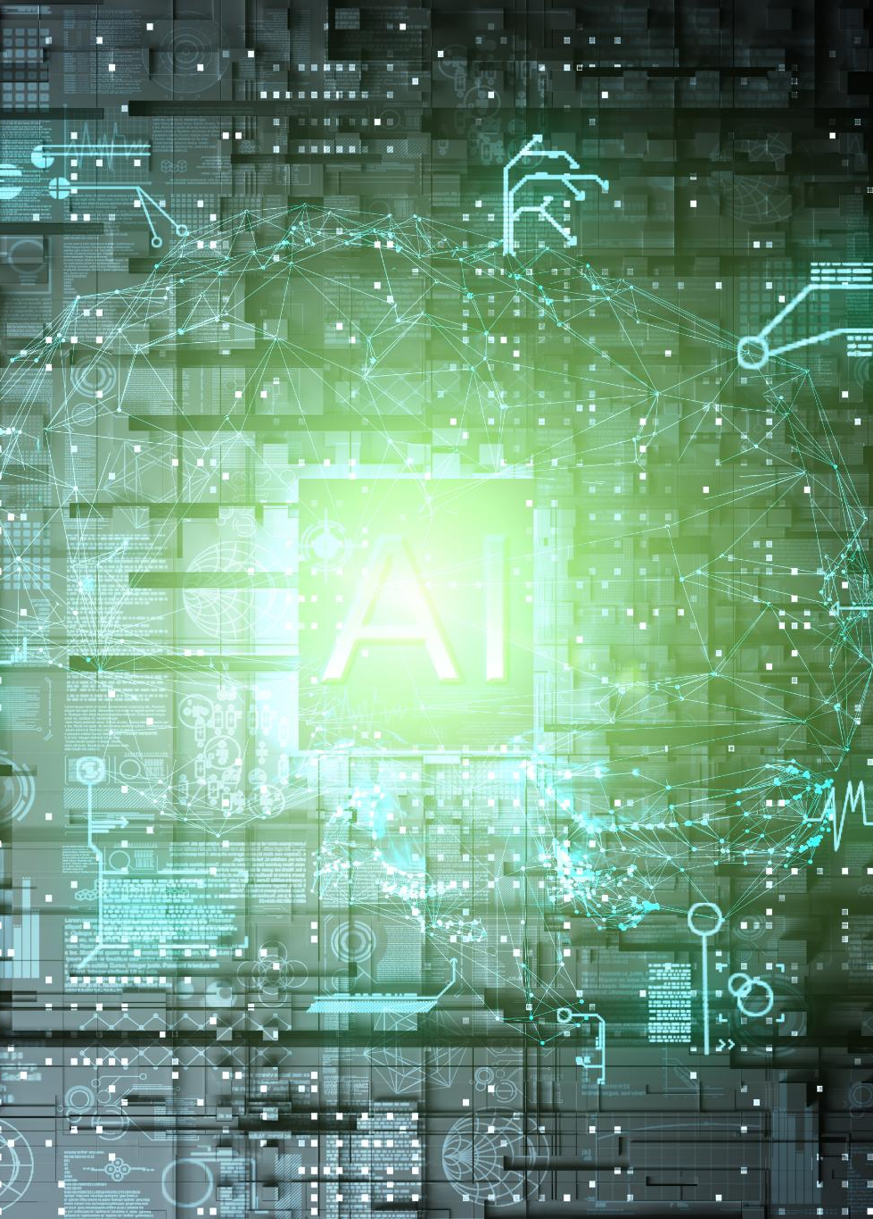
Future Enhancements
Integrating OpenAI's GPT
We plan to enhance classification accuracy by integrating OpenAI's advanced GPT technology.
Storing Past Classifications
Implementing a database to store past classifications will allow for better tracking and analysis.
Enhancing User Interface
We aim to improve the user interface by adding more filtering options for enhanced user experience.
Notes:
Looking ahead, we plan to integrate OpenAI's GPT to improve classification accuracy further. We also aim to store past classifications in a database for better tracking and analysis, alongside enhancing the UI with more filtering options for users.

Slide 9

Thank You!
Appreciation for Attention
We sincerely thank you for taking the time to engage with our presentation.
Open to Questions
We invite and encourage your questions about our AI project to clarify any doubts.
Notes:
Thank you for your attention! We are happy to answer any questions you may have regarding the AI-Powered Email and Document Classification project.

