Slide 1
Gen AI Powered Email Classification
Sriram | Santhosh | Haritha | Suraj | Aditya

Slide 2
Introduction
Background:
Commercial bank lending teams receive high volumes of service requests via email, often with attachments.
Manual triage by "gatekeepers" is time-consuming, error-prone, and inefficient during peak volumes.
Problem:
Inefficient manual email triage with risks of misclassification and duplicate handling.
Objective:
Automate email classification and data extraction using Generative AI (LLMs) to improve accuracy, efficiency, and reduce turnaround time.

Slide 3
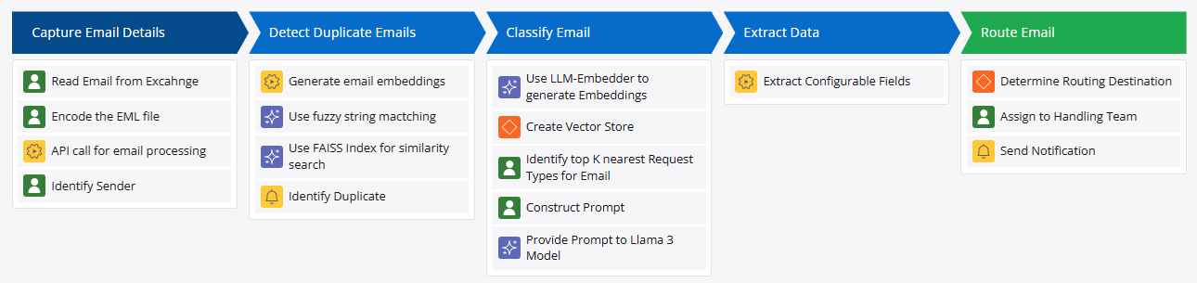
Solution Overview
Email Ingestion → Embedding Generation → FAISS for Duplication Check → Milvus for Similarity Search → LLaMA for Classification → NER for Entity Extraction → Output with Confidence Score

Slide 4
Components Used
Fuzzy String Matching + FAISS Index:
Detects duplicate emails by comparing embeddings.
LLM-Embedder (Hugging Face):
Generates embeddings for emails and stores them in Milvus DB.
Milvus DB:
Vector database to retrieve top N matching request types.
LLaMA 3:
Analyzes the email and provides the final request type with a confidence score.
NER Model:
Extracts entities like deal name, amount, expiration date, etc.

Slide 5
Why Fuzzy String Matching and FAISS over Other Methods for duplicate email detection?
1. Robust Duplicate Detection
Fuzzy matching captures minor textual differences.
FAISS ensures scalable and fast retrieval of semantically similar emails
2. Efficiency at Scale
FAISS handles large volumes of embeddings quickly.
Fuzzy matching complements by catching minor text variations.
3. Accuracy and Recall
FAISS retrieves the top-N most similar emails.
Fuzzy matching ensures near-duplicates with textual variations are flagged
4. Optimal for Real-World Scenarios
Email threads, forwarding chains, and replies often introduce small changes.
This combination handles both semantic and textual similarity effectively.

Slide 6
Why Use LLM-Embedder for Vector Creation and LLaMA 3 for Final Classification?
Efficient Semantic Representation:
LLM-Embedder (e.g., BAAI/LLM-Embedder or BAAI/bge-large-en) generates dense vector embeddings of emails that capture semantic meaning rather than just surface-level text features.
This allows us to find emails with similar context and intent, even if they use different wording.
Vectorization for Fast Retrieval:
By embedding emails into vectors and storing them in Milvus DB, you can efficiently search for the top-N most similar request types using FAISS.
This speeds up the request type retrieval process, as FAISS performs a fast approximate nearest neighbor (ANN) search.
Pre-Classification Based on Historical Data:
By retrieving the top-N request types from similar historical emails, you leverage the prior context and improve the accuracy of the final classification.

Slide 7
Why Pass it to LLaMA 3 after Similarity Search ?
Contextual Classification with Reasoning:
Even though FAISS provides the top-N similar request types, it doesn't assign confidence scores or explain the classification.
LLaMA 3 interprets the email content and refines the classification by considering:
The email content.
The top-N request types from FAISS.
Contextual cues from the email body and attachments.
Confidence Score and Explanation:
LLaMA 3 outputs the final request type with a confidence score and provides a reasoning explanation.
This makes the classification more transparent and reliable.

Slide 8
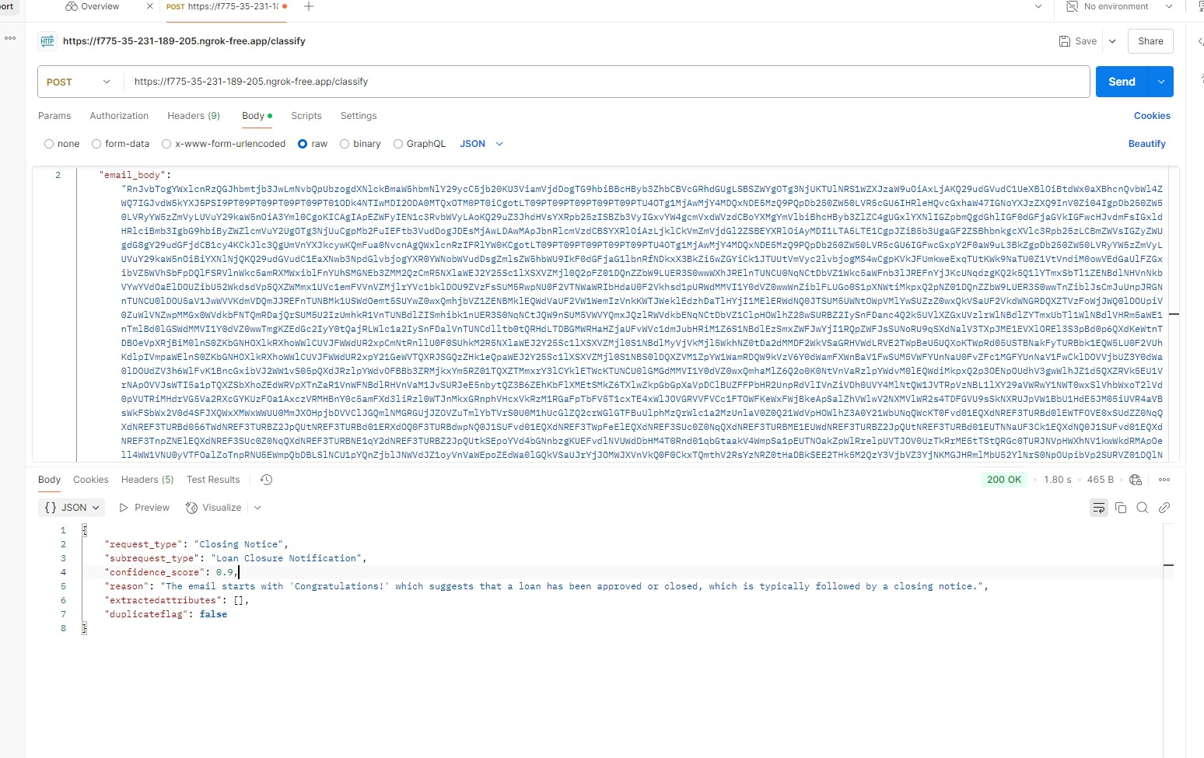
Results

