Slide 1


Data Pipeline: GCS to JSON
This project automates ticketing. It categorizes an incoming stream of emails into fixed format JSON output for easy API integration. It provides relevant teams with structured data request feeds.
gaied-mail-chimpanzee

Slide 2
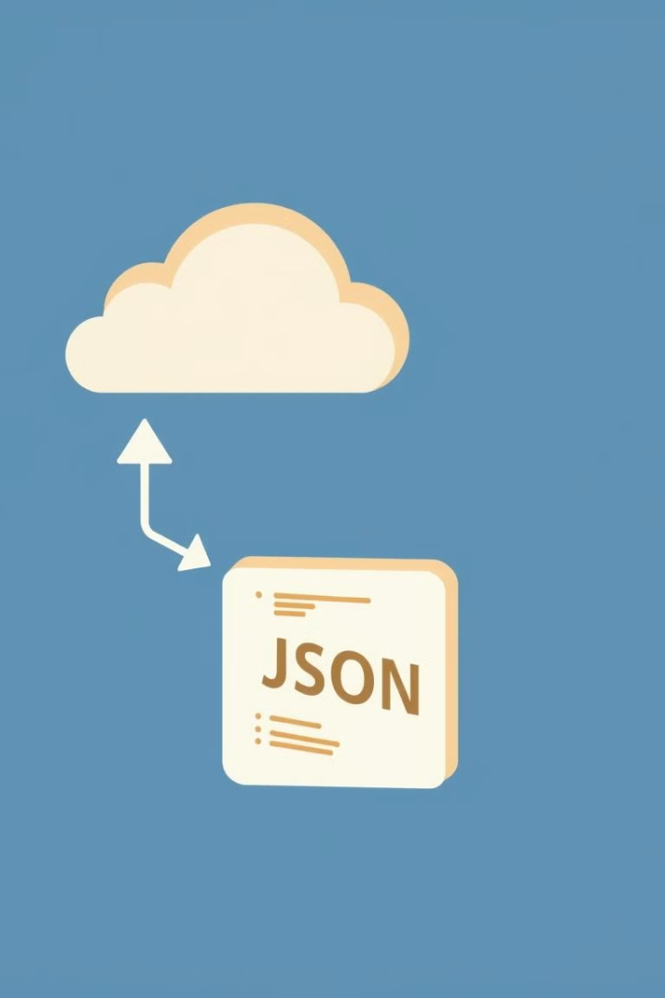




Project Workflow
Visualize the data's journey from raw files to structured JSON in hackathon scope.
GCS Bucket
Raw data (emails) files are uploaded.
Data Ingestion
LLM parses contents of email (and attachments, if any)
Information Extraction
Required output values are extracted from the emails.
JSON Output
Insight is delivered as fixed format JSON payload.

Slide 3


Gemini
Email
Cloud Function
Request Type Configuration (Fixed)
JSON Output

Slide 4
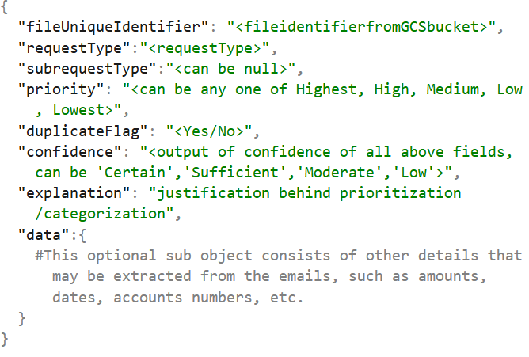
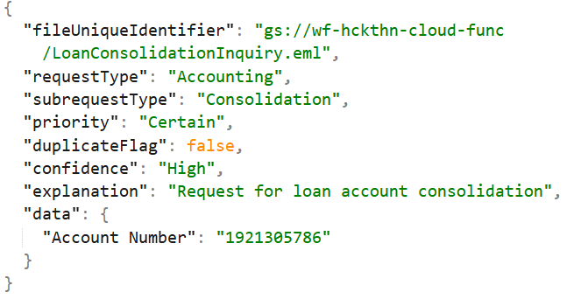
Request/Sub-Request Types
Adjustment
AU Transfer
Closing Notice
Reallocation Fees
Amendment Fees
Amendment Principal
Commitment Change
Cashless Roll
Decrease
Increase
Money Movement - Out
Inbound
Principal + Interest
Principal + Interest + Fee
Money Movement - In
Outbound
Timebound
Foreign Currency
Fee Payment
Outgoing Fees
Letter of Credit
Accounting
Transfers
Consolidation

Slide 5




Benefits and Next Steps
Automation
Scalability
Reduces manual effort and errors.
Handles large data volumes.
Structure
Provides structured data for analysis.

