Slide 1


Data Pipeline: GCS to JSON
This project automates ticketing. It converts data from Google Cloud Storage (GCS) to structured JSON format. The pipeline ingests, processes, categorizes, and formats data. It provides data analysts and developers with structured data feeds.
gaied-mail-chimpanzee

Slide 2
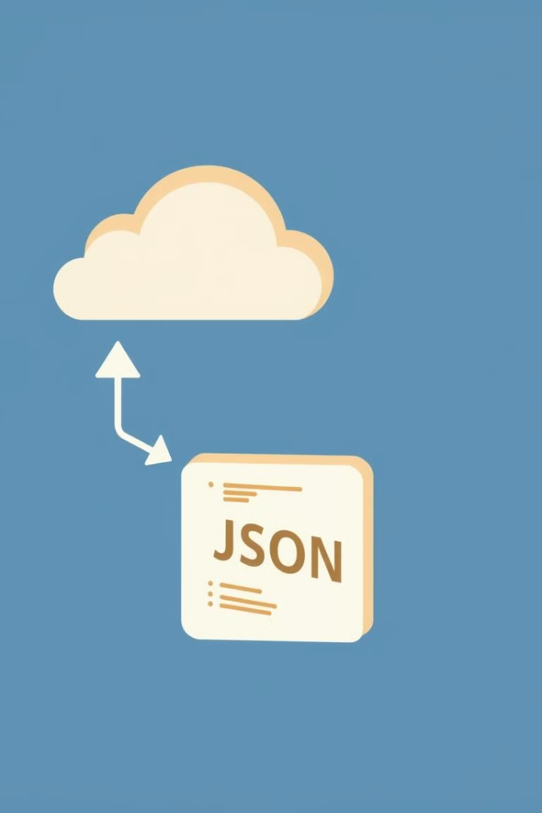




Project Workflow
Visualize the data's journey from raw files to structured JSON.
GCS Bucket
Raw data files are uploaded.
Data Ingestion
Dataflow pipeline triggers.
Data Processing
Data is cleaned and transformed.
JSON Output
Data is formatted into JSON.

Slide 3
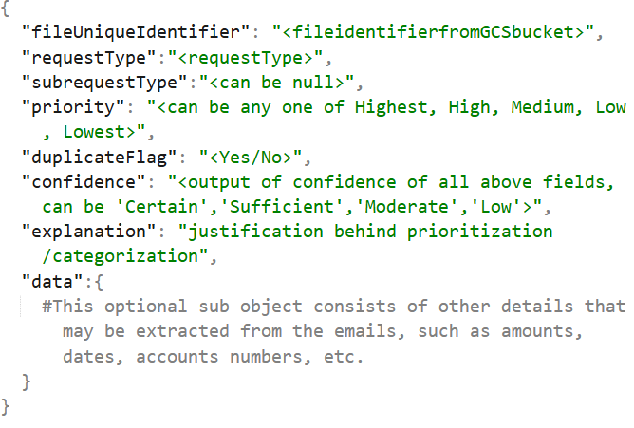
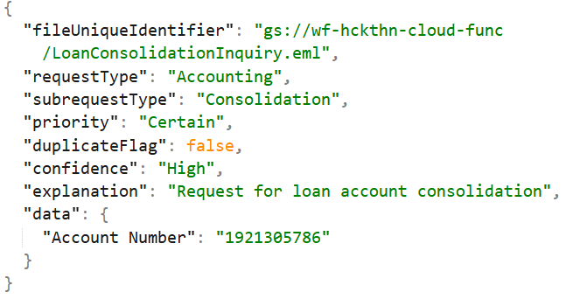
Request/Sub-Request Types
Adjustment
AU Transfer
Closing Notice
Reallocation Fees
Amendment Fees
Amendment Principal
Commitment Change
Cashless Roll
Decrease
Increase
Money Movement - Out
Inbound
Principal + Interest
Principal + Interest + Fee
Money Movement - In
Outbound
Timebound
Foreign Currency
Fee Payment
Outgoing Fees
Letter of Credit
Accounting
Transfers
Consolidation

Slide 4




Benefits and Next Steps
Automation
Scalability
Reduces manual effort and errors.
Handles large data volumes.
Structure
Provides structured data for analysis.

