Slide 1
Agenda
Background and Problem Statement
Solution Out Line & System Flow
Infrastructure Solution
Demo

Slide 2
Intelligent eMail System (Commercial Loan)
Background: Commercial Bank Lending Service teams handle a high volume of service requests via email, requiring manual classification, data extraction, and routing. This process is slow, error-prone, and inefficient. The challenge is to automate email processing using Generative AI (LLMs) to improve accuracy, reduce manual effort, and accelerate request handling. We can develop AI-driven solutions to classify, extract, and auto-route requests, transforming service operations.
Problem Statement: Develop a Gen AI-powered Email Classification and OCR solution to:-
Extract and interpret email context (categorizing requests based on intent)
Perform context-based data extraction from email bodies and attachments.
Handle multi-request emails, detecting the sender’s primary intent.
Enable priority-based extraction focusing on key information.
Detect duplicate emails, preventing redundant service requests.
The goal is to build an AI-driven solution that enhances accuracy, efficiency, and automation in service request processing.

Slide 3
Solution Outline
AI-driven NLP automates service request creation from unstructured emails. Few-shot learning helps generalize patterns without large-scale fine-tuning. Using an open-source LLM (e.g., Gemini 1.3) ensures cost-effectiveness, adaptability, and scalability for both PoC and future deployment.
Solution Approach:-
Input: Email Ingestion & Pre-processing (Extracts email body, metadata, attachments, Cleansing, De-sensitization, flattening to one text document)
De-Duplicate solution : conditional logic involving NER, Literals, Embedding, Cosine Similarity , Confidence score (Alternate: email/s (Generate summarization with n (config.) words, Compare with rest of eMails (Cosine Similarities on n words))
Synthesizing Few-Shot Examples (Creates 3–4 labelled sample emails with change types & attributes - Enhances LLM’s pattern recognition) and Configuration File
AI-Based Analysis & Service Request Creation: Call LLM , Classify or Derive request type, extract structured details referring configuration (change type, sub-change type, deal name, amount, expiration, etc.) from email body & attachments.
Flag for manual review if not classified or matched with any Service/Sub Service type.
Output: Format in standard SR JSON, Display into Screen, flag SR to Appropriate Topic (Kafka) for downstream processing
Scalability & Automation (Containerized deployment, API based Invocation, distributed and event based architecture to cover 4 consumption pattern, Logging & Monitoring)
We take Hackathon out as PoC result to address strategic solution following above solution outline

Slide 4

Intelligent eMail Process: Service Request Management
eMail Pre-Process
Duplication Check
Duplicate (Y/N ?)
Configuration file & Few shots Prepn.
Prompt Instruction Template (PIT)
Prompt Processing
LLM Call
(Gemini 1.3)
N
eMails
Y
PreProcess
De-sensitive, Text Concatenation (Text & pdf/doc)
Duplicate
Summarization,
Cosine Similarity/(NER, Threshold (Conf.)
Display
Mgt.
Parse Response
(Req., Sub Req, Prioritization, Attributes etc.)
End
Output Template
(JSON, KV etc.)

Slide 5
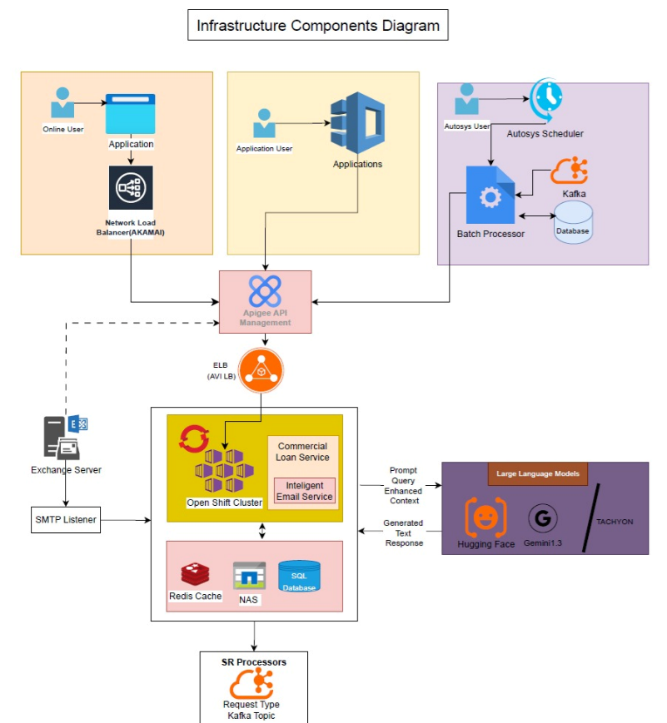
Infrastructure Alignment (Long Term Solution)
Note: This is the strategic application solution aligning with adequate Infrastructure components fulfilling the need of (a) Scaling (b) Availability © Maintainability (d) addressing 4 consumption pattern – Online, Batch , On-Demand and Event Driven

Slide 6
Demo Capsule (Insert Objects with Code, Input , Output, Samples)

