Slide 1




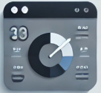
Email
Websocket
LangChain
Service Request Raised by client
Email received in Inbox
GenAI model(gemini 2.0 flash)
Classified emails
React
Dashboard
Material UI

