Slide 1
Team Prompt Whisperers
Team members: Koteswar Rao Sirikonda
Mudimbi, Sreenivasan
Balaraj goud Kalai
Gopikrishna Muvva

Slide 2
Purpose:
Automates the classification of loan-related emails.
Extracts key information such as intent, sentiment, and entities.
Detects spam emails and provides reasons for classification.
Key Features:
Processes emails and attachments.
Classifies emails into categories (e.g., Loan Completion, Address Change).
Identifies spam emails.
Displays results in a user-friendly UI.
Technologies Used:
Backend: Node.js, Express.js, OpenAI API.
Frontend: React.js, Material-UI.
File Parsing: EML and MSG file parsing libraries.
NLP: OpenAI GPT-3.5 for classification, sentiment analysis, and entity extraction.

Slide 3
Email Processing Pipeline:
File Parsing:
Parses .eml and .msg files using eml-parser and @kenjiuno/msgreader.
Attachment Handling:
Extracts text from PDFs, Word documents, and images using pdf-parse, mammoth, and Tesseract.js.
NLP Tasks:
Classification: Categorizes emails into loan-related request types.
Sentiment Analysis: Determines if the email sentiment is Positive, Negative, or Neutral.
Intent Detection: Identifies the purpose of the email (e.g., Query, Complaint).
Entity Extraction: Extracts customer details like name, loan amount, and account number.
Spam Detection: Identifies spam emails and provides reasons.
API Endpoint:
/process-emails: Processes all emails in the folder and returns structured results.
Tools Used:
OpenAI API: For NLP tasks.
File Parsing Libraries: eml-parser, @kenjiuno/msgreader.
Text Extraction Libraries: pdf-parse, mammoth, Tesseract.js.

Slide 4
Title: Frontend Overview
Content:
Purpose:
Displays the processed email data in a user-friendly interface.
Key Features:
Fetches data from the backend API (/process-emails).
Displays email details such as:
Subject
Request Type and Sub-Requests
Confidence Score
Sentiment
Intent
Extracted Entities
Spam Status and Reasons
Uses Material-UI for a clean and responsive design.
Tools Used:
React.js: For building the UI.
Material-UI: For styling and components.
Fetch API: For making API calls to the backend.

Slide 5
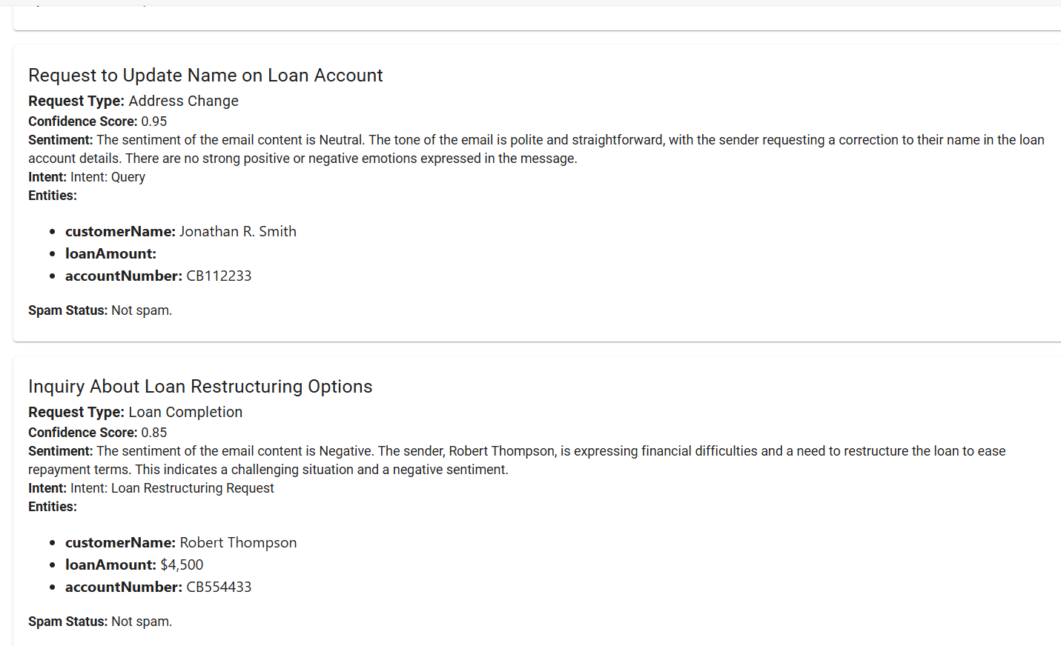
Screenshot form the application

Slide 6
Thanks

