Slide 1
Gen AI Based Email Classification and OCR

Slide 2
INTRODUCTION
Overview:
* This AI-powered tool automates email classification and data extraction using Gen AI LLMs.
* Enhances efficiency, accuracy, and turnaround time for processing emails.
* Generates classified service requests automatically.
Key Features:
* Users can upload emails, PDFs, and images via a user interface.
* The system extracts and classifies content.
* Helps reduce manual effort and human errors in classification.

Slide 3
Inspiration 💡
Problem Statement:
Current manual process requires a team of gatekeepers.
Time-consuming and prone to human errors.
Inconsistent data extraction and classification.
Objective:
Automate the entire email classification and data extraction process
Reduce human intervention while improving accuracy and speed.

Slide 4
What It Does ⚙️
Content Extraction : Extracts text from emails and their attachments.
OCR for PDFs and Images : Uses pytesseract and PyMuPDF for image and PDF text recognition.
Context-Based Data Extraction : Uses LLMs to extract relevant data based on the email context.
Duplicate Detection : Generates vector embeddings stored in Elasticsearch to identify duplicate emails.
Email Classification : Categorizes emails into predefined request types using Gen AI LLMs.
Handling Multi-Request Emails : Identifies primary intent when multiple requests exist in a single email.
Priority-Based Extraction : Users can set priority rules for extracting important information first.
User Interface : Users can upload emails and view classification responses.
Handling Disputes for Duplicates : If an email is wrongly marked as a duplicate, the user can dispute it, and the system will reclassify it.

Slide 5
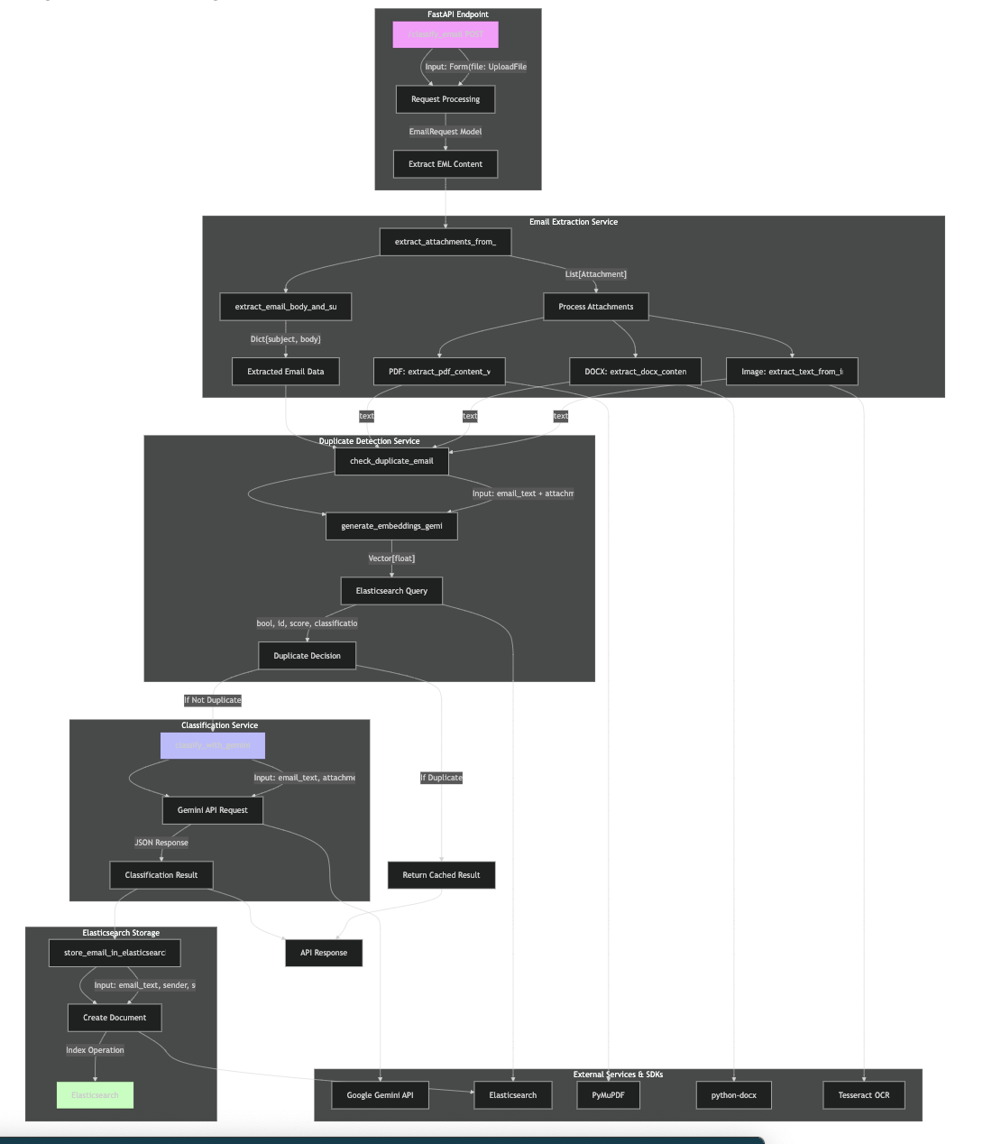
ARCHITECTURE DIAGRAM

Slide 6
How We Built It 🛠️
Backend:
FastAPI → API framework.
Uvicorn → Runs the FastAPI application
Elasticsearch → Stores email data and performs similarity searches.
Google Gemini (GenAI) → Text classification and embeddings.
Spacy → NLP processing.
pytesseract → OCR for image-based text extraction.
PyMuPDF (fitz) → PDF text extraction.
docx library → Extracts text from DOCX files.
BeautifulSoup → Parses HTML content from emails.
Frontend:
ReactJS → UI for uploading files and viewing responses.
Tools Used:
Postman → API testing.
Jupyter & VSCode → Development environment.
Canva → Demo video creation.

Slide 7
Challenges We Faced 🚧
OCR Implementation for PDFs:
Initially used pdf2image, but it did not convert PDFs to images properly.
Switched to PyMuPDF and pytesseract, improving accuracy.
LLM Prompt Optimization:
Faced difficulty in getting reliable classification results.
Optimized LLM prompts and fine-tuned responses for better accuracy.

Slide 8
Tech Stack 🏗️
Component | Technology Used
Frontend | HTML, CSS, React, TypeScript
Backend | Python, FastAPI, Google GenAI
Database | Elasticsearch
Gen AI Models | LLM: "gemini-2.0-flash", Embeddings: "text-embedding-004"

Slide 9
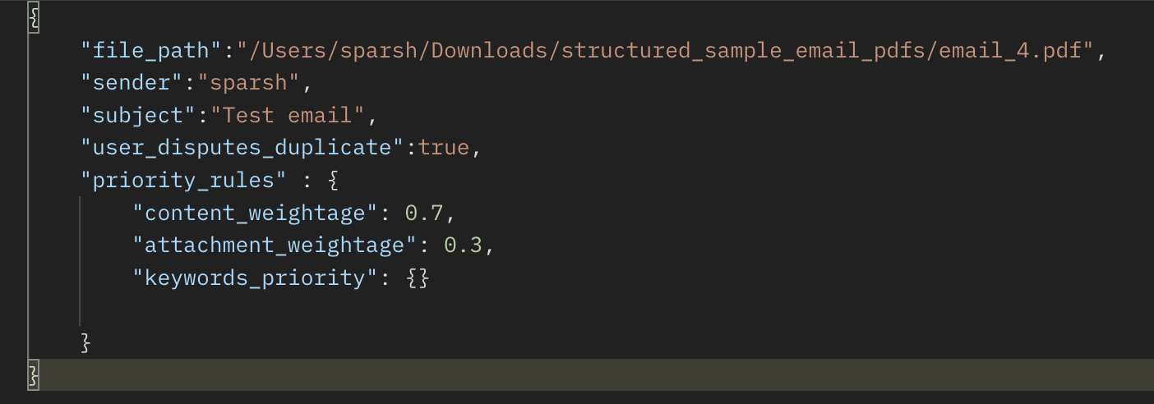
API Request Format

Slide 10
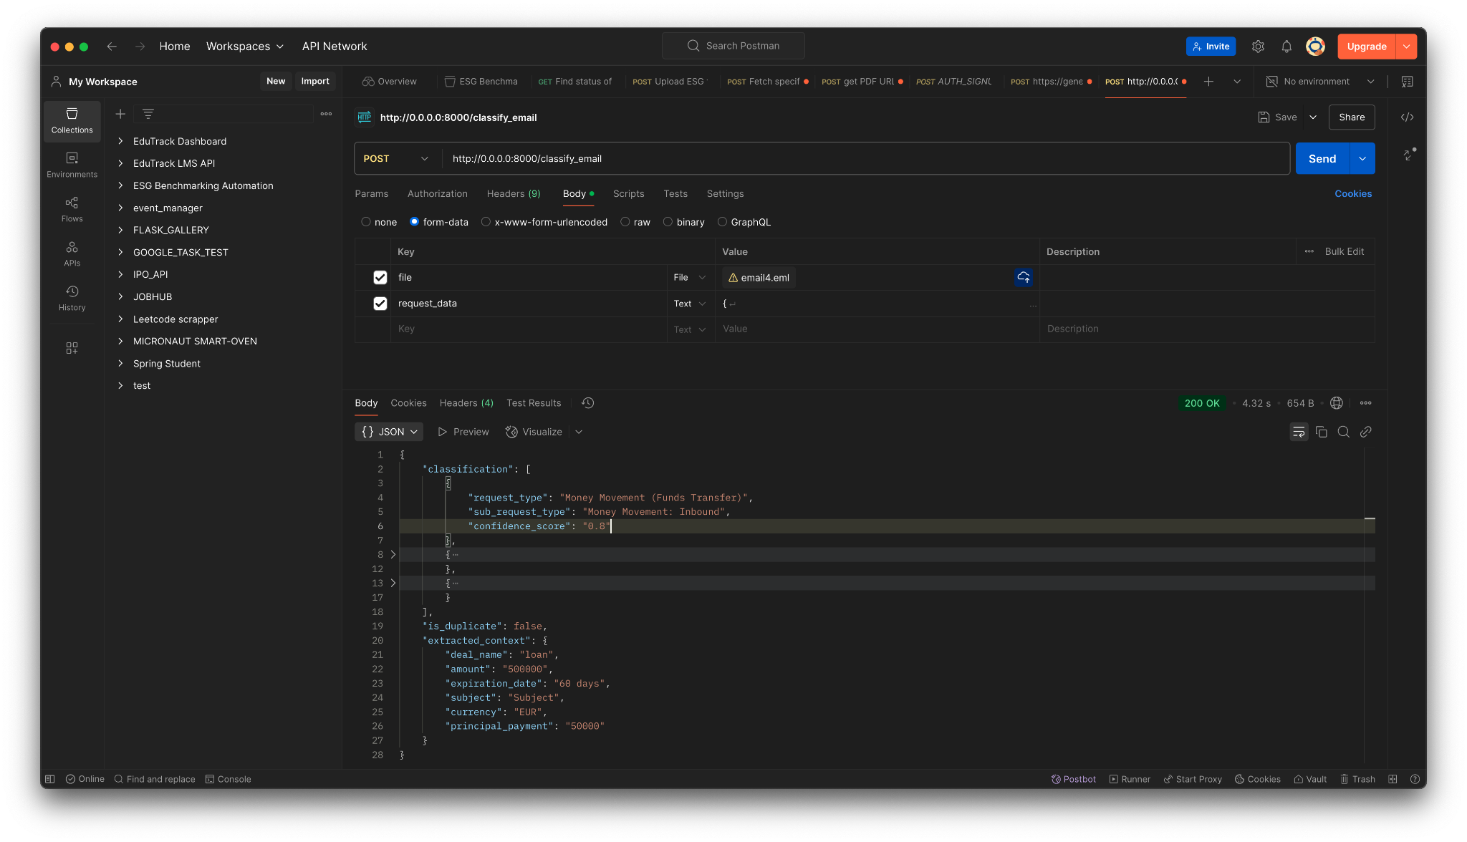
API RESPONSE

Slide 11

THANKS
OUR TEAM
Sparsh - GitHub | LinkedIn
Ashish - GitHub | LinkedIn
Madhurya - GitHub | LinkedIn
Ashwini - GitHub | LinkedIn
Saraiah - GitHub | LinkedIn

