Slide 1
Gen AI-Based Email Classification
Team Name : Semper Fortis
Team Members :
Abhishek Gupta
Yatish Gupta
Gaurav Kumar
Project Repo : https://github.com/ewfx/gaied-semper-fortis

Slide 2
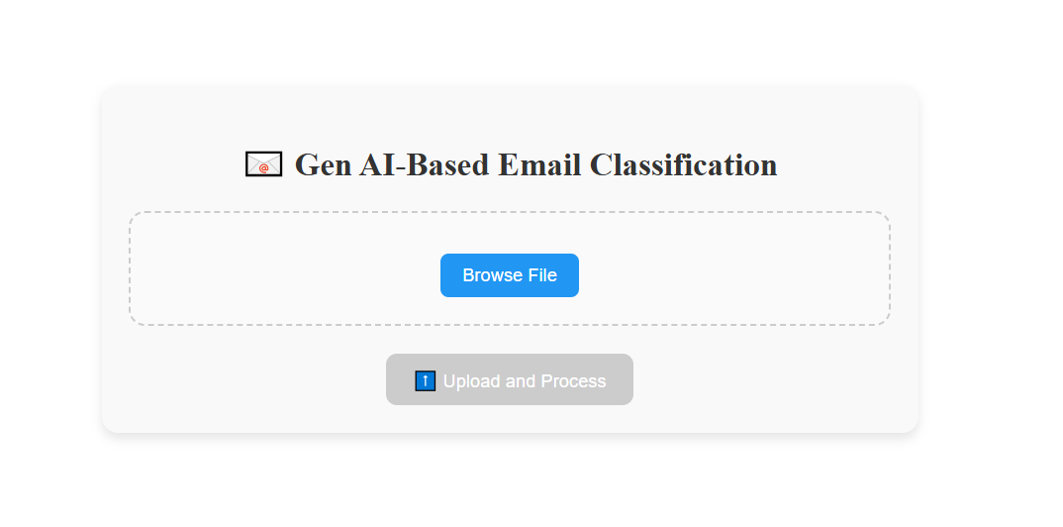
Landing Page

Slide 3
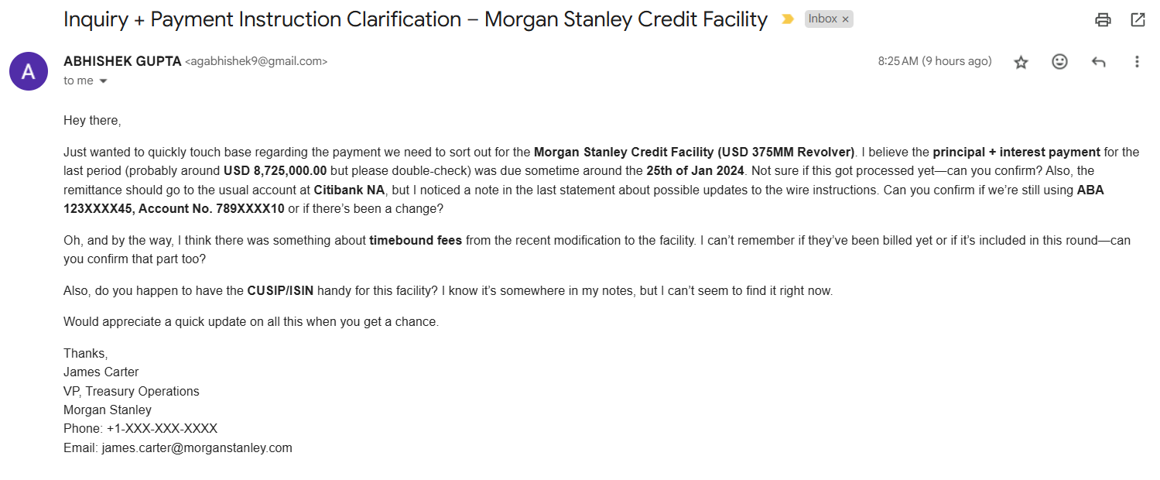
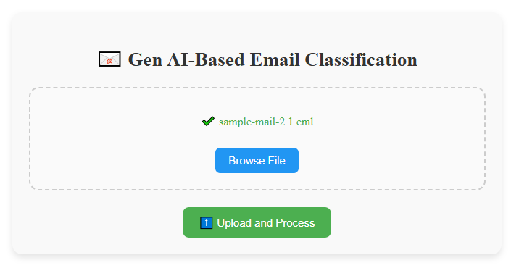
On Selecting The Target File – New Request
Manual file selection functionality allows user to choose the relevant file from multiple file type (.eml, .pdf, .docx)
File can be chosen on clicking the ‘browse File’ button
Selected file can be submitted for processing by clicking ‘Upload and Process’ button

Slide 4
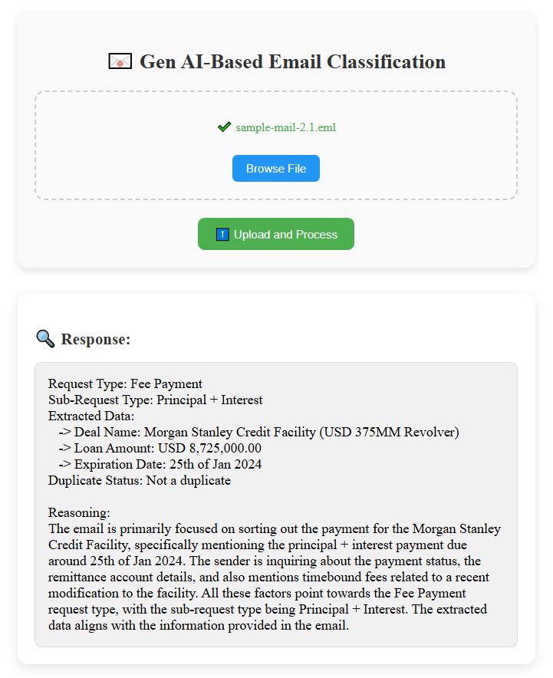
Response Data - New Request
Dynamic response from the LLM would display :
Request Type
Sub-request type
Extracted data including :
Deal name
Amount
Expiration date
Any addl. relevant data
Duplicate status of the mail
Short description of the context

Slide 5
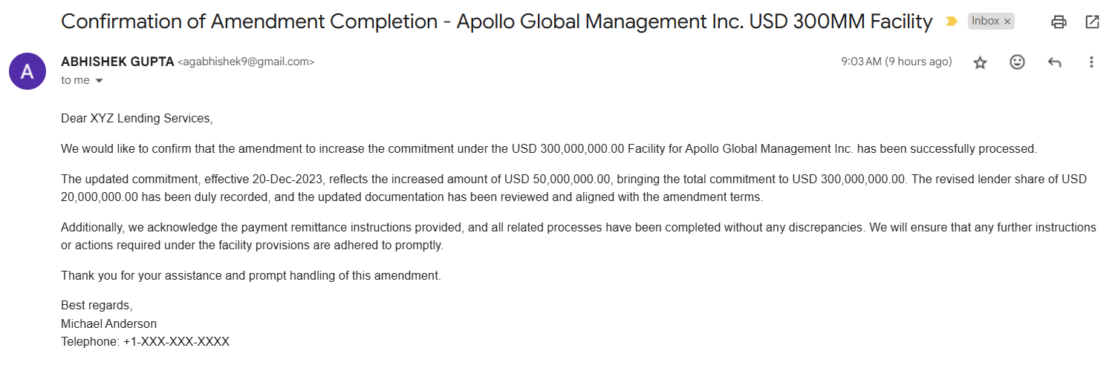
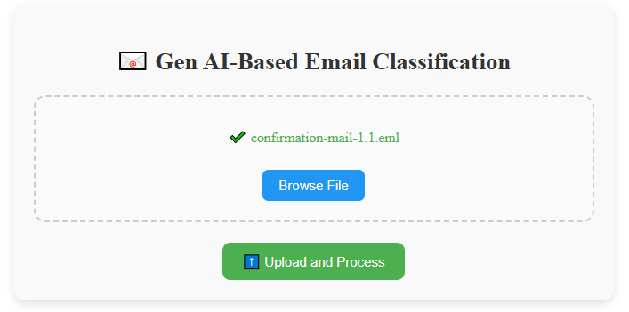
On Selecting The Target File – Duplicate Request
The sample file contain the duplicate data for the existing service request.

Slide 6
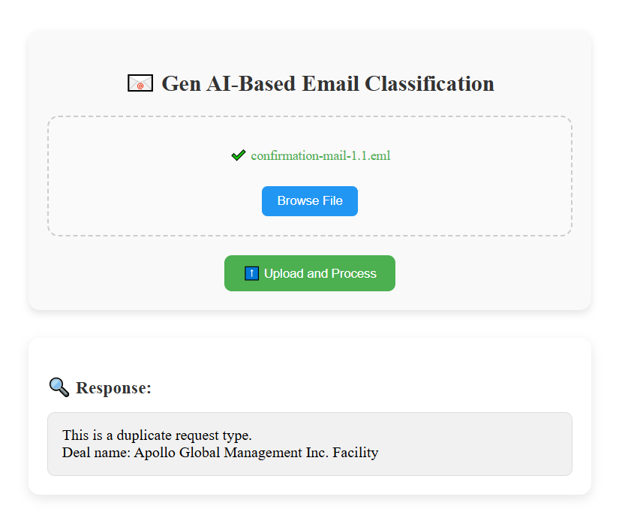
Response Data – Duplicate Request
Duplicate service request response will be generated for the cases may arise due to multiple replies or forward within an email thread

Slide 7
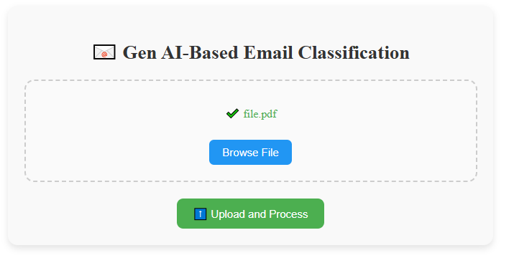
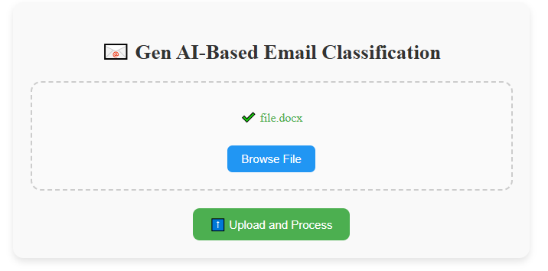
Supported File Formats
.pdf
.docx
.eml

Slide 8






Tech Stack Used
Angular
Flask/ Python
OpenAI API
VC Code
Git
Github

Slide 9
Thank You

