Slide 1
Approach
Using the Easy OCR the PDF/Image will convert to the text output
Based on the preconfigured set of rules classifications on the Request and Sub Request type which needs to be sent the LLM for prompting and training.
LLM Model used : ChatGPT 3.5
Output Structure : Dictionary ( Key and Value Pairs)
LLM responds back with required output.

Slide 2
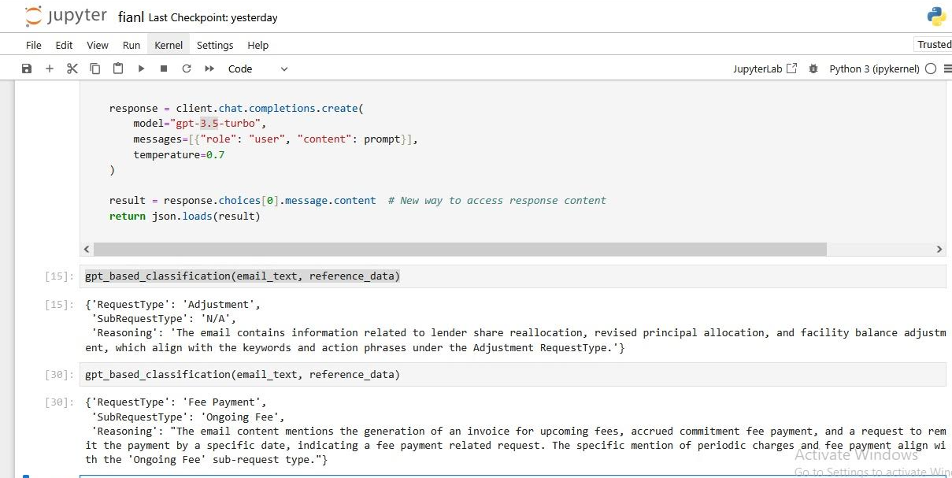
Sample Output

