Slide 1
AI-Powered Email Classification & OCR Solution
Team: T2-10F5
Challenge: Automating financial email triage

Slide 2
Problem Statement
Lending Service teams handle high email volume
Manual email classification is slow & error-prone
Key tasks: Extracting context, detecting duplicates, assigning teams

Slide 3
Hackathon Requirements
Use Gen AI for email classification
Extract request type, sub-type & key attributes
Handle multi-request emails & priority detection
Ensure scalability, explainability, & efficiency

Slide 4
Solution Overview
AI-powered pipeline for email classification
NLP, OCR, & deep learning for text extraction
LLMs & fine-tuned models for intent recognition
Duplicate detection with sentence embeddings
Duplicate email overview : with duplication percentage and Intent identification of the re-sent email (For easier decision making)
Fine-tuning model based on information from LLM calls ; scheduled every night / based on frequency.

Slide 5
Key features
User Interface to add and maintain new request and sub-request types
Auto training model to save cost on external calls
Local classification model in absence of external LLM
In depth email classification including attachment
Provide hints for routing the email to destination team
Duplicate recognition and hints on duplicate email (With intent of re-send email)

Slide 6
System Design & Architecture
Ingestion layer: PDFs, DOCs, EMLs processed
NLP Pipeline: Preprocessing, Named Entity Recognition (NER), LLM Classification
Duplicate detection using SentenceTransformer
Output: Classified requests assigned to teams

Slide 7
Tools & Technologies Used
Python, Spacy, Transformers (Hugging Face)
SentenceTransformers for embeddings
DeepSeek API for classification
pdfplumber, pytesseract for OCR
Logging, dotenv, requests for integrations

Slide 8
Key Code Components
Text extraction from PDFs, DOCs, & EMLs
Classification using DeepSeek & fine-tuned models
Named entity recognition (NER) for finance terms
Priority & duplicate detection logic

Slide 9
Sample Output & Results
Example email classifications
Confidence scores, detected duplicates
Assigned team & priority levels
JSON output:

Slide 10
Sample responses
Duplicate file:
"duplicate": true,
"duplicate_of": "Shravan\n\n[Attachment: 2023.11.10_CANTO R FITZGERA 24FEB21.pdf]\nSubject: Request for Money Movement Inbound\nDear Team,\nI would like to request a money movement for the following transaction:\n- Amount: $10,000\n- Type: Principal + Interest\n- Date: 24FEB21\n- Account: CANTO R FITZGERA\nPlease process this request at the earliest.\nBest regards,\nJohn Doe",
"similarity_score": 1.0,
"change_analysis": {
"important_changes": false,
"changes_summary": "No significant changes detected",
"intent": "Other"
}

Slide 11
Sample responses
"classification": {
"label": "Money Movement Inbound",
"subtype": "Principal + Interest",
"score": 0.95,
"reasoning": "The email explicitly states a 'Request for Money Movement Inbound' in the subject and details a transaction involving a transfer of funds ($10,000) into the specified account (CANTO R FITZGERA) on 24FEB21",
"llm_entities": {
"amount": "$10,000",
"date": "24FEB21",
"account": "CANTO R FITZGERA",
"loan_id": null,
"current_rate": null,
"requested_rate": null
}

Slide 12
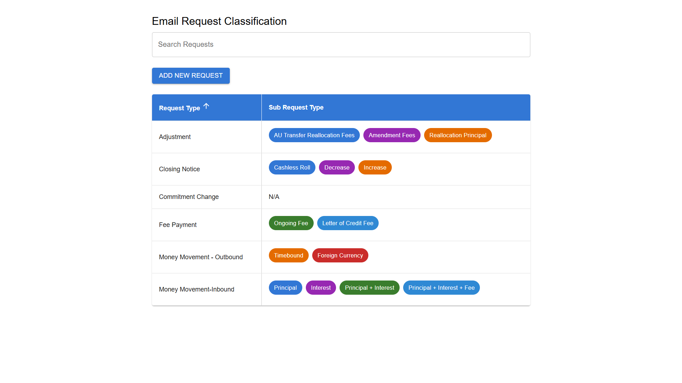
User Interface to manage request and sub-request type

Slide 13
Future Enhancements
Fine-tuning the model with more data
Integration with real-time banking workflows
Improving OCR for better text extraction
Backend to store previous emails for better “duplicate” comparison and training purposes.

