Slide 1
Architecture

Slide 2
Main flow (high level)
Continuous Trainer
Main Flow
Main flow
Daily Scheduler
Init Trainer
Process files
Split & Tokenize
Train model
Extract
Analyse
Classify
Update Trainer
Duplicate check
Save Model
Output
*Daily Schedule uses classification output from LLMs to train

Slide 3
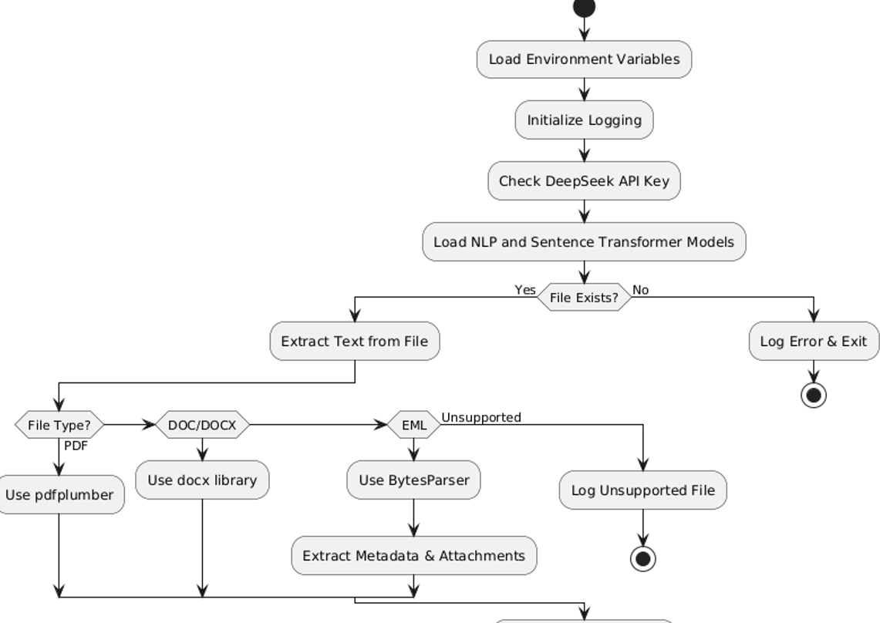
Process & Extraction of files/ email data
NLP, OCR, & deep learning for
text extraction
Extracts metadata of email.
Extracts all attachment information
as text , to be used in classification.
Classify

Slide 4
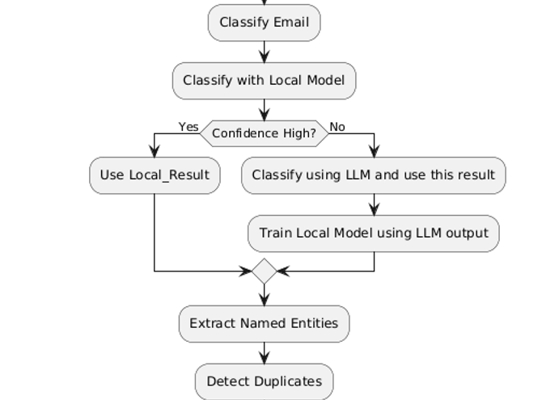
Optimized Classifier
LLMs & fine-tuned models for intent
recognition
Classified with local trained model, if
high confidence , local classification is used
To classify email. Avoiding external calls
To commercial LLM models.
If classified using external LLMs, classification
Is stored & used in training local model. Thus
Improving local model.

Slide 5
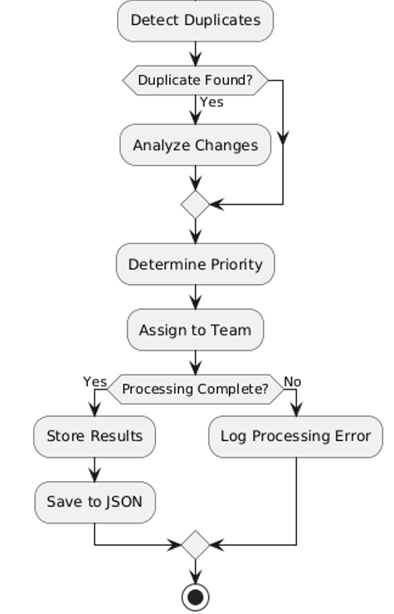
Enhanced Duplicate handler
File compared against previous emails (30days), to determine
if file/email is duplicate.
If duplicate file/email, file is analyzed to check for changes.
Duplicate information details , with intent ; critical changes
if any is returned for easy handling of duplicate data.
Eg: A thank you email, is classified as
not-important changes and with intent as thank you
*Previous email classification is stored for 30days and is cleaned up via a scheduled job

