Slide 1
Gen AI-Based Email Classification and OCR
The proposed solution for automating the processing of service requests received by Commercial Bank Lending teams via email. It addresses the requirements detailed in the "Technology Hackathon - Early Talent Gen AI-Based Email Classification and OCR" and leverages the approach and solution implemented in the provided Python scripts.

Slide 2
Introduction
Problem: Commercial Bank Lending teams face a high volume of diverse service requests via email, demanding significant manual effort for triage, classification, and data extraction. This manual process is time-consuming, error-prone, and inefficient, especially with large volumes.
Solution: A Gen AI-Based Email Classification designed to automate the classification of incoming email requests and the extraction of relevant data from both the email body and attachments. This will minimize manual intervention, improve accuracy, and accelerate turnaround times.

Slide 3
Proposed Solution Architecture and Components
Email Reception and Parsing:
The system will process emails (currently reading from .eml files as demonstrated in main.txt using the email library).
It will extract key metadata: sender, subject, and body.
Attachments will be identified and saved.
Attachment Processing:
PDF documents: Text will be extracted using the PyPDF2 library.
DOCX documents: Text will be extracted using the docx2txt library
Text Extraction and Combination:
The text from the email body and all processed attachments will be combined into a single text input for the Gen AI model.
Email Classification (using Google Gemini Pro):
The solution leverages the Google Gemini Pro model (implemented using google.generativeai in main.py) for classifying emails into predefined request types.
The classify_email function takes the combined email text and a list of request_types (e.g., "Adjustment", "Fee Payment") as input.
The expected output includes the request type, sub-request type, reasoning, and a confidence score.

Slide 4
Proposed Solution Architecture and Components
Primary Intent Detection (using Google Gemini Pro):
The detect_primary_intent function in main.txt utilizes Gemini Pro to determine the main intent of the email content.
Data Extraction (using Google Gemini Pro):
The extract_data function in main.txt uses Gemini Pro to extract specific, relevant fields (e.g., "Deal Name", "Amount", "Expiration Date") from the email text based on
the identified request_type. If a field is not found, it returns "N/A".
Duplicate Email Detection:
The detect_duplicate_emails function in duplicate_detector.txt and main.txt employs
TF-IDF vectorization and cosine similarity (using sklearn) to identify emails with high
Textual similarity.
A threshold (e.g., 0.8) is used to flag potential duplicate emails.

Slide 5
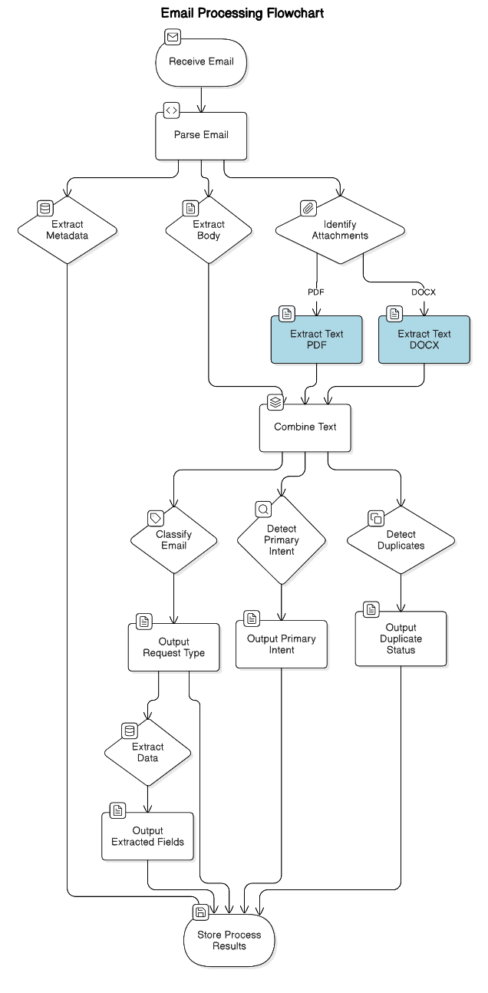
Architecture Diagram

Slide 6
Solution Workflow
Receive Email (.eml file): The process begins with receiving an email, which in the current implementation is read from an .eml file.
Parse Email: The email is parsed to separate its components.
Extract Metadata: Sender, Subject: Key information like the sender's address and the email's subject are extracted.
Extract Body Text: The main textual content of the email is retrieved.
Identify and Save Attachments?: The system checks if the email has any attachments.
Process Attachments: If attachments exist, they are further processed.
Is Attachment PDF?: The system checks if an attachment is a PDF file.
Extract Text using PyPDF2: If it's a PDF, the text is extracted using the PyPDF2 library.
Is Attachment DOCX?: The system checks if an attachment is a DOCX file.
Extract Text using docx2txt: If it's a DOCX, the text is extracted using the docx2txt library.
Combine Email Body Text and Attachment Text (if any): The text extracted from the email body and any processed attachments is combined into a single text.
Use Email Body Text: If there are no attachments, only the email body text is used for further processing.

Slide 7
Solution workflow
Classify Email using Google Gemini Pro: The combined text is sent to the classify email function, which uses the Google Gemini Pro model to classify the email into predefined request types. The output includes the request type, sub-request type, the reasoning behind the classification, and a confidence score.
Output: Request Type, Sub-Request Type, Reasoning, Confidence Score: The classification results are obtained.
Detect Primary Intent using Google Gemini Pro: The combined text is also sent to the detect_primary_intent function, which uses Google Gemini Pro to determine the main intent of the email.
Output: Primary Intent: The primary intent of the email is identified.
Extract Data using Google Gemini Pro (based on Request Type): Based on the classified request type, the combined text is sent to the extract_data function, which uses Google Gemini Pro to extract specific, relevant data fields (e.g., Deal Name, Amount, Expiration Date).
Output: Extracted Fields (e.g., Deal Name, Amount, Expiration Date): The extracted data fields are obtained.
Perform Duplicate Email Detection (Optional): The text content of the processed email can be compared with other processed emails using TF-IDF and cosine similarity to detect potential duplicates. This step is currently implemented to run on a list of processed emails.
Output: List of Potential Duplicate Emails with Similarity Score: If duplicates are detected, a list of the duplicate pairs and their similarity scores is generated.
Store/Process Results: Finally, all the extracted information (sender, subject, classification details, primary intent, extracted data, and duplicate information if detected) is stored or further processed as needed.

