Slide 1
GenAI Orchestrator for Email and Document Triage
Automating email processing and classification using AI

Slide 2
Introduction
- Project Name: GenAI Orchestrator for Email and Document Triage
- Objective: Automate processing & classification of email attachments using AI
- Tech Stack: .NET Core, LLaMA 3.2 3B Instruct, RabbitMQ, iText for PDF processing

Slide 3
System Architecture
- Components:
• API Gateway (ASP.NET Core)
• AI Processing (LLaMA 3.2 3B Instruct)
• PDF Extraction (iText)
• Messaging Queue (RabbitMQ)
• Storage & Logging
- Workflow:
1. Upload PDF
2. Extract text
3. AI processes text
4. Classifies email content
5. Publishes results to RabbitMQ

Slide 4
API Design
- `EmailController`
Endpoint: `POST /api/email/process`
Accepts PDF files
- `EmailProcessingService`
Extracts text using iText
Calls AI Processing Service
Publishes results

Slide 5
AI Processing Service
- Model: LLaMA 3.2 3B Instruct
- Runs locally using GPT4All Server

Slide 6
PDF Extraction & Processing
- Uses iText.Kernel.Pdf
- Extracts text for AI processing
- Code Example: C#
using (var pdfReader = new PdfReader(stream))

Slide 7
Messaging System (RabbitMQ)
- Queue Name: `email_classification`
- Publishes classified emails

Slide 8
Deployment & Setup
Install GPT4All & LLaMA 3.2 3B Instruct
Run GPT4All server
Deploy .NET API
Start RabbitMQ service
Submit test pdf using Postman client.

Slide 9
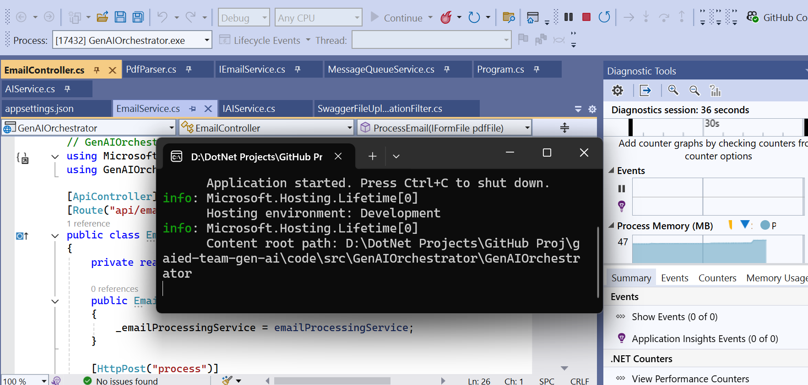
Application Walkthrough
Step 1:- Run the application

Slide 10
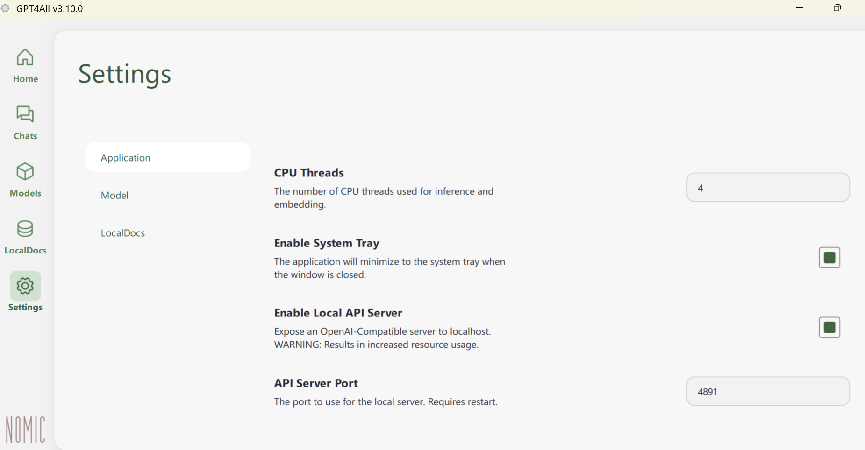
Application Walkthrough
Step 2:- Run GPT4All Server

Slide 11
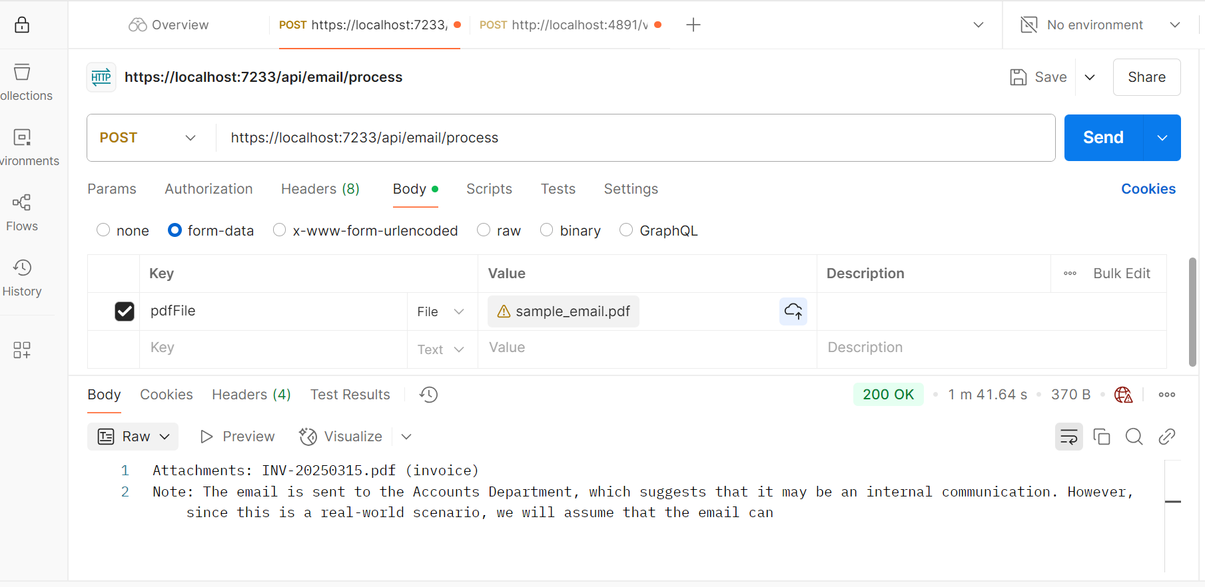
Application Walkthrough
Step 3:- Send the test pdf using postman client

Slide 12
Conclusion & Future Scope
- Automates document triage
- Reduces manual effort
- Future Enhancements:
Multi-file support
AI fine-tuning
Cloud deployment

