Slide 1
Reimagining Platform Support with GenAI
Accelerating Resolution with Intelligence, Context and Automation
Presented by - AchaarAI

Slide 2
Problem Statement
Teams managing large-scale applications and infrastructure juggle between,
Knowledge Bases
Automation Scripts
Telemetry Dashboards
Configuration Items (CIs)
Platform teams face,
Frequent Context Switching
Slower Incident Resolution
Increased Operational Overhead
Complex and Fragmented Workflows

Slide 3
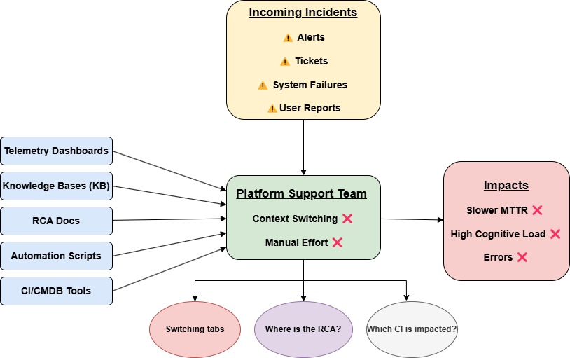

Slide 4
Solution : GenAI-Powered Platform Support
Unified Platform Console Centralized access to incidents, telemetry, config data & automation tools
LLM-Based Agents Multi-agent system handles RCA, summarization, and auto-remediation
Conversational Chatbot Natural language interface to query incidents, KB, and trigger actions
Embedded Knowledge Intelligence Auto-links incidents with known errors, RCA docs & relevant workarounds
Contextual Recommendations Suggests proactive actions based on telemetry, history, and CI impact
MCP-Based Orchestration Coordinates agents and platform data using Model Context Protocol

Slide 5
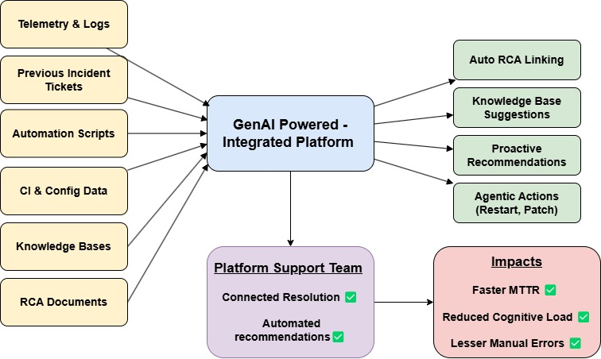

Slide 6
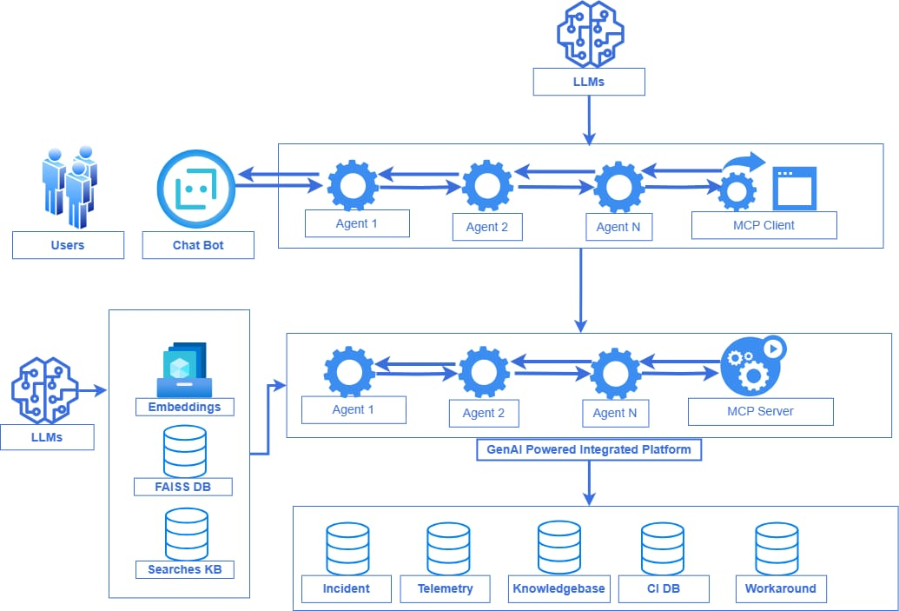

Slide 7
Thank You!

