Slide 1
Reimagining Platform Support with GenAI
Accelerating Resolution with Intelligence, Context and Automation
Presented by - AchaarAI

Slide 2
Problem Statement
Teams managing large-scale applications and infrastructure juggle between,
Knowledge Bases
Automation Scripts
Telemetry Dashboards
Configuration Items (CIs)
Platform teams face,
Frequent Context Switching
Slower Incident Resolution
Increased Operational Overhead
Complex and Fragmented Workflows

Slide 3
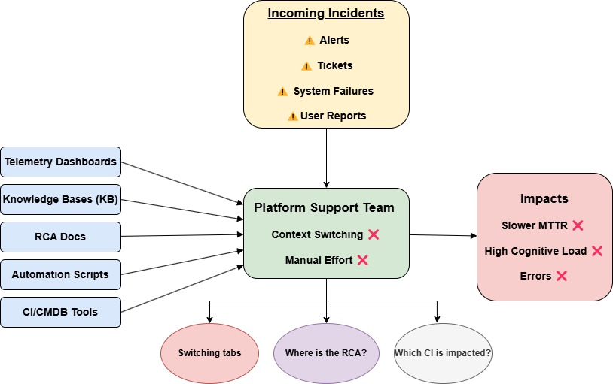

Slide 4
Solution : GenAI-Powered Platform Support
Unified Platform Console Centralized access to incidents, telemetry, config data & automation tools
LLM-Based Agents Multi-agent system handles RCA, summarization, and auto-remediation
Conversational Chatbot Natural language interface to query incidents, KB, and trigger actions
Embedded Knowledge Intelligence Auto-links incidents with known errors, RCA docs & relevant workarounds
Contextual Recommendations Suggests proactive actions based on telemetry, history, and CI impact
MCP-Based Orchestration Coordinates agents and platform data using Model Context Protocol

Slide 5
Automated Actions for Resilience
Health Monitoring
- Server CPU, memory, disk usage
- App latency, error rates
- DB connection & performance
- API health & uptime
- Network ping/traceroute
Service & System Ops
- Start/Stop/Restart services
- Log checks, status reports
- Config updates & cleanup
- Rotate system logs
Database & App Tasks
- Backups & health queries
- Clear DB & app caches
- Data sync & repair scripts
Network & CI/CD
- DNS lookups, port scans
- Trigger rollback or deployment checks

Slide 6
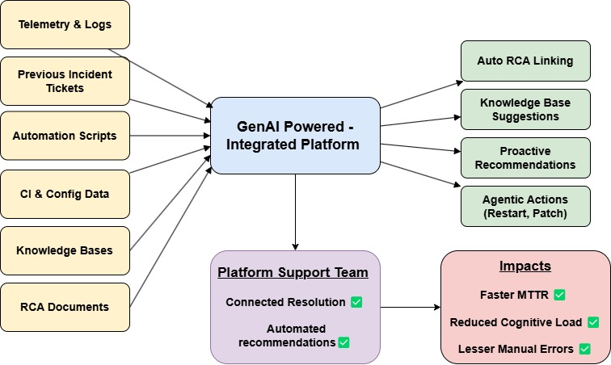

Slide 7
Core Use Case: Agentic AI for Incident Resolution
Automate Root Cause Analysis (RCA)
Execute diagnostic & resolution scripts
Analyze telemetry for anomalies
Recommend actions using ML & heuristics

Slide 8
Agentic Workflow for RCA Handling
1. Input: Incident triggers workflow
2. Probabilistic RCA generation using CI Graph
- Analyze dependencies & changes
- Use specialized agents: planning, meta-reasoning, script, KB
3. Suggest corrective actions & draft RCA
4. Summarize RCA for chatbot/user delivery

Slide 9
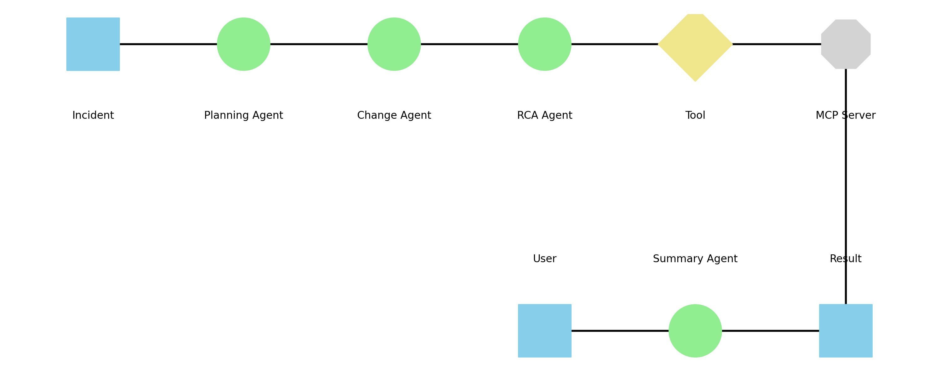
Tool Flow

Slide 10
MCP Client-Server Tooling
Tools registered on MCP Server:
- CI Graph Change Tracker
- Past RCA DB Search
- Enterprise KB Search
- Automation Scripts
- Known Issues & Workarounds
- Incident Correlation Engine

Slide 11
Implementation Plan & Action Items
- Generate unresolved incidents by CI/Change ID
- Build & expose tools to LLM
- Register MCP tools
- Use client as execution proxy
- Terminate workflows based on API responses

Slide 12
Design Considerations
- Use reflection & meta-reasoning
- Tool chaining for complex resolutions
- Confidence scores for decisions
- Define clear termination conditions
- Designed for scalability

Slide 13
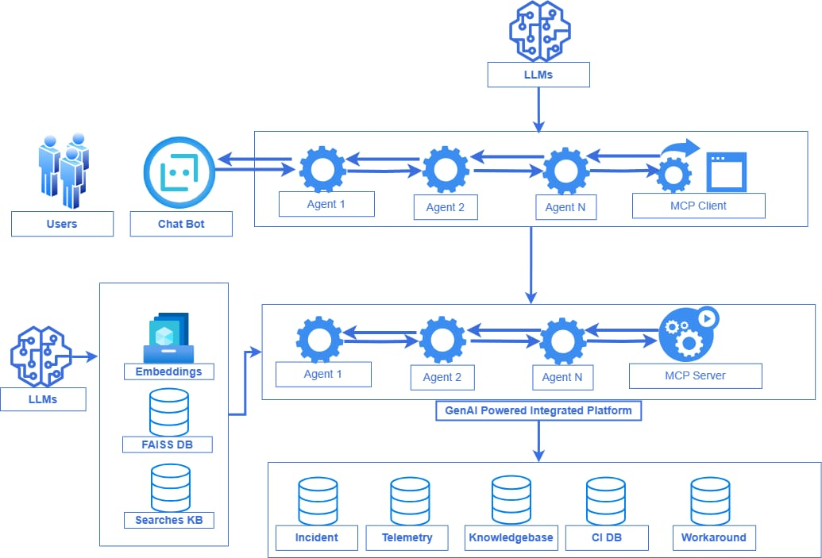

Slide 14
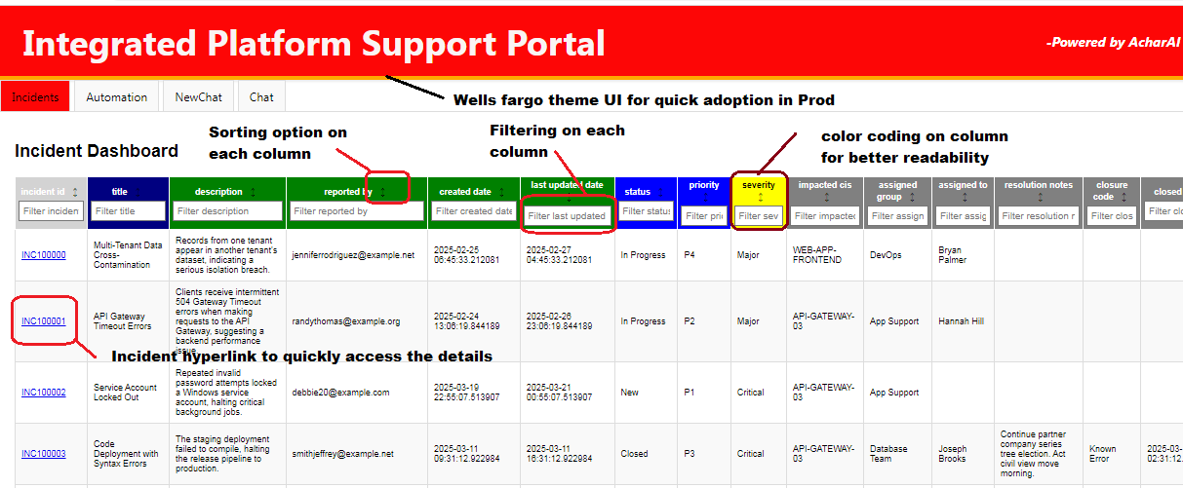
Home Page of the Application – post login

Slide 15
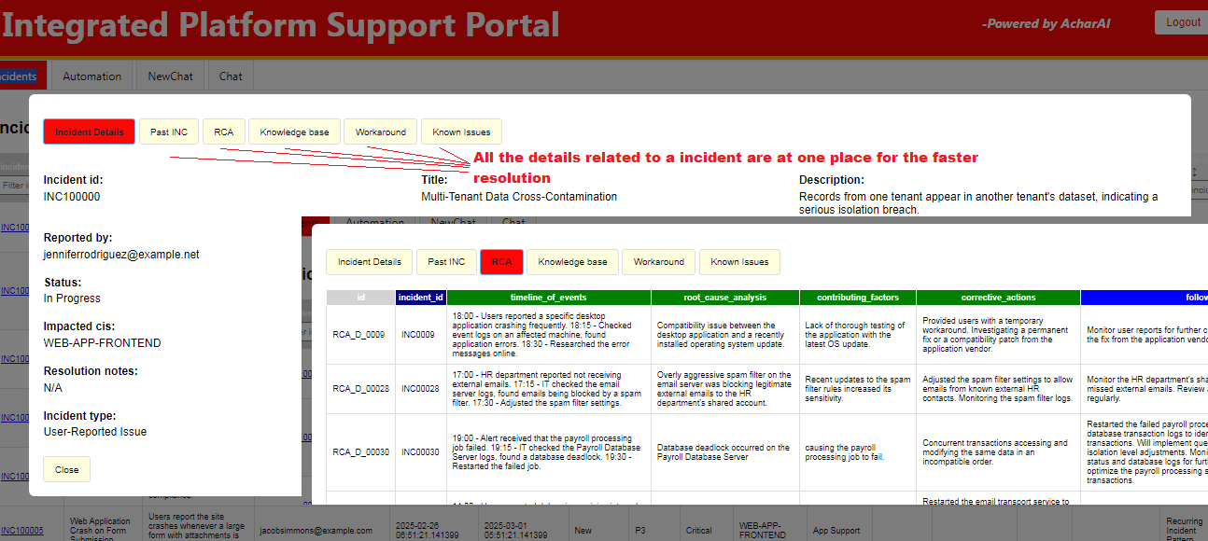
Incident and its all the matching details as one place On click of the INCIDENT number hyperlink

Slide 16
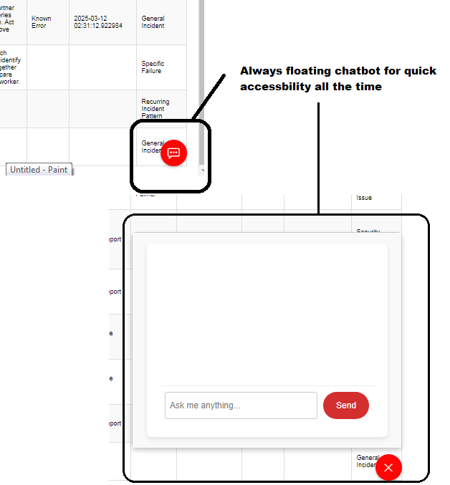
Smart GenAI powered Chat Bot Always floating, always available

Slide 17
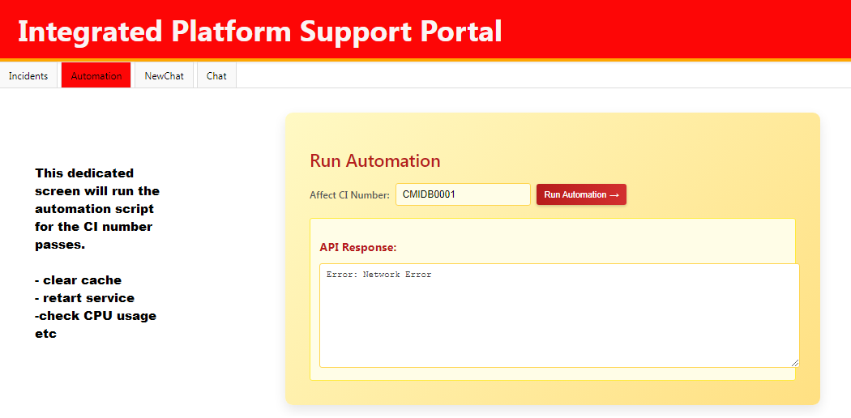
Run Automation from the screen itself

Slide 18
Demo Video
Video was of bigger size so uploaded it on google driven and here is the link – https://drive.google.com/file/d/1P75L8NqxtVimZmjNl-pZCMgHS77z_jpD/view?usp=sharing

Slide 19
Thank You!

