Slide 1

Integrated Platform Environment
AI Agents

Slide 2

Team Members
M P V Aditya
Datta Sai Krishna Somesula
Subhajit Mondal
Prasant Panda
Giribabu Goli

Slide 3

Content
Introduction
Frameworks and Tools
Architecture diagram
Approach
Future scope

Slide 4
Introduction
To enhance operational efficiency and reduce complexity, we have developed a robust and versatile tool designed to consolidate various functionalities into a single, unified solution. Often, platform teams face the challenge of managing multiple applications, which not only consumes valuable time but also hinders productivity. This tool addresses these issues by eliminating the need to switch between multiple solutions, offering an integrated platform that fosters streamlined workflows.
One of its standout features is its seamless integration with key applications, such as Incident Management systems. By connecting to these systems, the tool ensures that issues are quickly identified and analyzed. It also provides actionable insights and workarounds by leveraging Knowledge Base (KB) articles, making the resolution process faster and more effective. This capability minimizes downtime and improves service delivery.

Slide 5
Introduction cont.
Additionally, the tool interfaces with project management applications, creating a cohesive environment for tracking progress, managing tasks, and collaborating across teams. This ensures better visibility into project milestones and deliverables, promoting informed decision-making and teamwork.
By unifying diverse functionalities and fostering interoperability, our tool empowers platform teams to focus on strategic initiatives rather than manual, repetitive tasks. It is a significant step forward in simplifying operations and driving organizational success.

Slide 6
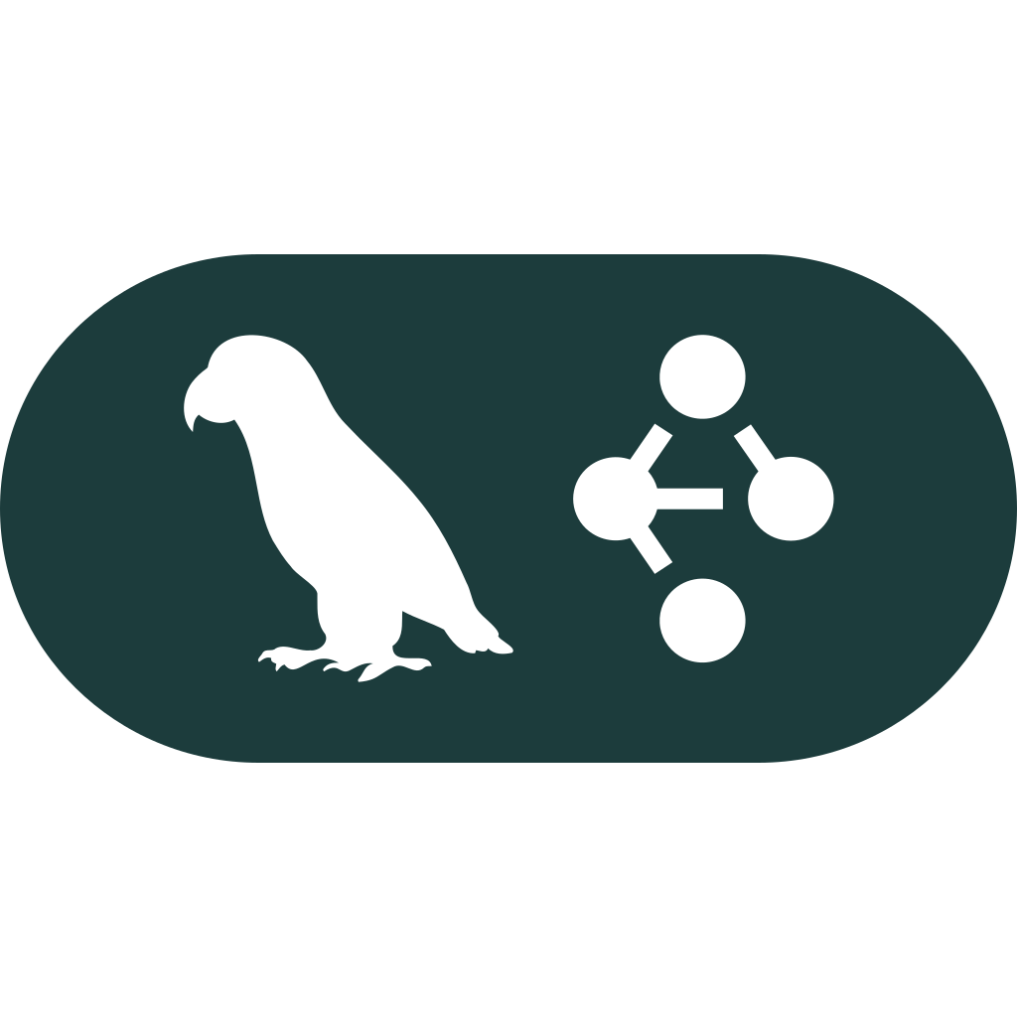

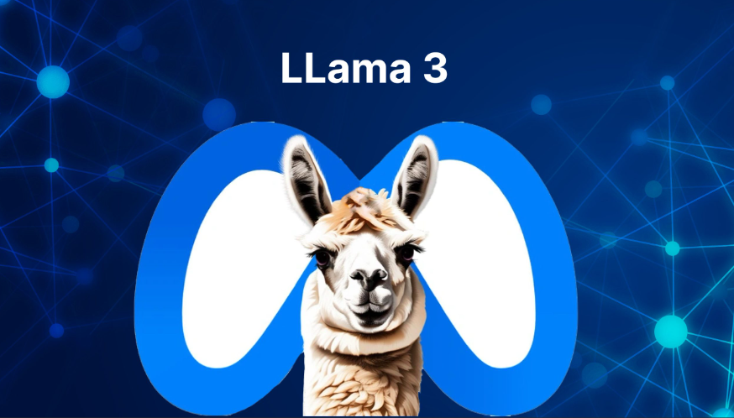


Tools and Frameworks
🔹 Streamlit
🔹 python
🔹 LangChain
🔹 LangGraph
🔹 LLama3
🔹 Servicenow API

Slide 7
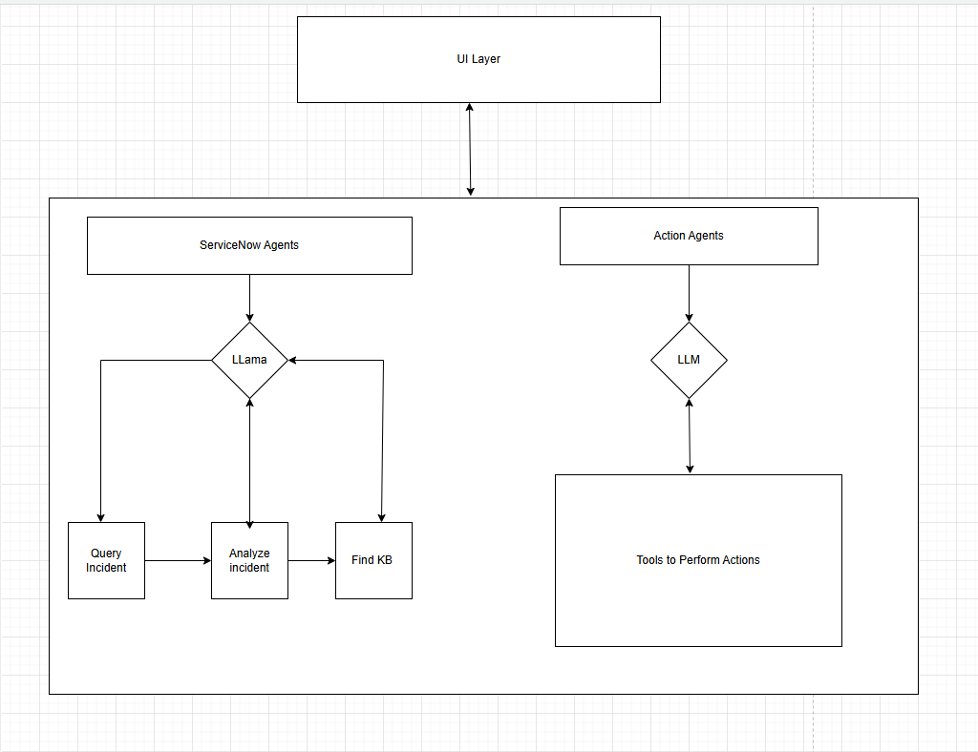
Architecture Diagram

Slide 8
Approach
This is a Streamlit-based web application that implements an Integrated Platform Environment (IPE) with chat functionality. Here's a breakdown of its main components:
Core Components:
Uses Streamlit for the web interface
Implements a chat-based interface with a sidebar
Integrates with LangChain for workflow management
Includes file operation capabilities
Key Functions:
initialize_workflow(): Sets up the workflow management system
initialize_session_state(): Manages the application's state and initializes chat
process_user_input(): Handles user messages and generates responses
update_chat_history(): Maintains the chat conversation history
display_chat_history(): Shows the chat interface

Slide 9
Notable Features:
Supports different LLM models (currently shows "lama3")
Allows framework selection between Langchain and lamaindex
Has special handling for commands starting with "runfor file operations
Implements error handling and logging throughout the code
User Interface:
Shows a title "Integrated Platform Environment"
Has a sidebar for model and framework selection
Displays a chat interface with message history
Includes a chat input field for user queries
Session Management:
Maintains chat history across sessions
Stores workflow manager instance in session state
Handles both user inputs and system responses
The code follows a modular structure and includes error handling, making it robust for production use. It's designed to be extensible, allowing for additional features to be added to the platform.

Slide 10
Future Scope
In the future, our tool can integrate with additional platforms like Jira and Autosys to expand its functionality. Integration with Jira would provide seamless project management by syncing tasks, tracking issues, and facilitating collaboration directly within the tool, ensuring efficient project workflows. Connecting with Autosys would enable advanced job scheduling and workflow automation, allowing users to monitor, manage, and optimize job execution seamlessly. These enhancements would further streamline operations, reduce manual tasks, and provide a unified platform to handle diverse requirements. By incorporating these integrations, the tool would cater to a broader audience and deliver even greater value.

Slide 11
Thank you

