Slide 1
AI-Powered Incident Detection & Alerting System
Proof of Concept (PoC)
Advanced Technical Overview

Slide 2
Problem Statement
• Need for automated incident detection
• Challenges with manual monitoring
• Importance of AI-driven analysis

Slide 3
System Architecture
• Frontend: React (UI & Visualization)
• Backend: Python (FastAPI, Flask)
• AI Engine: Generative AI Model
• Database: PostgreSQL / MongoDB
• Knowledge Base Integration

Slide 4
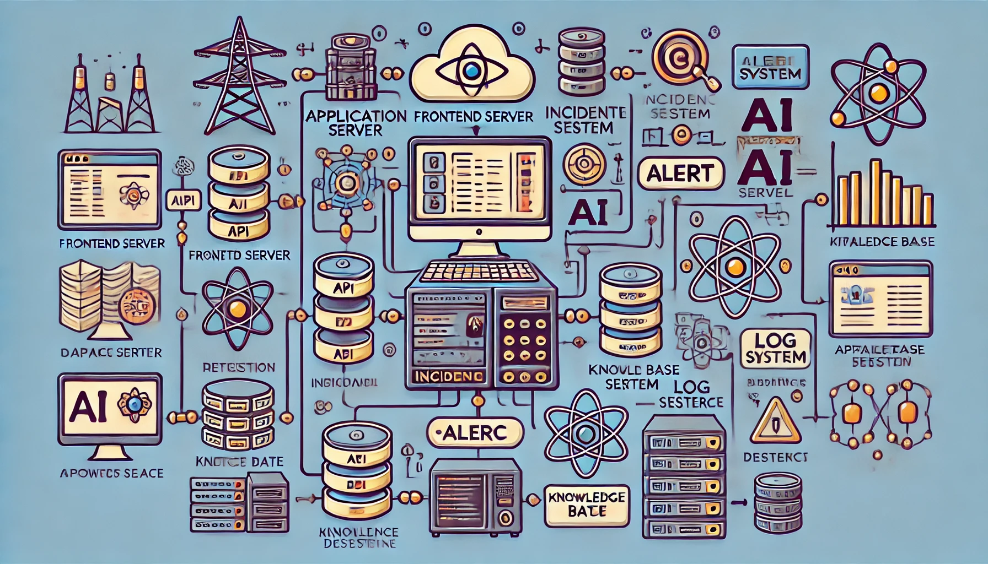
Architecture Diagram
Frontend (React UI)
Below is the architecture overview of the system.
Backend (Python AI Engine)
Database (PostgreSQL/MongoDB)
AI Model (Generative AI)
Knowledge Base (FAISS/Elasticsearch)

Slide 5
Data Flow & Processing
1. Data Ingestion (Logs, Events, Metrics)
2. AI Model Analysis (Anomaly Detection)
3. Incident Classification
4. Knowledge Base Lookup
5. Alert Generation & UI Display

Slide 6
Flowchart: AI Model Processing
• Input: Event Logs & Metrics
• AI Model Inference: NLP & Pattern Matching
• Output: Incident Classification & Knowledge Base Lookup

Slide 7
AI Model & Detection Mechanism
• Model Type: Transformer-based / LLM
• Training Data: Historical incidents & logs
• Detection Logic: Pattern Recognition, NLP-based classification

Slide 8
Knowledge Base Integration
• AI searches past incidents for similarity
• Fetches relevant documents for resolution
• Enhances troubleshooting with contextual insights

Slide 9
API Endpoints & Data Schema
• /detect-incident (POST) - Accepts event logs, returns incident classification
• /get-alerts (GET) - Fetches active alerts
• /related-docs (GET) - Retrieves knowledge base documents
• Data Schema: JSON format for structured responses

Slide 10
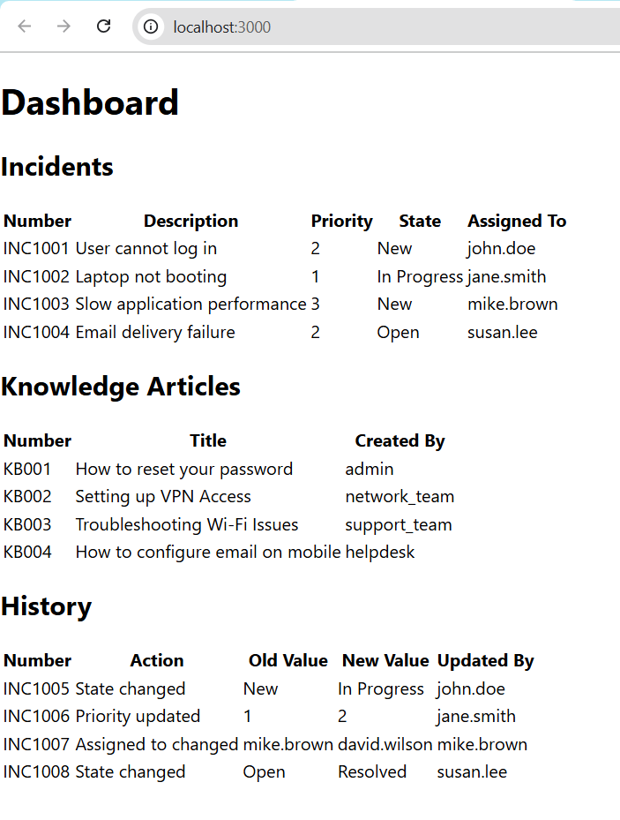
Frontend - React Implementation
• State Management: Redux / Context API
• API Integration: RESTful API calls to the backend
• UI Components: Incident Dashboard, Alerts Panel, Knowledge Base Section
Source Code:

Slide 11
Backend - Python AI Engine
• Frameworks: TensorFlow / PyTorch
• Model Deployment: FastAPI / Flask
• Alert System: WebSockets / Messaging Queue
• Knowledge Base Retrieval: Vector Search (FAISS / Elasticsearch)

Slide 12
Logging & Monitoring
• Log Collection: ELK Stack / Prometheus
• Monitoring Tools: Grafana, Kibana
• Error Handling & Alerting Mechanisms

Slide 13
Security & Scalability
• Secure API Authentication (OAuth, JWT)
• Rate Limiting & Logging
• Horizontal Scalability with Microservices

Slide 14
Demo & Technical Walkthrough
• Live demonstration (if available)
• API Endpoints & Logs Processing

Slide 15
Next Steps
• Model Fine-tuning & Accuracy Improvements
• Integration with External Monitoring Tools
• Expansion of Knowledge Base Data Sources

Slide 16
Q&A
Thank you! Open to technical discussions.

