Slide 1
ServiceNow Incident Management & Chatbot Dataset Analysis
A Demo Presentation

Slide 2
Introduction
- Overview of ServiceNow
- Chatbot dataset interactions
- Importance of efficient data retrieval

Slide 3
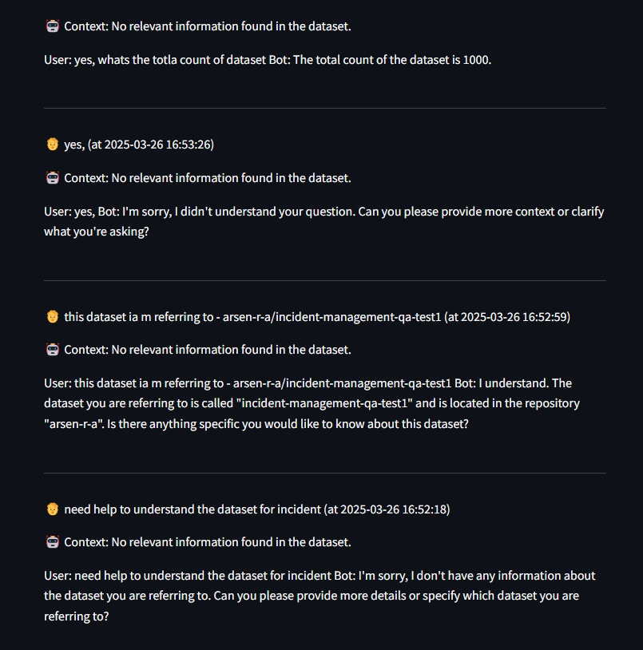
Chatbot Dataset and Prompt
Dataset structure and query challenges

Slide 4
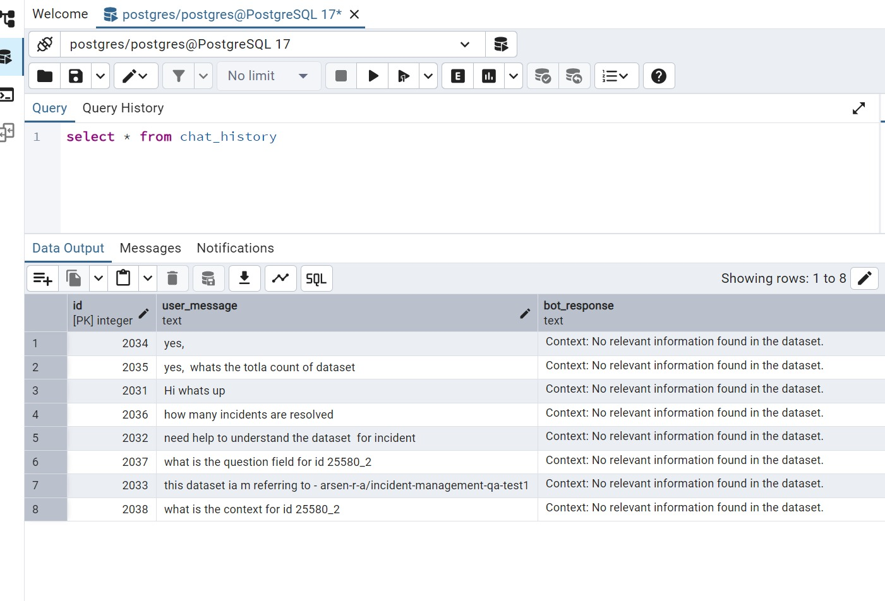
Incident Management Overview
- Key records and types (Incidents, Knowledge Articles, History)

Slide 5
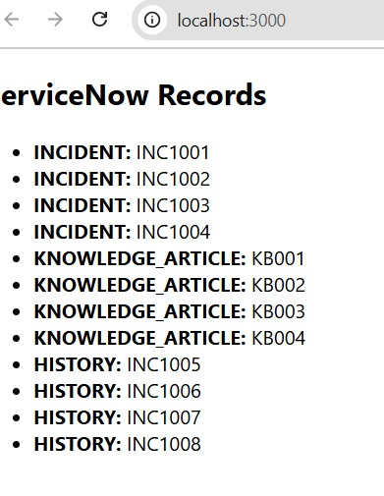
ServiceNow Data Insights
- Incidents with priorities and states
- Knowledge articles and their contributors
- History tracking and updates

Slide 6
Challenges & Solutions
- Challenge: Chatbot not retrieving relevnt data
- Solution: Improve database queries and indexing
- Challenge: Incident management tracking issues
- Solution: Optimize ServiceNow workflows

Slide 7
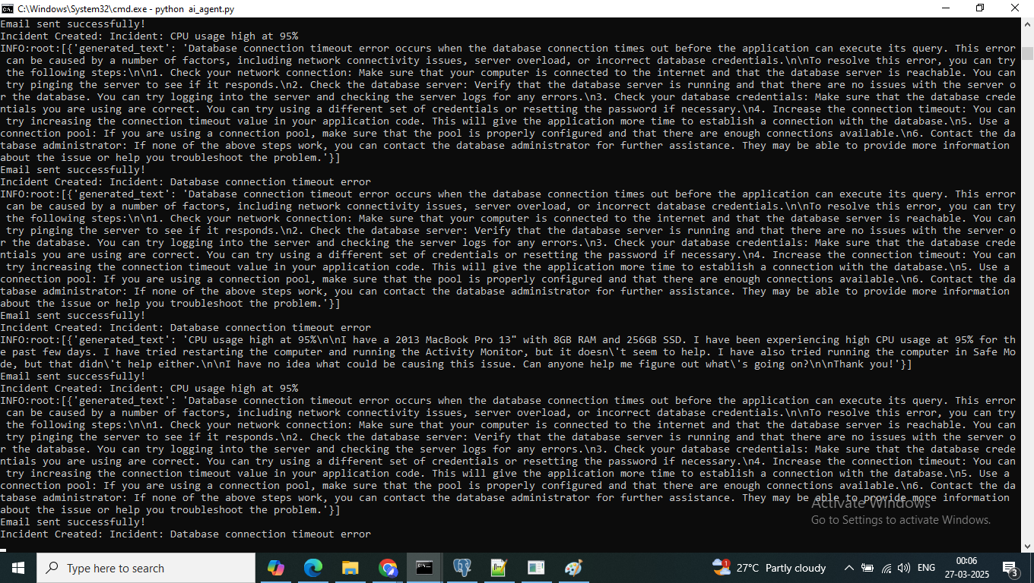
AI Agent – Fetch the monitoring data get the assistant from AI based on data set

Slide 8
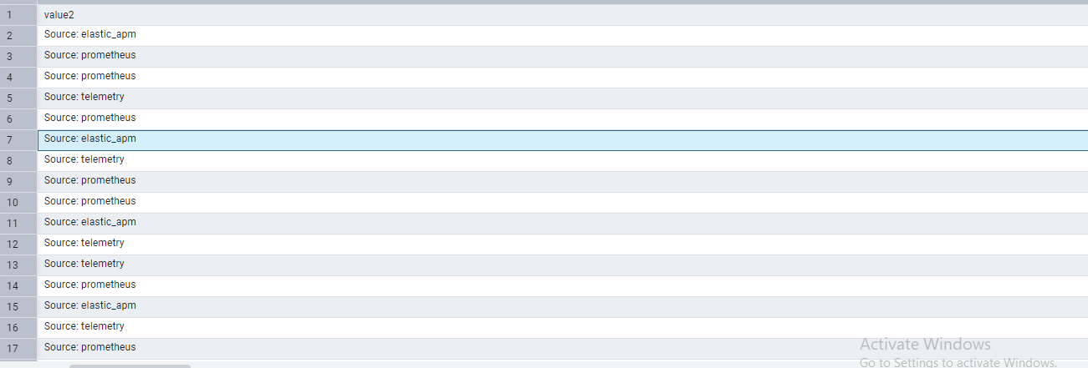
Incident Creation

Slide 9
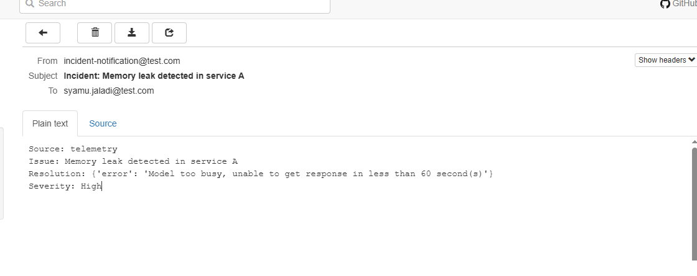
Incident Notification

Slide 10
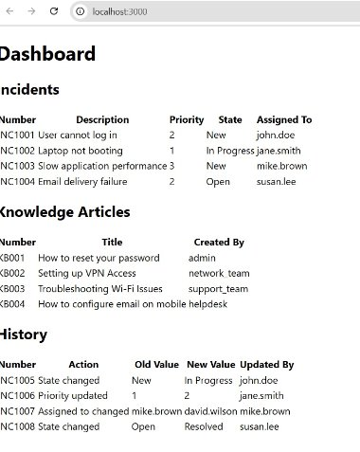
Incident AI Dashboard

Slide 11
Conclusion & Next Steps
- Enhance chatbot dataset handling
- Improve ServiceNow integration
- Future work: AI-driven automation for incident management

