Slide 1
Gen AI – Integrated Platform Environment
End-to-End Incident Resolution Flow

Slide 2
Tools integrated into the system: ServiceNow, Prometheus, AppDynamics, and ChatGPT LLM

Slide 3
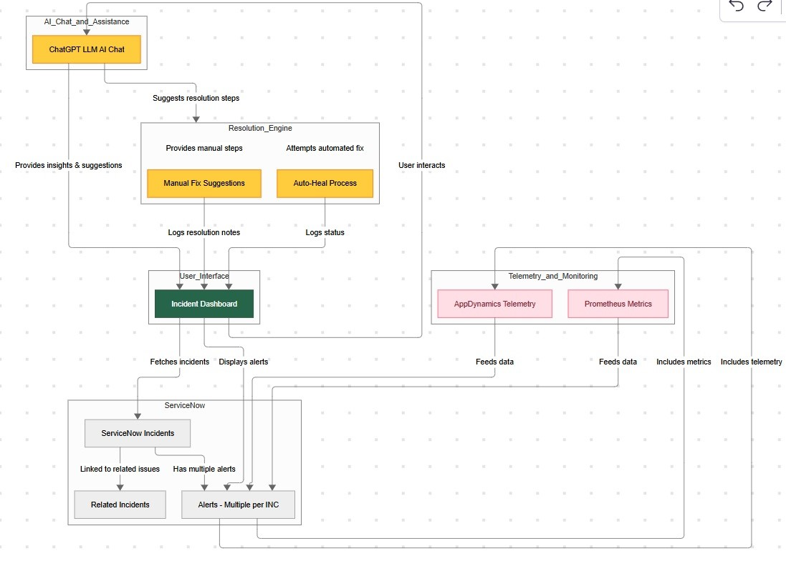
Architecture

Slide 4
Screenshots

Slide 5
Sachin Kulkarni Subramanyam Sisthi Saran Kaarthik Ramu Chittiprolu Barath Srinivasan Abhinav Sinha
Team

