Slide 1
Gen AI – Integrated Platform Environment
End-to-End Incident Resolution Flow

Slide 2
Introduction
Prajña, the Integrated Platform Environment is, a one-stop solution for all essential services, applications, tools, interfaces knowledge banks, etc. It equips Service Desk Engineers with everything they need to be effectively notified, triage and resolve incidents. The Wisdom or Prajña (प्रज्ञा) comes from integrating GenAI into the platform, thereby vastly increasing the amount of information and past knowledge available to the engineer to resolve incidents in the most efficient way reducing the MTTR.
The use of LLMs and agentic capabilities will help in resolving incidents up to 80% faster, thereby reducing costs. Additionally, a large number of Service Desk Engineers will have the opportunity to upskill and contribute towards building the generation applications.
Prajña (Sanskrit: प्रज्ञा) is the highest and purest form of wisdom, intelligence and understanding. Prajñā is the state of wisdom which is higher than the knowledge obtained by reasoning and inference. (Wikipedia)

Slide 3
Design

Slide 4
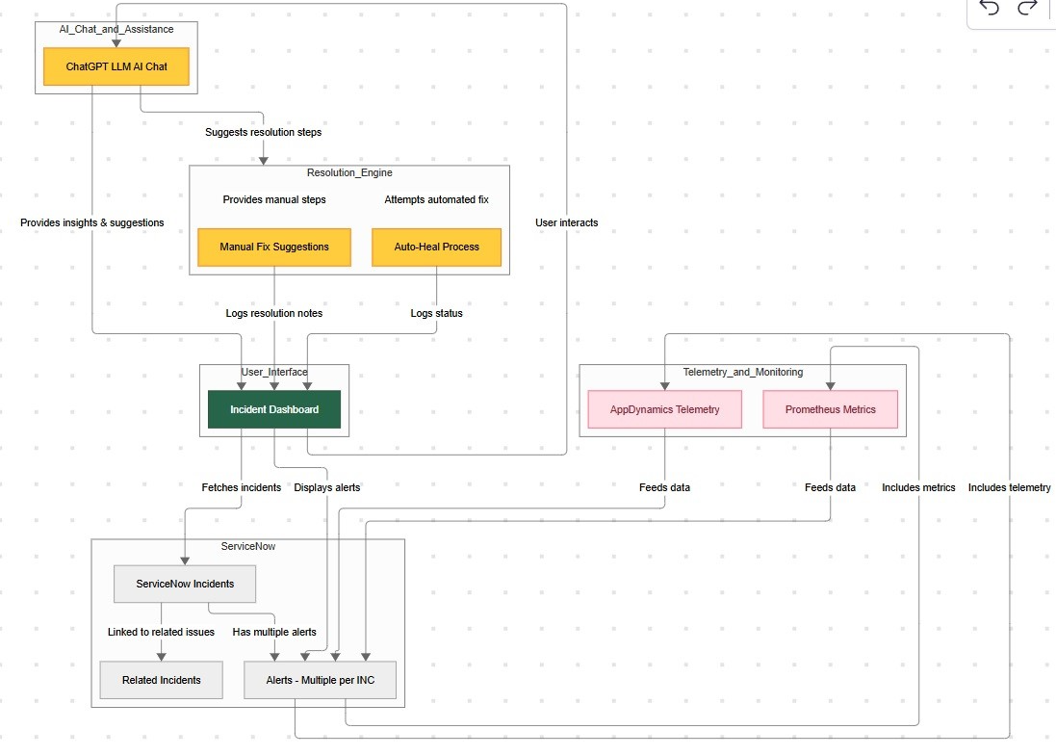
Data Flow Diagram
The primary components of the Integrated Platform Management are
User Interface: This component is used by the end-users to view/triage and resolve incidents.
Services-Connect API: This backend service is an integration service that fetches data from third-party services like APP-D, ServiceNow, Prometheus, Telemetry information etc.
AI-Connect API: This backend service is responsible for creating the Context for LLMs and

Slide 5
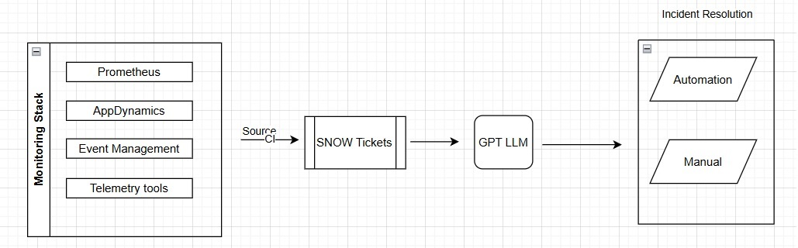
Flow Diagram

Slide 6
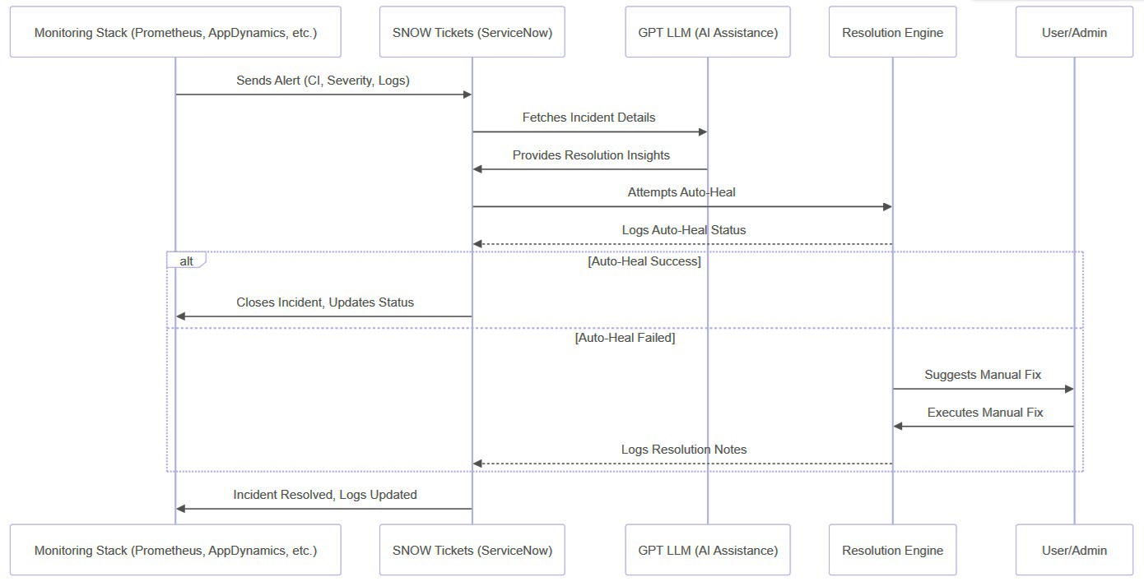
Interaction Diagram

Slide 7
Screenshots

Slide 8
Opening Screen

Slide 9
Incidents Loaded

Slide 10
Automation Executed (bottom right)

Slide 11
Quick Links
Component | Link
Front End App | https://github.com/ewfx/gaipl-ai-pragnya/tree/main/code/web
Services-Connect | https://github.com/ewfx/gaipl-ai-pragnya/tree/main/code/services-connect
AI-Connect | https://github.com/ewfx/gaipl-ai-pragnya/tree/main/code/ai-connect

Slide 12
Team
Developer | Introduction
Subramanyam Sisthi | Lead UI developer
Saran Kaarthik | UI developer and AI-expert
Ramu Chittiprolu | SME for Incident Resolution Workflow
Abhinav Sinha | UI developer
Barath Srinivasan** | AI consultant
Sachin Kulkarni | API developer and Team Captain
<Team Photo Here>

