Slide 1
Integrated Platform Environment (IPE)
ByteBrains_AI
Udaya Ramu P Rajiv Kumar Venkata Aditya V Veerendhranadh V Satyanarayna P

Slide 2
Introduction
The Integrated Platform Environment (IPE) is a Gen-AI enabled platform designed to enhance support operations by combining below into a unified solution powered by OpenAI.
AI-Powered Chat Interface
Real-time Telemetry Dashboard
Knowledge Base Management
Automation Engine
Role-Based Access Control
AI-Powered Task Automation
Task Management System
Task History
Log Analysis
Anomaly Detection
Recommendation Engine

Slide 3
Demo
🔗 Live Demo
📹 Video Demo

Slide 4

Inspiration
Platform support teams face challenges due to context switching between multiple tools for troubleshooting, running Ansible scripts, and reviewing telemetry and CI data.
This platform consolidates these tasks into a unified interface for faster issue resolution and improved operational efficiency.

Slide 5

What It Does
AI-Powered Chat Interface
Real-time Telemetry Dashboard
Knowledge Base Management
Automation Engine
Task Management System
Log Analysis
Anomaly Detection

Slide 6
How We Built It
Technologies Used: Python, Open AI GPT 3.5 Turbo LLM, Streamlit, Chroma DB
Tools Used: PyCharm CE, Git
Security: JWT-based authentication, Role-based access control, Secure token refresh

Slide 7
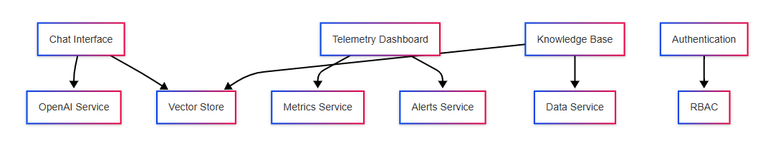
Data Flow diagram

Slide 8
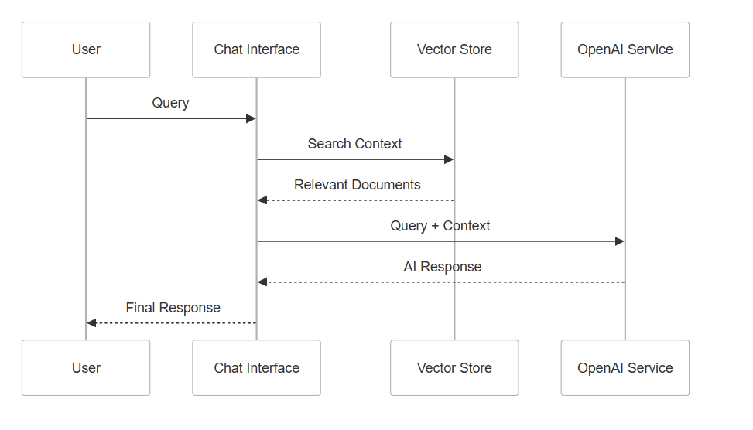
Sequence Diagram

Slide 9
Challenges We Faced
Dataset preparation and data consistency across sources
Identifying the most suitable Python packages for implementation
Determining the optimal approach to solve the problem statement effectively

Slide 10
How to Run
Clone repository
1
Install dependencies
3
Start
Streamlit app
4
Access Application via
http://localhost:8501
5
Test with sample data
6
Create Virtual Environment
2

Slide 11
Tech Stack
Frontend: Streamlit Python Library
Backend: Python 3.10
Database: Chroma DB
LLM Model: OpenAI API Turbo 3.5

Slide 12
Documentation
System Integration - docs/markdown.md
System Architecture - docs/system_architecture.md
Test Cases - docs/test_cases.md

Slide 13
Team
Udayaramu Peethani
Rajiv Kumar
Venkata Aditya Vajapeyajula
Veerendranadh Valeti
Satyanarayana Pampana

Slide 14
Thank you

