Slide 1
Chatbot Routing & Escalation in Salesforce
Enhancing Customer Support with AI & Live Agent Assistance

Slide 2
Introduction to Chatbot Routing
• Customers interact with a chatbot via the Salesforce Experience Cloud.
• The chatbot handles order inquiries and updates.
• If the chatbot cannot resolve the issue, it escalates to a live agent.
• A routing engine determines whether to assign an agent or route to a queue.

Slide 3
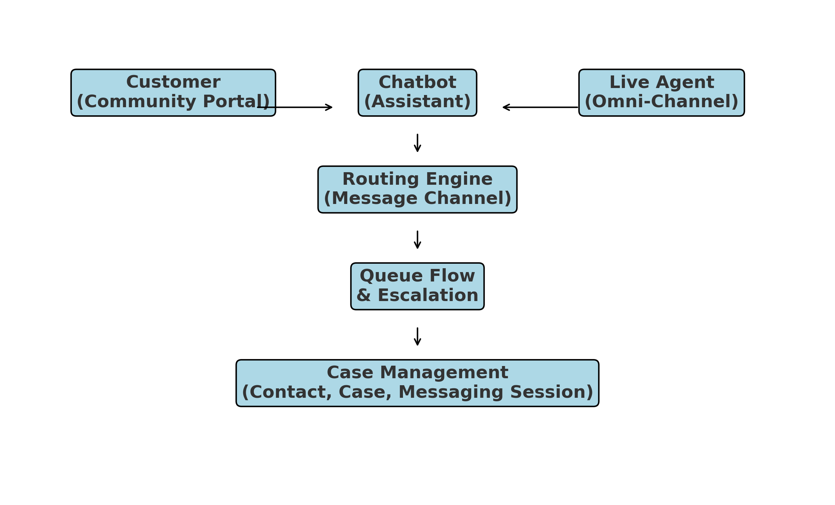
Chatbot Routing Flow - Block Diagram

Slide 4
Escalation & Case Management
• If an issue is unresolved, the chatbot routes the case to an agent.
• The routing engine uses predefined rules to direct cases to the right support team.
• If no agents are available, the request moves to a queue for later processing.
• Cases are logged, associated with customer contacts, and tracked for resolution.

