Slide 1
IPE – Integrated Platform Environment
Team GenAvatars

Slide 2
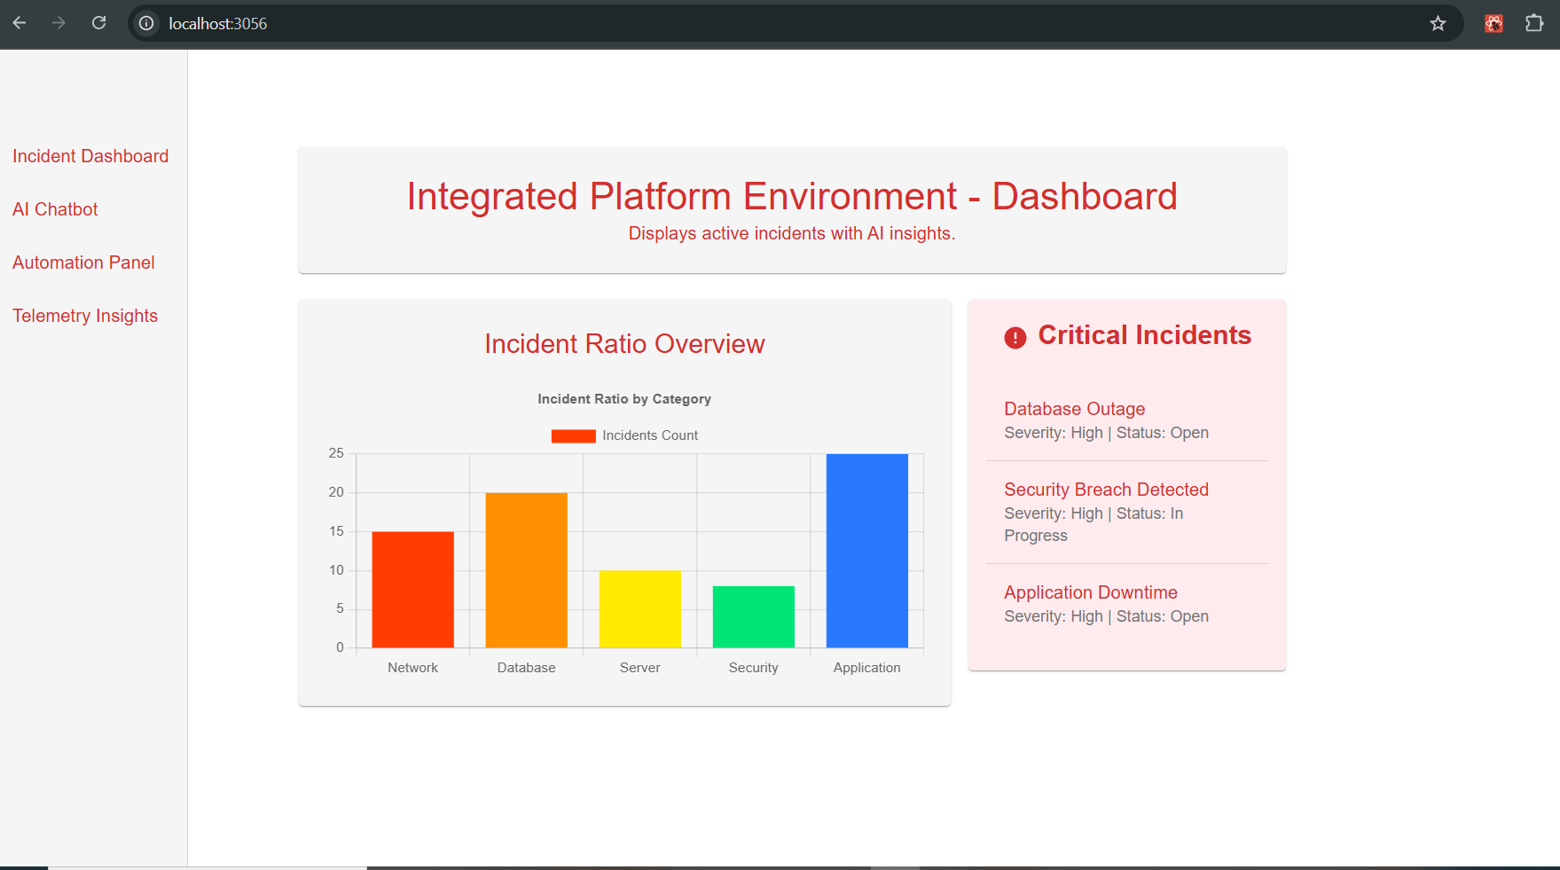
IPE - Dashboard
The IPE Dashboard is designed to integrate Incident Management, AI-powered Chatbot, Automation Execution, and Telemetry Insights into a unified platform.
Key Features
AI-based Incident
Resolution
Real-time Logging & Session Tracking
Secure API Integration
- Scalable Microservices Architecture

Slide 3
IPE - Components
Incident Management
Displays real-time incident reports, tracks and issue resolution.
AI Contextual Chatbot
LLM powered chatbot assists with troubleshooting and automation
Automation Panel
Execute Workflow and automation.
Telemetry Insights
Visualize heath checks and logs

Slide 4
IPE – Architecture component
React Frontend: Provides the user interface for the dashboard.
API Gateway: Handles requests and routes them to microservices.
Microservices:
Incident Management: Logs and tracks incidents.
Chatbot Service: Interfaces with an LLM for AI responses.
Automation Service: Executes predefined workflows.
Telemetry Service: Monitors system performance.
MongoDB: Stores incident logs, telemetry data, and chatbot interactions
Model
LLM Integration: Provides AI-driven responses for troubleshooting.

Slide 5




IPE – Incident Management Flow
Apps (Structured)
Information pulled from ServiceNow
Reports, Charts
Retrain Model & Model Management
Incident Dashboard
Visualization
Visualization Tools
2
7
Incident Request
Structured Data
1
Captures and forwards incident data
Analytics Services
Users
3
AI Chatbot
4
Automation
5
Telemetry
6
Model & Serve
Indicated on Incident report
AI assisted responses
Executed pre-defined tasks or scripts for issue resolution
Visualizes Logs, System Activities
Apply Model
Machine Learning, NLP
Local LLM Model
DB
Logs, Files, confluene pages etc
Detection,
Patterns,
Predictions
7
Predictions/Detections

Slide 6
IPE – AI Chatbot architecture
ChatBot
UI
Action Execution
User Intent
Request
Info Retrieval
Dialogue Management
Context Info
Response
LLM and Data source like Confluence, JIRA, SharePoint, internal portals
Response Generation

Slide 7
Thank You

