Slide 1
IPE Console
Intelligent Platform Engineering System
Team: IRIS
Team Members:
Naresh Krishna Vemuri
Pavani racham
Sujith Kanaparthi
Vai Kumar Somanapalli
Chappa Vijaya Durga

Slide 2
Project Overview
The Integrated Platform Environment (IPE) Console is a unified, intelligent platform for modern DevOps teams, designed to streamline incident management and platform operations. It centralizes GitHub, OpenShift, Jira, telemetry, and dependencies in a single user-friendly interface empowered by Agentic AI.

Slide 3
Problem Statement
DevOps teams face fragmentation due to tool migrations, middleware upgrades, validations, and scattered information sources. Gathering setup details like versions, cluster data, and dependencies across tools is time-consuming and inefficient.

Slide 4
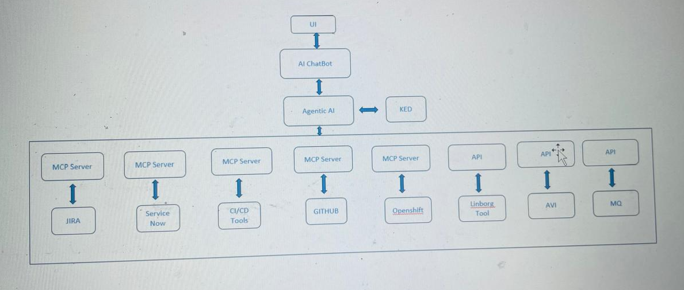
Our Proposed Solution
Agentic AI automates routine DevOps tasks by offering infrastructure details, outage banners, and migration metrics. It recommends documentation, enabling efficient operations and issue resolution.

Slide 5
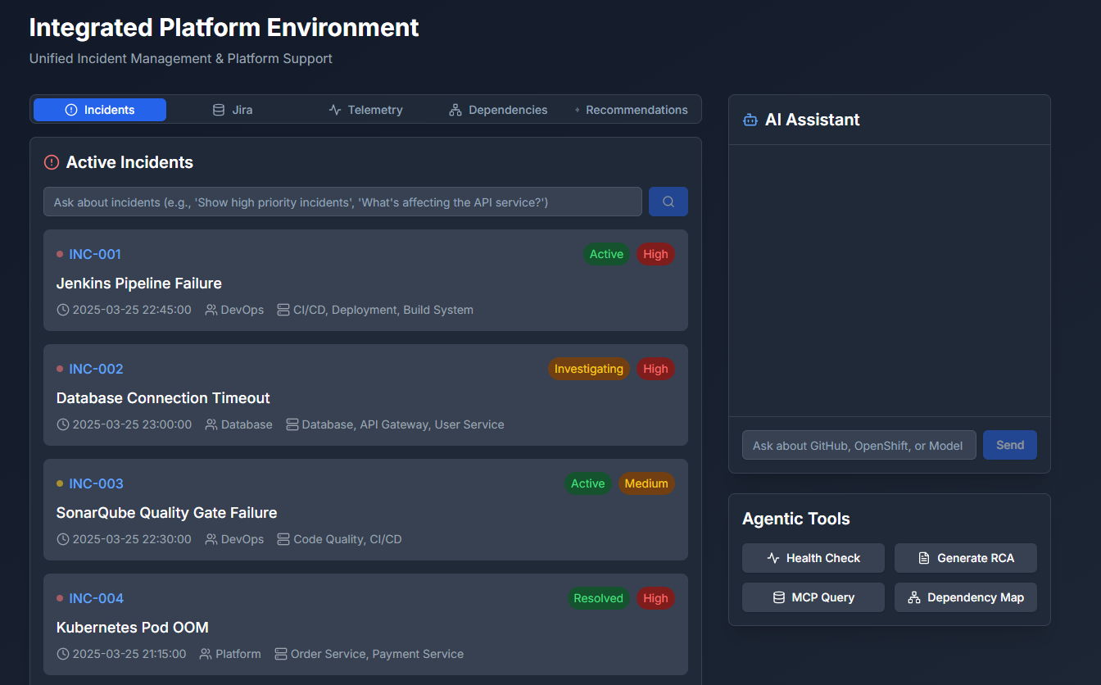
How IPE Console Helps
Seamless Integration: GitHub, OpenShift, Jira, alerts
Unified Interface: Tabs for Incidents, Jira, Telemetry, Dependencies, AI
Natural Language Querying: Ask contextual system questions
Real-time Incident Panel: Impact, priority, tagging
Agentic Toolset: Health checks, RCA, MCP, dependency maps

Slide 6
Core UI Features
Incidents Tab: Live feed, NLP filters, tagging
Jira Tab: JQL search, instant incident creation
Telemetry Tab: Env metrics with visual bars
Dependencies Tab: Health and latency of services
Recommendations Tab: AI-powered insights with actions

Slide 7
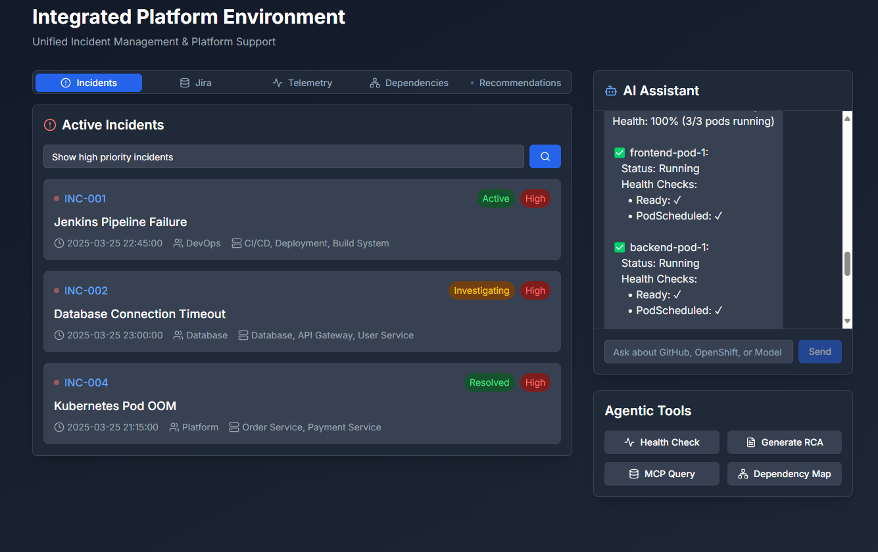
Incidents Tab
Live incident feed with priority/status badges
Filters based on NLP queries

Slide 8
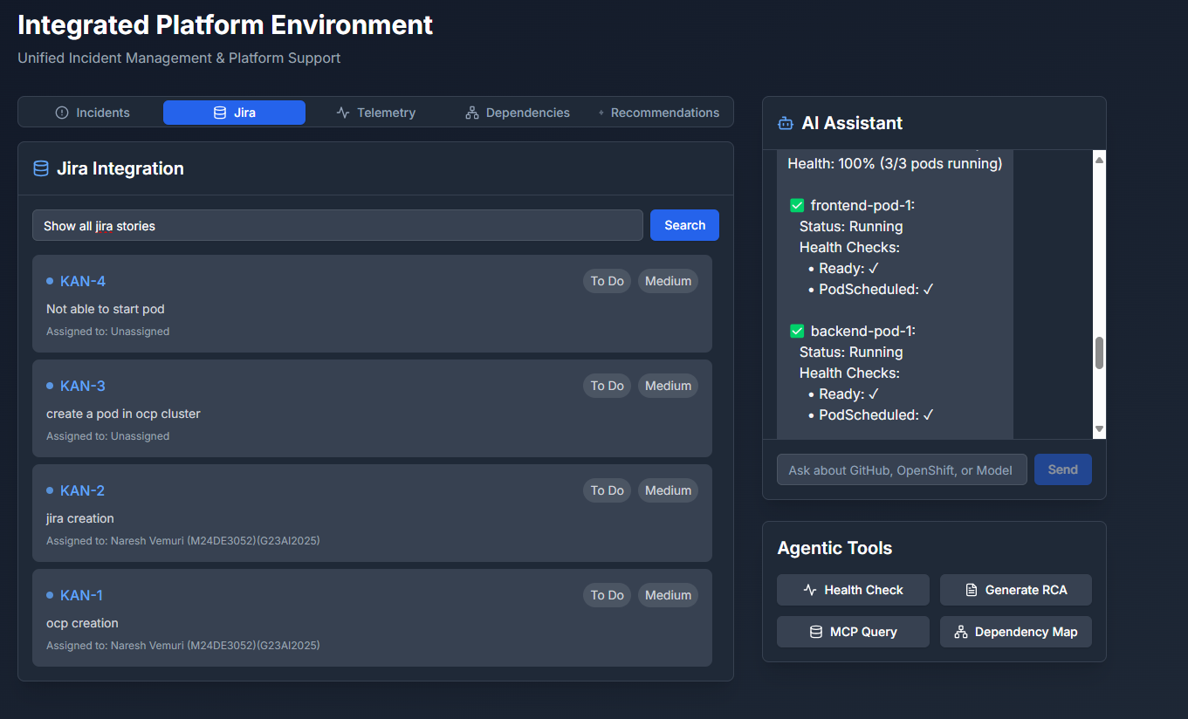
JIRA Tab
Gets the details of the stories from JIRA via MCP’s.
Based on the prompt given , search will be processed and results are shown.
Filters based on NLP queries

Slide 9
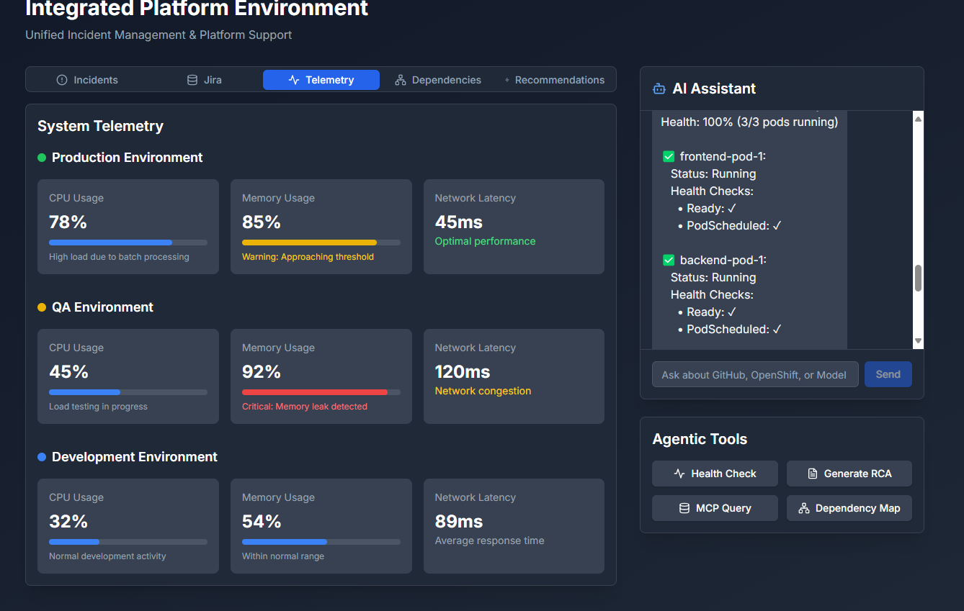
Telemetry Tab
Live reports of each resource quotas' in all environments based on MCP’s.
Environment-wise performance metrics
CPU, memory, latency usage with visual progress bars
Critical/warning indicators for quick triage

Slide 10
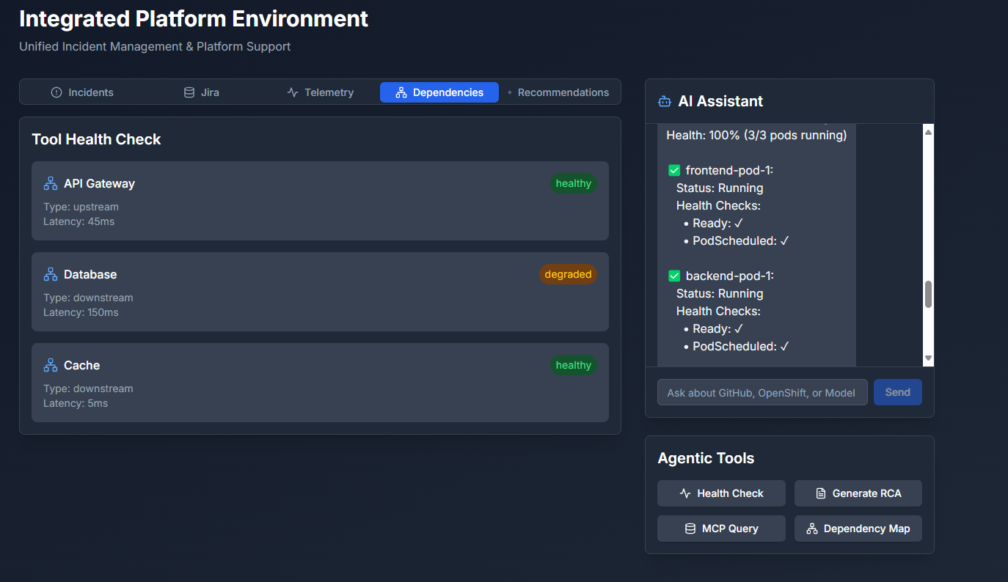
Dependencies Tab
Real-time health of upstream/downstream services
Latency and degradation highlights

Slide 11
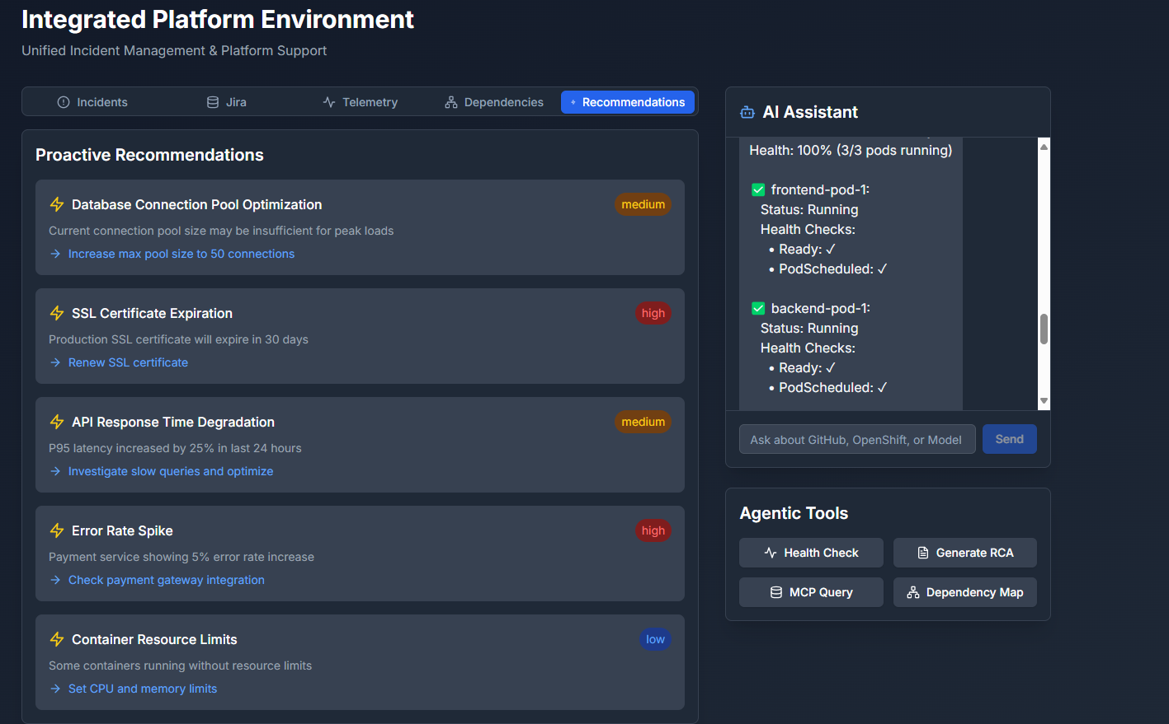
Recommendations Tab
AI-generated optimization, security, and performance suggestions
Severity-tagged insights and actionable recommendations

Slide 12
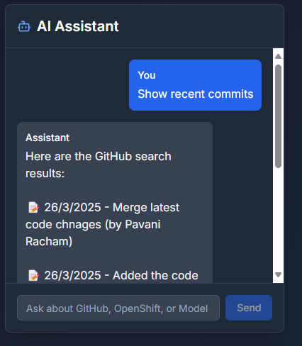
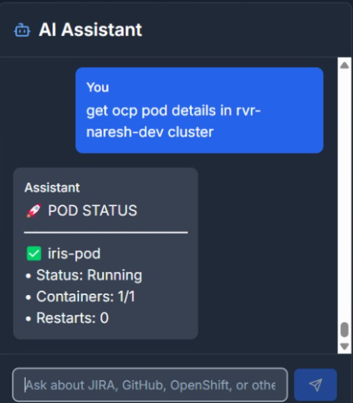
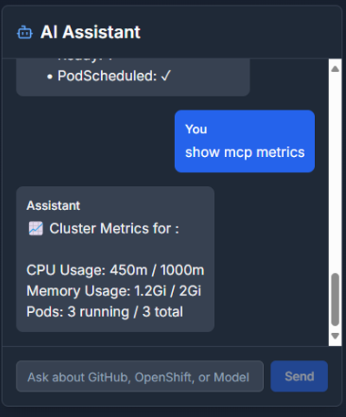
AI Assistant
Multimodal chat interface: GitHub, OCP, MCP Metrics, Jira, Jenkins, Splunk ,Kibana …
Chat interface with live streaming responses
Cross-platform query routing and summarization
GITHUB
OCP
MCP Metrics

Slide 13
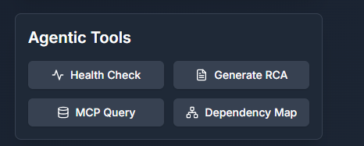
Agentic Tools
Health Check: Pod diagnostics
Generate RCA: Auto-filled from incident context
MCP Query: Command-based checks
Dependency Map: Visual service impacts

Slide 14
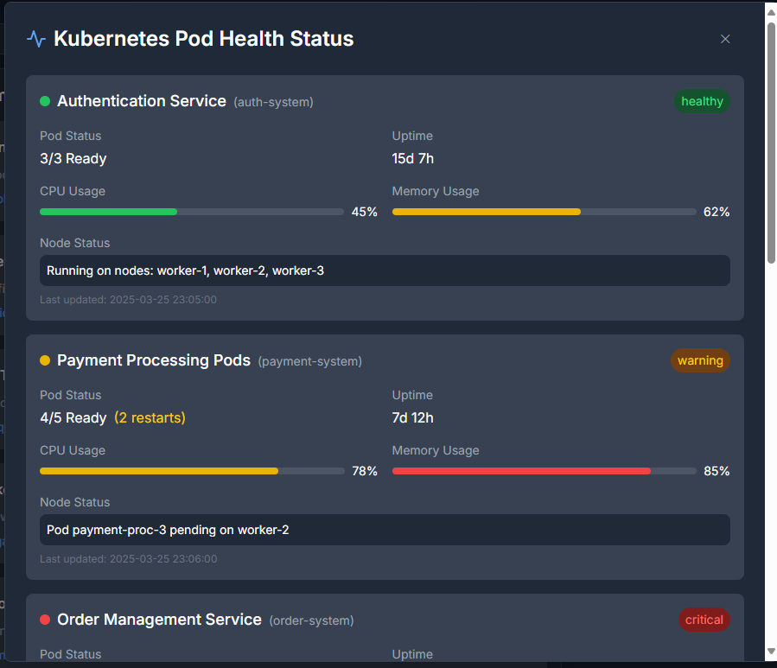
Health status
Agentic Toolset: One-click health checks, RCA generation, MCP querying, and dependency map exploration

Slide 15
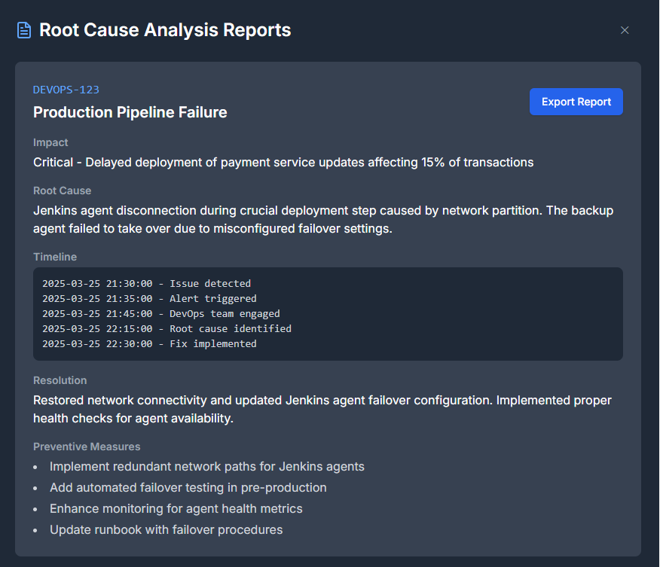
RCA
Auto-filled root cause analysis reports from incident context

Slide 16
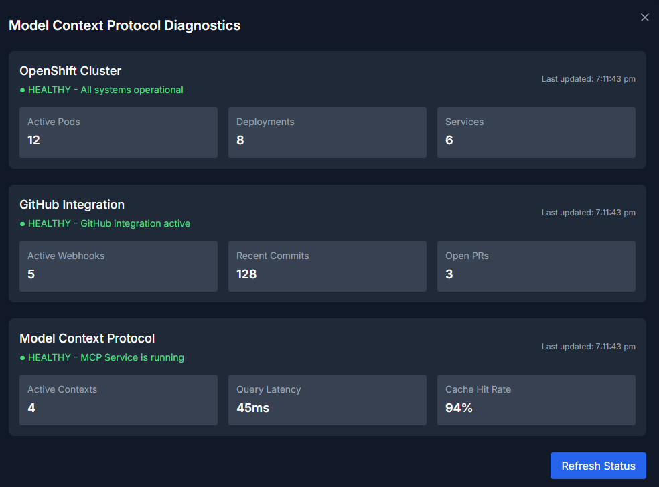
MCP Query
Model Context Protocol diagnostics via system commands (e.g., STATUS service.health)

Slide 17
Technical Stack
- Frontend: React 18, TypeScript, Tailwind CSS, Framer Motion
- State & Logic: Context-based search, LLM handlers
- AI: GPT-4, contextual NLP
- Integrations: Jira, GitHub, OpenShift, MCP

Slide 18
Links
GitHub: https://github.com/ewfx/gaipl-i-r-i-s

Slide 19
Conclusion
The IPE Console is production-ready, combining automation, observability, and security for cloud-native DevOps teams. It enables real-time insights, high performance, and extensibility for platform operations.

