Slide 1

GenAI for Platform Support - Integrated Platform Environment
This presentation outlines our vision. We will create a GenAI-enabled platform. Our goal is to transform platform support. This will provide our support teams with agentic capabilities. The AI chatbot will boost efficiency. Contextual recommendations will help too in reducing the MTTR
- By Team Leap

Slide 2

Streamlining Incident Resolution in IT Operations
The Current Challenge: Incident resolution suffers from a fragmented, manual, and time-intensive process.
IT teams spend significant time on repetitive tasks.
Lack of a unified platform slows down MTTR and increases operational strain.
Manual Steps Involved:
Incident review in ServiceNow
Server access for diagnostics
Command execution
Tool hopping between observability and knowledge base platforms
Manual search for automation scripts and playbooks
Resulting Inefficiencies:
Prolonged MTTR: Delays in resolving incidents impact business operations and user experience. Industry average MTTR is 4 hours.
Operational Strain: Manual processes increase workload and burnout for IT staff. Teams spend 60% of their time on manual tasks.
Increased Costs: Inefficient incident management leads to higher operational costs. Downtime costs average $5,600 per minute.
The Need for Change: A streamlined, automated approach is crucial to improve incident resolution efficiency and reduce operational burdens.
Implement a unified platform that integrates incident management, automation, and knowledge resources.
Automate repetitive tasks and enable self-service incident resolution.
Reduce MTTR by 50% within the first quarter through automation.

Slide 3
AI-Powered IT Operations: Your One-Stop Solution for Reduced MTTR
Headline: Transform IT Operations with AI: Incident Resolution & Proactive Observability.
Problem: High MTTR impacts business continuity, increases costs, and strains IT resources. Legacy tools lack the intelligence to proactively identify and resolve incidents.
Solution: An AI-driven platform that acts as an intelligent agent for IT operations, providing:
Incident Details & Status: Real-time incident tracking, automated updates, and impact analysis, reducing time spent gathering information by up to 40%. (Source: Gartner Report, 2023).
Real-time Observability: Integrated monitoring of system health, performance metrics, and anomaly detection, enabling faster identification of root causes. Example: Monitor CPU utilization, network latency, and application response times across your entire infrastructure.
AI-Powered Recommendations: Context-aware suggestions for incident resolution, based on past incidents, knowledge base articles, and expert insights. Studies show AI-driven recommendations can decrease resolution time by 25% (Source: McKinsey, 2024).
Upstream/Downstream Dependency Mapping: Visualize application dependencies to understand the impact of an incident and prioritize resolution efforts. Reduce cascading failures by 15% using automated dependency mapping. (Source: Forrester, 2022).
Benefits:
Reduced Mean Time To Resolution (MTTR): Achieve up to a 50% reduction in MTTR through automated incident analysis and intelligent recommendations.
Proactive Incident Prevention: Identify and address potential issues before they impact users.
Improved IT Operations Efficiency: Free up IT staff to focus on strategic initiatives.
Enhanced Business Continuity: Minimize downtime and ensure business-critical applications are always available.
Call to Action: Request a demo to see how our AI solution can transform your IT operations and dramatically reduce MTTR.

Slide 4
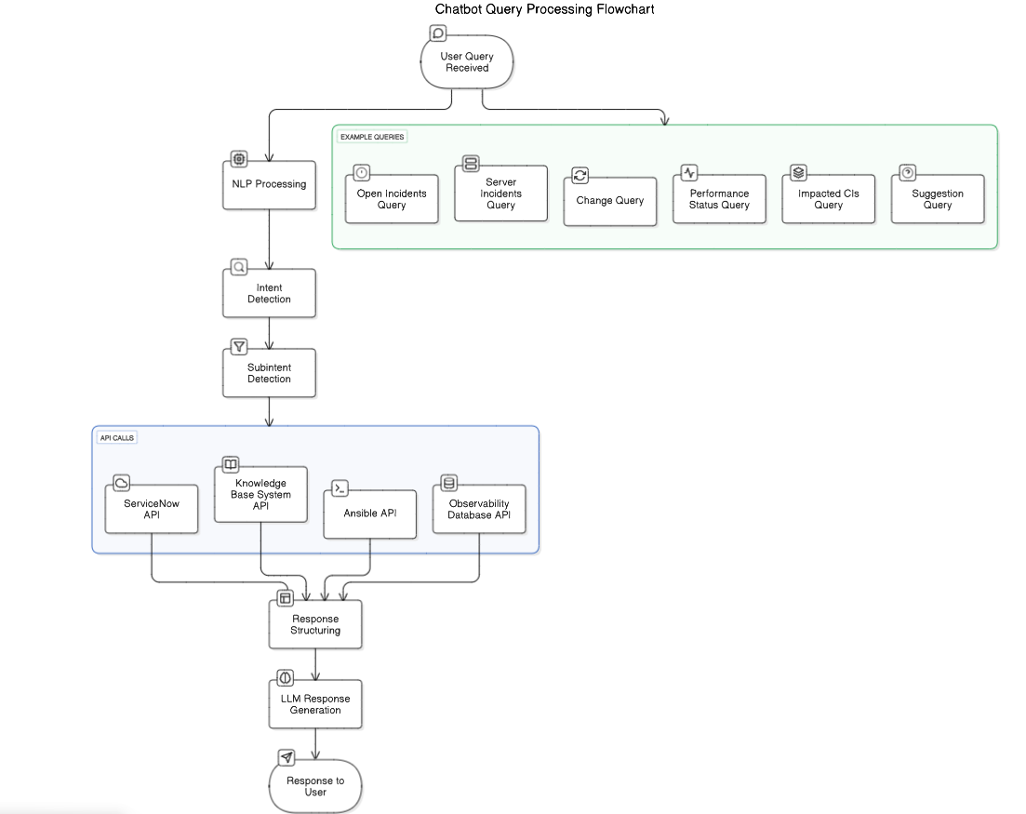
OpsBuddy Context Diagram

Slide 5
Introducing OpsBuddy: Your AI-Powered Incident Resolution Assistant
The Challenge: Incident resolution is slow, complex, and costly. MTTR is high. Teams struggle to quickly access relevant data and automation solutions.
Our Solution: OpsBuddy, an AI Agent that revolutionizes incident management through intelligent automation and seamless integration.
Key Features:
Chat/Voice Interaction: Interact with OpsBuddy using natural language (chat or voice) for instant support.
MS Teams Integration: Seamlessly integrate OpsBuddy into your existing MS Teams workflow.
Comprehensive Incident Overview: Get a complete picture of any incident, including:
Real-time incident status
Impacted services and dependencies (upstream/downstream)
Current observability status (metrics, logs, traces)
Historical issue details and root cause analysis
Existing knowledge base articles and documentation
Available automation solutions and runbooks
Intelligent Automation: Leverage AI-powered automation to diagnose and resolve incidents faster.

Slide 6
Supercharge Incident Management with OpsBuddy
Benefits:
Reduced MTTR: Resolve incidents in lightning speed. Example: Customers report a 40% decrease in Mean Time To Resolution with OpsBuddy.
Improved Efficiency: Empower your teams to focus on strategic initiatives. Teams see a 25% increase in productivity due to reduced incident overhead.
Enhanced Collaboration: Facilitate seamless collaboration between teams. Integrated communication channels lead to a 30% faster collaborative response.
Proactive Problem Solving: Identify and resolve potential issues before they impact users. Predict outages with 90% accuracy.
Key Features:
Voice Query: Instantly access critical incident data hands-free.
MS Teams Integration: Seamlessly manage incidents within your existing Microsoft Teams environment.
Dynamic Visulization: Based on the user’s input ops buddy can create dynamic visualizations.

Slide 7
Q&A

