Slide 1

Gen AI Enabled Integrated Platform Environment

Slide 2

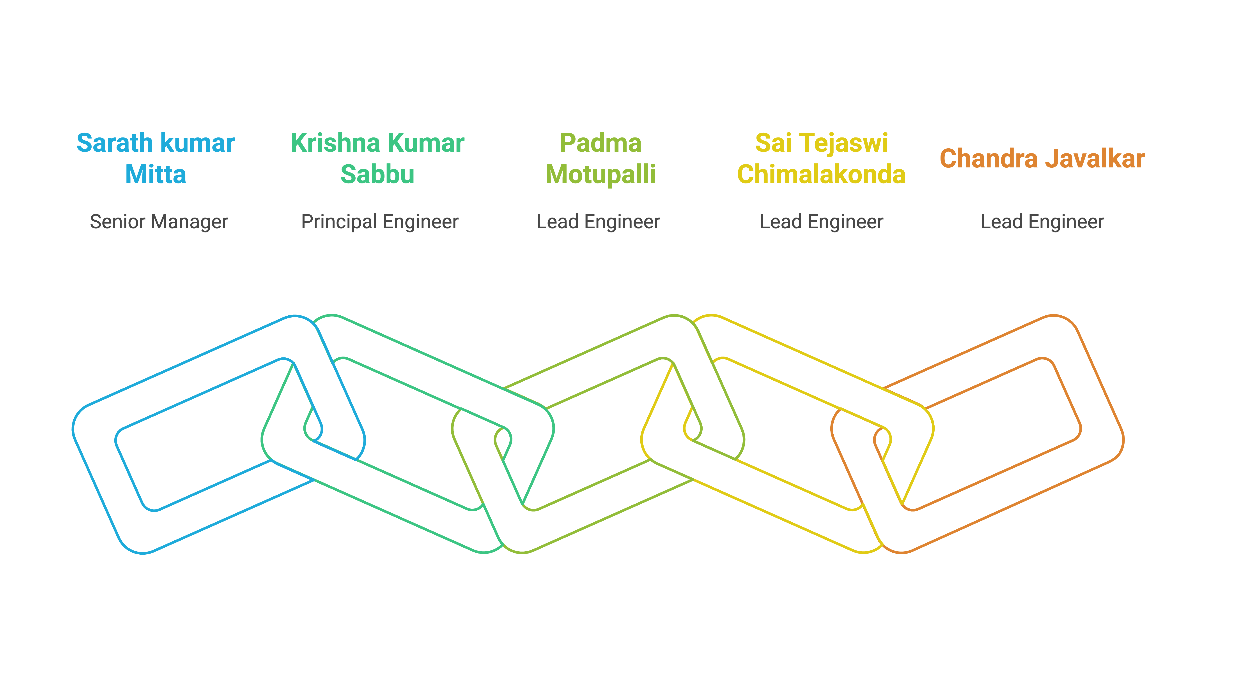
Team Mind Over Machines

Slide 3








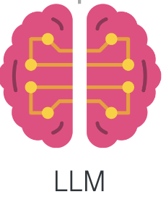







Design
Integrations Layer
Agentic Layer
Metrics
Hugging Face Model
context
prompt
< / > Vector
Embeddings
Python
Chatbot
response
response
Actions
User
Elastic Search
Llama(70B)
start/stop ansible script
Incidents
Observations
C
Web Layer
Model Layer
Email

Slide 4
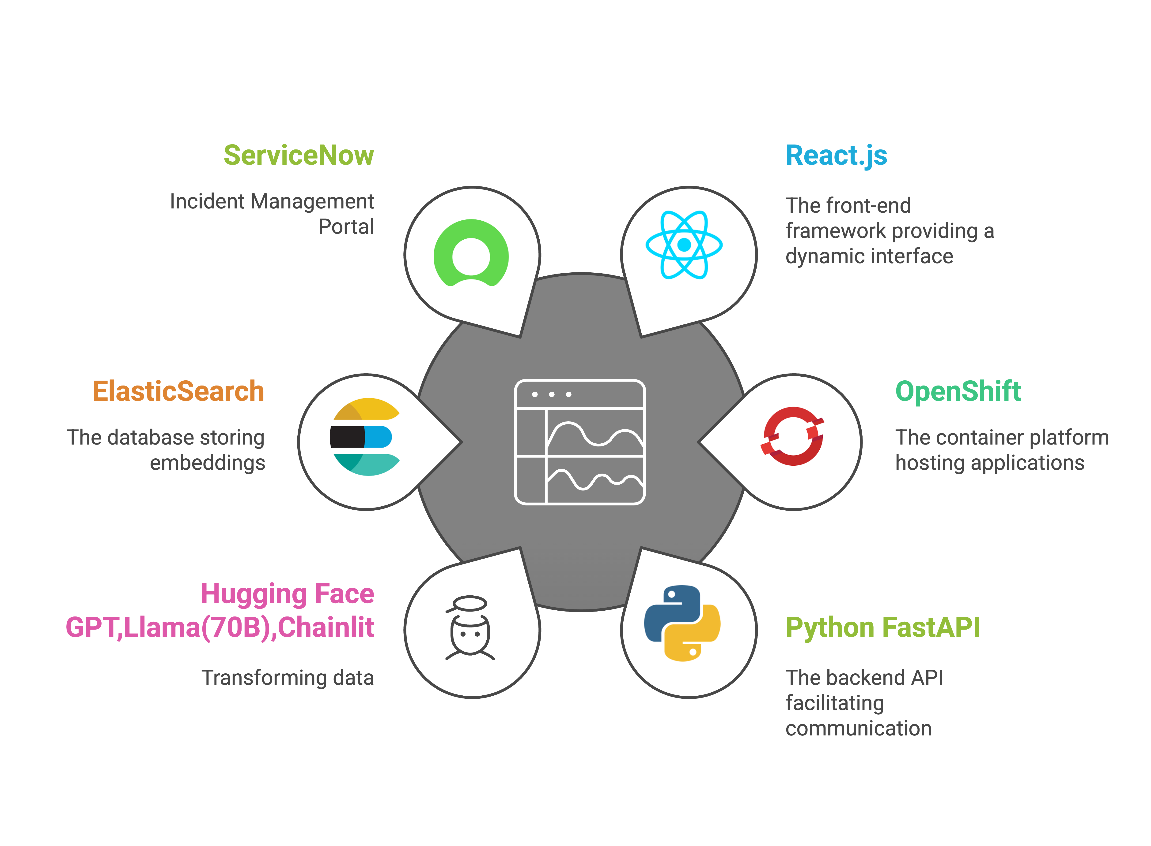
Tech Stack

Slide 5
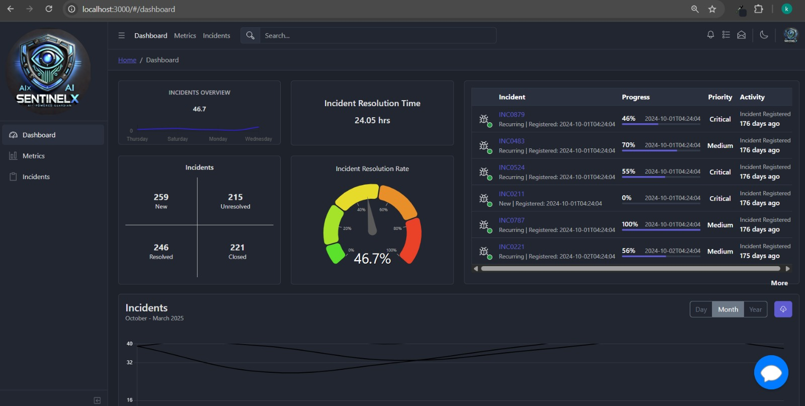

Dashboard

Slide 6
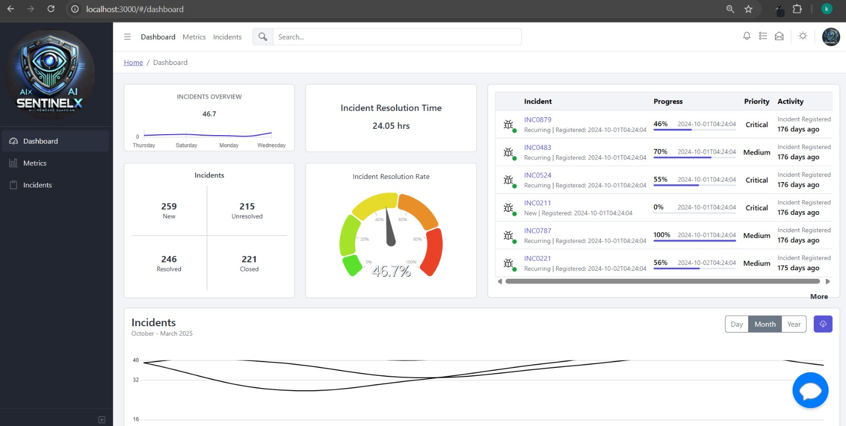
Dashboard [light]

Slide 7
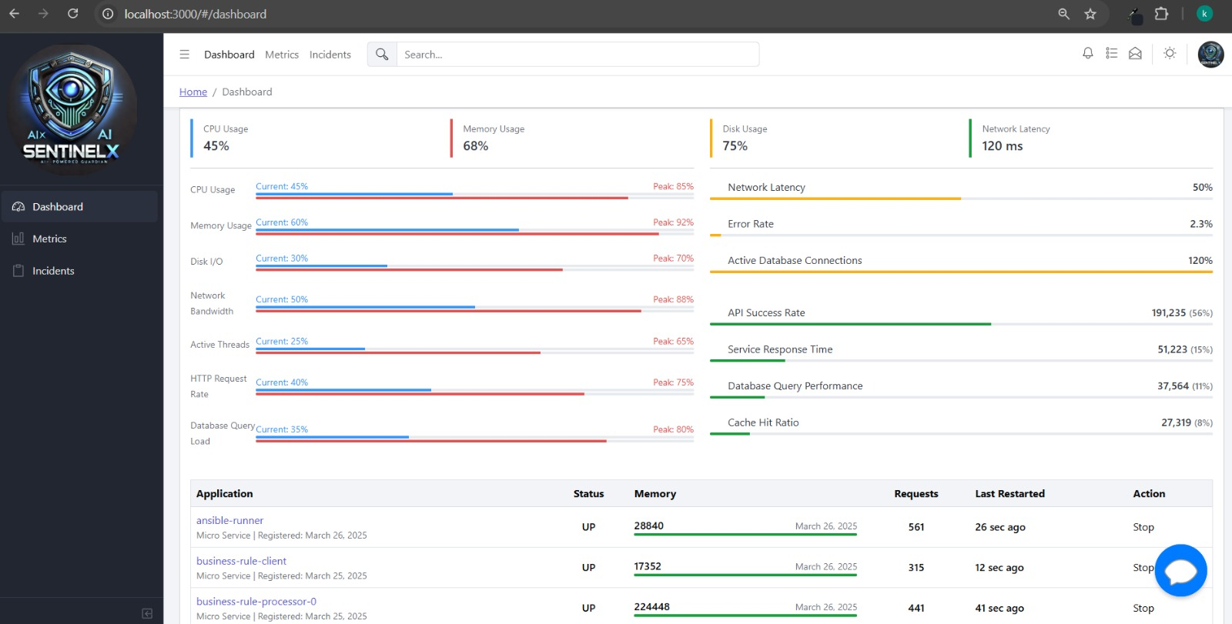
Dashboard [Continued]

Slide 8
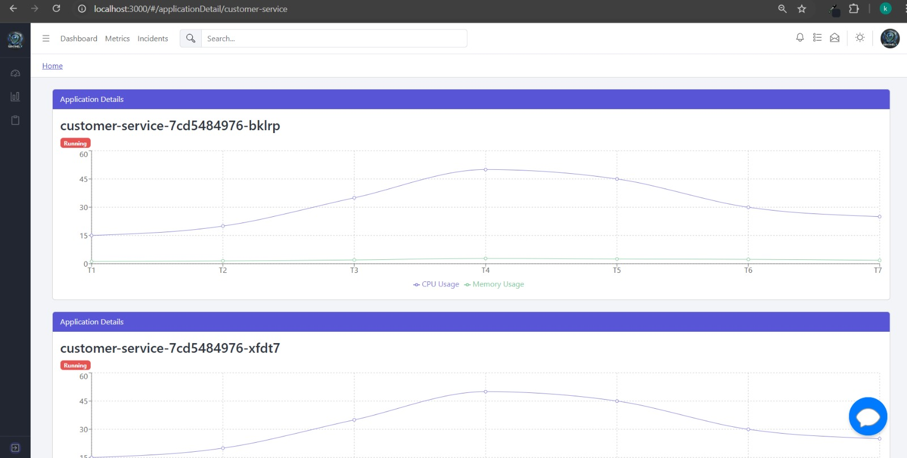
Dashboard [Continued]

Slide 9
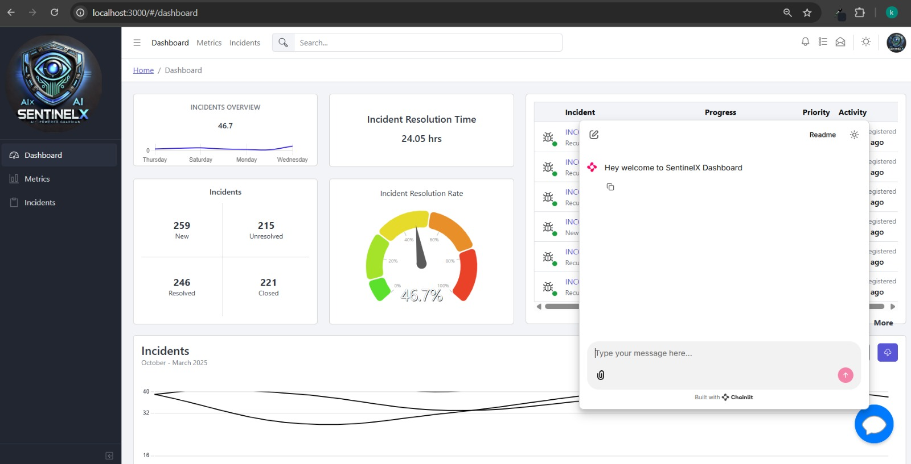

Dashboard Chatbot

Slide 10
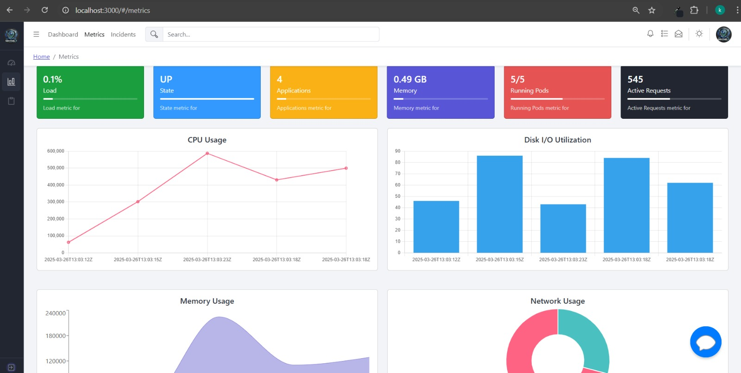
Metrics

Slide 11
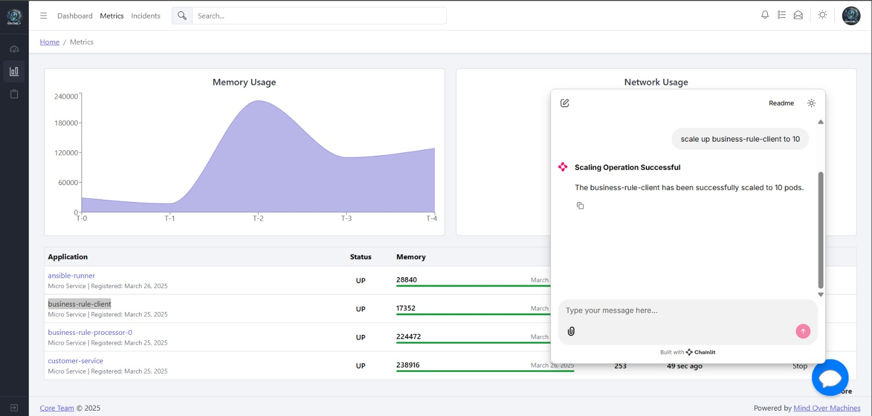
Metrics [Continued]

Slide 12
Metrics Chatbot

Slide 13
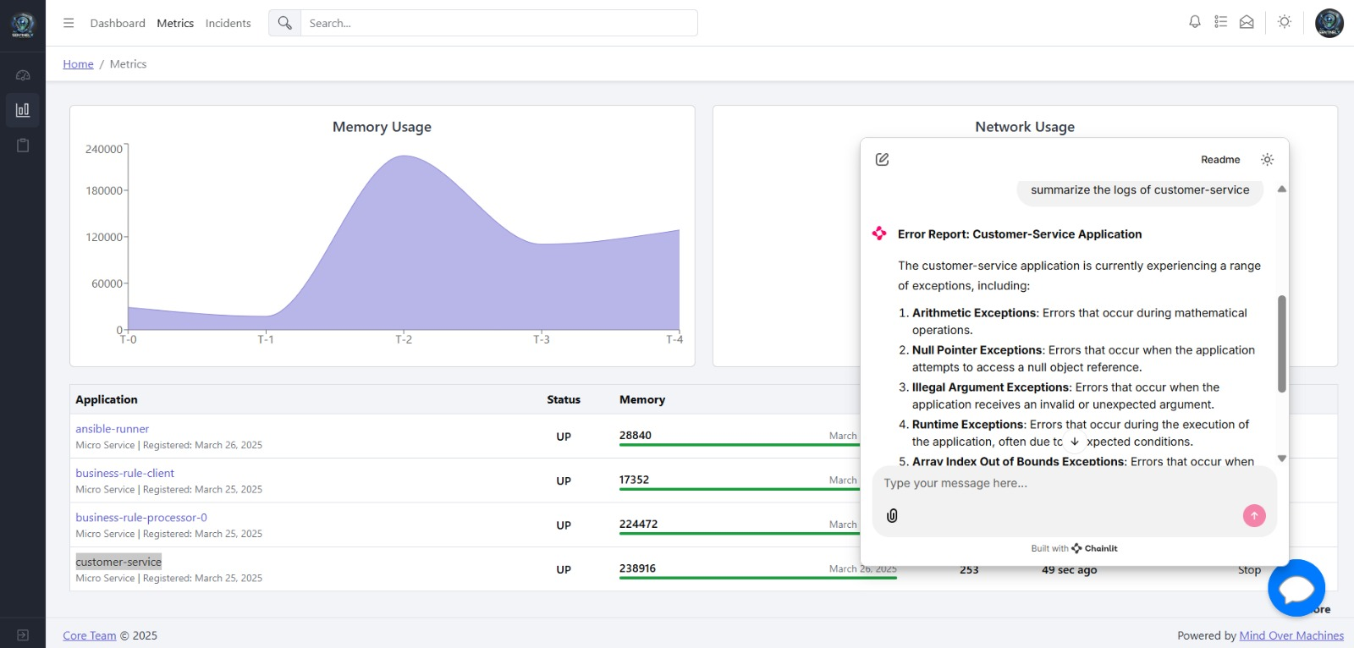
Metrics Chatbot [continued]

Slide 14
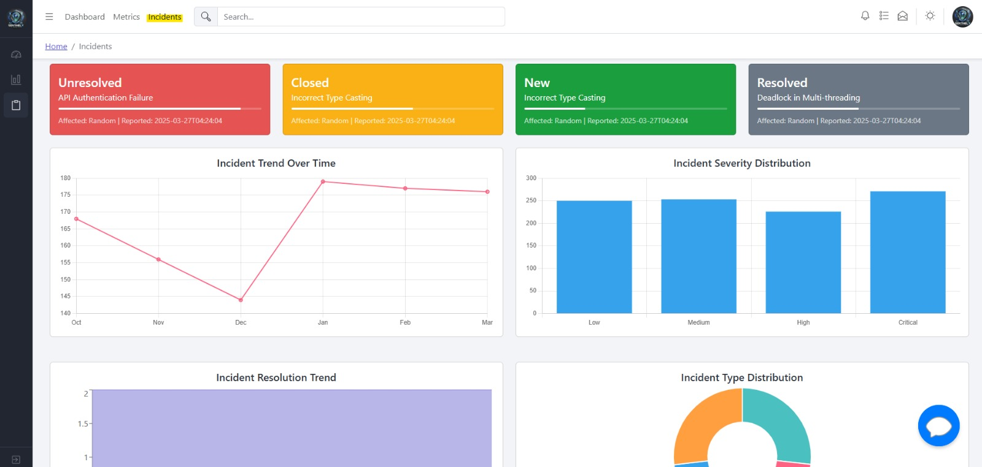

Incidents

Slide 15
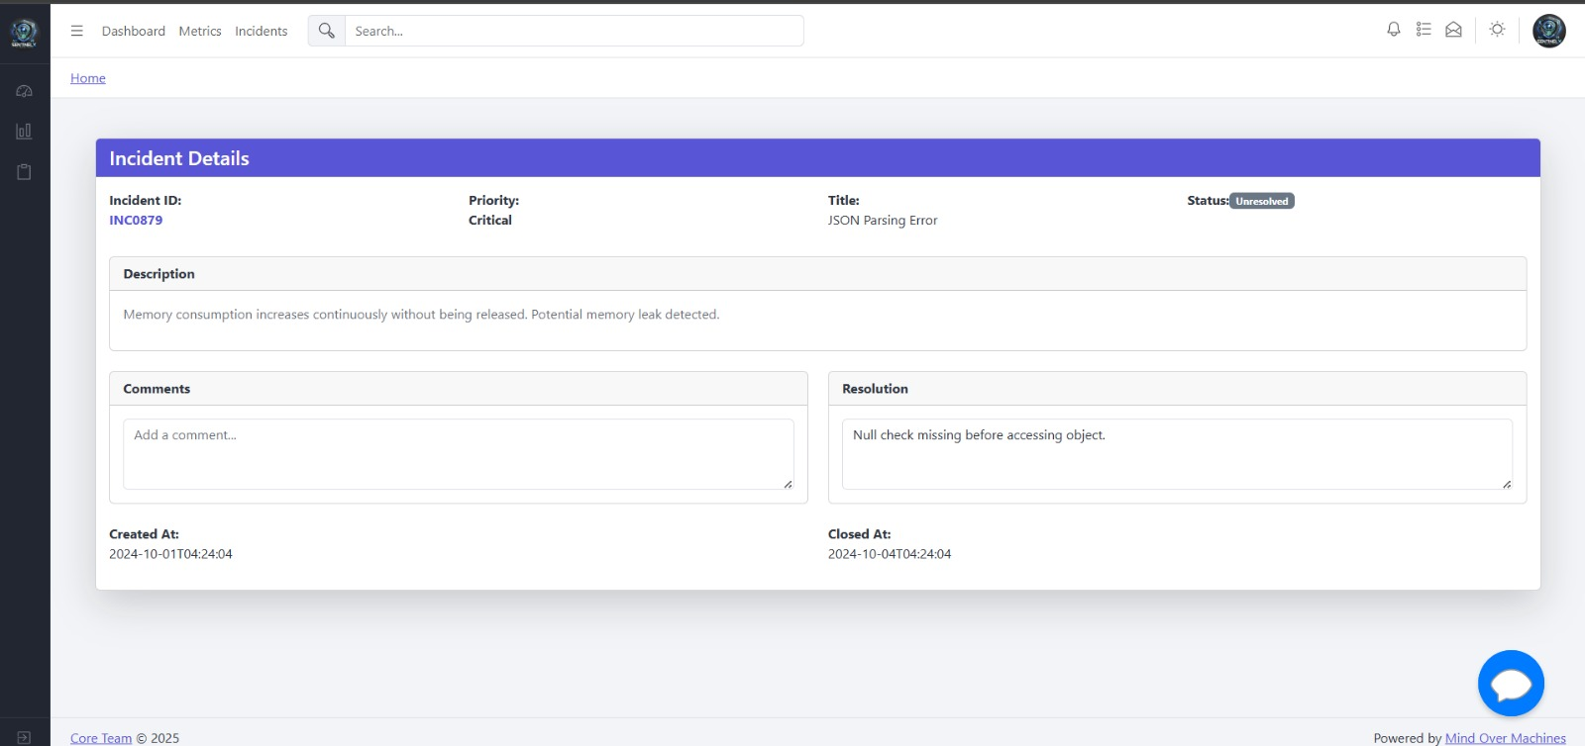
Incidents Details

Slide 16
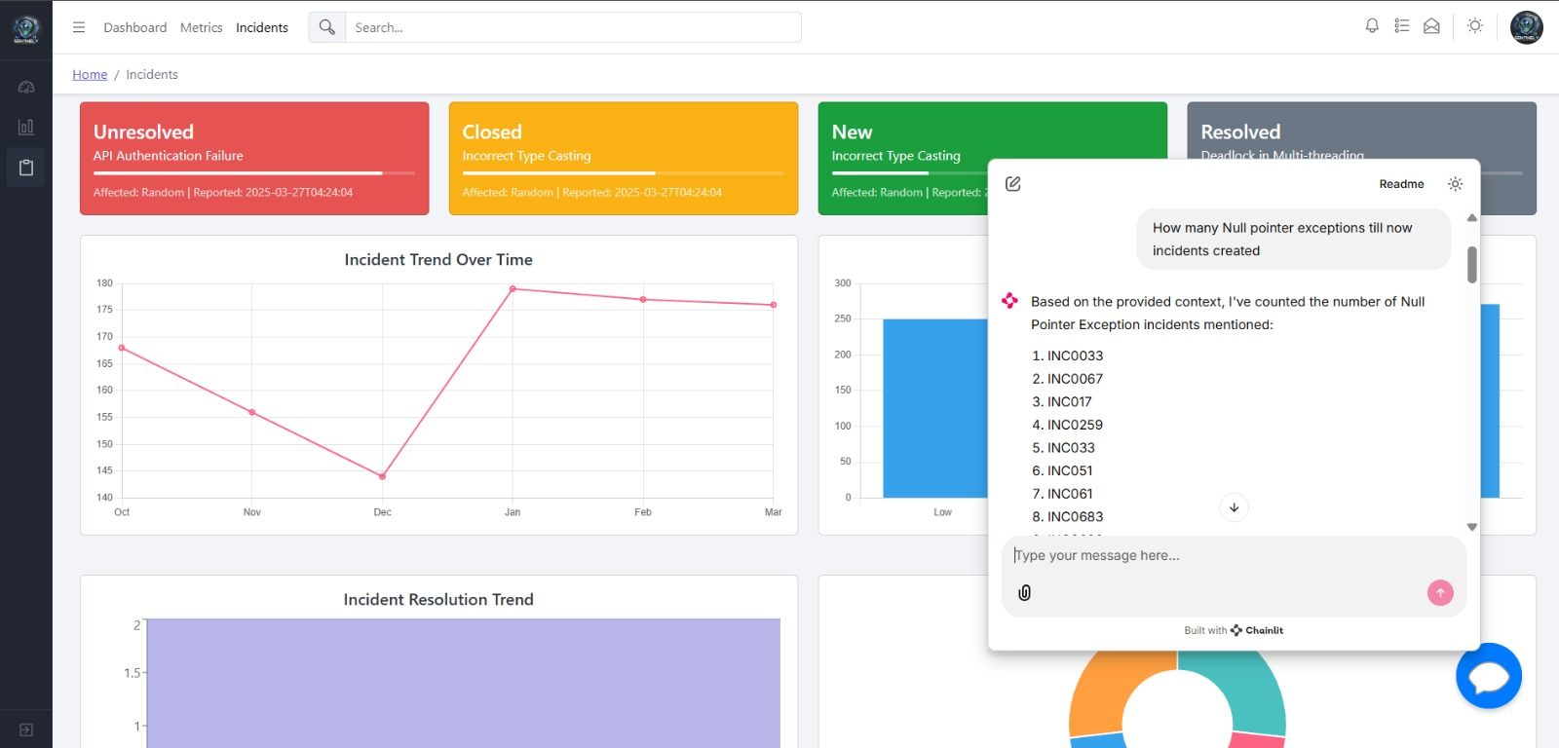
Incidents Chatbot

Slide 17
Incidents Chatbot [continued]

Slide 18





Advantages
Proactive Management
Efficient Incident Resolution Management
Knowledge Integration
Scalability
Automation

Slide 19
Thank you
“Empowering Platforms with AI Intelligence”

