Slide 1
GEN AI HACKATHON
Gen AI enabled Integrated Platform Environment
NEURAL NORM Abhishek , Sajeev, Pallavi, Varun

Slide 2
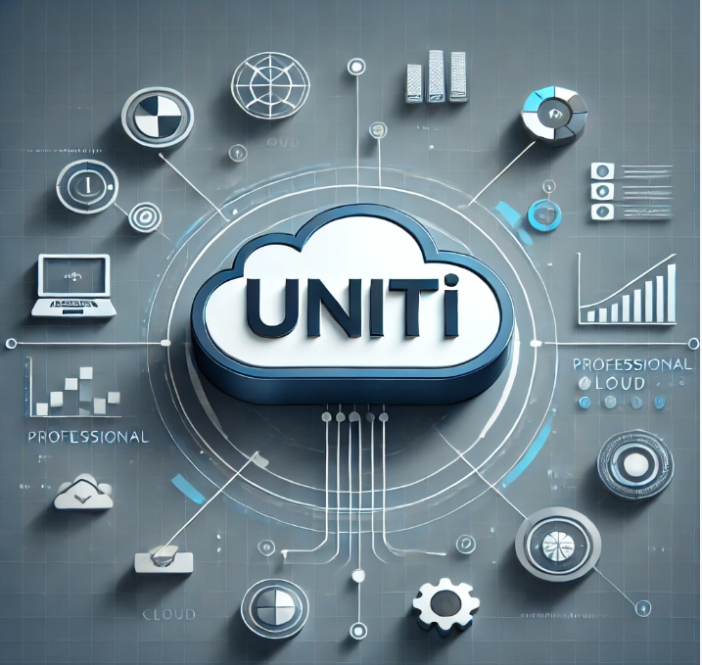
UNITI (Unified Networked Infra & Tech Intelligence)
IT operations can be overwhelming -
Incidents pile up
Related issues are scattered across different systems
Engineers spend hours manually troubleshooting problems.
Our project is designed to make life easier for system engineers by bringing everything they need into one intelligent, AI-powered assistant.

Slide 3
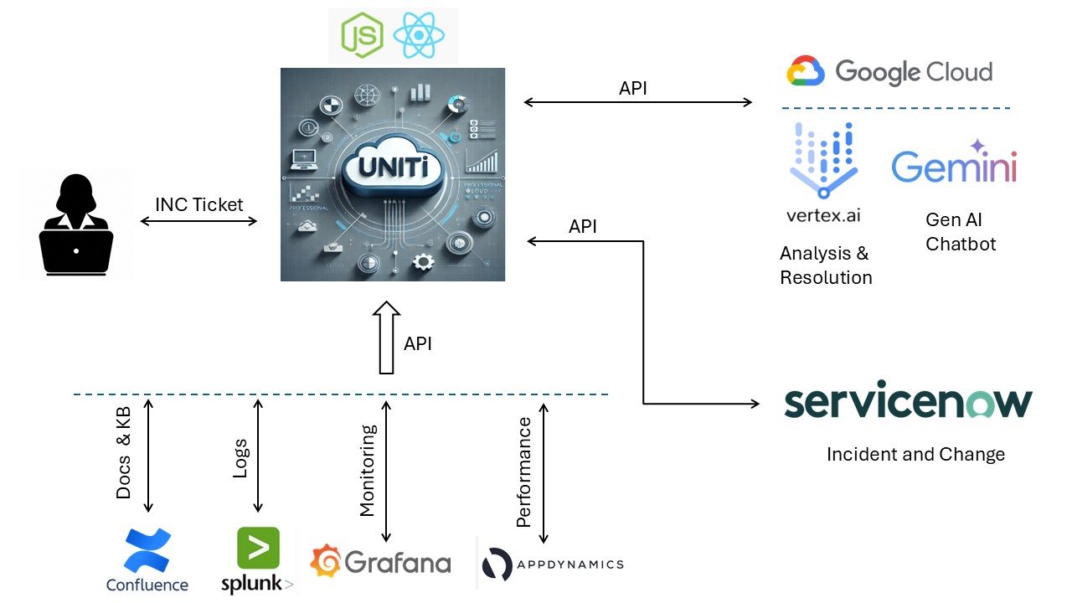
ARCHITECTURE OF UNITI

Slide 4
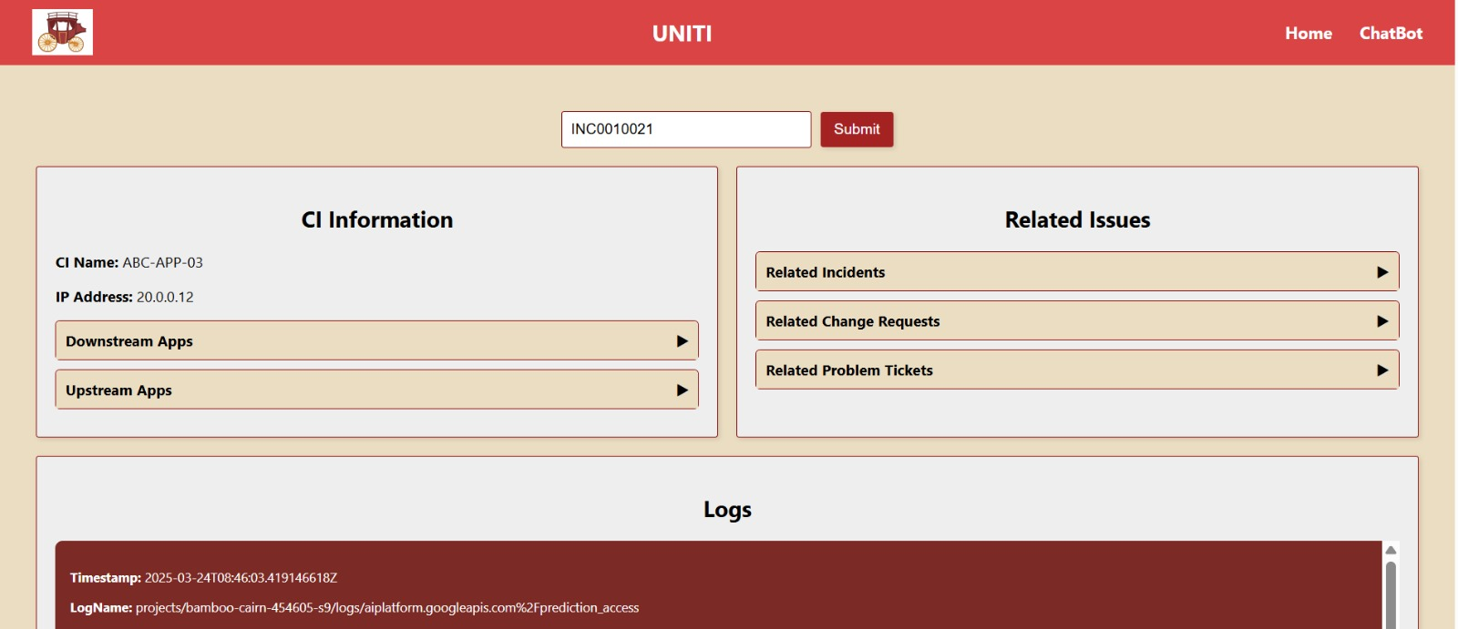
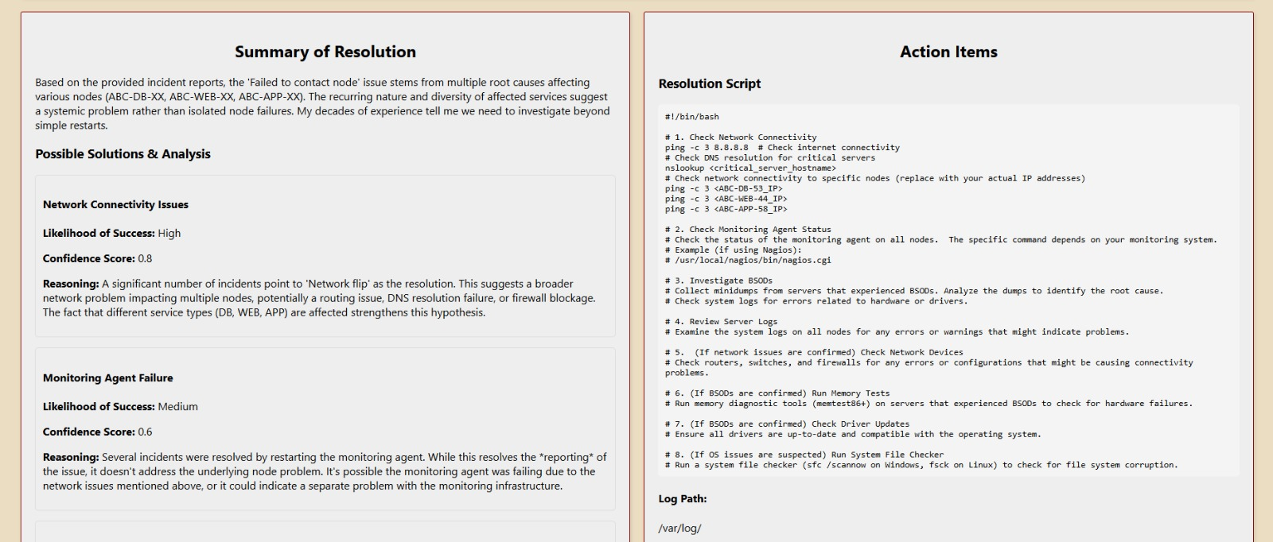
Features
ServiceNow API Integration:
Seamless connectivity with ServiceNow for streamlined operations and incident management.
Google Vertex LLM:
Leverage the power of Google’s Vertex Large Language Model for intelligent insights and automation.
Google Gemini 2.0 Chatbot
Advanced conversational AI for efficient communication and issue resolution.

Slide 5
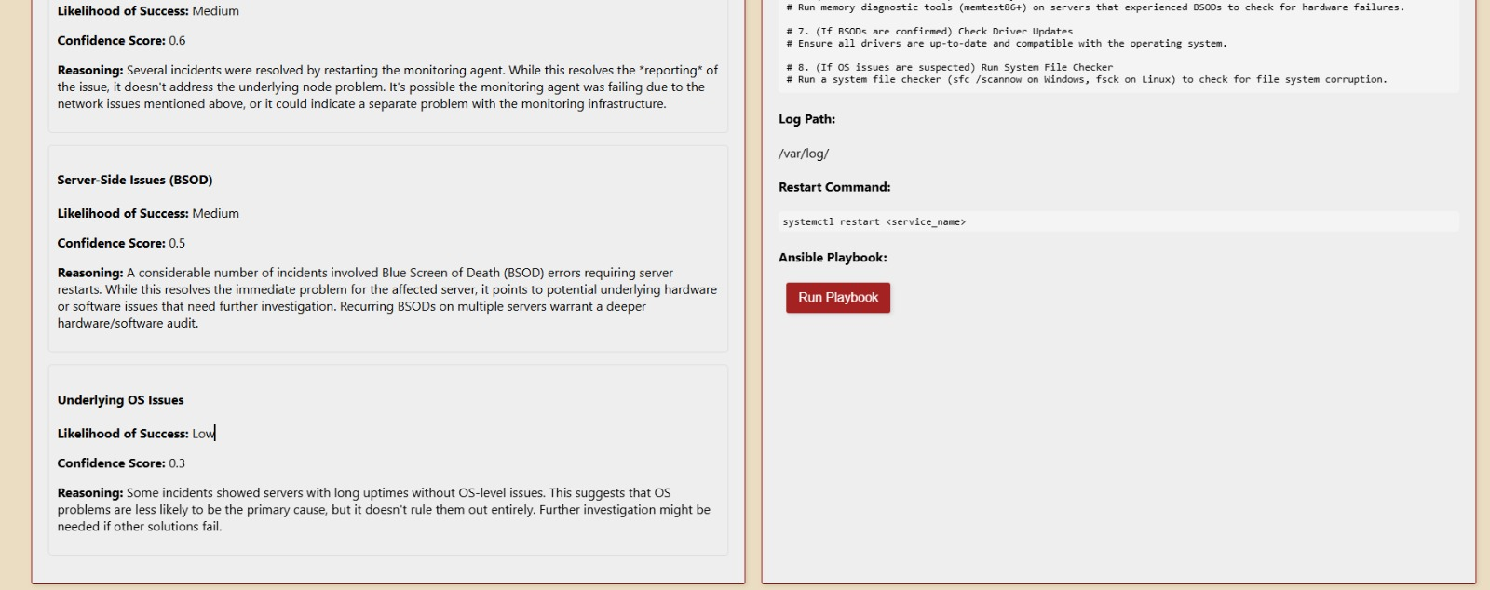
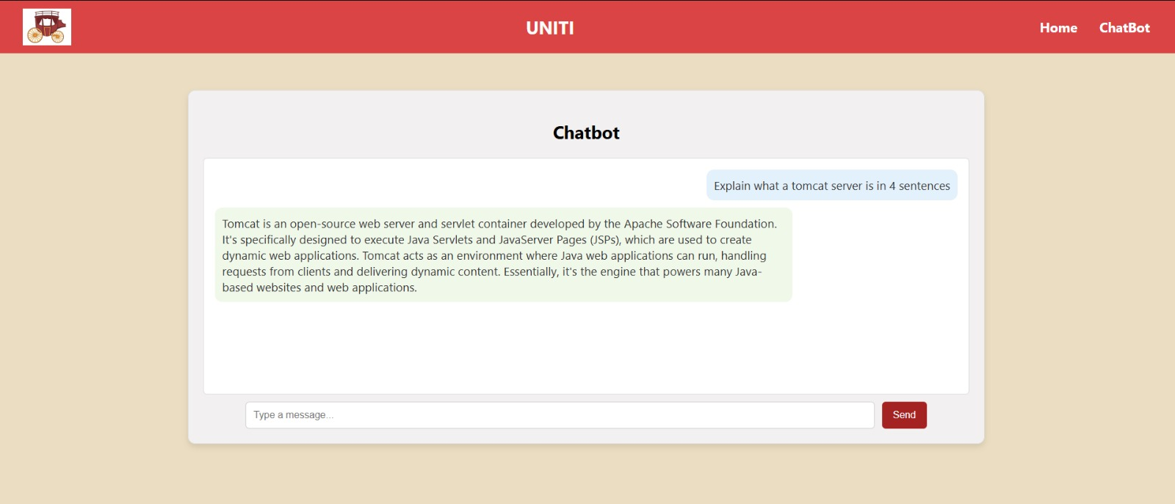
Functionalities
Unified Information Hub for System Engineers:
A single pane of glass for system engineers to access critical data and insights.
Contextual Incident, Change, and Problem Correlation:
Automatically links related incidents, changes, and problems for faster issue resolution.
Telemetry Data Insights for CIs:
Telemetry data associated with Configuration Items (CIs) for better decision-making and proactive maintenance.
AI-Driven Incident Resolution:
Utilize AI-powered Large Language Models to propose accurate solutions for incidents, reducing manual intervention.
Automated Remediation with AI-Curated Scripts:
Remediate issues efficiently using AI-generated scripts, ensuring quick and precise actions.
Ansible Integration for Playbook Execution:
Seamlessly integrate Ansible for the execution of pre-defined automation playbooks, accelerating problem resolution.

Slide 6
How we Built It?
Technologies
Javascript
REST API
Google Vertex AI
Google Gemini
ServiceNow
Tools
Visual Studio Code
PowerShell
Google CLI
GPT4

Slide 7
THANK YOU

