Slide 1

Wells Fargo Technology Hackathon 2025
Seagulls
- sky is the limit
Gen AI for Platform Support – Integrated platform Environment
Seª_{g}ullsV25
Trivia – each letter used in SeagullsV25 is written using different font, font size, style and font color ☺
Jarvis- One stop AI solution for Platform Support

Slide 2


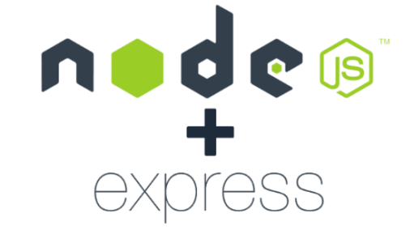



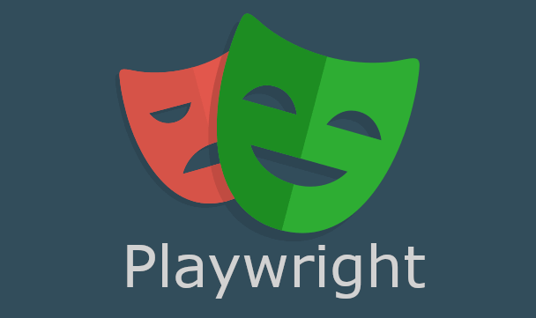



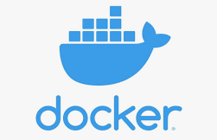
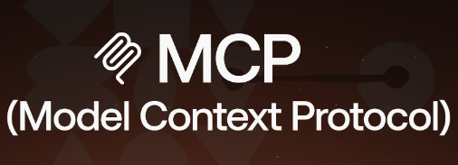

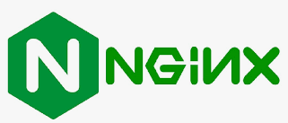
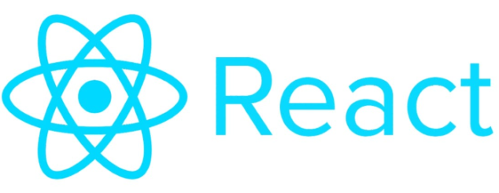
Jarvis- Diversified Technology Stack

Slide 3
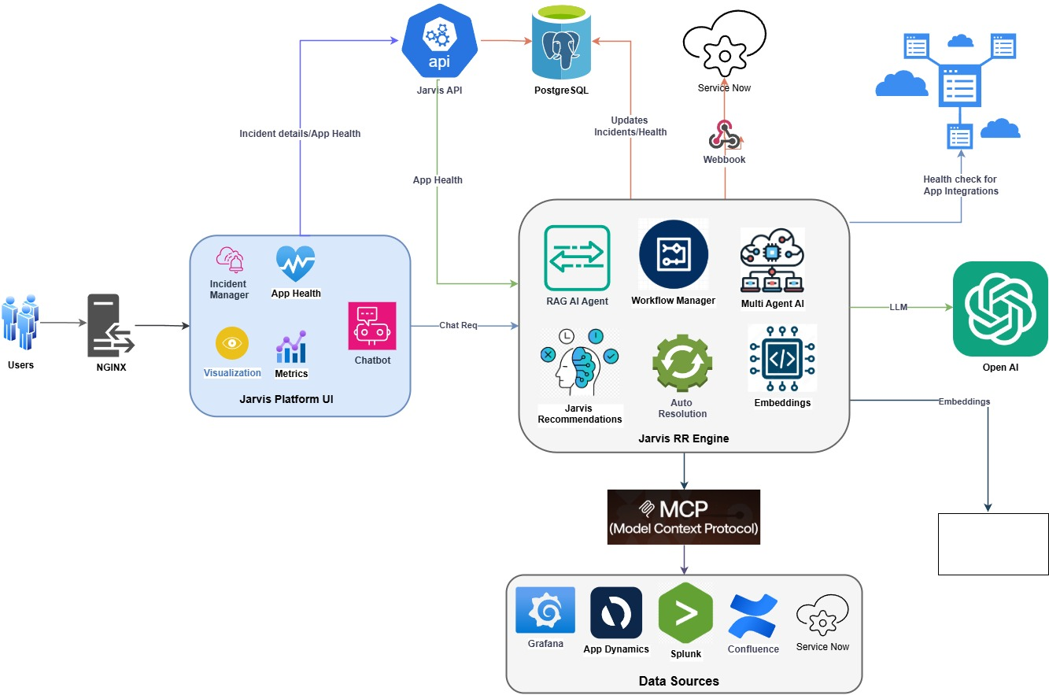
Jarvis- Architecture

Slide 4
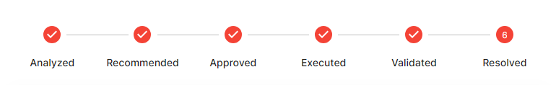
“Jarvis” summary
Problem Statement:
Develop a gen-AI enabled Integrated platform environment that provides an integrated console to platform support
Novelty:
Self-healing and automated incident resolution in ServiceNow using GenAI-driven workflows.
Real-time data synchronization for new incidents and data source updates into a vector database.
Configurable workflows for RAG-based retrieval and data synchronization.
Multi-agent orchestration to streamline task delegation and execution.
Application and dependency health dashboard for enhanced monitoring.
Portfolio health view tailored for managers and leadership teams.
Comprehensive platform metrics to track key capabilities and performance.
Integrated, customizable toolkit (e.g., Docker) with framework-supported workflows.
Solution:
GenAI-powered workflows to enhance key platform capabilities.
Webhook integration with ServiceNow to trigger GenAI workflows for proactive recommendations, RCA summaries, and resolutions.
User-friendly UI with an AI-powered chatbot, offering incident management, triaging, and resolution capabilities, along with additional features to streamline daily operations..
Seamless data integration from enterprise tools like ServiceNow, Grafana, Splunk, and Confluence.
MCP-enabled architecture for efficient context management and smooth integrations.
APIs for easy integration between the UI and GenAI workflows.

Slide 5
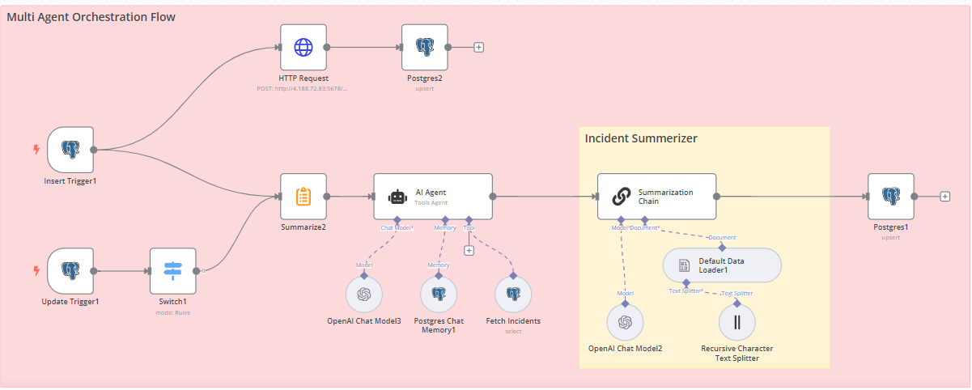
Multi Agent Orchestration workflow

Slide 6
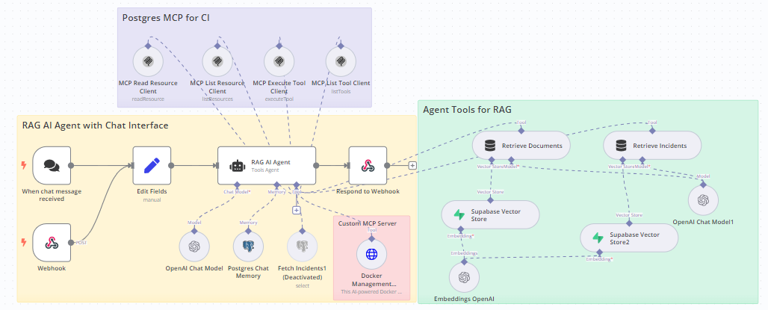
Incident Recommendation & Resolution MCP workflow

Slide 7
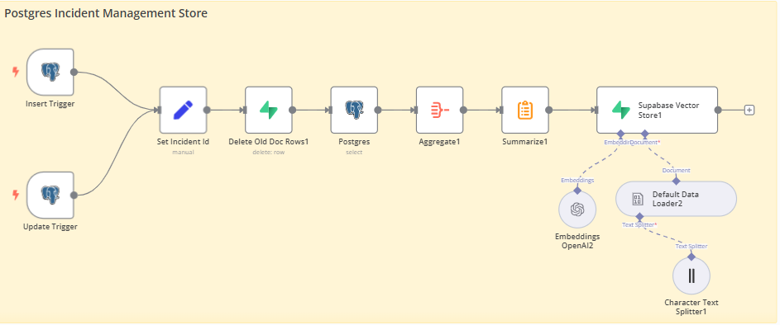
Incident data sync workflow

Slide 8
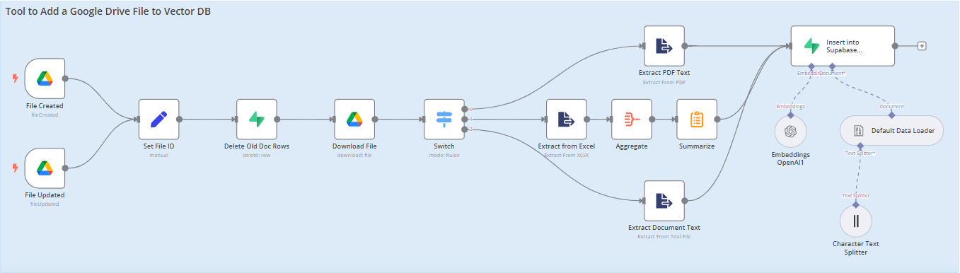
Knowledge source data sync workflow

Slide 9
Challenges
GenAI-powered workflows to enhance key platform capabilities.
Webhook integration with ServiceNow to trigger GenAI workflows for proactive recommendations, RCA summaries, and resolutions.
User-friendly UI with an AI-powered chatbot, offering incident management, triaging, and resolution capabilities, along with additional features to streamline daily operations..
Seamless data integration from enterprise tools like ServiceNow, Grafana, Splunk, and Confluence.
MCP-enabled architecture for efficient context management and smooth integrations.
APIs for easy integration between the UI and GenAI workflows.

Slide 10
Results

Slide 11
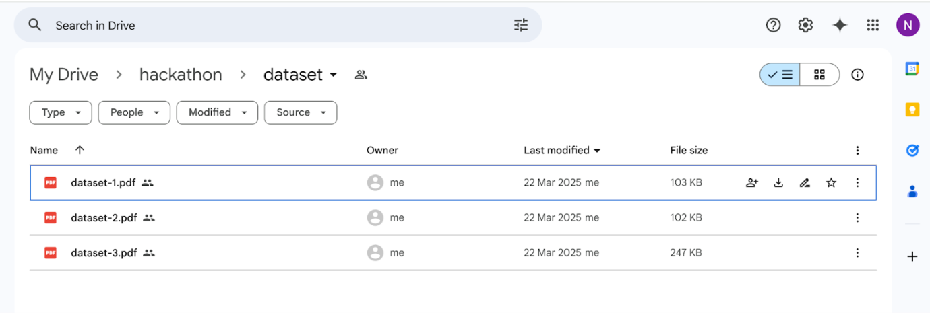
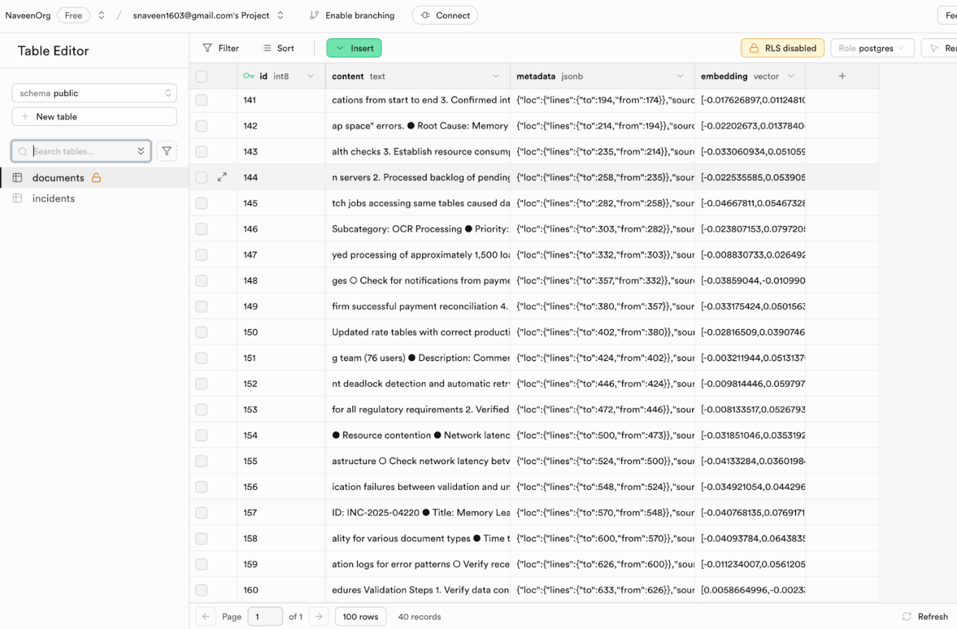
Jarvis RR Engine: Knowledge Source Creation & Updates
Current Knowledge Hub

Slide 12
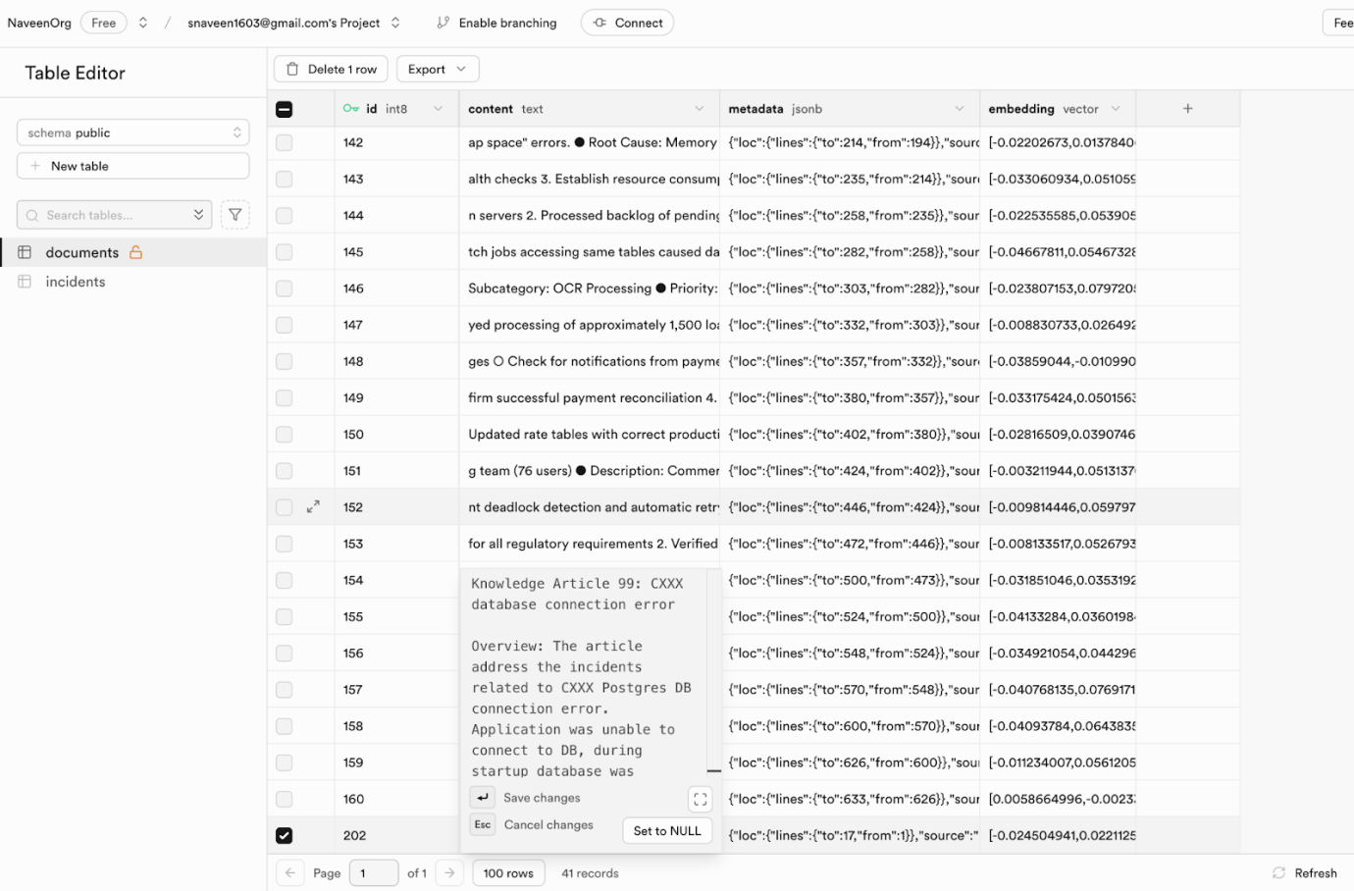
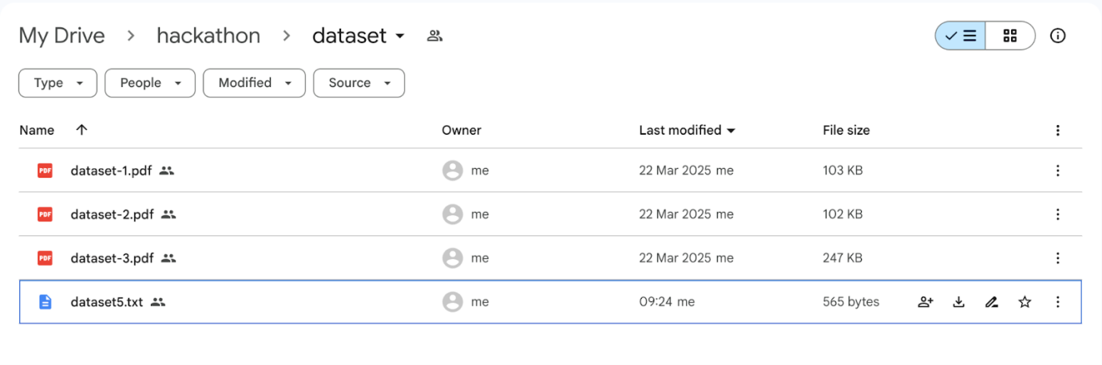
Jarvis RR Engine: Knowledge Source Creation & Updates
Updated Knowledge Hub when a new dataset gets added
A new row (202) was automatically added to the vector store along with the knowledge source.

Slide 13
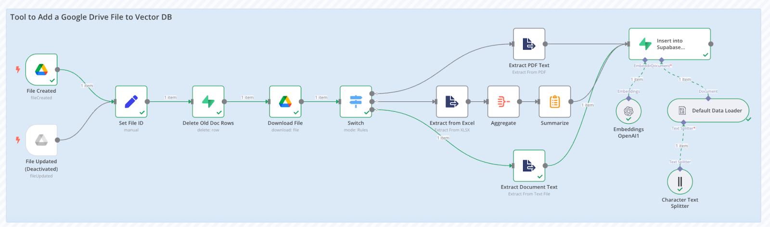
Jarvis RR Engine: Knowledge Source Creation & Updates
Invoked Flow

Slide 14
Jarvis RR Engine: Knowledge Source Creation & Updates
Invoked Flow

Slide 15
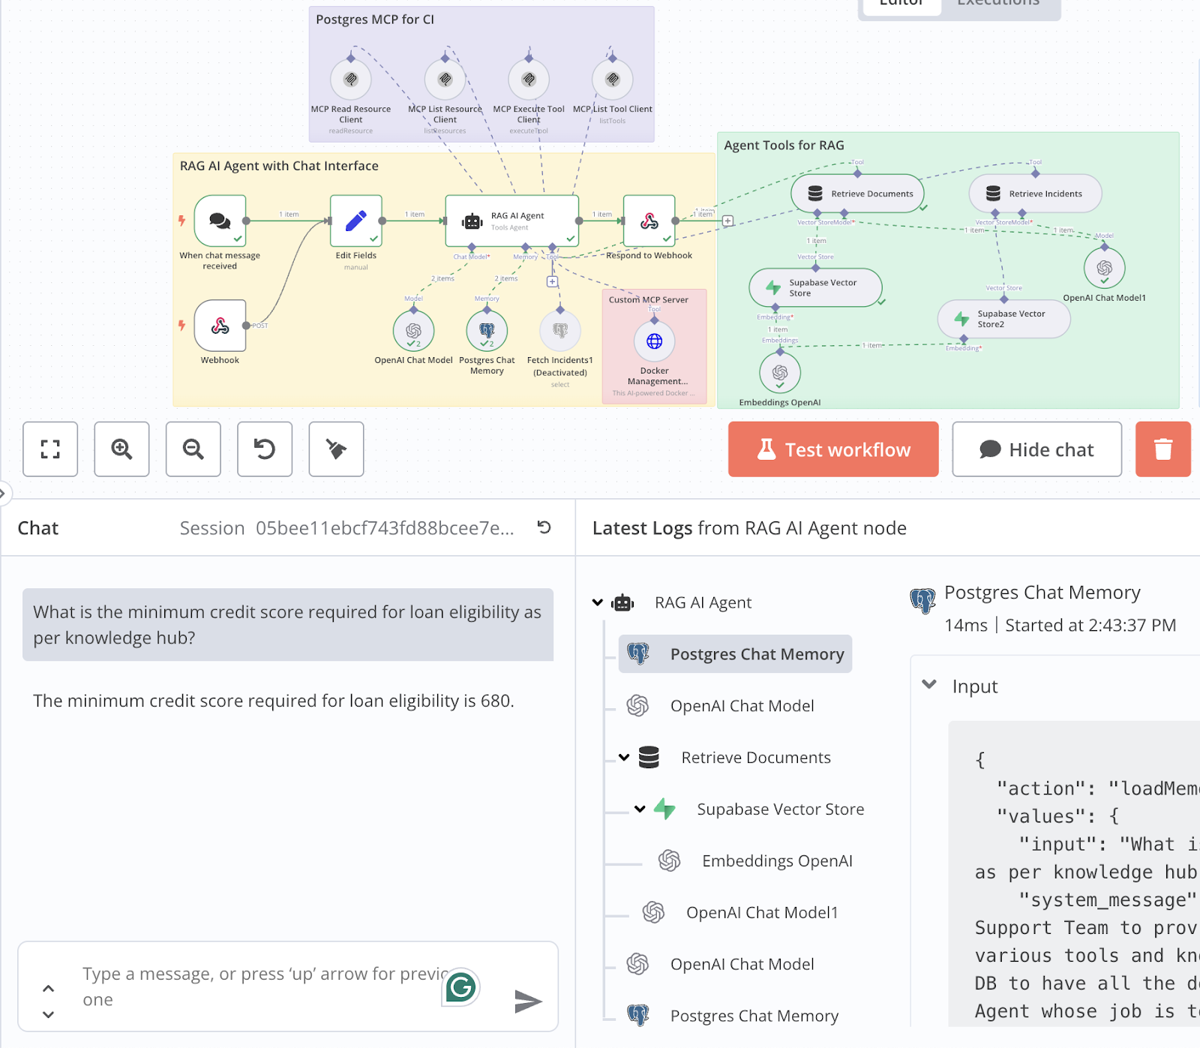
Jarvis RR Engine: Real time Knowledge Source Updates

Slide 16
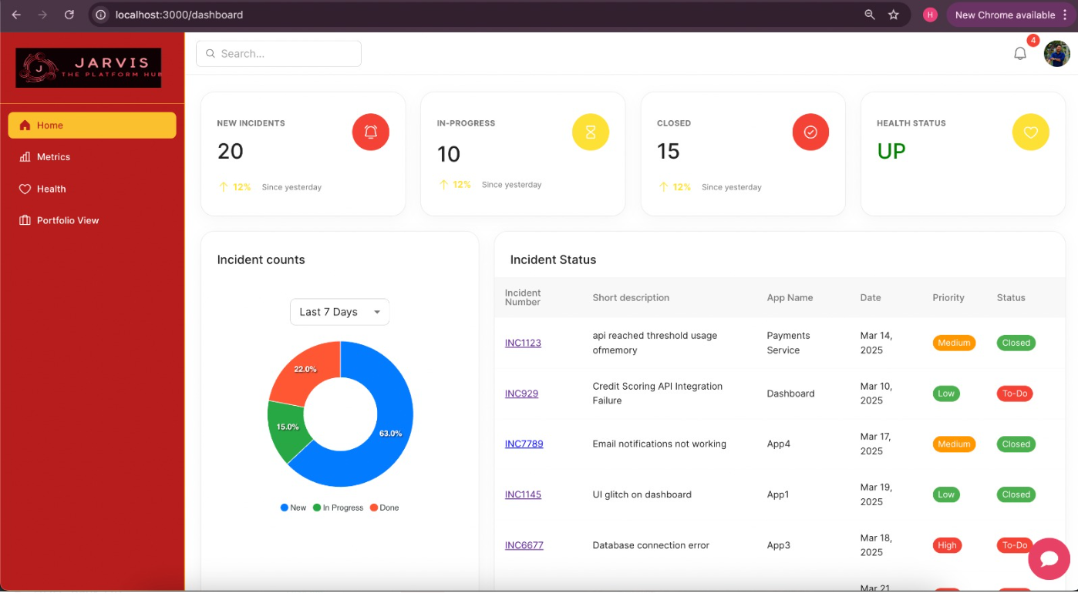
Jarvis UI: Homepage

Slide 17
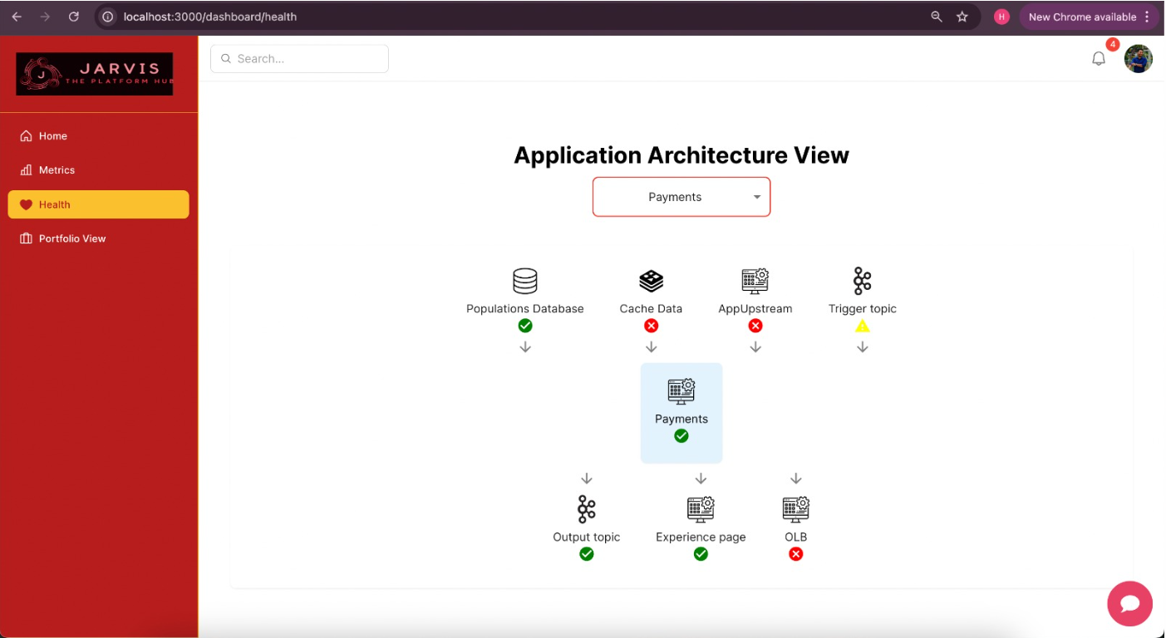
Jarvis UI: App dependency health View

Slide 18
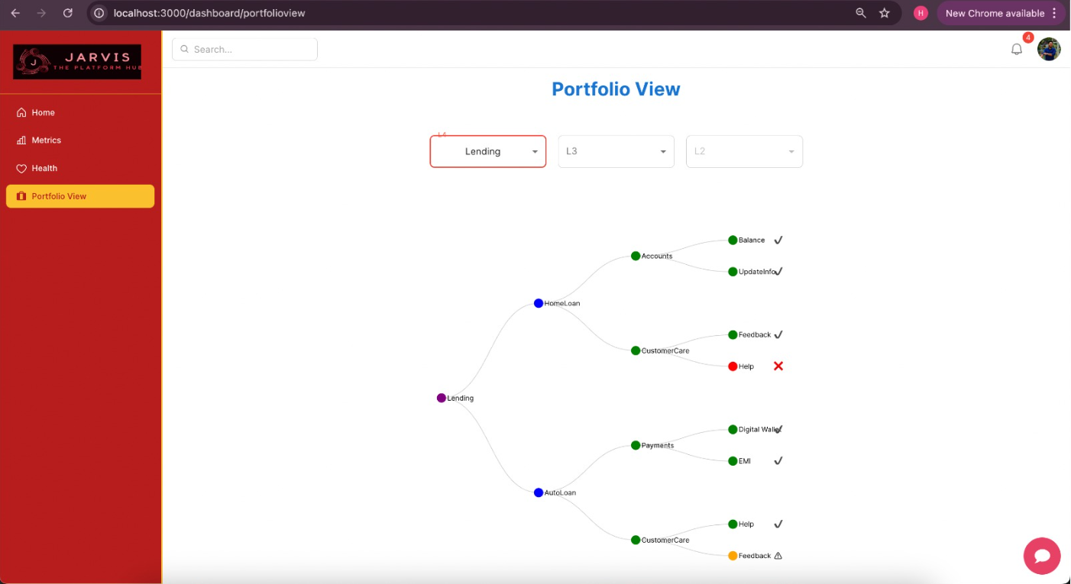
Jarvis UI: Portfolio health View

Slide 19
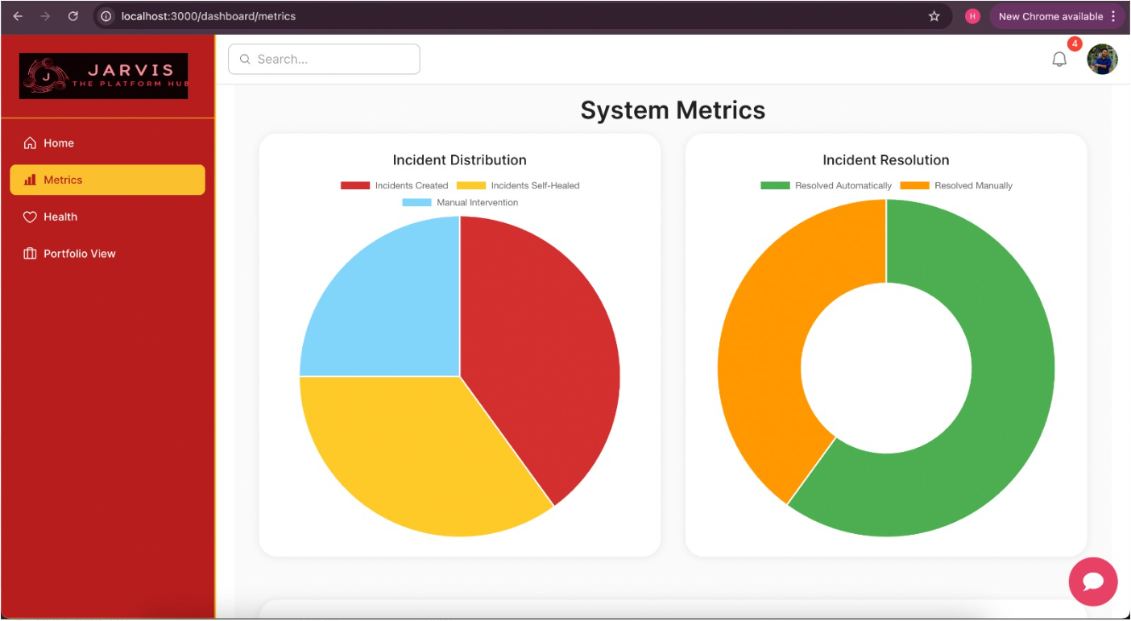
Jarvis UI: Metrics

Slide 20
Jarvis UI: Metrics

Slide 21
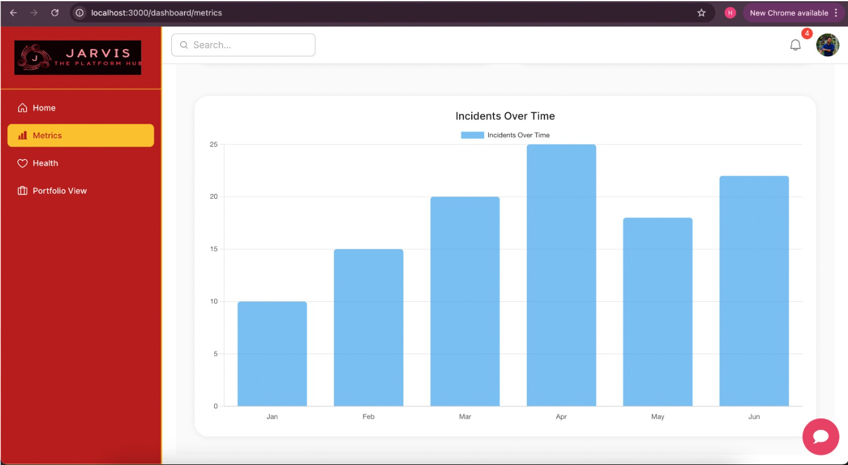
Jarvis UI: Metrics

Slide 22
Appendix

Slide 23
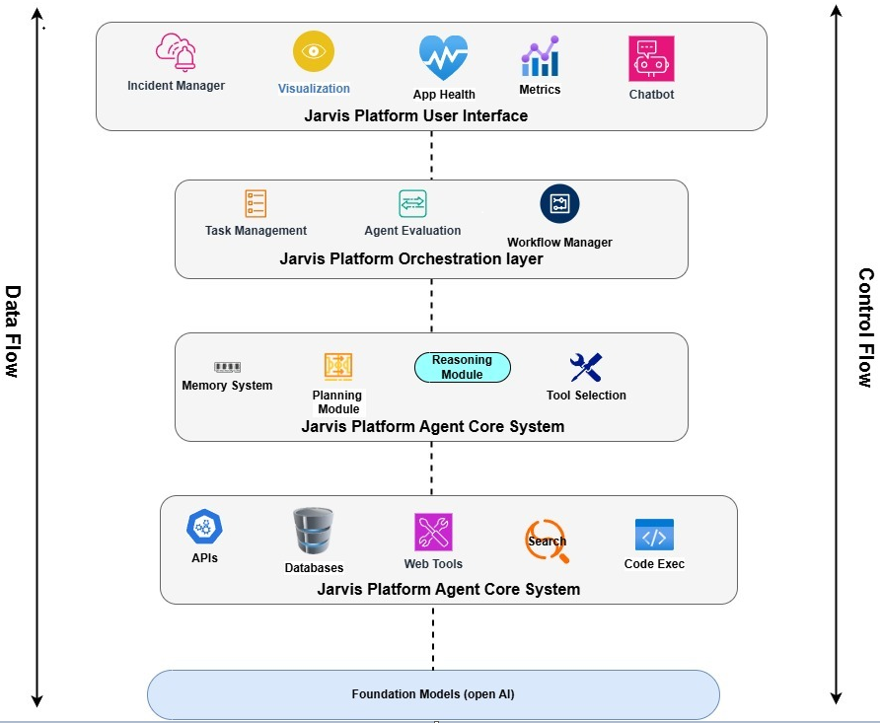
Jarvis- Control and Data flow

