Slide 1

Wells Fargo Technology Hackathon 2025
Seagulls
- sky is the limit
Gen AI for Platform Support – Integrated platform Environment
Seª_{g}ullsV25
Trivia – each letter used in SeagullsV25 is written using different font, font size, style and font color ☺
Jarvis- One stop AI solution for Platform Support

Slide 2


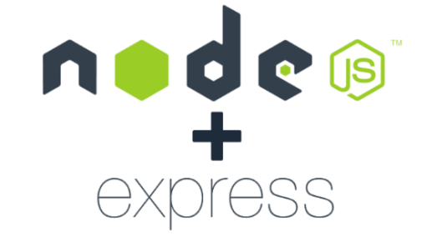



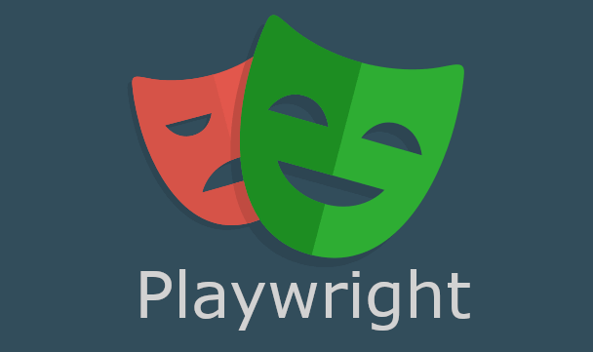



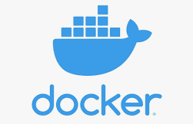
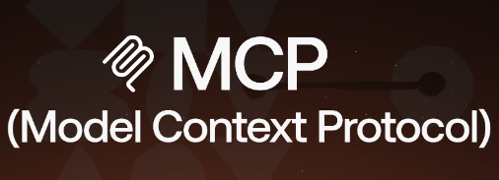



Jarvis- Diversified Technology Stack

Slide 3
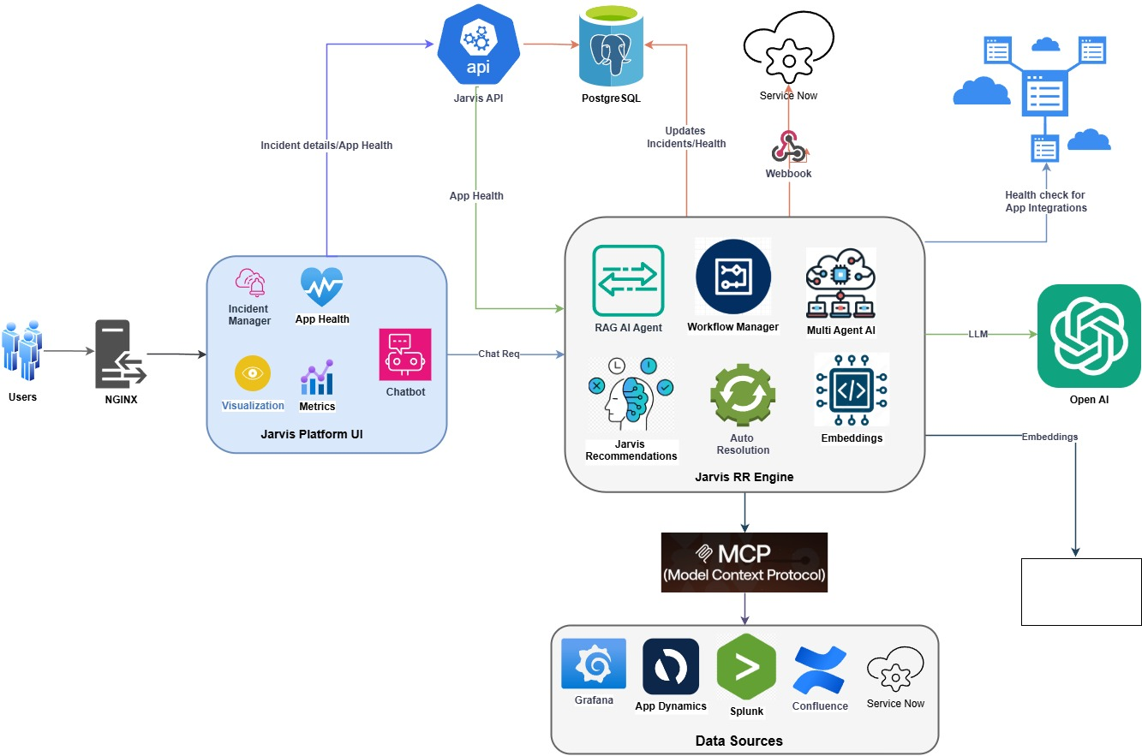
Jarvis- Architecture

Slide 4
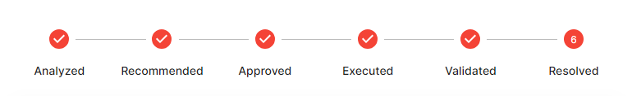
“Jarvis” summary
Problem Statement:
Develop a gen-AI enabled Integrated platform environment that provides an integrated console to platform support
Novelty:
Self-healing and automated incident resolution in ServiceNow using GenAI-driven workflows.
Real-time data synchronization for new incidents and data source updates into a vector database.
Configurable workflows for RAG-based retrieval and data synchronization.
Multi-agent orchestration to streamline task delegation and execution.
Application and dependency health dashboard for enhanced monitoring.
Portfolio health view tailored for managers and leadership teams.
Comprehensive platform metrics to track key capabilities and performance.
Integrated, customizable toolkit (e.g., Docker) with framework-supported workflows.
Solution:
GenAI-powered workflows to enhance key platform capabilities.
Webhook integration with ServiceNow to trigger GenAI workflows for proactive recommendations, RCA summaries, and resolutions.
User-friendly UI with an AI-powered chatbot, offering incident management, triaging, and resolution capabilities, along with additional features to streamline daily operations..
Seamless data integration from enterprise tools like ServiceNow, Grafana, Splunk, and Confluence.
MCP-enabled architecture for efficient context management and smooth integrations.
APIs for easy integration between the UI and GenAI workflows.

Slide 5
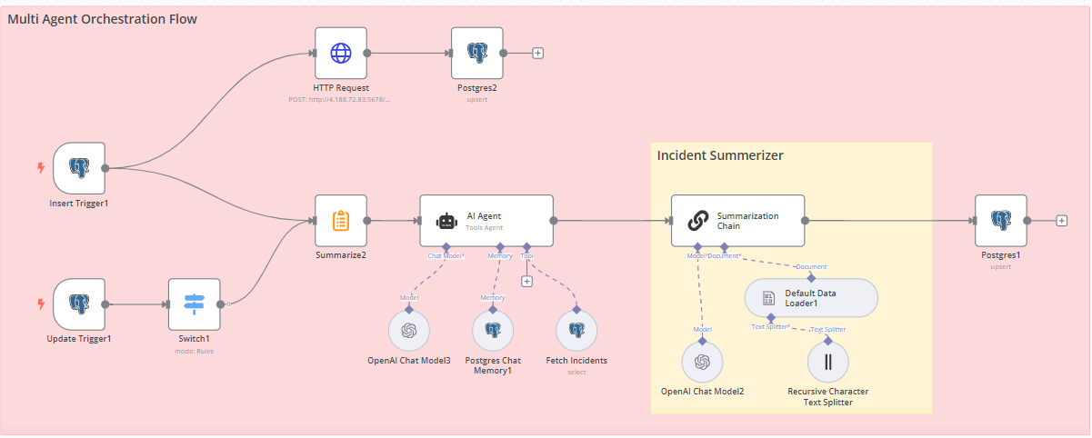
Multi Agent Orchestration workflow

Slide 6
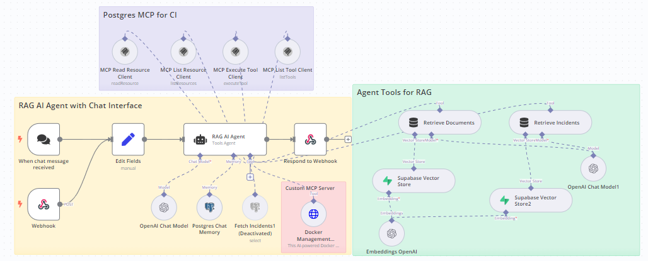
Incident Recommendation & Resolution MCP workflow

Slide 7
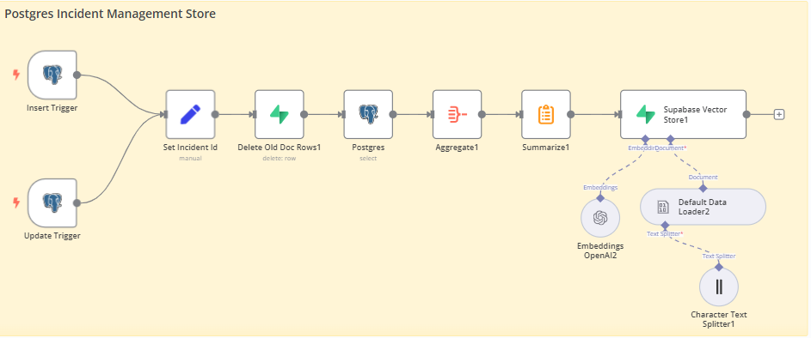
Incident data sync workflow

Slide 8
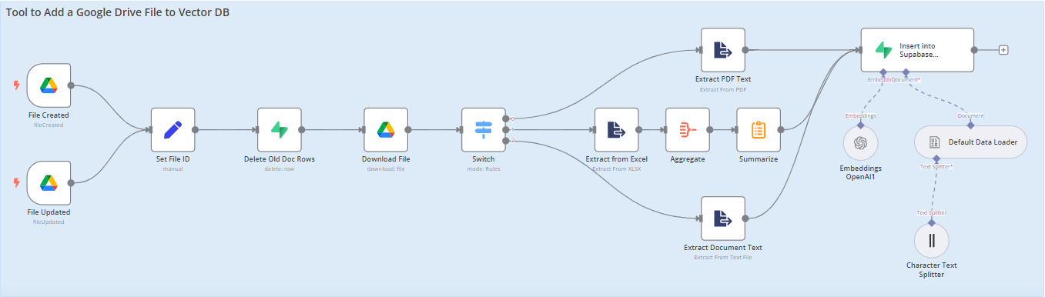
Knowledge source data sync workflow

Slide 9
Challenges
Real time integrations with Enterprise Tools like Service now, Splunk, Appdynamics
Creation of sample Datasets for incidents and telemetry related data
Hosting infrastructure for the complete solution
Cost of Professional AI models
Accuracy of Open source AI models
Roadmap
Extend the solution with Real time integrations for Enterprise Tools like Service now, Splunk, Appdynamics
Single click Paging when any application dependency is down
End to end Incident resolution updates in Service now ticket
Retry of failed automated resolutions
Role based authentication and authorisation

Slide 10
NFRs Implemented
Performance: The platform delivers fast response times, ensuring seamless integration with enterprise infrastructure.
Scalability: Jarvis components (UI, APIs, RR engine) are designed for easy scalability.
Security: Webhooks are secured using key-value authorization, with the flexibility to extend to OAuth.
Reliability: The system efficiently handles high volumes while maintaining stability.
Usability: Outputs are user-friendly, responsive, intuitive, and accessible to diverse audiences.
Accuracy: Generated content is relevant, coherent, and free from factual errors.
Ethical Considerations: Built on OpenAI’s platform, ensuring no stereotypes or harmful content in generated outputs.
Maintainability: Configurable workflows allow easy updates and adaptability to new requirements or technologies.
Auditability: Chat interactions are logged in a PostgreSQL database, and workflow executions are fully audited.
NFRs Planned
Security: The UI supports integration with enterprise authentication and authorization mechanisms, including Single Sign-On (SSO).
Reliability: The system ensures high availability, especially when transitioned to a multi-active architecture.
Usability: Accessibility features have been enhanced for an improved user experience.

Slide 11
Test Results and Screenshots

Slide 12
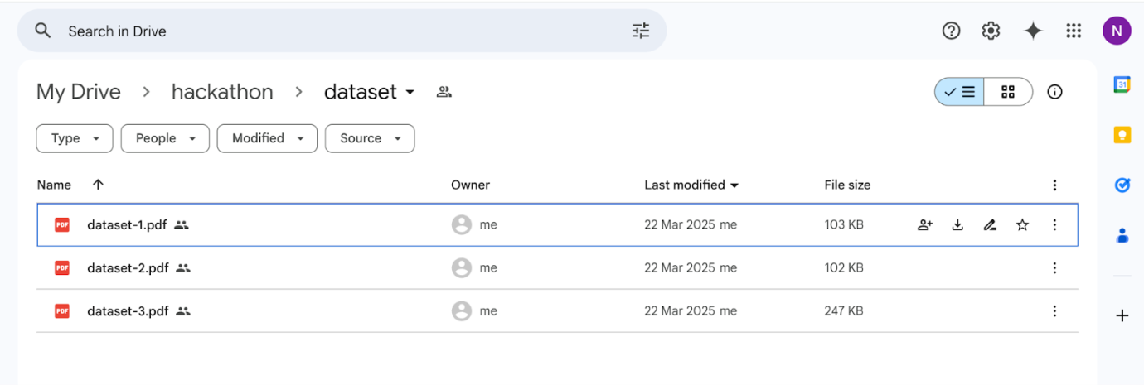
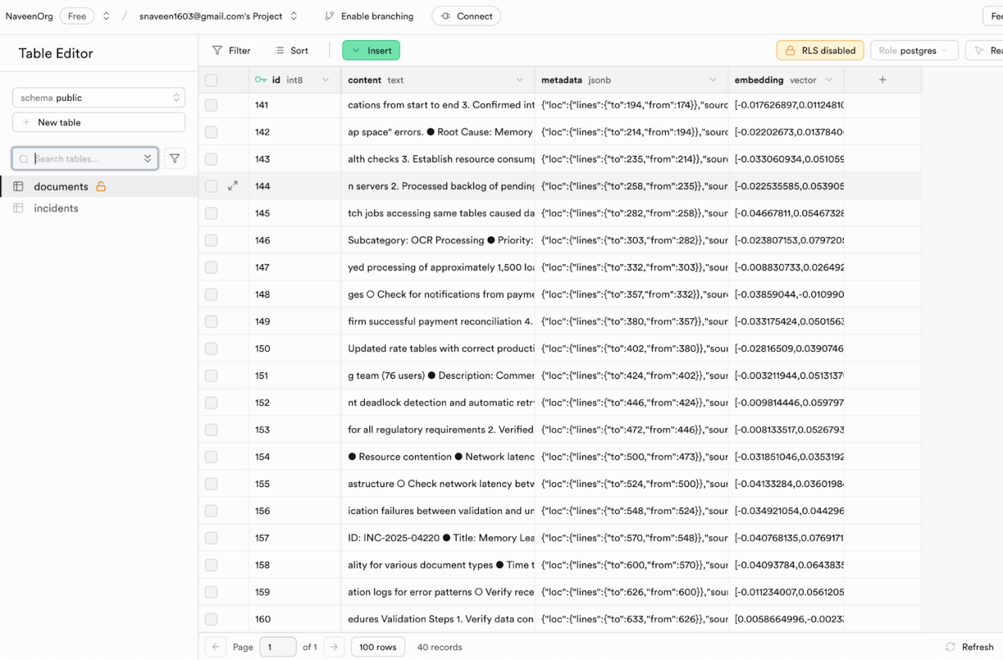
Jarvis RR Engine: Knowledge Source Creation & Updates
Current Knowledge Hub

Slide 13
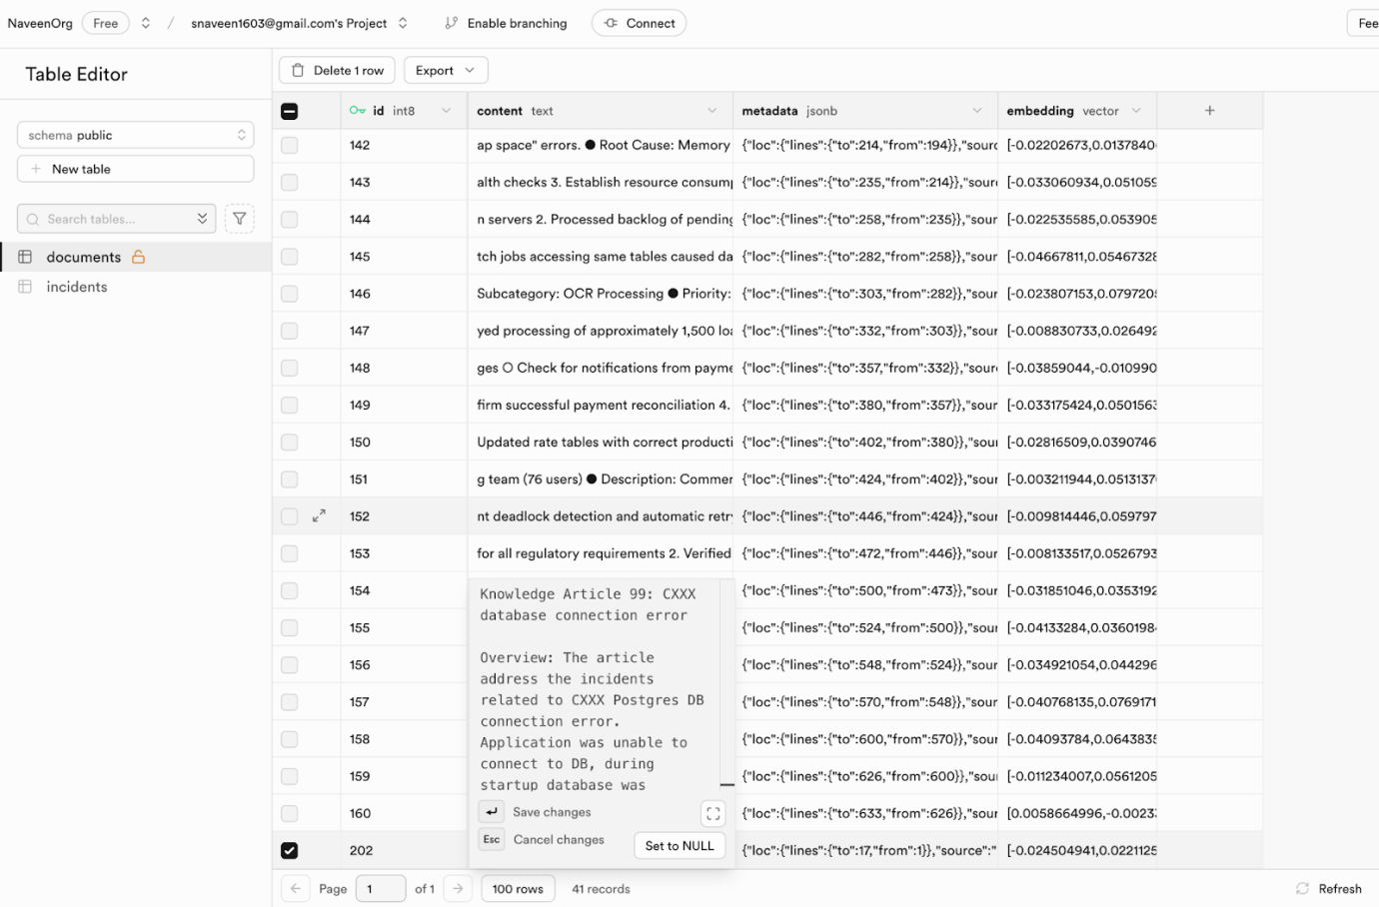
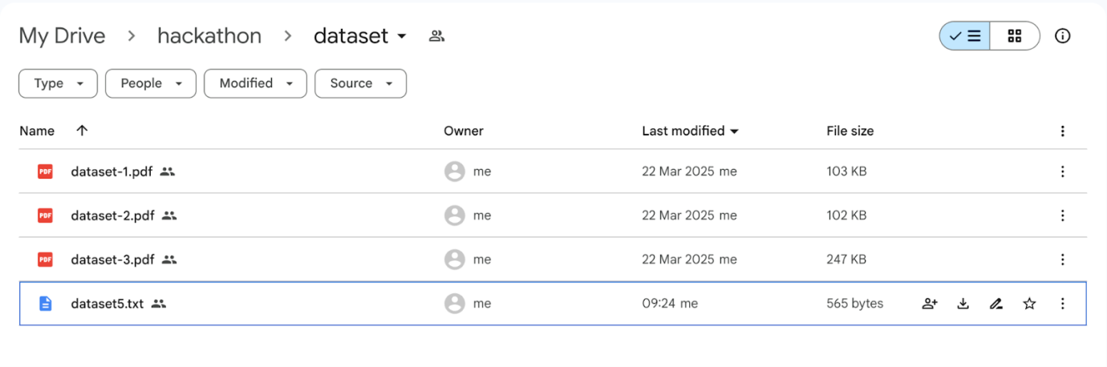
Jarvis RR Engine: Knowledge Source Creation & Updates
Updated Knowledge Hub when a new dataset gets added
A new row (202) was automatically added to the vector store along with the knowledge source.

Slide 14
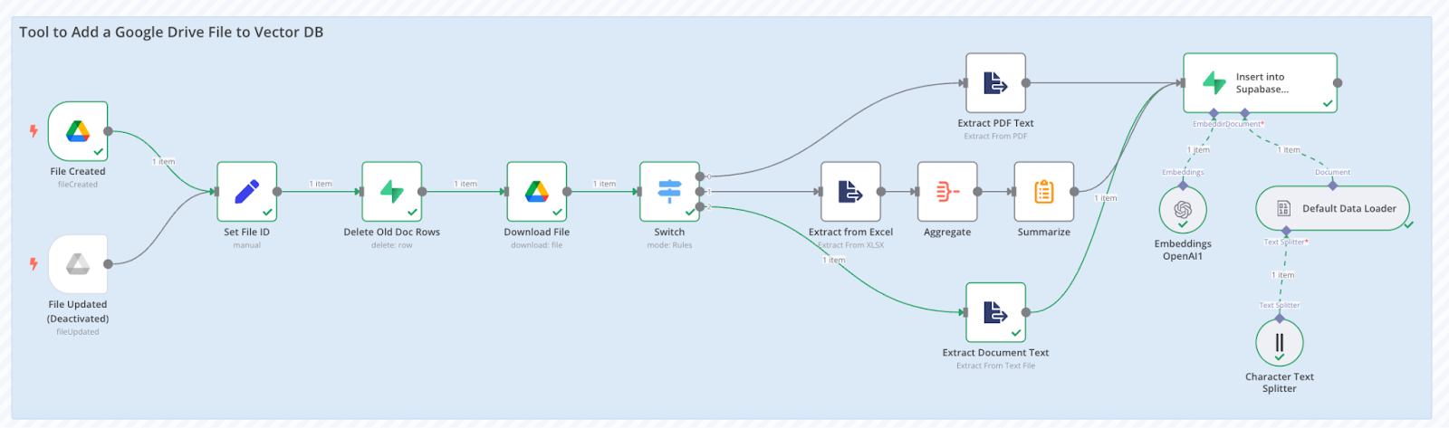
Jarvis RR Engine: Knowledge Source Creation & Updates
Invoked Flow

Slide 15
Jarvis RR Engine: Knowledge Source Creation & Updates
Invoked Flow

Slide 16
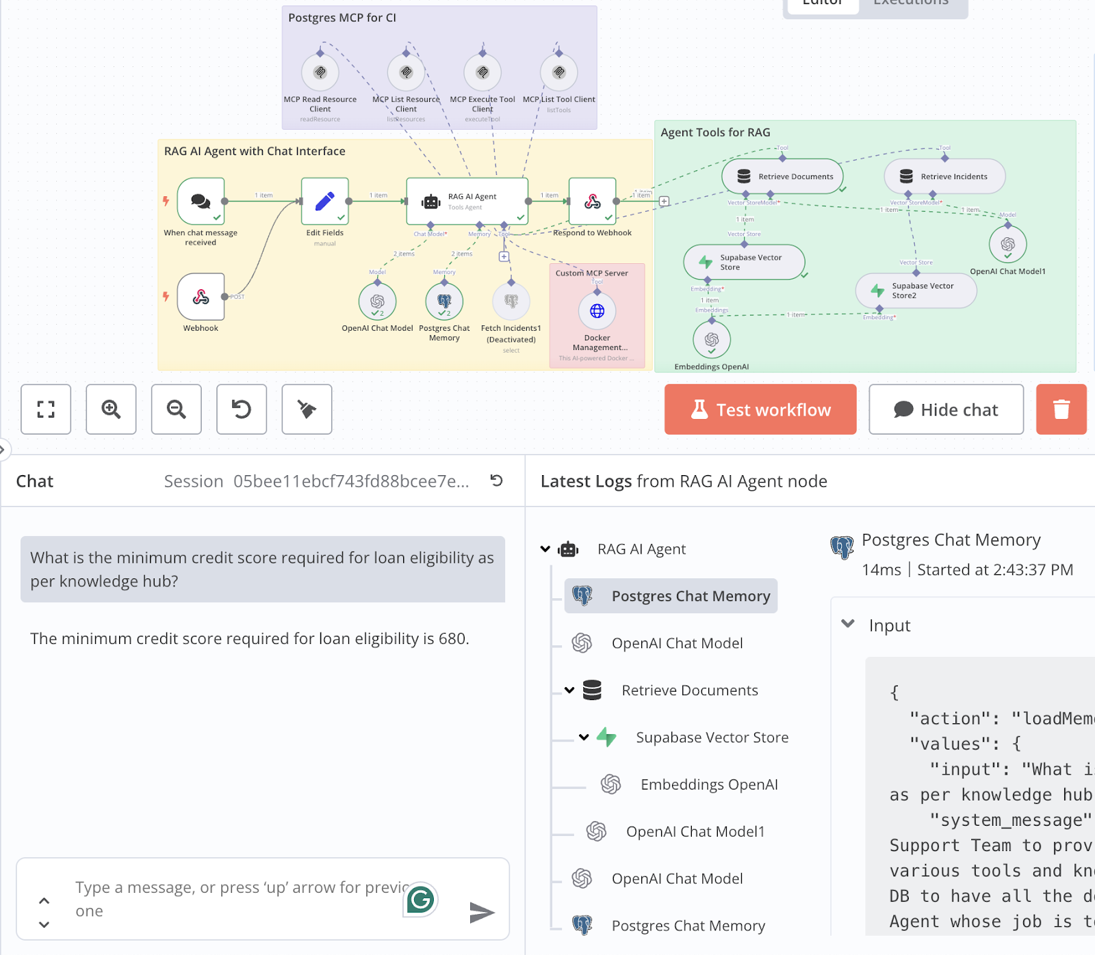
Jarvis RR Engine: Real time Knowledge Source Updates

Slide 17
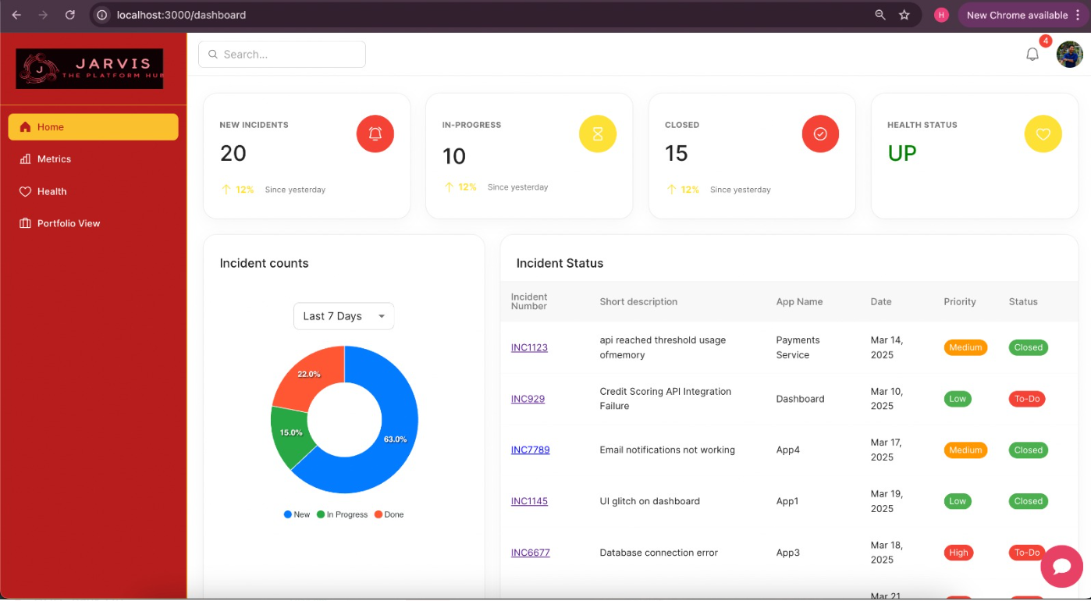
Jarvis UI: Homepage

Slide 18
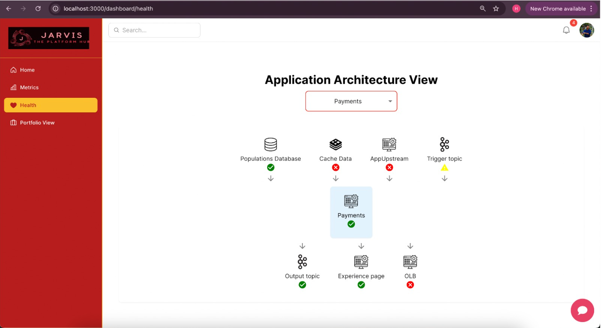
Jarvis UI: App dependency health View

Slide 19
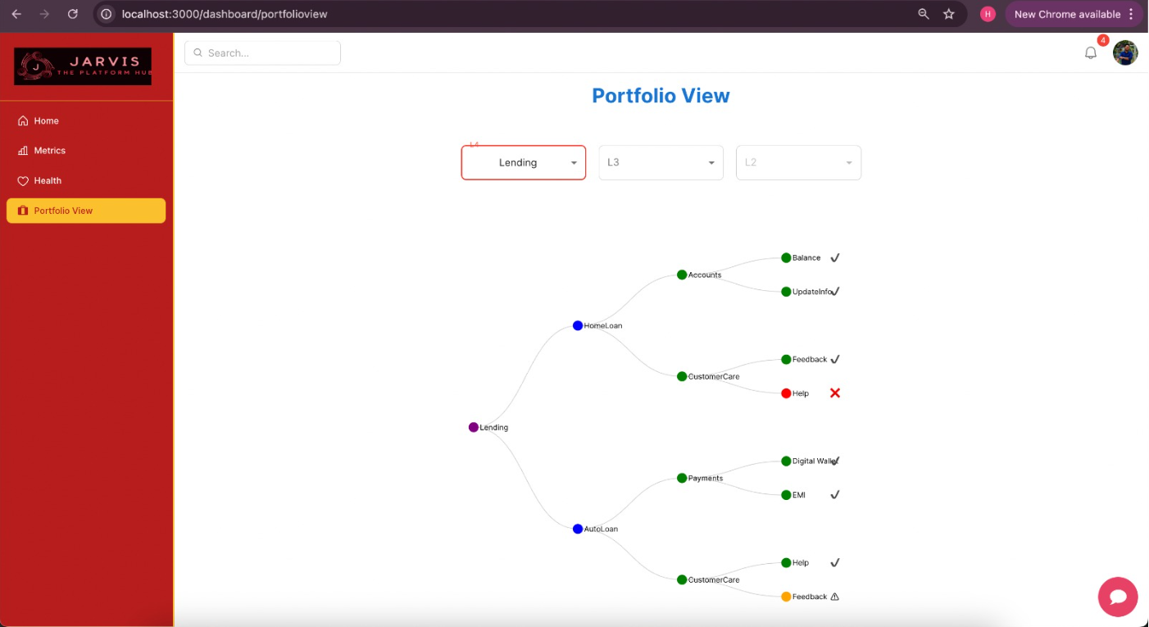
Jarvis UI: Portfolio health View

Slide 20
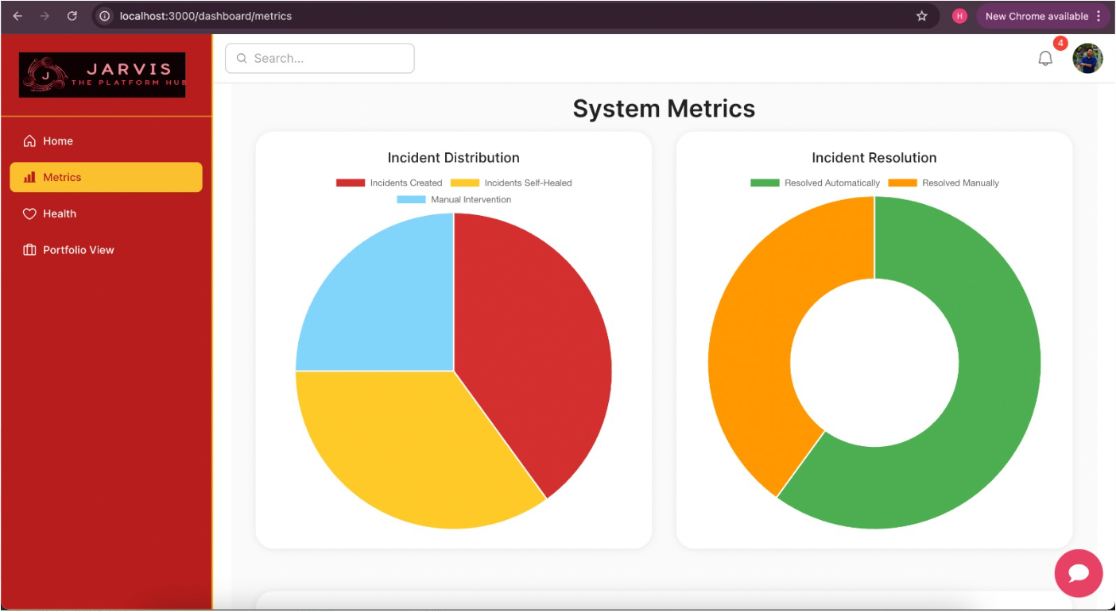
Jarvis UI: Metrics

Slide 21
Jarvis UI: Metrics

Slide 22
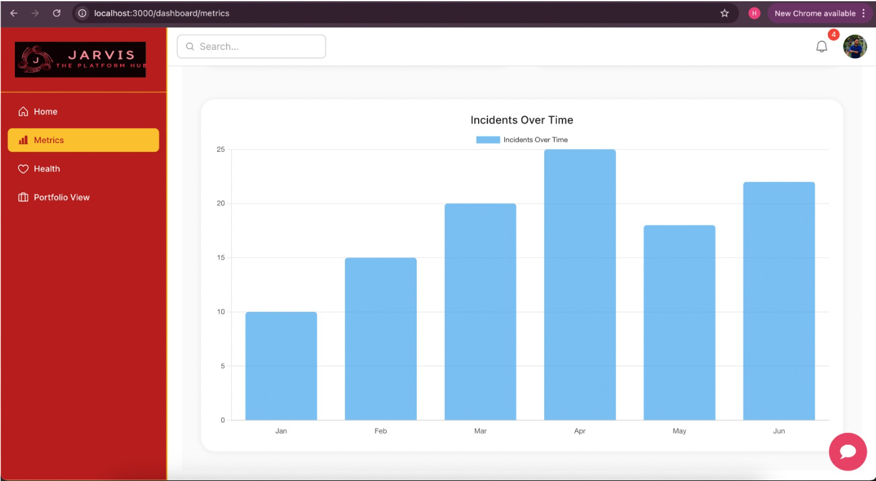
Jarvis UI: Metrics

Slide 23
Appendix

Slide 24
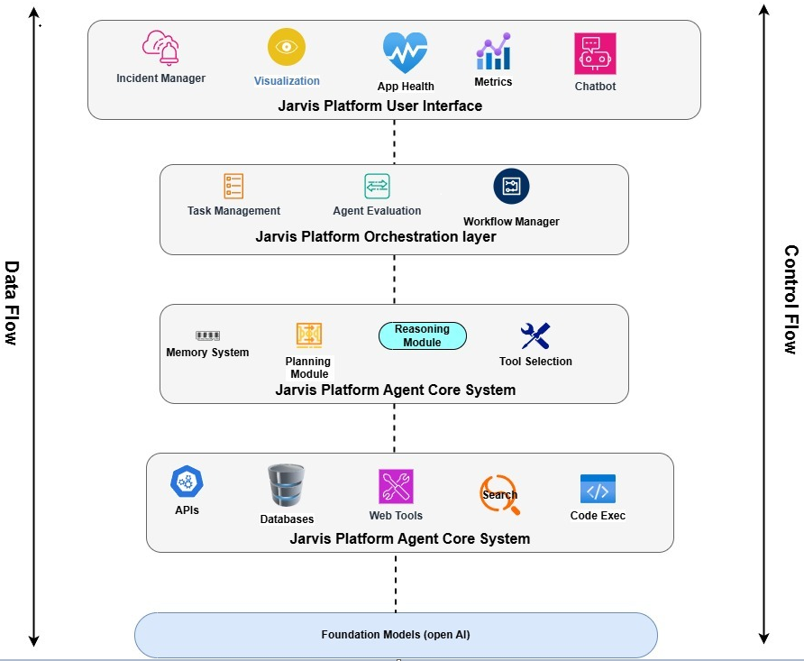
Jarvis- Control and Data flow

Slide 25
Thank You

