Slide 1
Gen Al for Platform Support – Integrated Platform Environment
Team Name: The_copilots

Slide 2
Challenge Description:
Platform support requires troubleshooting, accessing variety of KB (Knowledge base) articles, running ansible automation scripts, reviewing telemetry /observability metrics as well as leveraging foundational information about the Cls (Configuration items) including their relationships, dependencies, health etc.
All these tools and products require frequent context switching, cause significant time/effort overhead in accessing different tools, portals to provide the required platform support for the technology environment.

Slide 3
Solution Overview
This project was developed as a solution for the Wells Fargo Global Hackathon to automate the response
The solution must be built using freely available tools (e.g., OpenAl’s free-tier API, Hugging Face models, Scikit-learn, Pandas, LangChain, etc.).
The dataset used for by the participant can be from any of the open-source sample data sets(attached in Git)
This solution is incorporated both the mock-up/wireframe for the target IPE

Slide 4
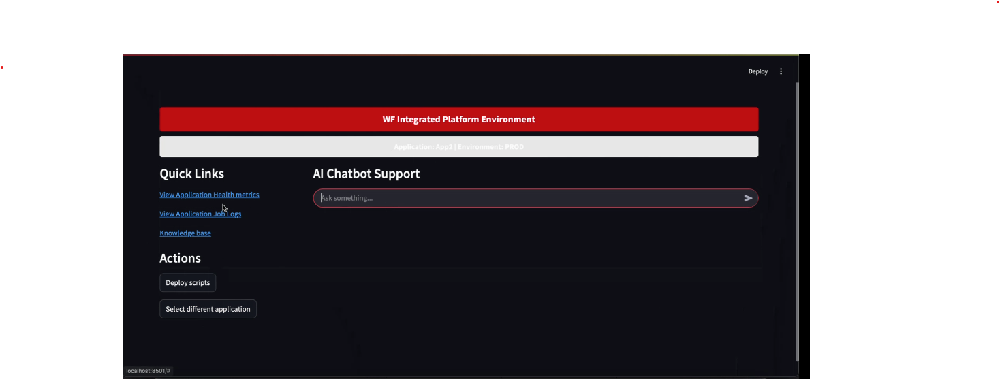
Sample Screen - Question

Slide 5
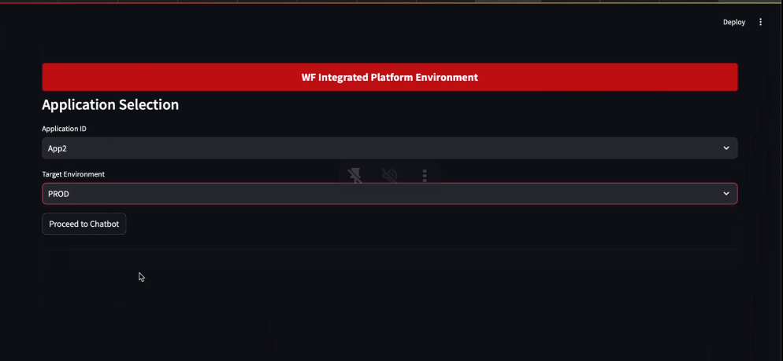
Sample screen2 – Answer from pdf

