Slide 1
Smarter Anomaly Detection in Banking Reconciliation
AI-Hackers

Slide 2
Problem History
Bank reconciliation is a crucial financial process that ensures the consistency and accuracy between an individual or company's accounting records and the information provided by their bank statement.
Few types of Bank Reconciliation includes
Vendor Reconciliation
Business-Specific Reconciliation
Intercompany Reconciliation
Customer Reconciliation
Wells Fargo is using Trovata, Xero and SWIFT tools for the Banking Reconciliation.
As the process includes handling different daily, monthly, yearly data volumes, it is challenging for the reconcilers (Business Users, Internal Employees, Audit Teams etc.) like
🔴 Manual reconciliation is time-consuming and error-prone.
🔴 Growing transaction volumes increase the risk of fraud.
🔴 Delay in anomaly detection impacts customer experience.

Slide 3
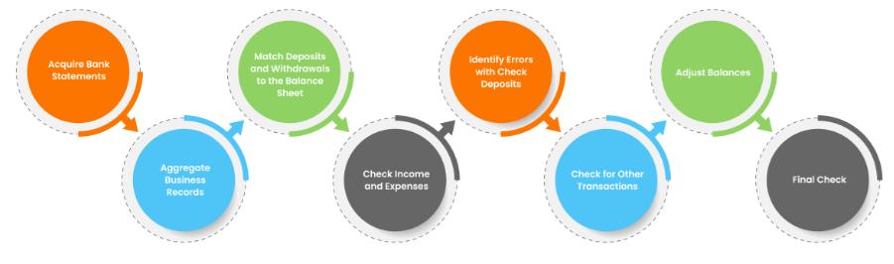
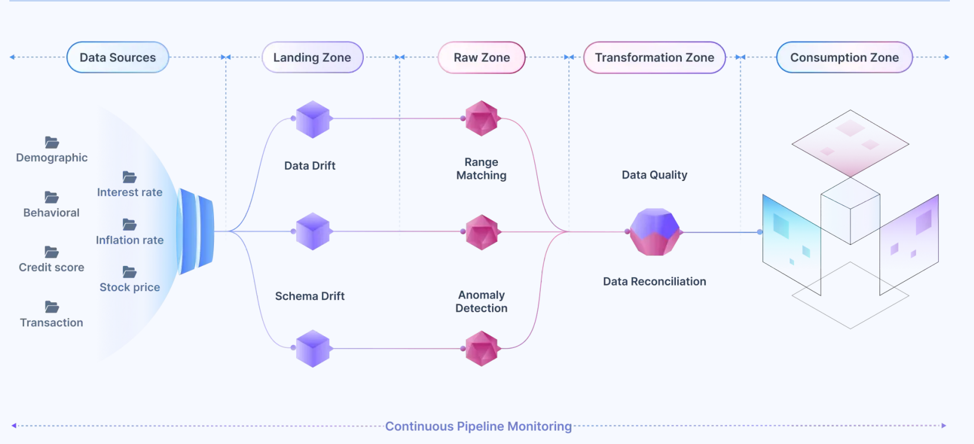
Solution Approach
To automate the process We are proposing Agent AI based Anomaly detection and Reconciliation to integrate to the existing Wells Fargo Reconciliation tools. This includes following steps

Slide 4
Solution Detail
To automate the process We are proposing Agent AI based Anomaly detection and Reconciliation to integrate to the existing Wells Fargo Reconciliation tools. This includes following steps
Data Ingestion (Core/GL/Payments/Catalyst/Ledger Accounts)
During Ingestion, analyse and Identify data patterns of the based on Timestamp (Daily/Weekly/Monthly).As per the use case requirements we have ingested sample data with 30000 records,5 years data which includes history and current date details.
Assumption: Standard Banking reconciliation comments data supplied by internal reconcilers is used as reference to identify Match/Break status during data the comparison.
AI/LLM-driven Anomaly Detection & Reasoning
In this deployment, we have used Isolation Forest model to detect the anomalies using random partitioning in the source data with the help of decision trees.
Encode categorical variables (Label Encoding / One-Hot Encoding).
Scale numerical values.
Create derived features like Balance Difference = abs(GL Balance - IHUB Balance).
Based on outcome of the Decision Trees precision will be evaluated and used as key metric for Model accuracy.

Slide 5
Solution Detail (contd.)
JIRA API set-up/Auto Email(SMTP) Integration for triggering alerts
After identifying the Anomalies, Comments will be classified and defined with reference to the Account Name/Type, Dates and reconciliation inputs.
SMTP, Trilio, WhatsApp APIs are integrated with the Isolation Forest Model outputs to trigger corresponding alerts to the users.
Continuous Improvement and Integration of the Model for better efficiency.
Since data volume is less we have used Isolation Forest for Anomaly Detection. However this solution can be scaled for future state with Advanced AI capabilities like Agentic AI, further models like Gaussian Mixer models, K-means clustering and self organizing maps. As suggested in problem document we can use LLaMa-3.0 and Falcon LLMs can be used for Data Classification in case of huge volumes. Since data is not available, Hugging Face Transformers cannot be used in the current model integration. Streamlit is used as a data source onboarding platform. To run Jira and Trilio provision accounts are required to integrate with Web environment.
Conclusion
As banking data continue to grow and transactions become more complex, efficient Anomaly detection Models integrated with existing reconciliation tools plays a vital role in processing and making appropriate decisions.

Slide 6
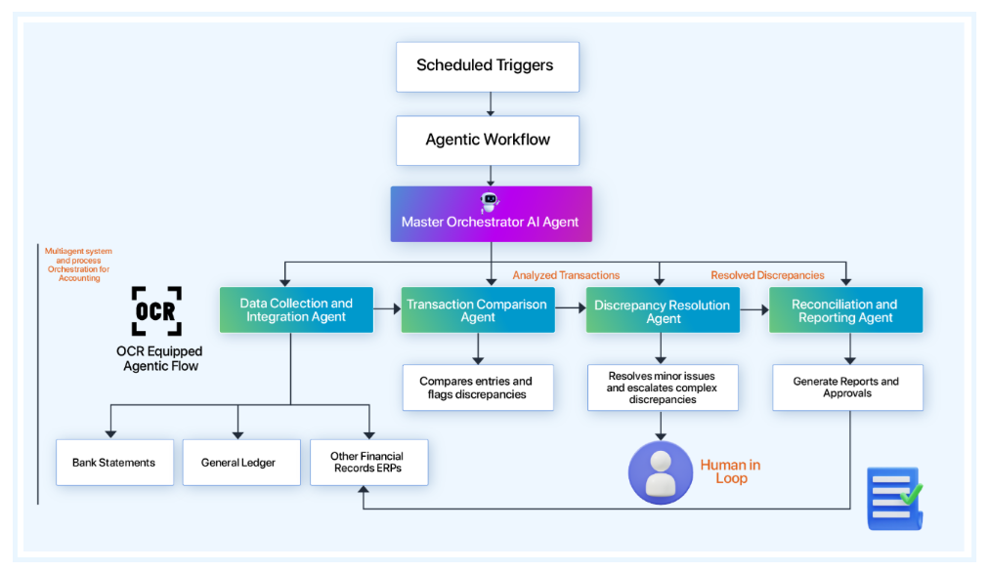
Futuristic AI Agentic Architecture

Slide 7
Thank You!

