Slide 1
Technology Hackathon 2025
Smarter Reconciliation and Anomaly Detection using GenAI
Team: AI-newbies
Members:
Sai Tejaswi Avvaru
Shobha Rani Ganta
Vijay Potturi
Rohan Bodhi Kadam
Nagesh Potharaju

Slide 2
Overview
Problem Statement:
Implement an anomaly detection system within the reconciliation process by leveraging historical data to identify patterns, trends, and expected ranges. The system should be able to:
Automatically detect data anomalies by comparing real-time data against historical baselines.
Provide insights into potential root causes of detected anomalies.
Integrate with existing reconciliation tools to streamline the anomaly identification process.
Reduce manual effort and minimize human error in anomaly detection.
Proposed Solution: We have divided the solution to 4 workflows
Anomaly Detection and Handling
Agentic Action through JIRA monitoring and integrating with core reconciliation systems
Feedback loop to identify if the anomalies detected are right (or) False Positive (or) False Negative
User queries through chain-of-thought ReAct processing

Slide 3











Anomaly Detection and Handling
Stores the excel data to DB
after validations
Detects Anomalies and Updates Database with
Category, Possible Cause and Recommended Actions
Reconciliation DB
Creates JIRA ticket
AI Agent
A LLM with AI Reconciliation Report Analyzer Persona
Request to Detect Anomalies
Sends out Email
TOOLS
Retrieval Augmented
Generation

Slide 4
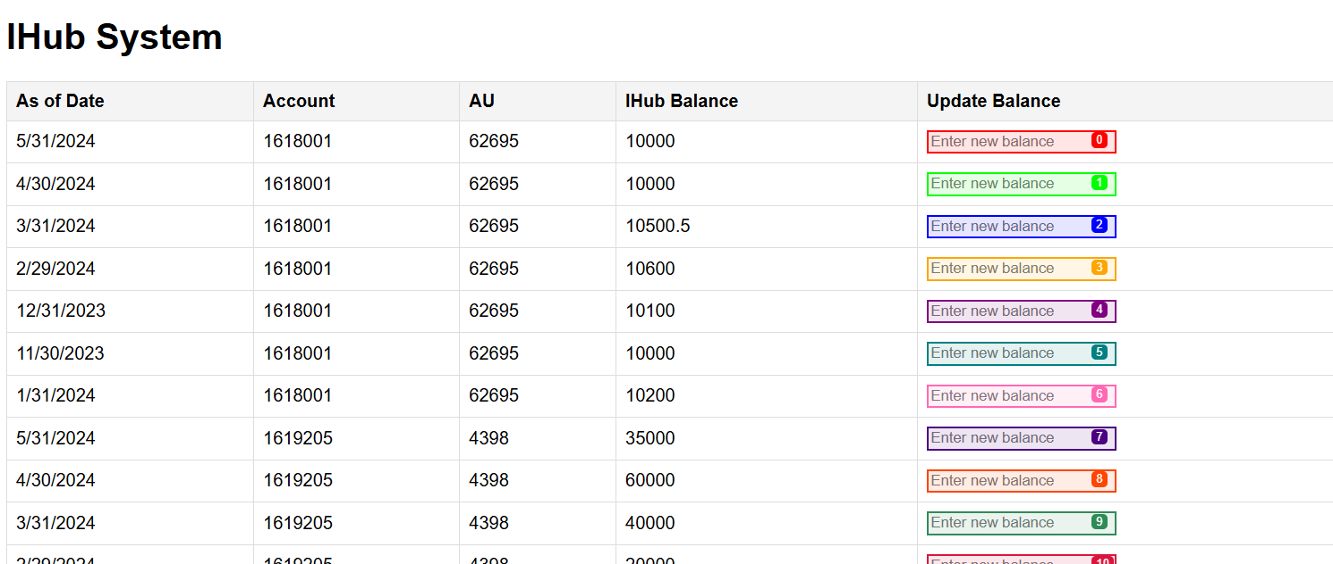

Agent Action on JIRA comments (\monitor command)
Retrieves most recent
updated comment
from JIRA ticket
Feeds comments to LLM
A LLM which parses the comments and generates a plan of action to update IHUB core system
IHub Balance Maintenance Page
(IHub Core system)
Plan of Action
Follows the action plan
Connects to IHUB Core system
Updates the balance and Submits the page
\monitor
AI Agent
Open source custom agent “browser-use”
Updates DB with new Balance
Sample plan of action
- Go to http://127.0.0.1:5000 website.
- Match the row with the extracted details.
- Update the balance field.
- Submit the changes.
Reconciliation DB

Slide 5
Feedback loop on Anomaly detection(\feedback command)
Retrieves the detected anomalies for which feedback has not been taken
Updates database with feedback
Reconciliation DB
Sample Feedback loop through Chainlit
\feedback
For every record asks user if
Detected Right
False Positive
False Negative
Feedback loop

Slide 6
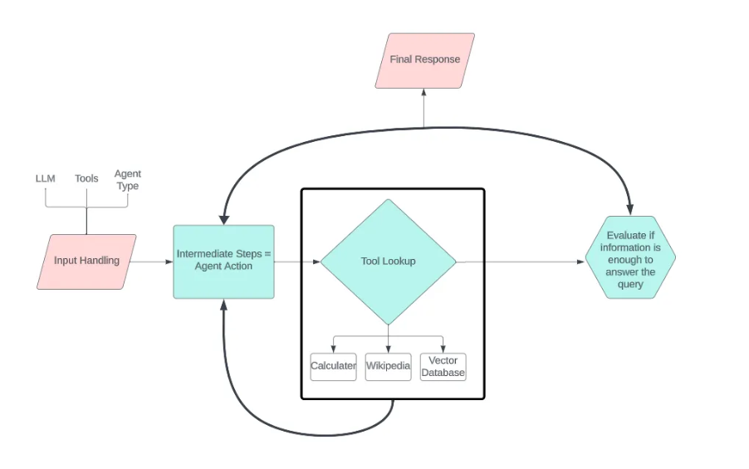
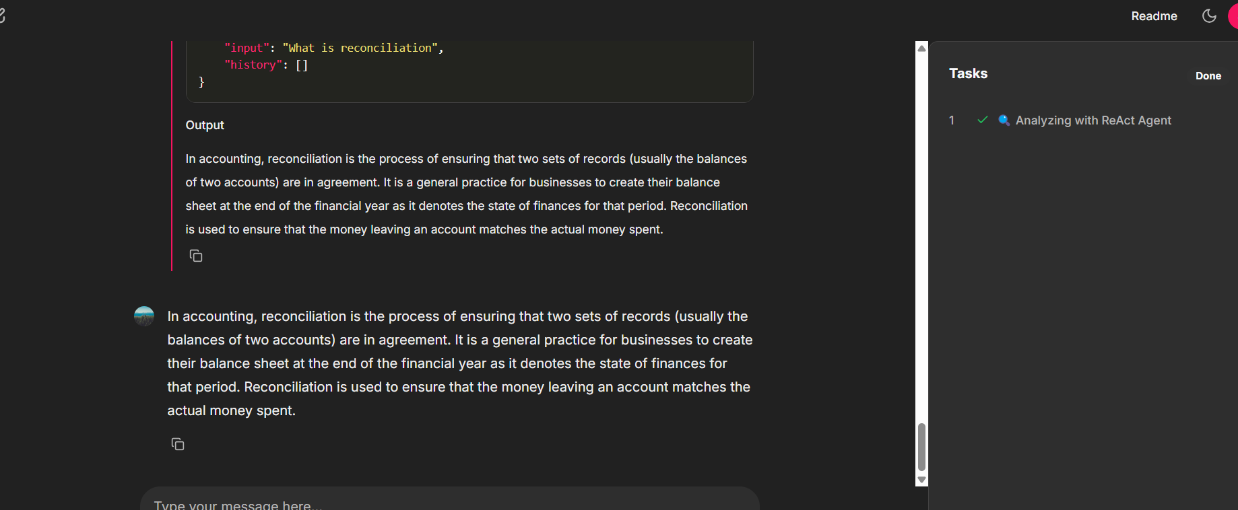
Reconciliation system / general queries through chain-of-thought processing through ReAct Agent
Sample screenshot through Chainlit
Source : https://medium.com/@laylabitar321/unlock-the-power-of-react-based-langchain-agents-a-beginners-guide-62c8fc58c3c8

Slide 7
Technical Components
Database refresh with historical data : insert.py
Chainlit key component: app.py
Anomaly detection: anomaly_detector.py
JIRA and Email creation: anomaly_action_agent.py (with tools email_handler.py and jira_handler.py)
JIRA monitor and update core system IHub:
jira_comments_monitor_agent.py
browser_agent.py
IHub_system.html
Feedback: feedback.py
System and User conversations: react_agent.py
Remaining Tools:
sqlite_tool.py
web_search_tool.py
wiki_search.py

Slide 8
Appendix

Slide 9
