Slide 1
AI-Driven Anomaly Detection and Automated Break Resolution
Team Members:
Sahithi Lingannagari
Lakshmi Chaitanya

Slide 2
Current Challenges and Need for a Genetic AI-Driven Solution
Current Challenges: Traditional reconciliation processes are often manual, time-consuming, and error-prone.
Difficulty in detecting complex anomalies using static thresholds.
High dependency on human expertise for anomaly detection and resolution.
Limited scalability when dealing with large and diverse data sets.
Why Genetic AI?:
Genetic algorithms mimic natural selection to optimize anomaly detection, adapting over time based on feedback.
Capable of learning and identifying intricate data patterns that are challenging to detect with conventional methods.
Automates break resolution, minimizing human intervention while maintaining accuracy.
Integrates seamlessly with existing data ingestion and reconciliation workflows for a holistic approach.

Slide 3
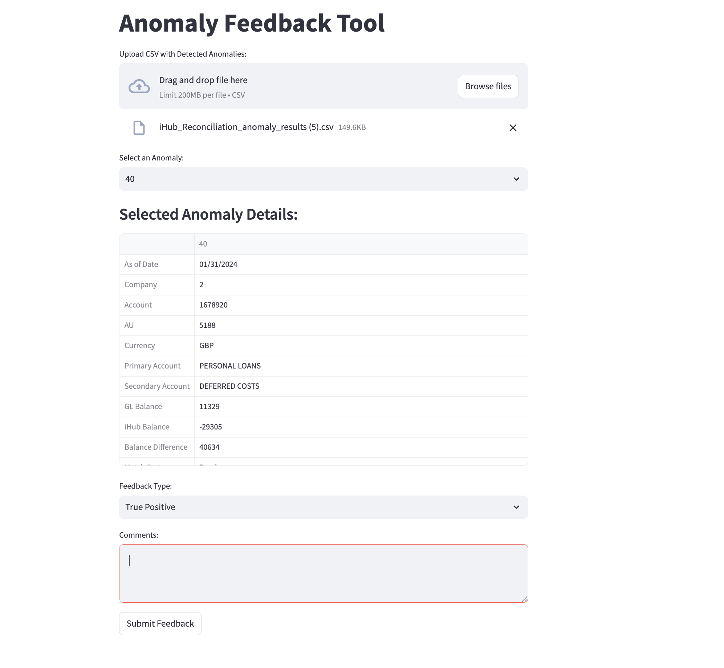
Proposed Solution & Key Metrics
Solution Overview:
A Genetic AI-driven anomaly detection and resolution system.
Combines genetic algorithms with feedback loops for continuous learning.
Automates anomaly detection, feedback collection, and resolution tasks.
Key Metrics:
Anomaly Detection Accuracy: Reduction in false positives and negatives.
Resolution Speed: Decreased time from detection to resolution.
Operational Efficiency: Reduction in manual effort and increased scalability.
Feedback Utilization: Leveraging user feedback to refine detection over time.

Slide 4
Level of Impact of the Genetic AI-Based Solution
Operational Impact:
Streamlined reconciliation processes and efficient anomaly management.
Reduced time and effort in break resolution.
Financial Impact:
Minimized financial discrepancies and potential revenue losses.
Cost-effective automation reducing reliance on manual effort.
Strategic Impact:
Supports data-driven decision-making.
Strengthened cybersecurity and compliance adherence.

Slide 5
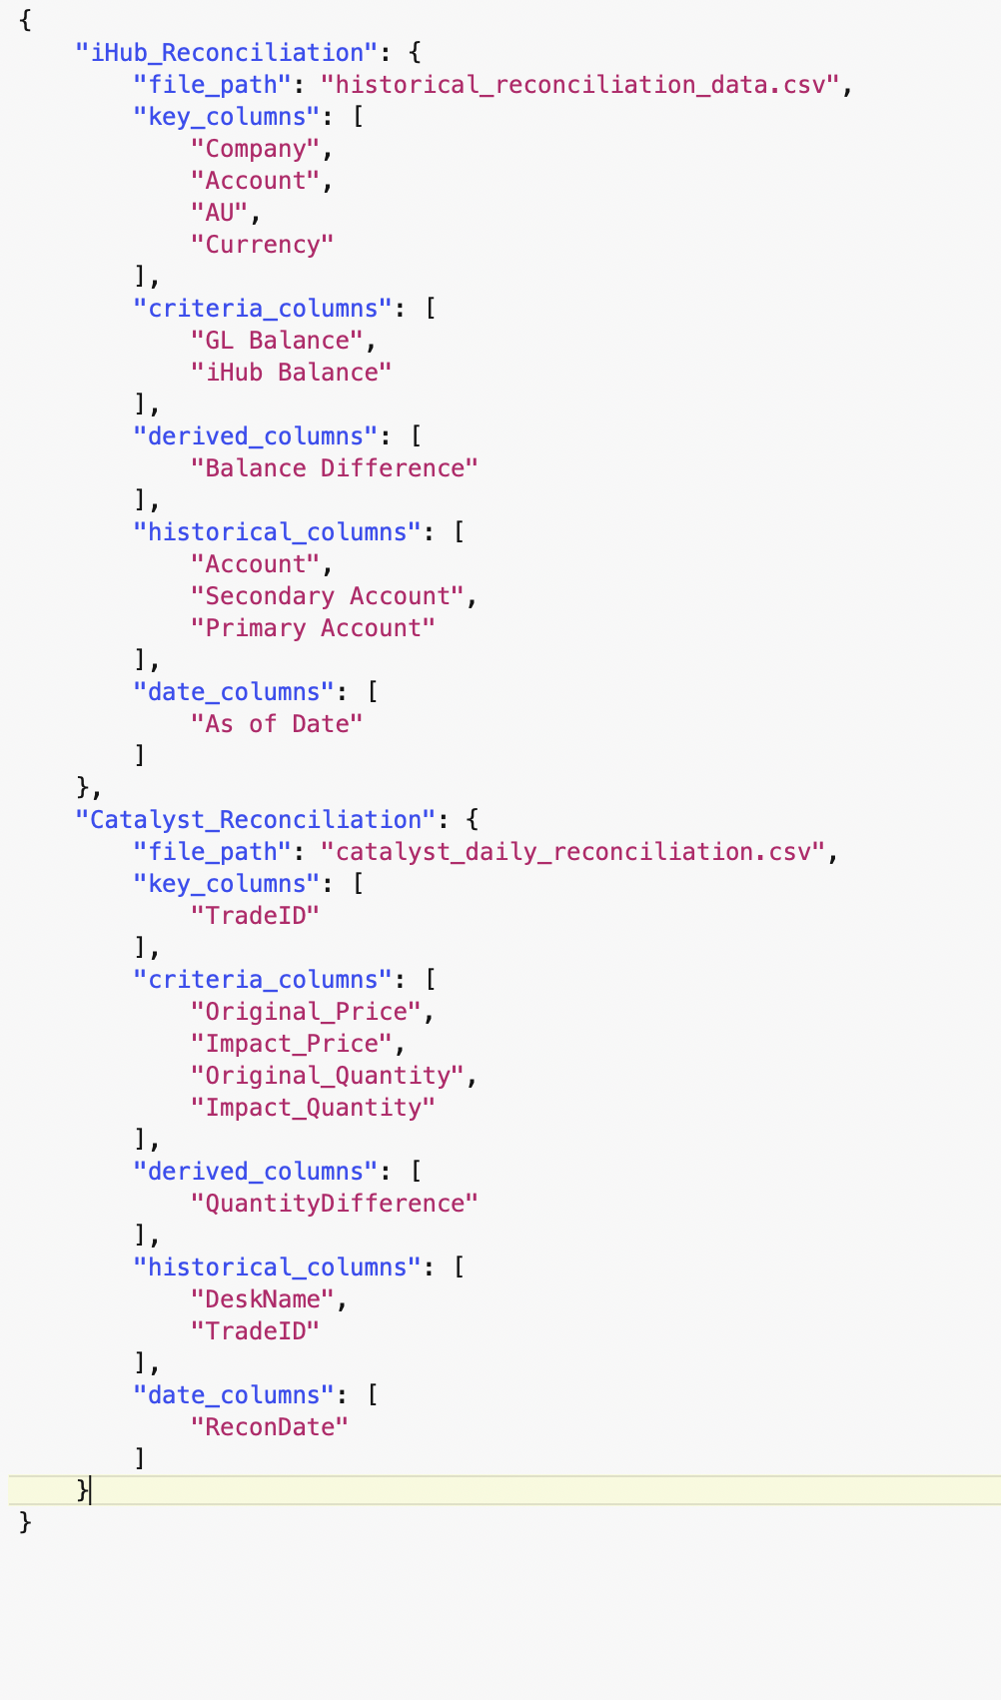
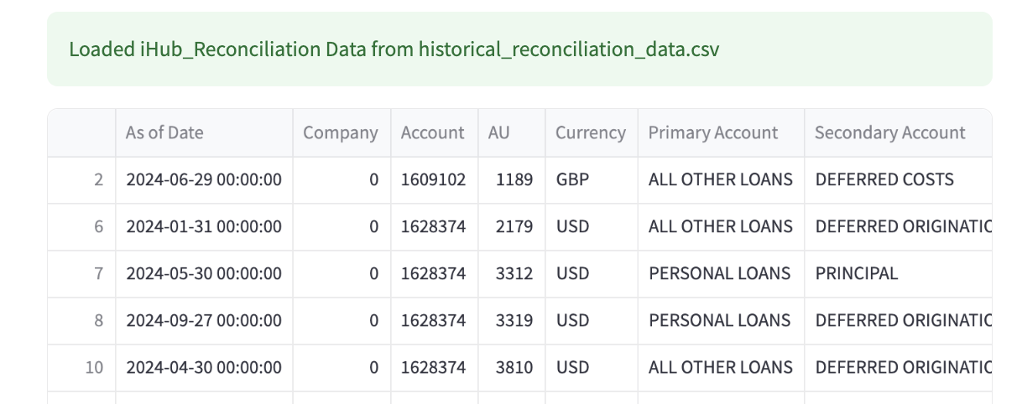
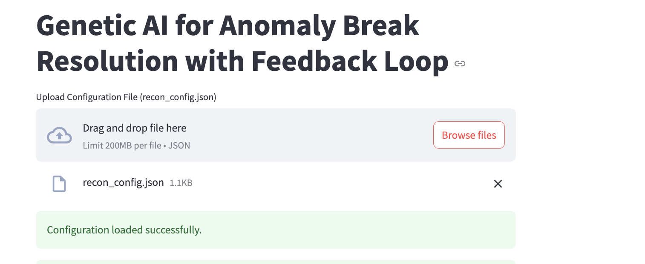
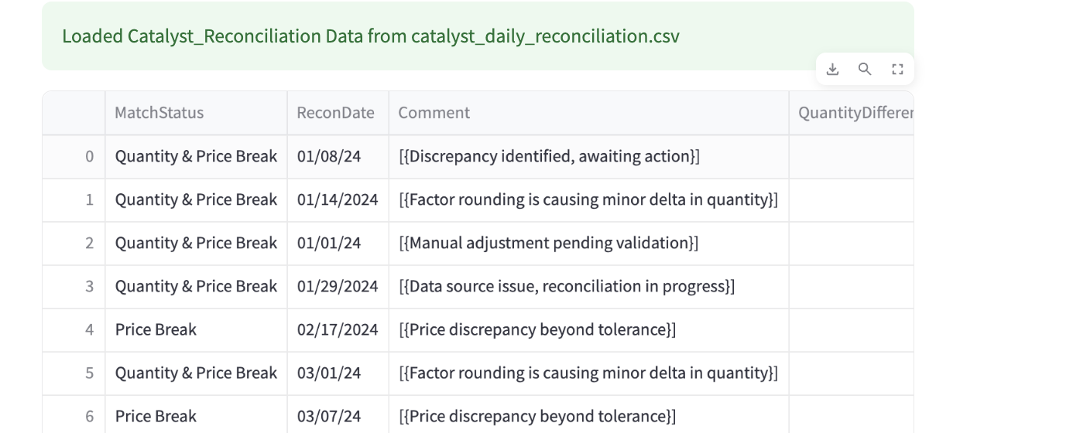
Data Sources, Dependencies & Integration
Data Sources:
Reconciliation files from iHub and Catalyst.
Configurable CSV files detailing criteria columns and thresholds.

Slide 6
Data Sources, Dependencies & Integration
Dependencies:
Accurate data ingestion from upstream systems.
Configuration files to guide anomaly detection.
Feedback mechanism for improving detection precision.

Slide 7
Present State vs. Future State of Reconciliation
Present State:
Manual, reactive, and resource-intensive anomaly management.
High dependency on static thresholds and human expertise.
Future State:
Automated, proactive, and scalable anomaly detection.
Dynamic thresholds powered by genetic algorithms and feedback loops.
Reduced manual dependency, increased efficiency, and data-driven insights.

